Slide 1
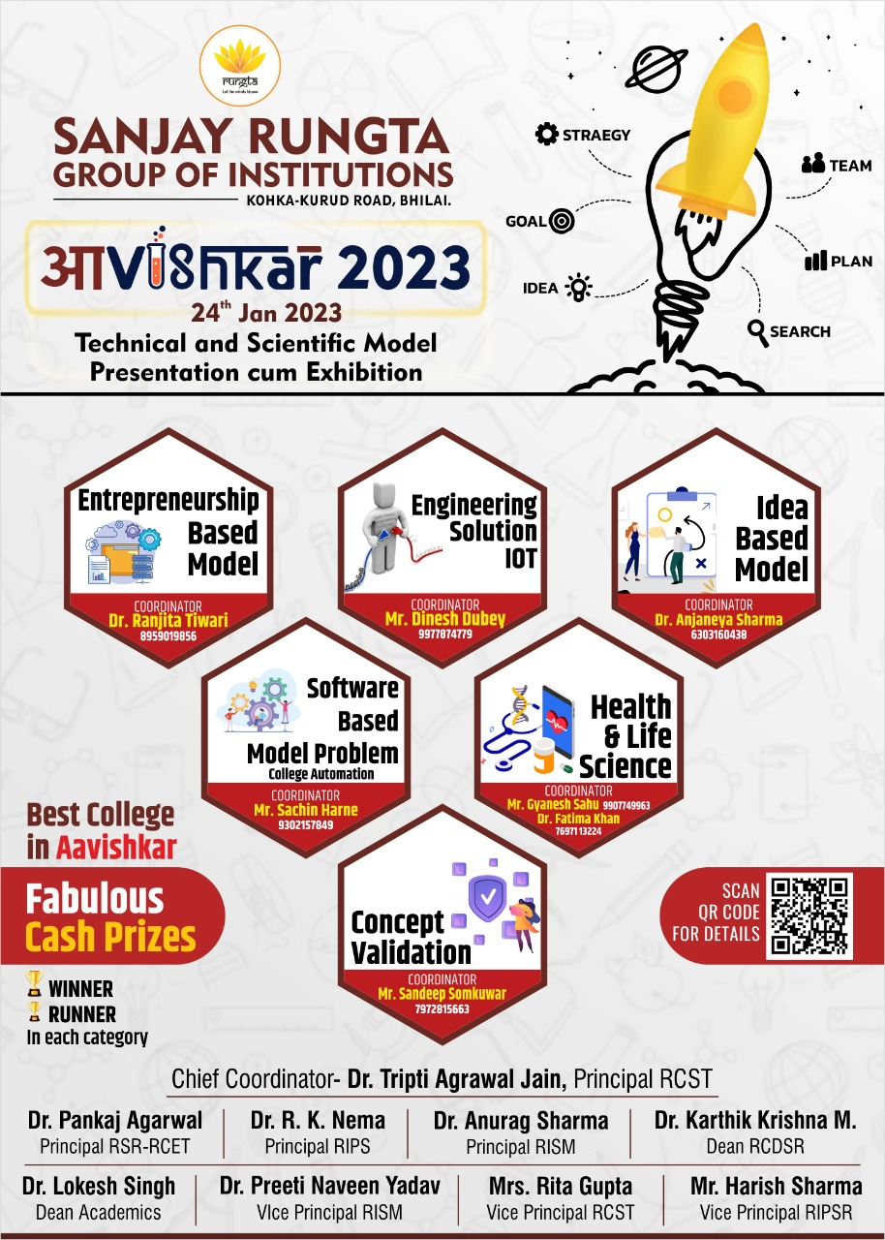
SMART CANTEEN

Slide 2

Team Members :
Name | Branch | Semester
Takeshwar Janghel | CSE | 3rd
Lokeshwar Prasad | CSE | 3rd
Saurabh Rajwade | CSE | 3rd
Dushyant Das | CSE | 3rd
Khilendra Dewangan | CSE | 3rd
Deepanshu Sinha | CSE | 3rd
Course
B-Tech
B-Tech
B-Tech
B-Tech
B-Tech
B-Tech
SUPERVISOR :
Mrs. Kusum Sharma
Head Of Department CSE
Contact no. - 9993557468

Slide 3
Contents
Objective
Problem Statement
Functionalities provided by proposed system
Report Generation
1-Level DFD
User Interface
Employee Interface
Manager Interface
Conclusion

Slide 4
Objective
The main objective is to built an Application program to reduce manual work and introduce Automated process from Placing an Order including Payment to Managing the Food items, Ingredients and Tracking all the details of Sales.

Slide 5
Problem Statement
The current system is not Automated.
Time is wasted for ordering food in queues.
Manual record keeping trends of the expanses.
Not Updating their menu frequently.
Such as adding new items and items is low.
And canteen manager also might change prices.
leads to lack of understanding between the customers and the employees.

Slide 6
Functionalities provided by Proposed system
Order food through application. Orders can be paid through UPI.
The food items of placed order shall be displayed on the screen which indicate the cooks to prepare the ordered items and the message “Order Placed Successfully” shall be displayed on the users screen.
When the order id delivered its status is updated. When the status of the order is updated to “Completed” it goes off the screen.
Editing, adding and updating of records is improved which result in proper resource management of Food Data.
It tracks all the information of items, orders and sales.
Shows the information and description of items and sales.

Slide 7
Report Generation
It generates Daily and Monthly reports on Transactions .
Provides filter reports on sales of Food items.

Slide 8
Smart Canteen
Food Management
System User Management
Employee Management
Sales Mangement
Generate Canteen Report
Generate sales Report
Generate Food Report
Generate Employee Report
Generate Canteen Report
1-Level DFD

Slide 9
User
Adding Food items and Quantity
Receive Food
Process Complete
Placing Order including Payment
User Interface

Slide 10
Employee
Updating Food items and Specials
Ask Cook to prepare ordered foods
Deliver Food
Receive Orders From Users
Confirm delivery
Process Complete
Employee Interface

Slide 11
Manager
Transaction Report
Filtered Reports on Sales of Food items
Canteen Report
Manager Interface

Slide 12
Conclusion
Reduce time wasted waiting to order in Queue.
The interface will be user-friendly and easy to use by any user
Efficient in managing the crowd.
Efficient in maintaining the information of products available in canteen.
Efficient in maintaining the records of sales.

Slide 13
THANK YOU

