Slide 1
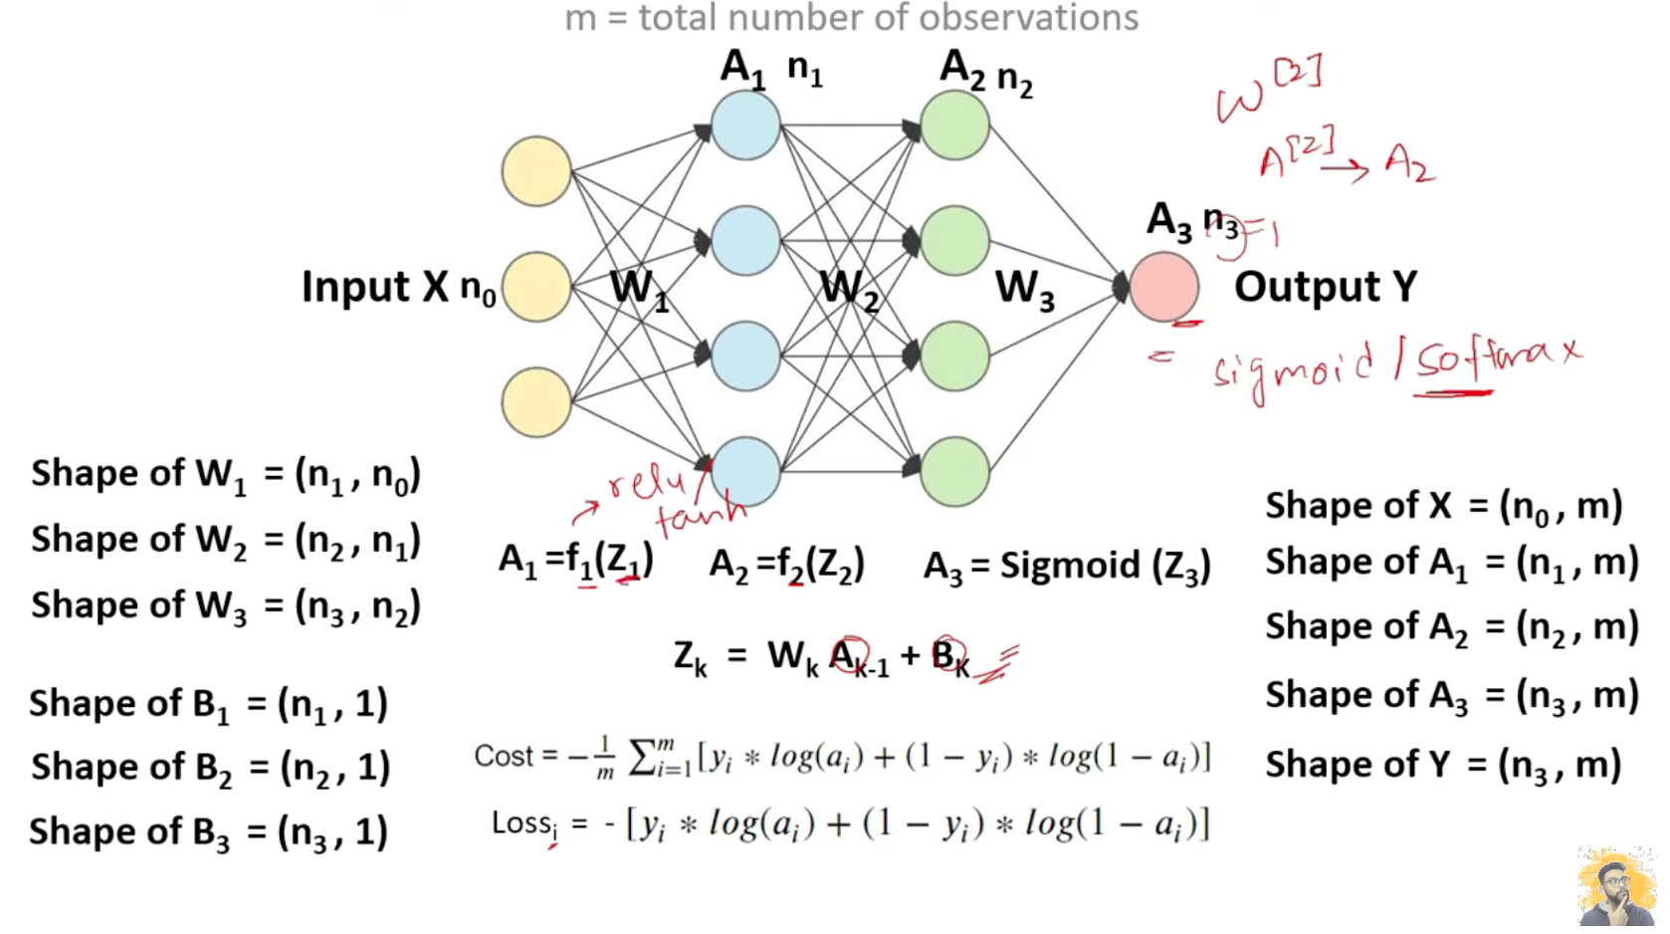

Slide 2
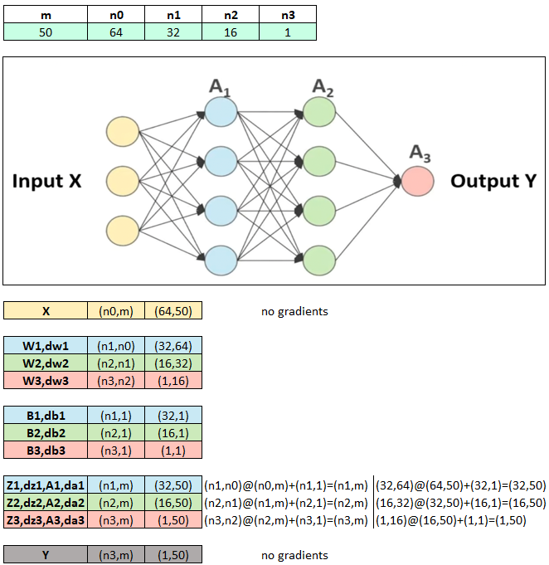
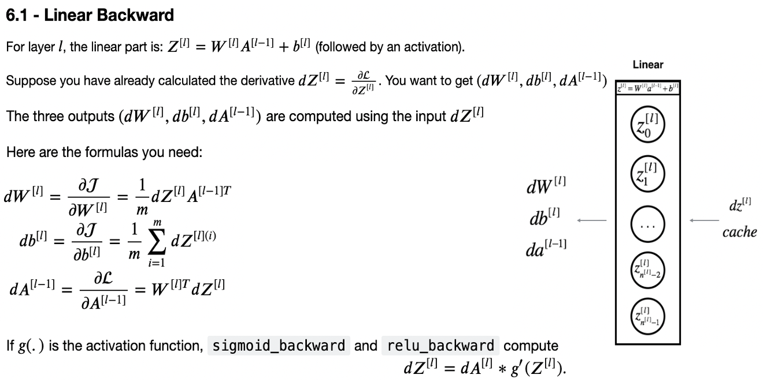
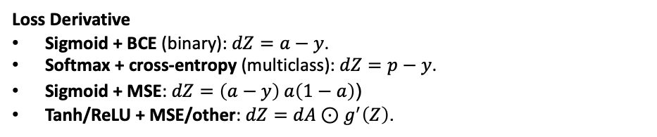
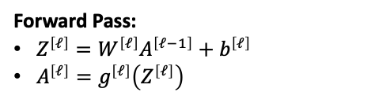
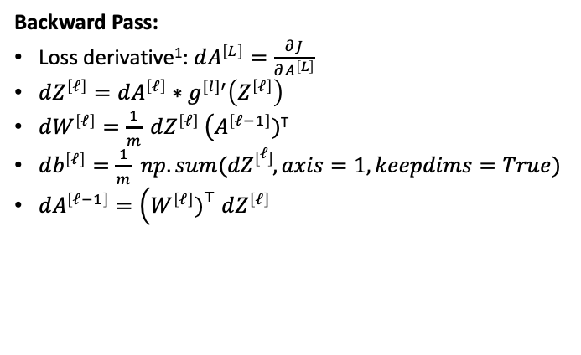
Forward Pass:
$Z^{\left[ℓ\right]}=W^{\left[ℓ\right]}A^{\left[ℓ−1\right]}+b^{\left[ℓ\right]}$
$A^{\left[ℓ\right]}=g^{\left[ℓ\right]}\left(Z^{\left[ℓ\right]}\right)$
Backward Pass:
Loss derivative¹: $dA^{\left[L\right]}=\frac{∂J}{∂A^{\left[L\right]}}$
$dZ^{\left[ℓ\right]}=dA^{\left[ℓ\right]}∗g^{[l]′}\left(Z^{\left[ℓ\right]}\right)$
$dW^{\left[ℓ\right]}=\frac{1}{m} dZ^{\left[ℓ\right]} \left(A^{\left[ℓ−1\right]})\right.$^{T}
$db^{\left[ℓ\right]}=\frac{1}{m} np.sum(dZ\left[ℓ\right], axis=1,keepdims=True)$
$dA^{\left[ℓ−1\right]}=\left(W^{\left[ℓ\right]}{\left.)\right.}^{⊤} dZ^{\left[ℓ\right]}\right.$
Loss Derivative
Sigmoid + BCE (binary): $dZ=a−y$.
Softmax + cross-entropy (multiclass): $dZ=p−y$.
Sigmoid + MSE: $dZ=\left(a−y\right) a\left(1−a\right)$(
Tanh/ReLU + MSE/other: $dZ=dA⊙g^{′}\left(Z\right)$.

Slide 3
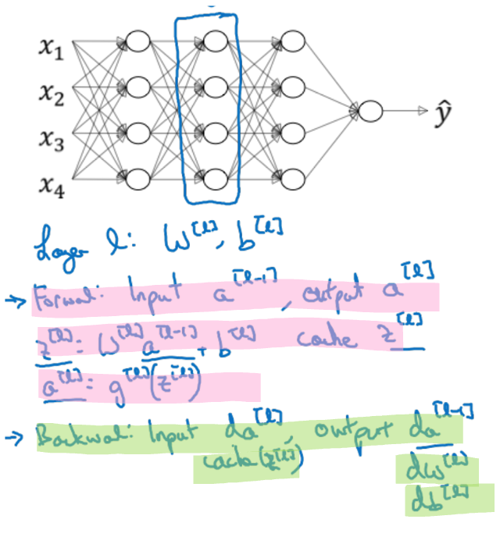
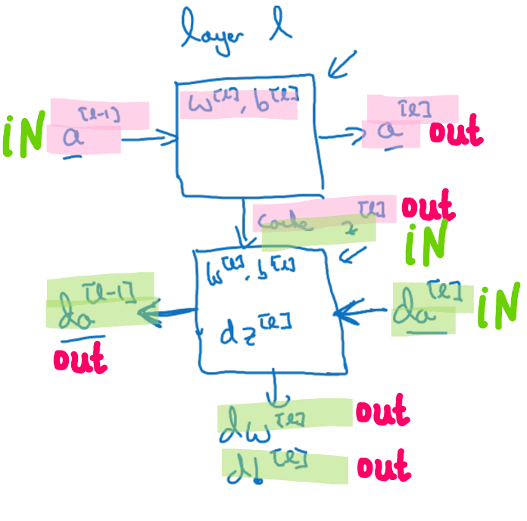
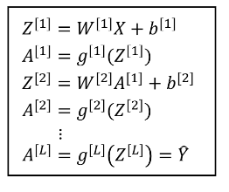
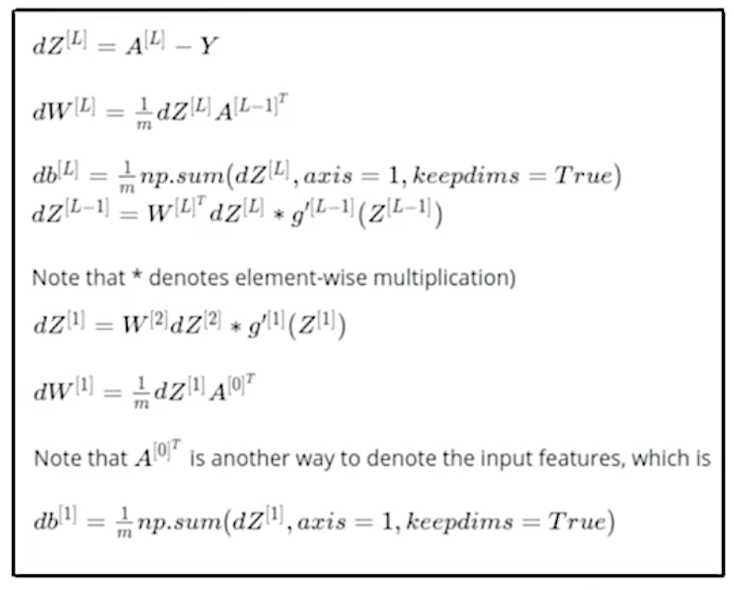
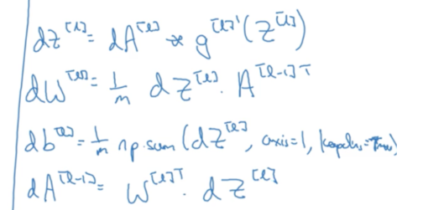
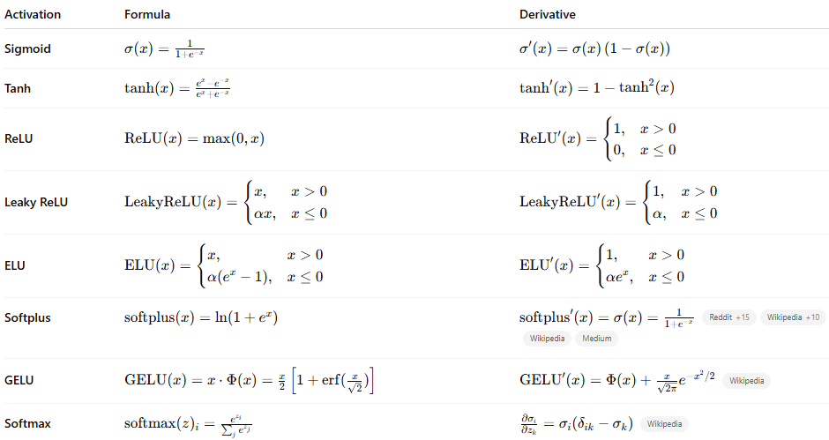
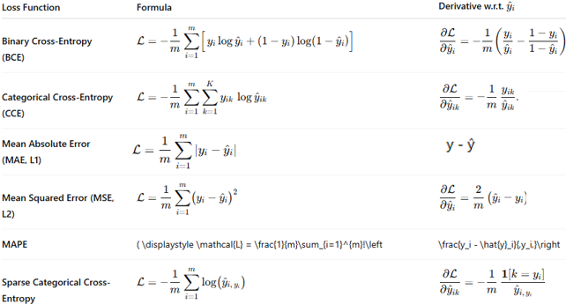

Slide 4
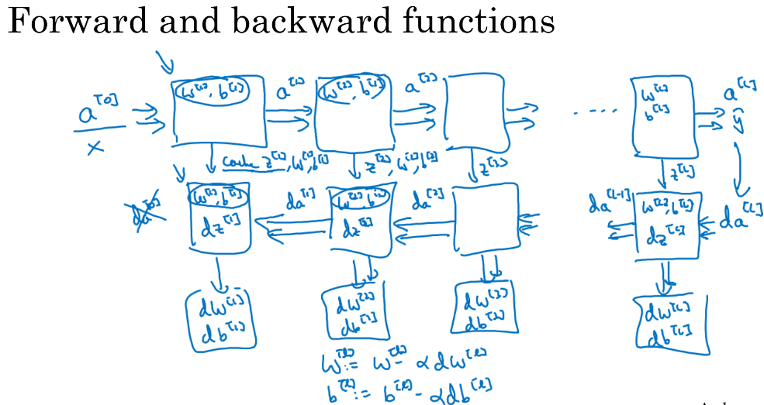
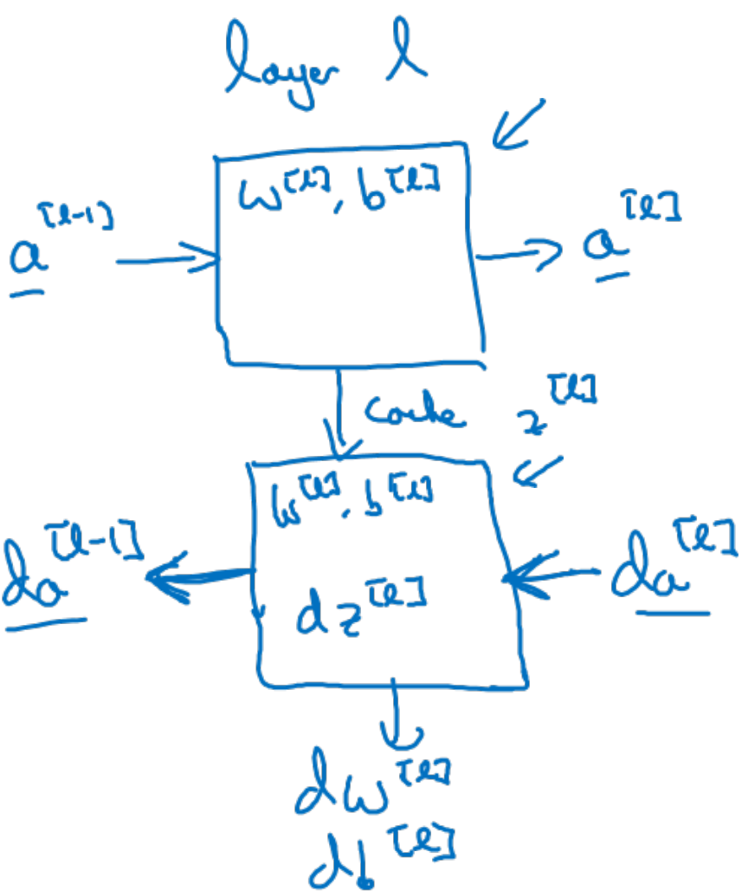
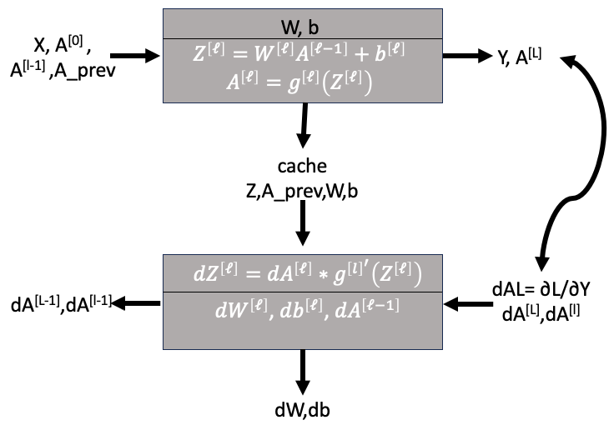
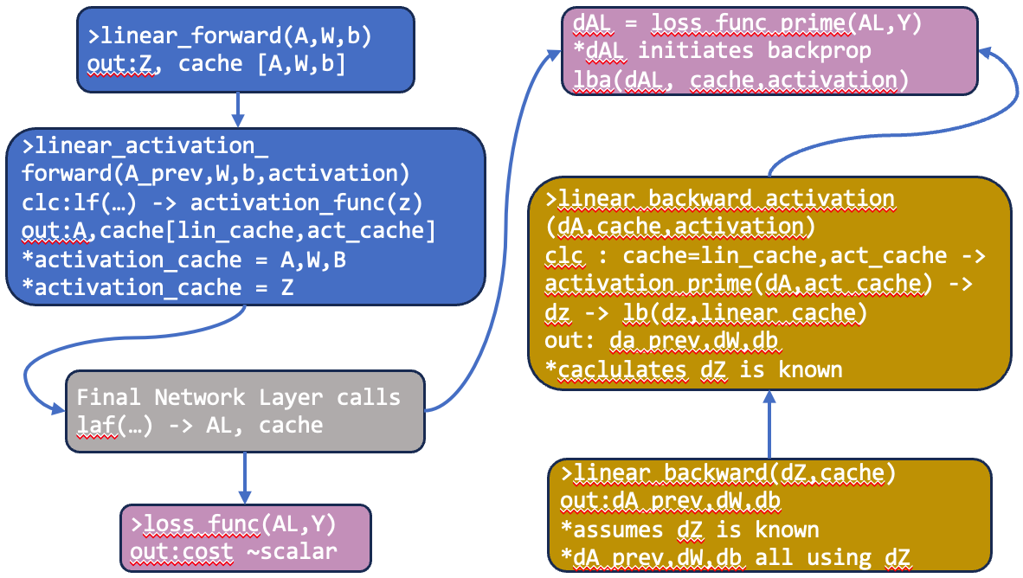
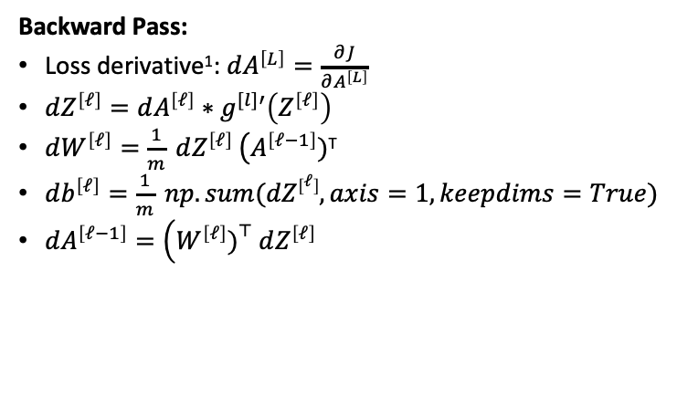
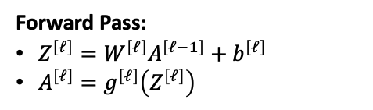
Forward Pass:
$Z^{\left[ℓ\right]}=W^{\left[ℓ\right]}A^{\left[ℓ−1\right]}+b^{\left[ℓ\right]}$
$A^{\left[ℓ\right]}=g^{\left[ℓ\right]}\left(Z^{\left[ℓ\right]}\right)$
Backward Pass:
Loss derivative¹: $dA^{\left[L\right]}=\frac{∂J}{∂A^{\left[L\right]}}$
$dZ^{\left[ℓ\right]}=dA^{\left[ℓ\right]}∗g^{[l]′}\left(Z^{\left[ℓ\right]}\right)$
$dW^{\left[ℓ\right]}=\frac{1}{m} dZ^{\left[ℓ\right]} \left(A^{\left[ℓ−1\right]})\right.$^{T}
$db^{\left[ℓ\right]}=\frac{1}{m} np.sum(dZ\left[ℓ\right], axis=1,keepdims=True)$
$dA^{\left[ℓ−1\right]}=\left(W^{\left[ℓ\right]}{\left.)\right.}^{⊤} dZ^{\left[ℓ\right]}\right.$

Slide 5
APPENDIX

Slide 6
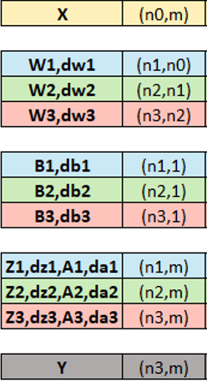
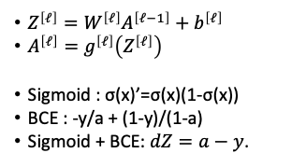
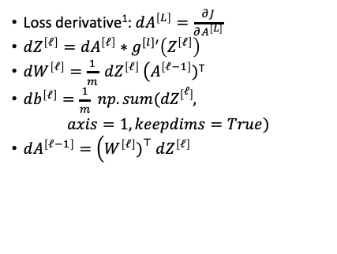
$Z^{\left[ℓ\right]}=W^{\left[ℓ\right]}A^{\left[ℓ−1\right]}+b^{\left[ℓ\right]}$
$A^{\left[ℓ\right]}=g^{\left[ℓ\right]}\left(Z^{\left[ℓ\right]}\right)$
Sigmoid : σ(x)’=σ(x)(1-σ(x))
BCE : -y/a + (1-y)/(1-a)
Sigmoid + BCE: $dZ=a−y$.
Loss derivative¹: $dA^{\left[L\right]}=\frac{∂J}{∂A^{\left[L\right]}}$
$dZ^{\left[ℓ\right]}=dA^{\left[ℓ\right]}∗g^{[l]′}\left(Z^{\left[ℓ\right]}\right)$
$dW^{\left[ℓ\right]}=\frac{1}{m} dZ^{\left[ℓ\right]} \left(A^{\left[ℓ−1\right]})\right.$^{T}
$db^{\left[ℓ\right]}=\frac{1}{m} np.sum(dZ\left[ℓ\right],$
$$axis=1,keepdims=True)$$
$dA^{\left[ℓ−1\right]}=\left(W^{\left[ℓ\right]}{\left.)\right.}^{⊤} dZ^{\left[ℓ\right]}\right.$

Slide 7
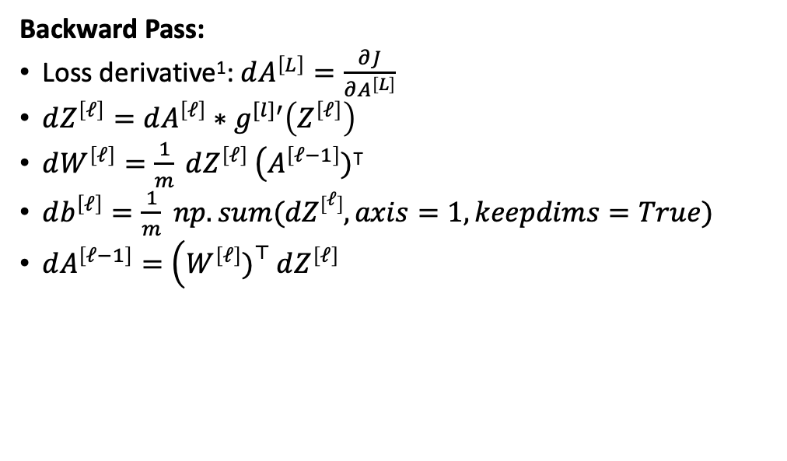
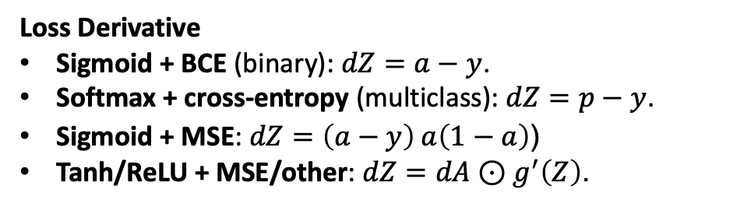
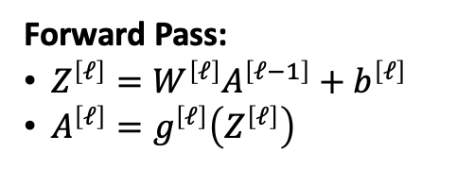
Forward Pass:
$Z^{\left[ℓ\right]}=W^{\left[ℓ\right]}A^{\left[ℓ−1\right]}+b^{\left[ℓ\right]}$
$A^{\left[ℓ\right]}=g^{\left[ℓ\right]}\left(Z^{\left[ℓ\right]}\right)$
Backward Pass:
Loss derivative¹: $dA^{\left[L\right]}=\frac{∂J}{∂A^{\left[L\right]}}$
$dZ^{\left[ℓ\right]}=dA^{\left[ℓ\right]}∗g^{[l]′}\left(Z^{\left[ℓ\right]}\right)$
$dW^{\left[ℓ\right]}=\frac{1}{m} dZ^{\left[ℓ\right]} \left(A^{\left[ℓ−1\right]})\right.$^{T}
$db^{\left[ℓ\right]}=\frac{1}{m} np.sum(dZ\left[ℓ\right], axis=1,keepdims=True)$
$dA^{\left[ℓ−1\right]}=\left(W^{\left[ℓ\right]}{\left.)\right.}^{⊤} dZ^{\left[ℓ\right]}\right.$
Loss Derivative
Sigmoid + BCE (binary): $dZ=a−y$.
Softmax + cross-entropy (multiclass): $dZ=p−y$.
Sigmoid + MSE: $dZ=\left(a−y\right) a\left(1−a\right)$(
Tanh/ReLU + MSE/other: $dZ=dA⊙g^{′}\left(Z\right)$.

Slide 8
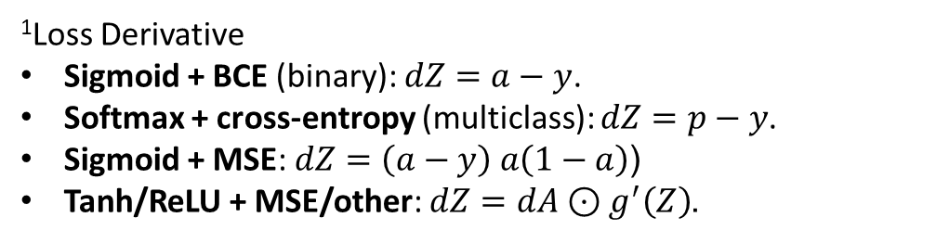
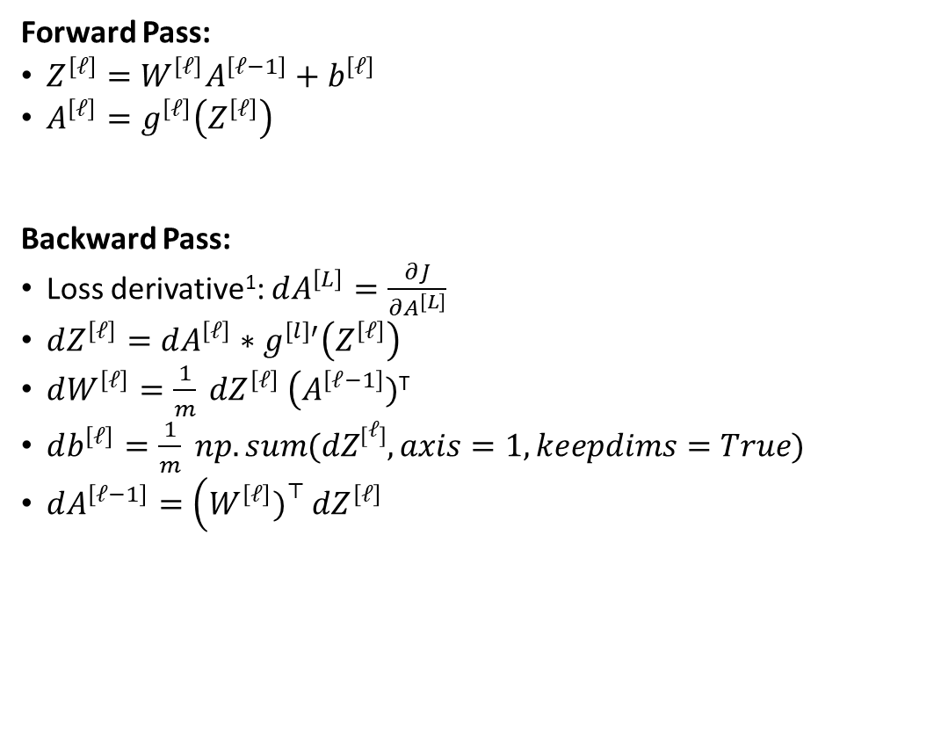
Forward Pass:
$Z^{\left[ℓ\right]}=W^{\left[ℓ\right]}A^{\left[ℓ−1\right]}+b^{\left[ℓ\right]}$
$A^{\left[ℓ\right]}=g^{\left[ℓ\right]}\left(Z^{\left[ℓ\right]}\right)$
Backward Pass:
Loss derivative¹: $dA^{\left[L\right]}=\frac{∂J}{∂A^{\left[L\right]}}$
$dZ^{\left[ℓ\right]}=dA^{\left[ℓ\right]}∗g^{[l]′}\left(Z^{\left[ℓ\right]}\right)$
$dW^{\left[ℓ\right]}=\frac{1}{m} dZ^{\left[ℓ\right]} \left(A^{\left[ℓ−1\right]})\right.$^{T}
$db^{\left[ℓ\right]}=\frac{1}{m} np.sum(dZ\left[ℓ\right], axis=1,keepdims=True)$
$dA^{\left[ℓ−1\right]}=\left(W^{\left[ℓ\right]}{\left.)\right.}^{⊤} dZ^{\left[ℓ\right]}\right.$
¹Loss Derivative
Sigmoid + BCE (binary): $dZ=a−y$.
Softmax + cross-entropy (multiclass): $dZ=p−y$.
Sigmoid + MSE: $dZ=\left(a−y\right) a\left(1−a\right)$(
Tanh/ReLU + MSE/other: $dZ=dA⊙g^{′}\left(Z\right)$.

Slide 9
Activations
Loss Funcs

Slide 10
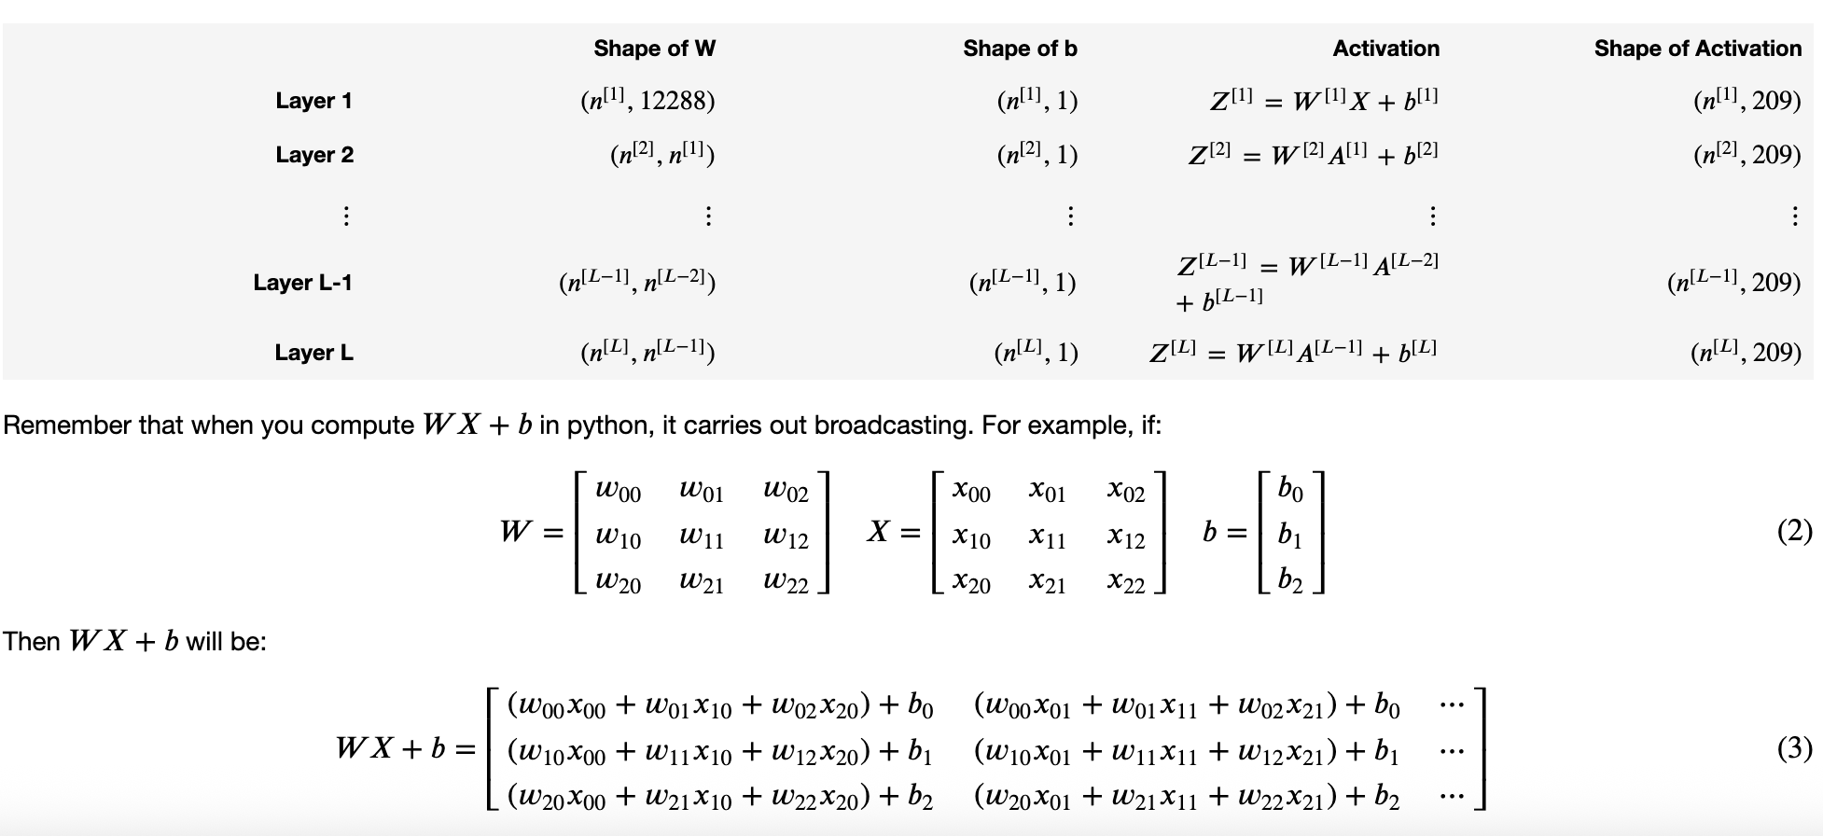

Slide 12
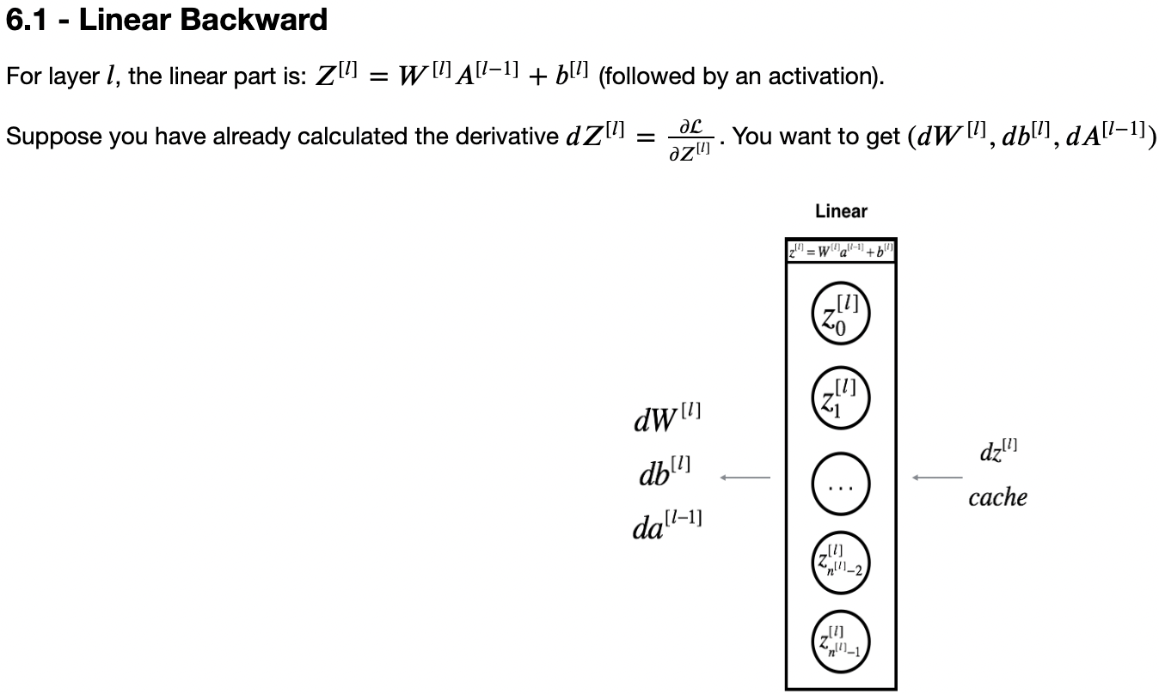
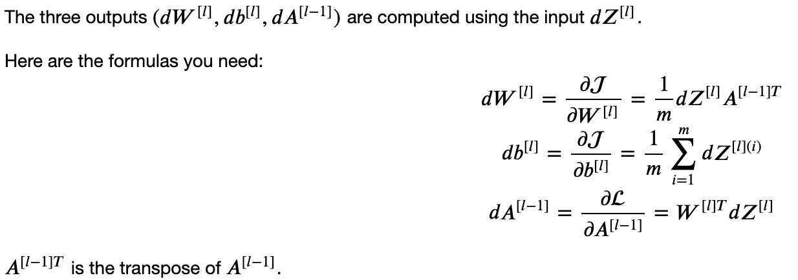

Slide 14
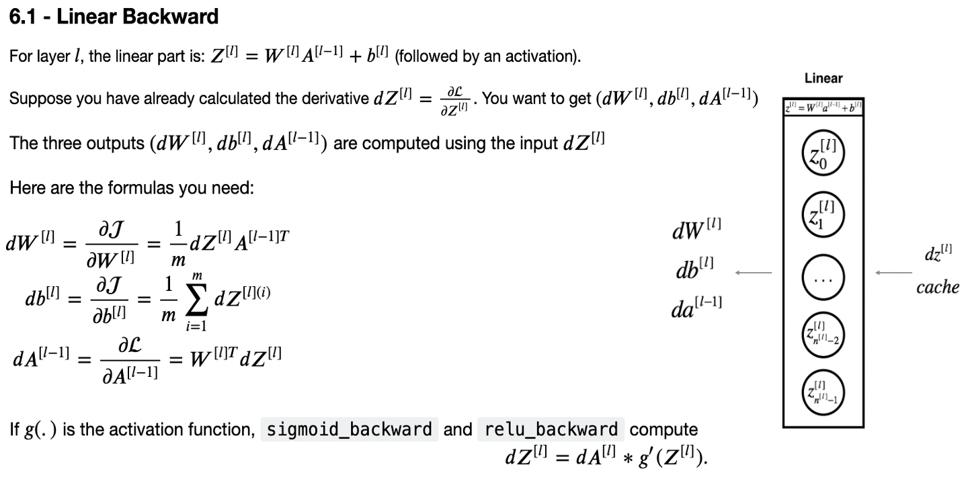
>linear_forward(A,W,b)
out:Z, cache [A,W,b]
dAL = loss_func_prime(AL,Y) *dAL initiates backprop lba(dAL, cache,activation)
>linear_activation_ forward(A_prev,W,b,activation)
clc:lf(…) -> activation_func(z)
out:A,cache[lin_cache,act_cache]
*activation_cache = A,W,B
*activation_cache = Z
>linear_backward_activation (dA,cache,activation) clc : cache=lin_cache,act_cache -> activation_prime(dA,act_cache) -> dz -> lb(dz,linear_cache)
out: da_prev,dW,db
*caclulates dZ is known
Final Network Layer calls laf(…) -> AL, cache
>linear_backward(dZ,cache) out:dA_prev,dW,db
*assumes dZ is known *dA_prev,dW,db all using dZ
>loss_func(AL,Y) out:cost ~scalar

Slide 15
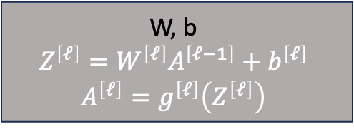
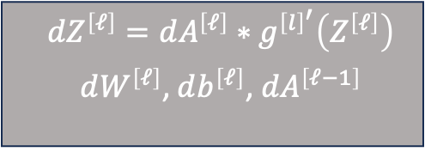
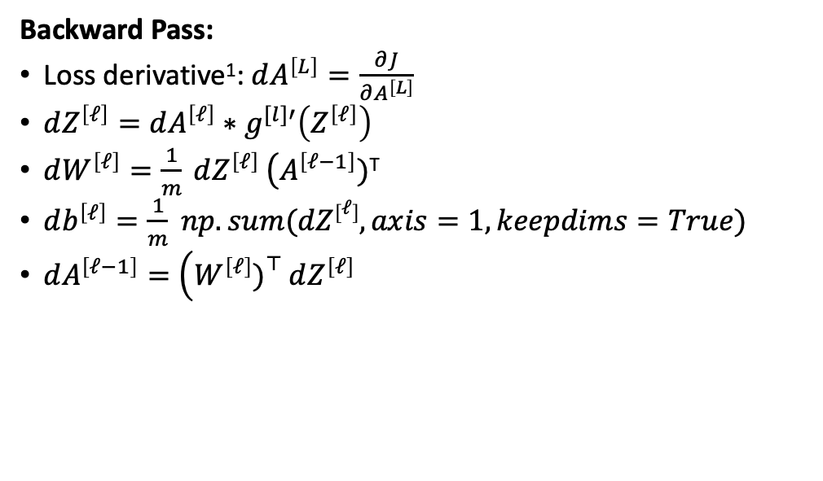
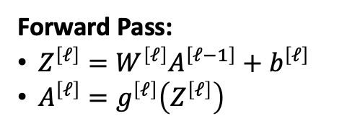
Forward Pass:
$Z^{\left[ℓ\right]}=W^{\left[ℓ\right]}A^{\left[ℓ−1\right]}+b^{\left[ℓ\right]}$
$A^{\left[ℓ\right]}=g^{\left[ℓ\right]}\left(Z^{\left[ℓ\right]}\right)$
W, b
$$Z^{\left[ℓ\right]}=W^{\left[ℓ\right]}A^{\left[ℓ−1\right]}+b^{\left[ℓ\right]}$$
$$A^{\left[ℓ\right]}=g^{\left[ℓ\right]}\left(Z^{\left[ℓ\right]}\right)$$
Backward Pass:
Loss derivative¹: $dA^{\left[L\right]}=\frac{∂J}{∂A^{\left[L\right]}}$
$dZ^{\left[ℓ\right]}=dA^{\left[ℓ\right]}∗g^{[l]′}\left(Z^{\left[ℓ\right]}\right)$
$dW^{\left[ℓ\right]}=\frac{1}{m} dZ^{\left[ℓ\right]} \left(A^{\left[ℓ−1\right]})\right.$^{T}
$db^{\left[ℓ\right]}=\frac{1}{m} np.sum(dZ\left[ℓ\right], axis=1,keepdims=True)$
$dA^{\left[ℓ−1\right]}=\left(W^{\left[ℓ\right]}{\left.)\right.}^{⊤} dZ^{\left[ℓ\right]}\right.$
X, A^{[0]} , A^{[l-1]} ,A_prev
Y, A^{[L]}
cache Z,A_prev,W,b
$$dZ^{\left[ℓ\right]}=dA^{\left[ℓ\right]}∗g^{{\left[l\right]}^{′}}\left(Z^{\left[ℓ\right]}\right)$$ $dW^{\left[ℓ\right]}$, $db^{\left[ℓ\right]}$, $dA^{\left[ℓ−1\right]}$
dAL= ∂L/∂Y dA^{[L]},dA^{[l]}
dA^{[L-1]},dA^{[l-1]}
dW,db

Slide 16
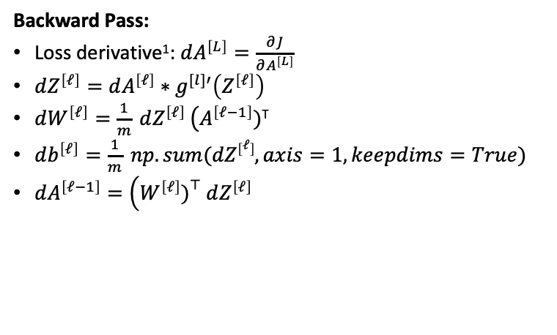
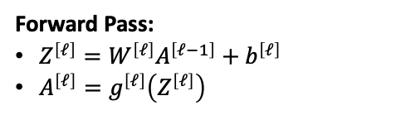
Forward Pass:
$Z^{\left[ℓ\right]}=W^{\left[ℓ\right]}A^{\left[ℓ−1\right]}+b^{\left[ℓ\right]}$
$A^{\left[ℓ\right]}=g^{\left[ℓ\right]}\left(Z^{\left[ℓ\right]}\right)$
Backward Pass:
Loss derivative¹: $dA^{\left[L\right]}=\frac{∂J}{∂A^{\left[L\right]}}$
$dZ^{\left[ℓ\right]}=dA^{\left[ℓ\right]}∗g^{[l]′}\left(Z^{\left[ℓ\right]}\right)$
$dW^{\left[ℓ\right]}=\frac{1}{m} dZ^{\left[ℓ\right]} \left(A^{\left[ℓ−1\right]})\right.$^{T}
$db^{\left[ℓ\right]}=\frac{1}{m} np.sum(dZ\left[ℓ\right], axis=1,keepdims=True)$
$dA^{\left[ℓ−1\right]}=\left(W^{\left[ℓ\right]}{\left.)\right.}^{⊤} dZ^{\left[ℓ\right]}\right.$

Slide 17
Forward Pass:
$Z^{\left[ℓ\right]}=W^{\left[ℓ\right]}A^{\left[ℓ−1\right]}+b^{\left[ℓ\right]}$
$A^{\left[ℓ\right]}=g^{\left[ℓ\right]}\left(Z^{\left[ℓ\right]}\right)$
Backward Pass:
Loss derivative¹: $dA^{\left[L\right]}=\frac{∂J}{∂A^{\left[L\right]}}$
$dZ^{\left[ℓ\right]}=dA^{\left[ℓ\right]}∗g^{[l]′}\left(Z^{\left[ℓ\right]}\right)$
$dW^{\left[ℓ\right]}=\frac{1}{m} dZ^{\left[ℓ\right]} \left(A^{\left[ℓ−1\right]})\right.$^{T}
$db^{\left[ℓ\right]}=\frac{1}{m} np.sum(dZ\left[ℓ\right], axis=1,keepdims=True)$
$dA^{\left[ℓ−1\right]}=\left(W^{\left[ℓ\right]}{\left.)\right.}^{⊤} dZ^{\left[ℓ\right]}\right.$

