Slide 1
Evolution of Sequence-to-Sequence Models
1. Sequence-to-Sequence Tasks
Some problems require mapping an input sequence to an output sequence that may be of different length and structure — for example:
Machine translation (“I am happy” → “Je suis heureux”)
Summarization
Speech-to-text
These are called sequence-to-sequence (Seq2Seq) tasks. They require models that can handle variable lengths, preserve order, and understand dependencies between elements across the sequence.
2. Early Sequence Models: RNNs
Recurrent Neural Networks (RNNs) were the first widely used models for sequence data. They process tokens step-by-step, passing a hidden state forward that summarizes what has been seen so far.
Strength: Naturally handles sequences and token order.
Weakness:
Vanishing gradients: The influence of earlier tokens fades as the sequence grows.
Short memory: Struggles to capture long-range dependencies.
3. LSTMs and GRUs: Fixing RNN Weaknesses
To address these issues:
LSTMs (Long Short-Term Memory) introduced:
A cell state to carry long-term information.
Gates (forget, input, output) to control what is remembered, updated, or output.
Better at preserving information over longer sequences.
GRUs (Gated Recurrent Units):
A simpler variant with only two gates (update, reset).
Merged hidden and cell states into one.
Fewer parameters, faster training, similar performance to LSTMs in many cases.
These gated RNNs made sequence modeling more effective, but they still processed tokens sequentially and struggled with tasks where input and output lengths differed significantly.
4. The Need for Encoder–Decoder Architectures
While LSTMs/GRUs improved memory, they still worked best when the input and output sequences were aligned in length and timing (e.g., labeling tasks).
For translation, summarization, and other Seq2Seq problems:
The input must be fully understood before output starts.
The output may be longer, shorter, or rearranged compared to the input.
The solution: split the process into two parts:
Encoder: Reads the entire input sequence, step-by-step, and produces a context vector summarizing it.
Decoder: Starts from the context vector and generates the output sequence, step-by-step.
Benefits:
Handles different-length input/output naturally.
Gives the encoder time to fully process the input before output generation.
Creates a clean separation between understanding (encoder) and producing (decoder).
5. The Context Vector Bottleneck
In the original encoder–decoder design:
The final hidden state of the encoder (the context vector) was the only information passed to the decoder.
This worked for short sequences, but in long or complex inputs, compressing all information into a single fixed-length vector caused an information bottleneck — some details were inevitably lost.
6. Attention Mechanism: Easing the Bottleneck
Attention was introduced to address the limitations of the single context vector.
Instead of using only the final encoder state, attention lets the decoder look back at all encoder hidden states when generating each output token.
At each step, the decoder calculates attention weights over the encoder states, focusing on the most relevant parts of the input.
Impact:
Greatly improves performance on long sequences.
Particularly effective for translation, where different output tokens align with different parts of the input.
Initially, attention was an add-on to RNN/LSTM/GRU encoder–decoders.
7. Transformers: Attention as the Foundation
The Transformer architecture took the attention idea further:
Removed recurrence entirely.
Built both encoder and decoder from stacked self-attention layers + feed-forward networks.
Added positional encodings to preserve order (since self-attention alone doesn’t know token positions).
Benefits:
Processes all tokens in parallel → much faster training.
Handles long-range dependencies without vanishing gradients.
Scales well to large datasets and deep networks.
At a high level, Transformers still follow the encoder–decoder pattern, but internally they rely entirely on self-attention and cross-attention instead of recurrent processing.
8. The Evolution Path
RNNs → basic sequence modeling, but poor long-term memory.
LSTMs / GRUs → improved memory with gates, but still sequential and limited for complex Seq2Seq tasks.
Encoder–Decoder (RNN/LSTM/GRU) → enabled variable-length input/output by separating encoding and decoding.
Encoder–Decoder + Attention → solved the single-vector bottleneck by letting the decoder attend to all encoder states.
Transformers → made attention the core computation, removing recurrence and enabling massive parallelization and scalability.

Slide 2
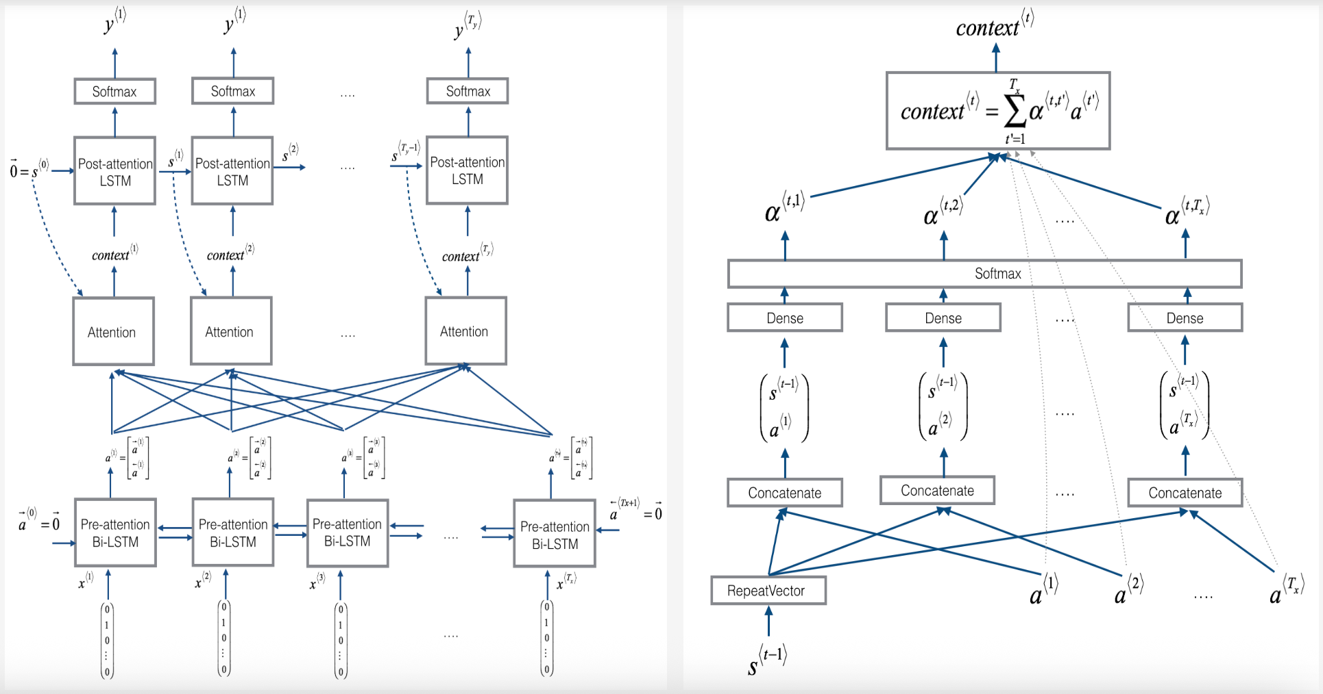
Attention in Sequential (RNN/LSTM/GRU) Encoder-Decoder Models

Slide 3
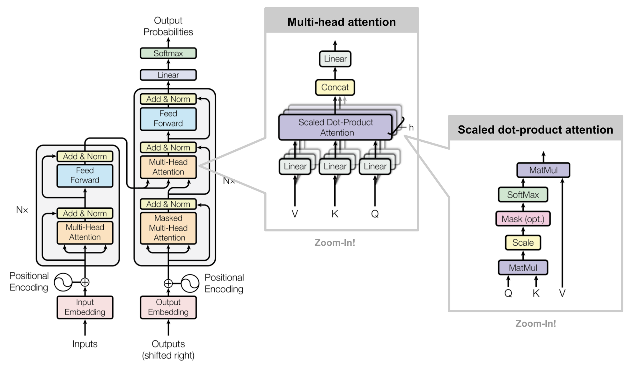
Attention in Transformer (Encoder-Decoder) Models

Slide 4
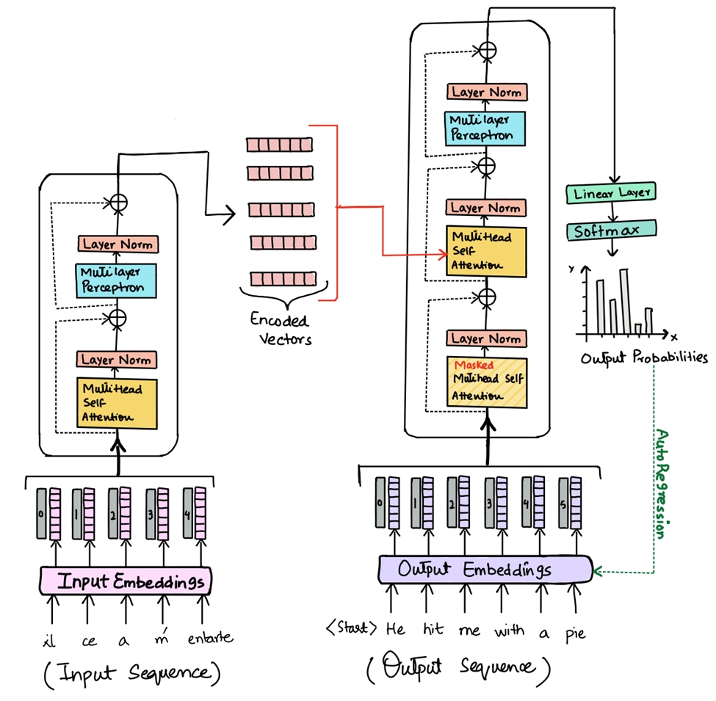
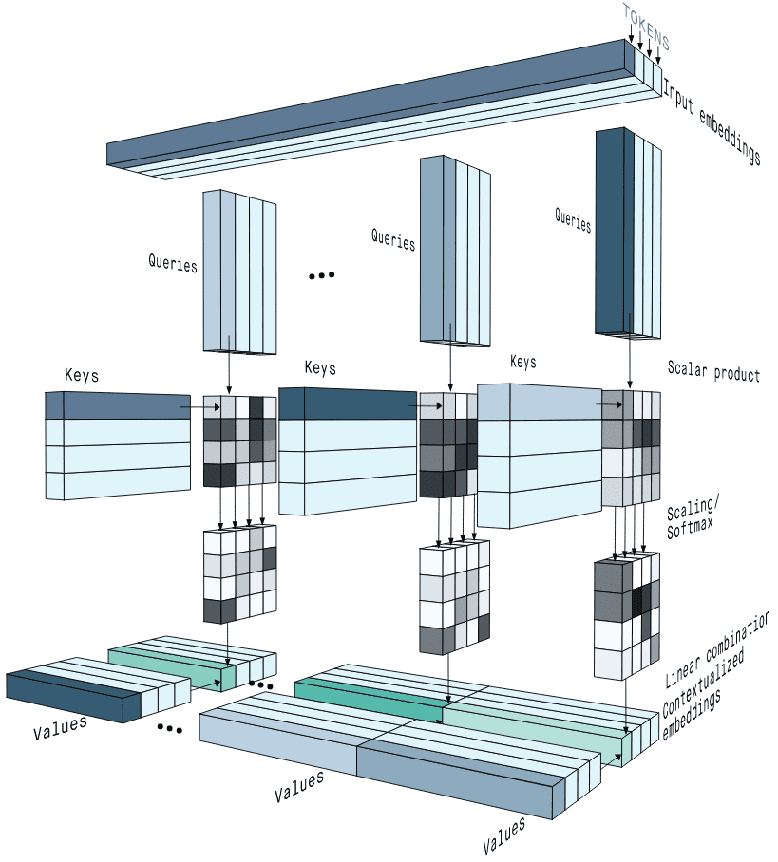

Slide 5
