Slide 1


Evaluating the Consistency of Explainable AI Methods in Hate Speech Detection on Social Media Platforms
Gonzalo Gamez
Supervised by: Dmitry Pavlyuk
Double degree in Computer Science:
Data Analytics and Artificial Intelligence
TSI and UWE
Notes:
Respected chairwoman and members of the commission, student Gonzalo Gamez is ready for defence. May I proceed?

Slide 2
AI Act
​Article 86 of the EU Artificial Intelligence Act (European Union, 2024) establishes the "Right to Explanation of Individual Decision-Making." This legislative development underscores the growing recognition that explainability is not merely a technical consideration but a fundamental requirement for responsible AI deployment.

Slide 3
XAI for Explainability
Explainable Artificial Intelligence (XAI) is an emerging area of research in the field of Artificial Intelligence (AI). XAI can explain how AI obtained a particular solution (e.g., classification or object detection) and can also answer other 'wh' questions (such as "why", "when", "where", etc.) . This explainability is not possible in traditional AI. (Gohel, Singh and Mohanty, 2021)

Slide 4
Research Object and Subject
The research object of this study is explainable artificial intelligence (XAI) methods applied to hate speech detection models on social media.
The research subject is defined as the consistency of XAI methods when applied to AI models that detect hate speech.

Slide 5
Research Question and Hypothesis
How do LIME and SHAP compare in terms of the consistency of their generated explanations for hate speech detection models under repeated applications?
The hypothesis is that SHAP provides more consistent explanations than LIME when applied to hate speech detection models, as measured by consistency metrics.

Slide 6
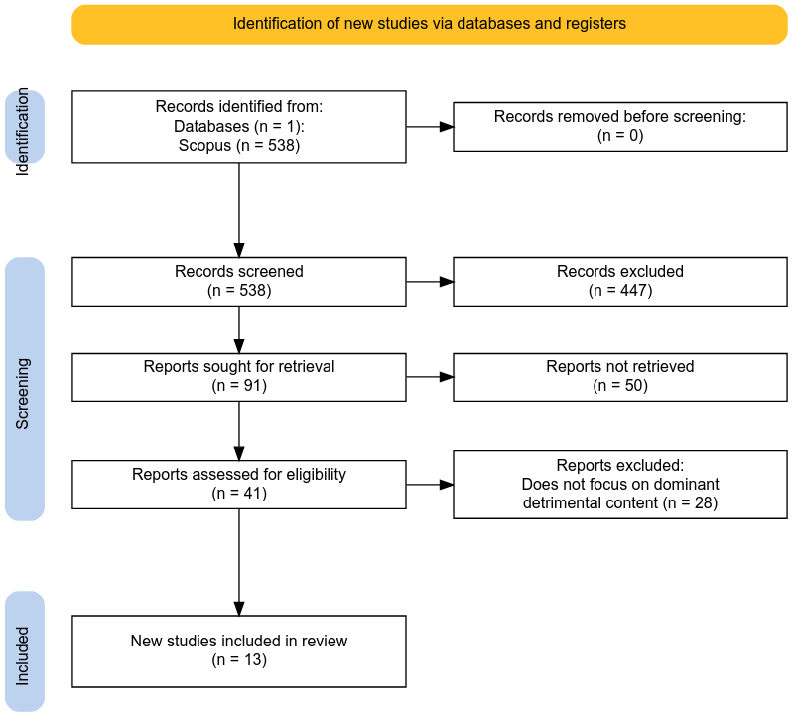
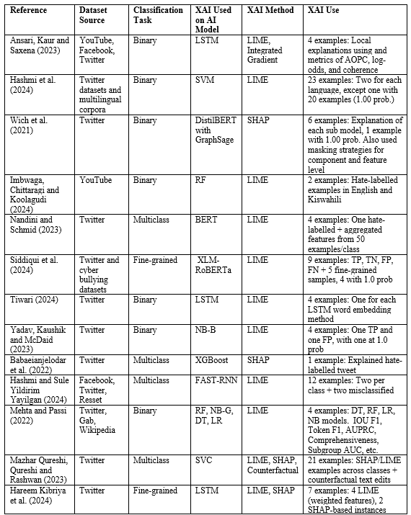
Literature Review
Fig. 1: PRISMA Flow Diagram of Included Studies
We found the following:
XAI methods - LIME and SHAP
Deep Learning models – LSTM and BERT variants
Few used metrics to measure XAI explanations
Inconsistent selection for which samples to explain - a common method was to select high accuracy predictions of TP, FP, TN, FN
Table 1: Literature Review of XAI for hate speech detection on social media
Notes:
We created a search strategy for "XAI use" for "detrimental content" on "social media". We found the dominant detrimental content was hate speech which led to our literature review.

Slide 7
Definition of Hate Speech
“any kind of communication in speech, writing or behaviour, that attacks or uses pejorative or discriminatory language with reference to a person or a group on the basis of who they are” (United Nations, 2024)

Slide 8
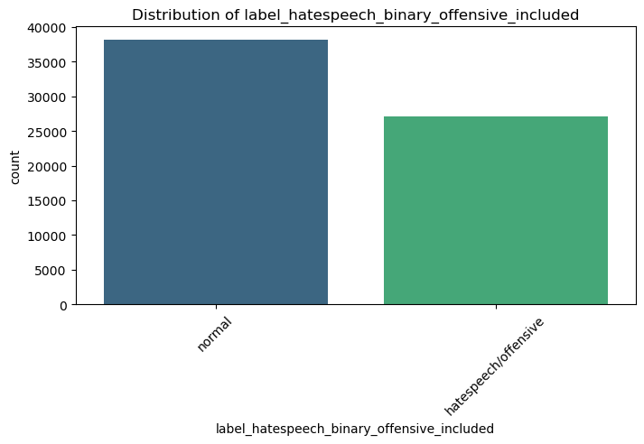
Processing and Merging Datasets
Loaded three distinct datasets: HateXplain (Mathew et al., 2021), MLMA (Ousidhoum et al., 2019), and Measuring Hate Speech(Kennedy et al., 2020).
Fig. 2: Distribution of Binary Hate Speech Labels in the Dataset

Slide 9
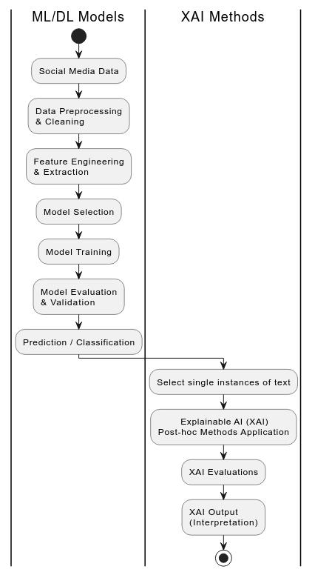
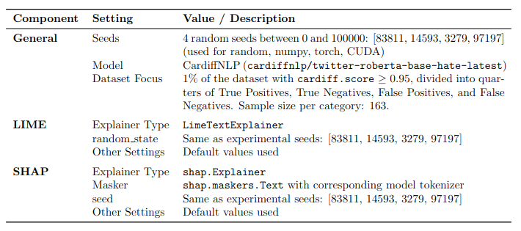
Methodology Overview
Table 2: Consolidated Experiment Settings and XAI Parameters
Fig 3: Process for Using XAI Methods on ML/DL models adapted from research from Gongane, Munot and Anuse (2024)
Notes:
Figure 3 show the process of using XAI methods. The process of using a ML/DL model was streamlined by using a readily available deep learning model from Cardiff University used to detect hate speech. We selected True and False positive and True and False negative samples that had high confidence using the model. 652 samples in total

Slide 10
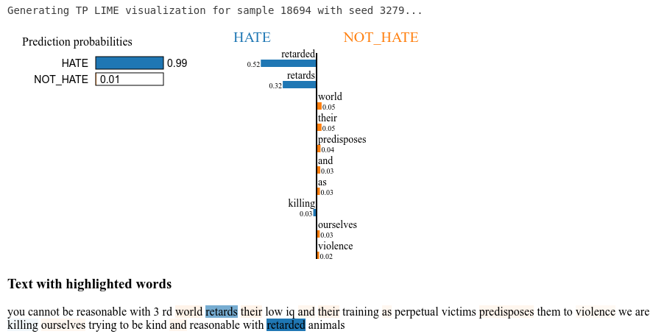
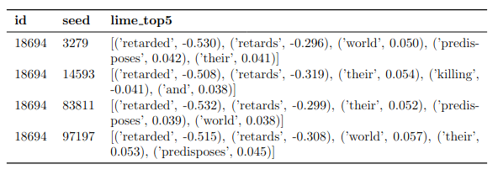
LIME
Fig 4: LIME explanation for sample 18694 with seed 3279 TP
Table 3: LIME Top-5 Feature Contributions Across Different Seeds
Notes:
"Now let's examine how LIME provides explanations in the form of feature contributions. Looking at Figure 4, we can see a LIME explanation for sample 18694 using seed 3279.
The model predicts this text as HATE with 99% confidence and NOT_HATE with only 1% confidence. LIME provides explanations by highlighting individual words and assigning them contribution scores. We extracted the top 5 feature contributions into vectors for them to be compared side by side of the 4 seeds for the 652 text samples.

Slide 11
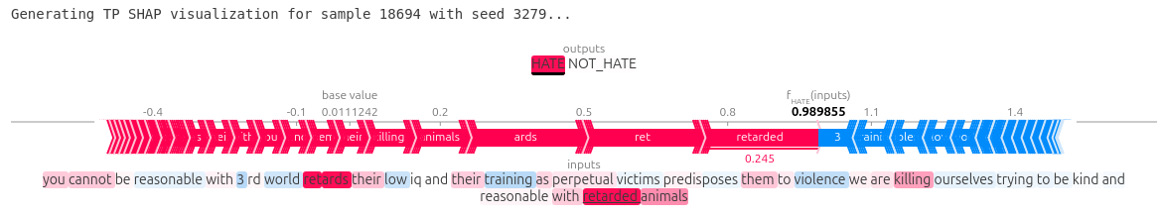
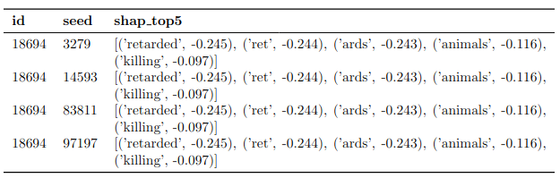
SHAP
Fig 6: SHAP explanation for sample 18694 with seed 3279 TP
Table 4: SHAP Top-5 Feature Contributions Across Different Seeds
Notes:
Now let's compare this with SHAP's approach to feature contributions using the exact same text sample and seed. SHAP presents feature contributions using a different visual approach, it shows a force plot where red bars indicate contributions toward the HATE class and blue bars indicate contributions toward the NOT_HATE class. We also extracted the top 5 feature contributions into vectors for them to be compared side by side by the 4 seeds for the 652 text samples.

Slide 12



Metrics
Jaccard Similarity
Spearman Correlation
Kendall Tau-b

Slide 13
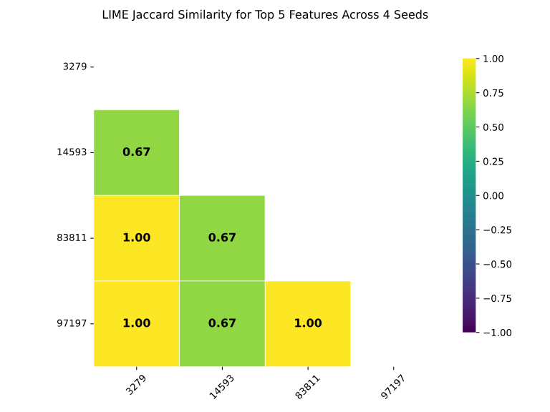
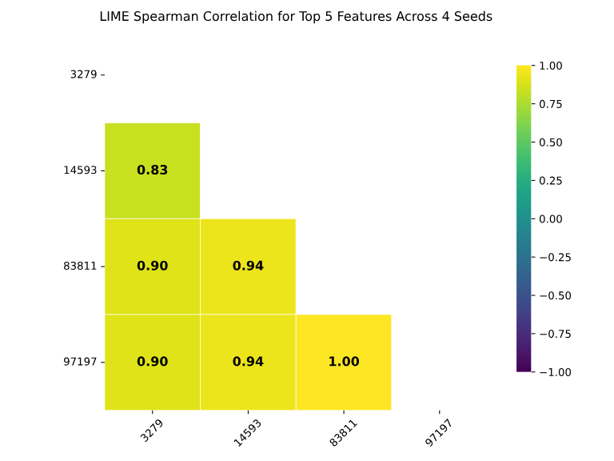
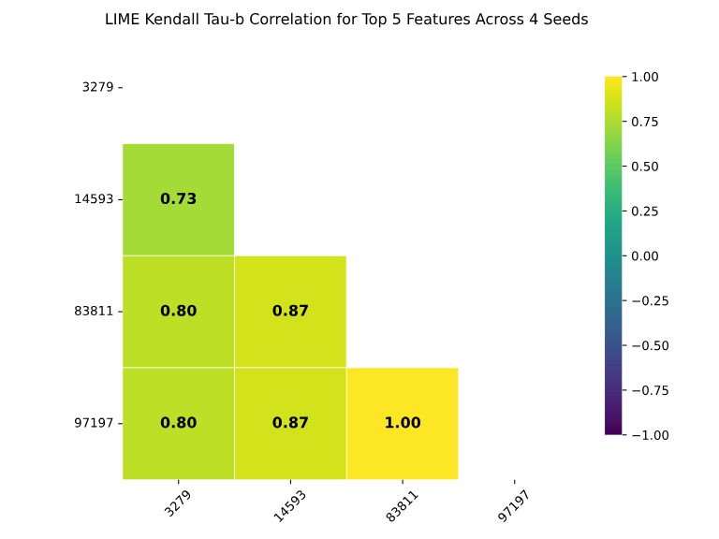
Quantitative Results -LIME
Fig 8. Heat Matrix for Jaccard Similarity across seeds
Fig 9. Heat Matrix for Spearman Correlation across seeds
Fig 10. Heat Matrix for Kendall Tau-b across seeds
Notes:
Now let's examine the quantitative results for LIME using heatmaps that show pairwise comparisons between different random seeds. Each heatmap is a 4x4 matrix where both axes represent our four random seeds. The color scale ranges from dark blue (lower consistency) to bright yellow (perfect consistency). You can see that LIME shows a mix of green and yellow, indicating variable consistency depending on which seeds are being compared.

Slide 14
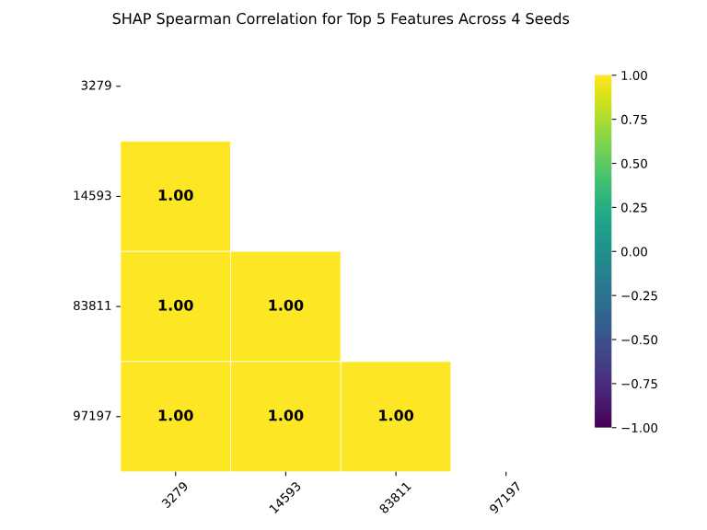


Quantitative Results -SHAP
Fig 11. Heat Matrix for Jaccard Similarity across seeds
Fig 12. Heat Matrix for Spearman Correlation across seeds
Fig 13. Heat Matrix for Kendall Tau-b across seeds
Notes:
In stark contrast to LIME, let's examine SHAP's heatmap results, The most striking feature of all three SHAP heatmaps is that every single cell shows a value of 1.00. This means that regardless of which two seeds we compare, SHAP always produces identical explanations for features and how they are ordered.

Slide 15
Aggregated Results over all instances
Table 5. Aggregated Consistency Metrics (Mean & Standard Deviation

Slide 16
Key Findings & Implications
Confirmed hypothesis: SHAP provides more consistent explanations than LIME for hate speech detection
Practical implications for hate speech text detection systems

Slide 17
Limitations & Future Work
Dataset limitations and model
Focus on default parameters only
Future directions: Other XAI methods, different domains, other detrimental content on social media, parameter tuning effects
Notes:
Data: only text, not recent, bias from annotation, definitions of hate speech
Model: only one model, could have done a variety of DL and ML models
Different domain such medical, finance, education and others

Slide 18
Conclusions
SHAP demonstrates superior consistency for feature contributions provided from explanations compared to LIME across metrics for hate speech text detection

Slide 19
Thank you
Gonzalo Gamez
Supervised by: Dmitry Pavlyuk
St83446@students.tsi.lv

Slide 20
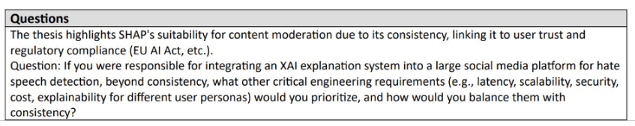
Review

Slide 21
Acknowledgements
My Supervisor and Director of the Programme – Professor Dr. sc. Ing. Dmitry Pavlyuk
Professors During Master's Program
UWE resources
State Education Development Agency of the Republic of Latvia for Scholarship

Slide 22
References
All sources at the following link
https://www.mybib.com/j/JudiciousDisgustingTiger

Slide 23
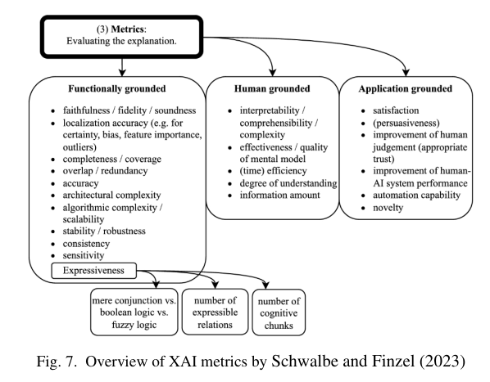
Other XAI metrics

Slide 24
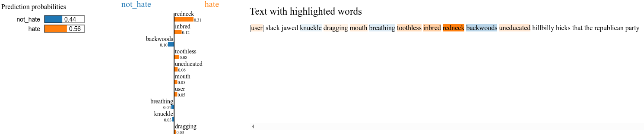
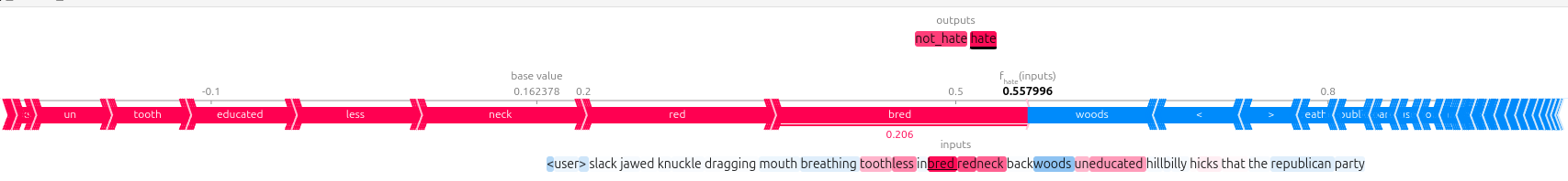
Extras
Figure 7: LIME Visualization Showing Word Contributions to a Classification
"Local interpretable model-agnostic explanations (LIME), proposed by Ribeiro, Singh, and Guestrin (2016), is an approach for fitting surrogate models. Surrogate models are trained to approximate the predictions of the underlying black box model." (Molnar, 2022)
Figure 8: SHAP Visualization of Feature Contributions to a Classification
"SHAP (SHapley Additive exPlanations) by Lundberg and Lee (2017) is a method to explain individual predictions. SHAP is based on the game-theoretically optimal Shapley values." (Molnar, 2019)

Slide 25
How LIME works (Molnar,2022)
Generate Variations: LIME creates new text variations by randomly removing words from the original text.
Feature Representation: Each word is represented by a binary feature (1 if included, 0 if removed).
Model Prediction: The model predicts the outcome (e.g., hate speech probability) for each generated variation.
Proximity Calculation: The proximity of each variation to the original text is determined.
Local Weight Estimation: LIME estimates local weights, highlighting words that strongly influence the model's prediction for a specific instance.

Slide 26
How SHAP works (Molnar,2019)
Game-Theoretic Approach: SHAP (SHapley Additive exPlanations) is based on Shapley values from cooperative game theory. It attributes a "payout" (the model's prediction) among features.
Feature Contributions: For text, "features" are typically individual words or tokens. SHAP calculates the contribution of each word to the overall prediction for a specific instance.
Coalitions: It considers all possible "coalitions" (subsets) of words from the text. For each coalition, it evaluates the model's prediction with and without a specific word to determine its marginal contribution.
Average Marginal Contribution: The Shapley value for a word is its average marginal contribution across all possible coalitions, ensuring fair attribution.

Slide 27

LIME (Local Interpretable Model-agnostic Explanations)
Formula:
Variables:
: : The explanation for instance x
g: Interpretable model from class G
G: Class of interpretable models
f: Original complex model being explained
L(f, g, π_x): Measure of how unfaithful g is in approximating f in the locality defined by π_x
π_x: Proximity measure around instance x
Ω(g): Complexity measure of the explanation model g
Description: Creates a locally faithful approximation of the original model around a specific prediction using an interpretable model. For text, it typically shows word contributions to the prediction.

Slide 28

SHAP (SHapley Additive exPlanations)
Formula:
Variables:
φᵢ(f,x): SHAP value for feature i
f: The model being explained
x: The specific instance being explained
F: Set of all features
S: Subset of features excluding feature i
|S|: Size of subset S
|F|: Total number of features
f(S∪{i}): Prediction with feature i included
f(S): Prediction with feature i excluded
Description: Based on game theory, assigns each feature an importance value for a particular prediction. The Shapley value represents the average marginal contribution of a feature across all possible coalitions.

Slide 29
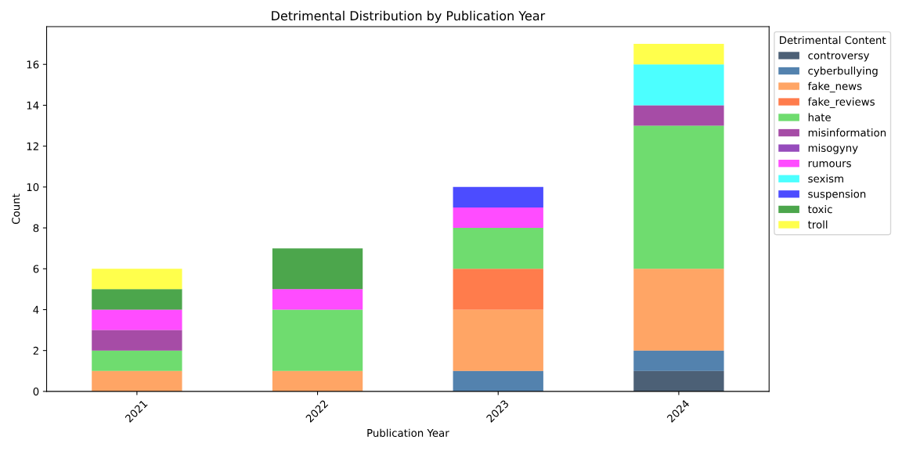
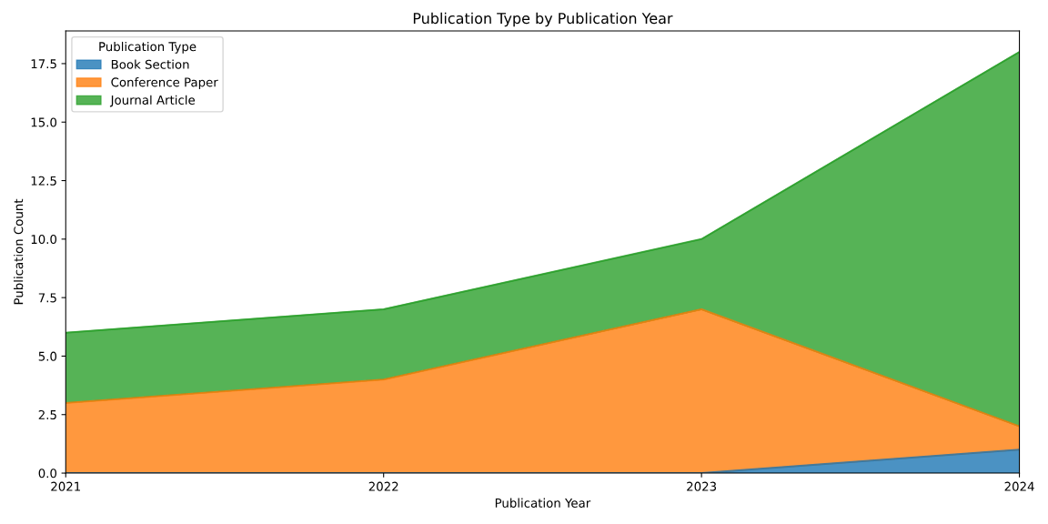
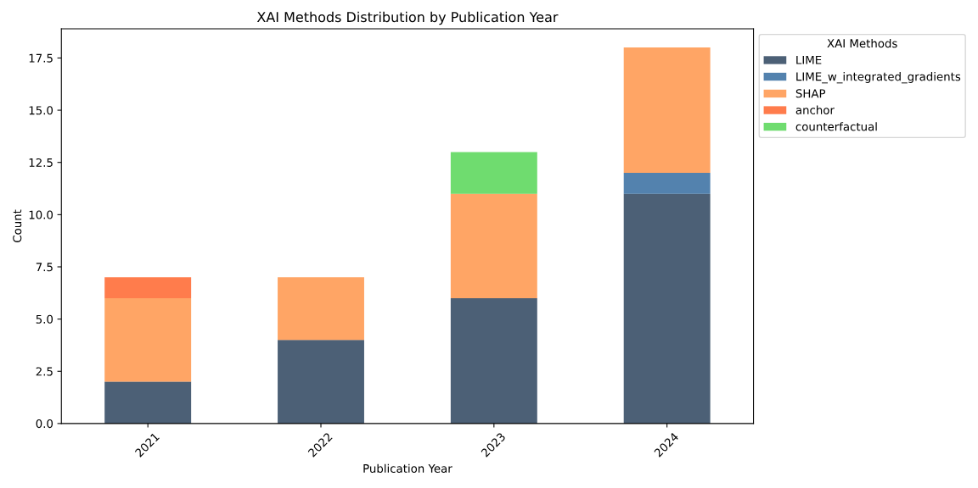
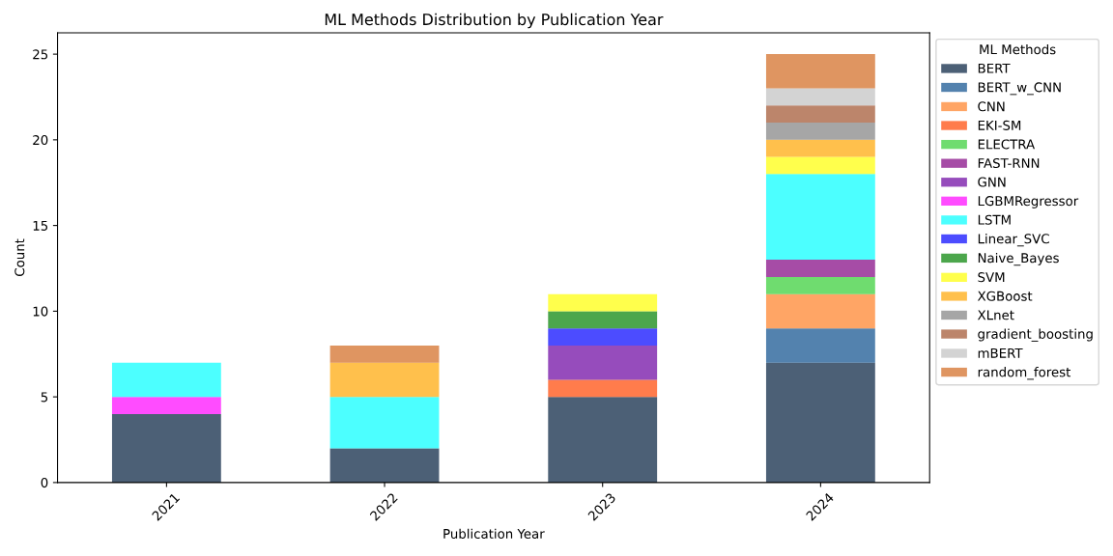
Detrimental Content from Search

