Slide 1
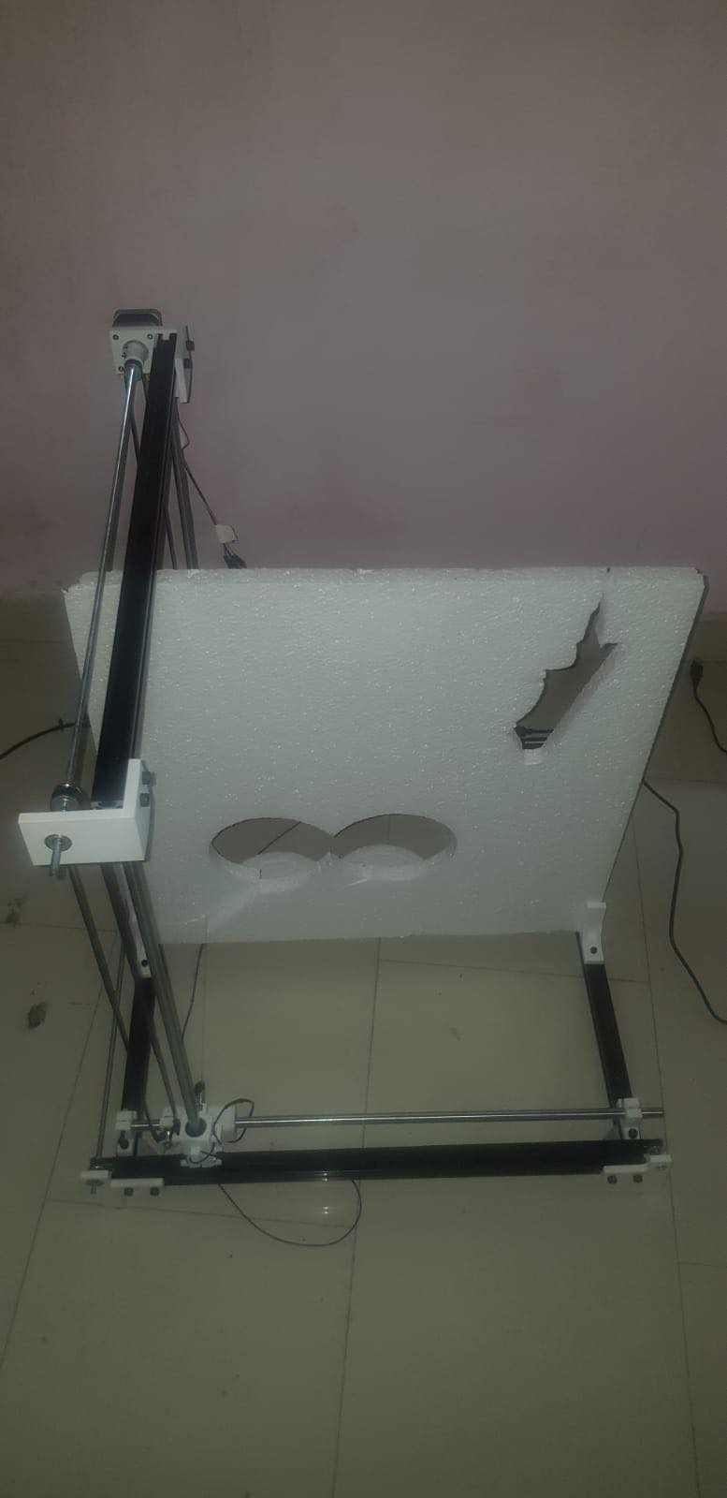
Arduino CNC Foam Cutting Machine
Presented by:
Takreem Abdallah
Haya Khufash
Supervisor:
Dr.Asmaa Afifi

Slide 2
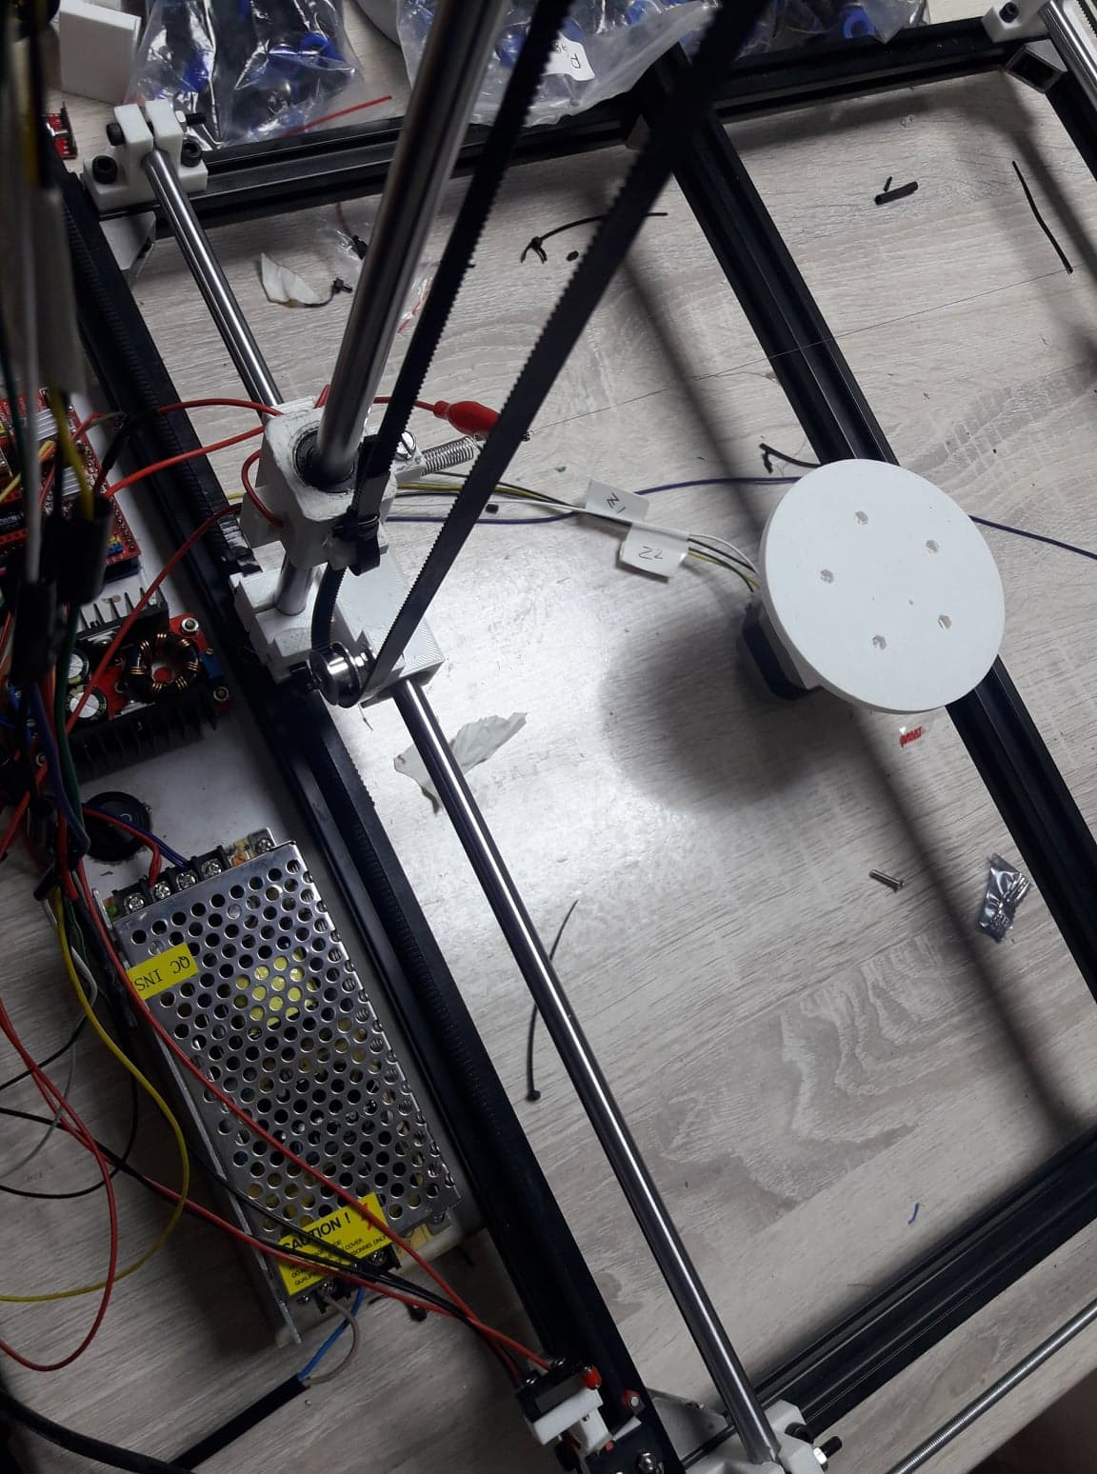
Outline
Main Features.
Tools.
How does it work.
Constrains.
Conclusion.
Future Work..

Slide 3
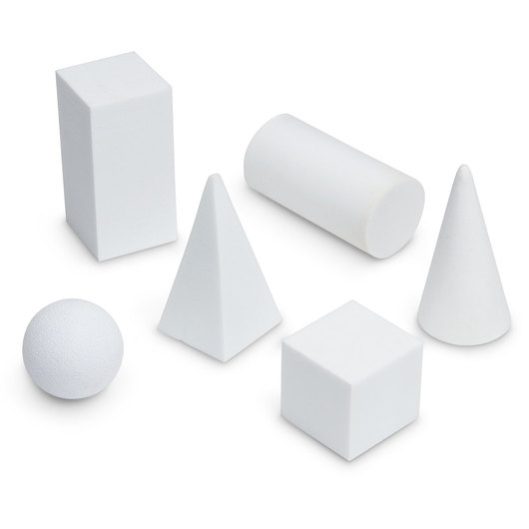
Main Feature
Main feature in our project is to draw different shapes like square, triangle, cylindrical and polygonal, ext. in foam.

Slide 4
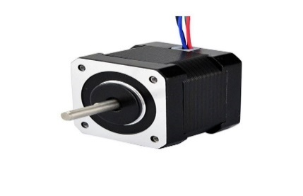
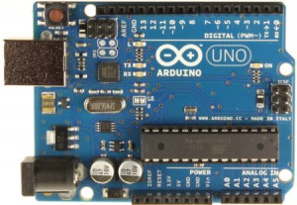
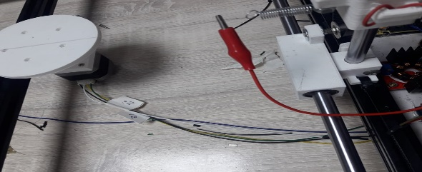
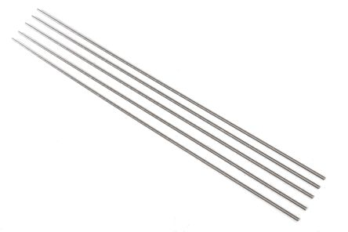
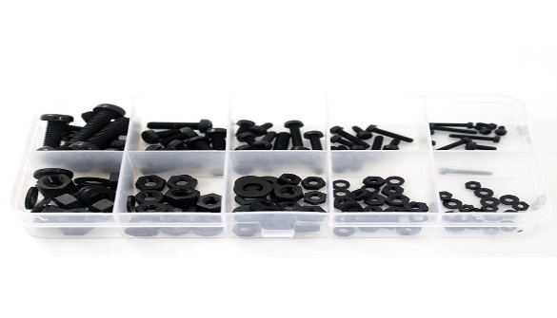
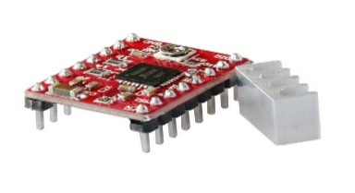
Tools
Stepper Motor
Arduino Uno
Hot Wire
Threaded Rod
Spacer Nuts and Bolts
Stepper Driver

Slide 5
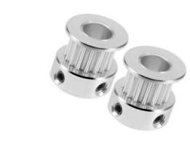
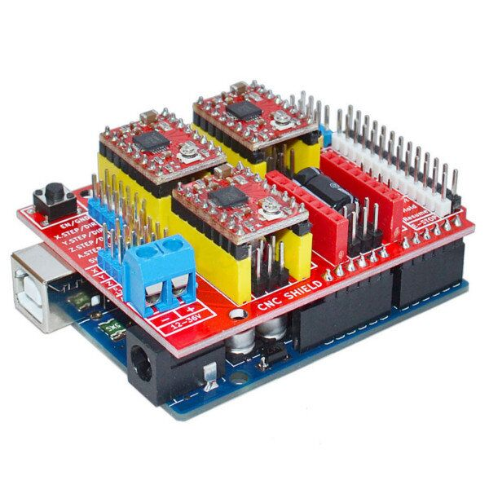
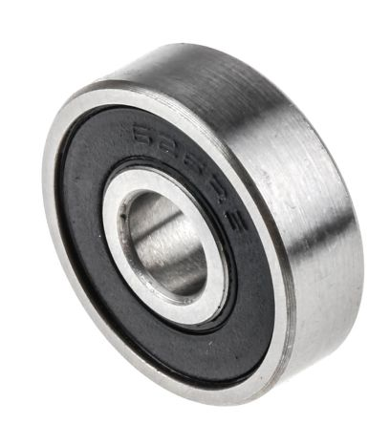
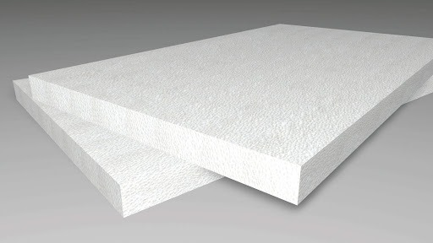
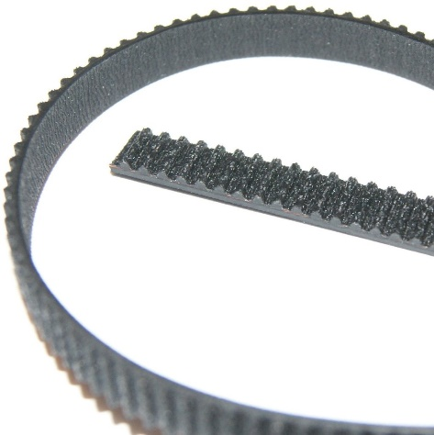
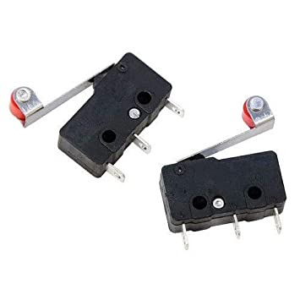
Tools
Tooth Pulley
Arduino CNC Shield
Bearing
Foam
GT2 Belt
Limit Switch

Slide 6
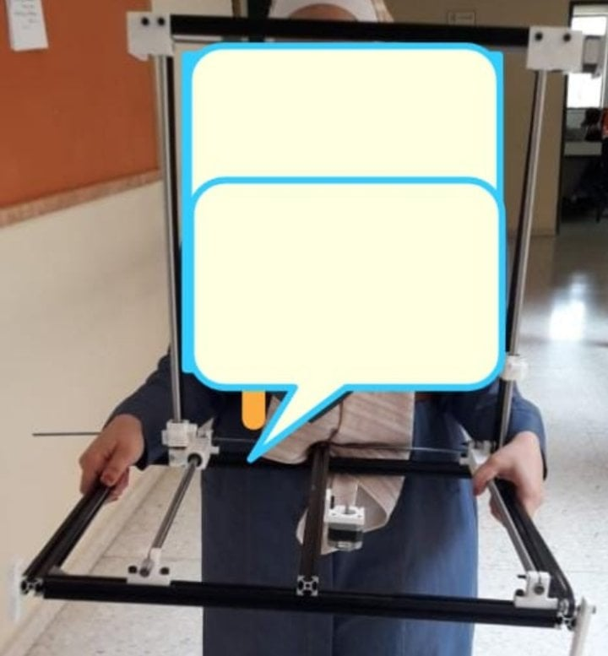
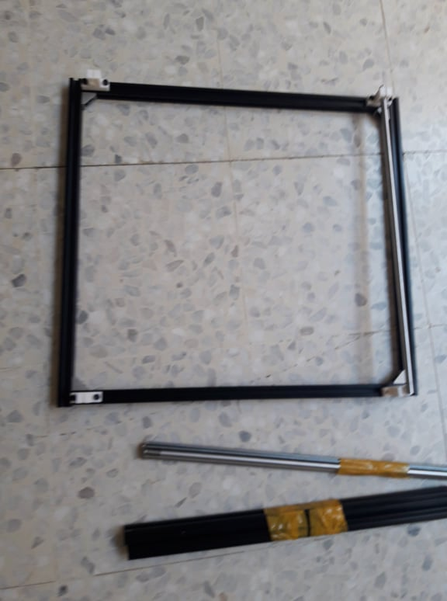
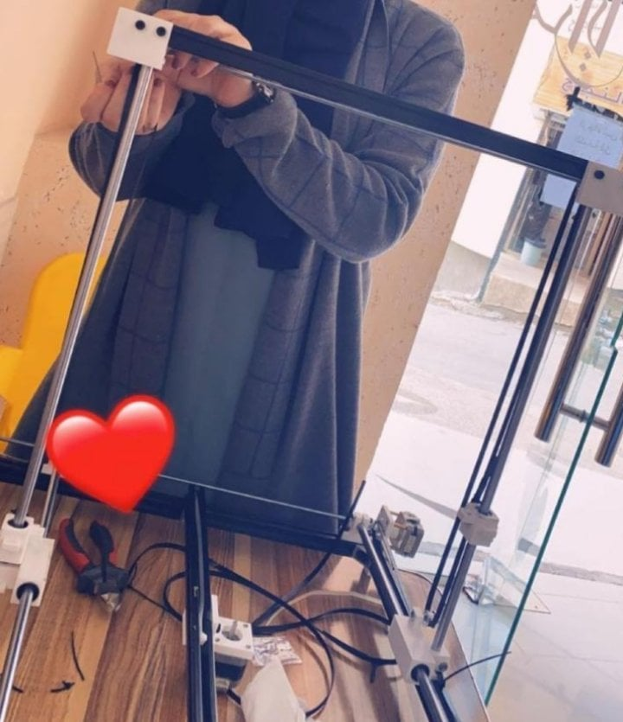
Tools
T-Slot

Slide 7
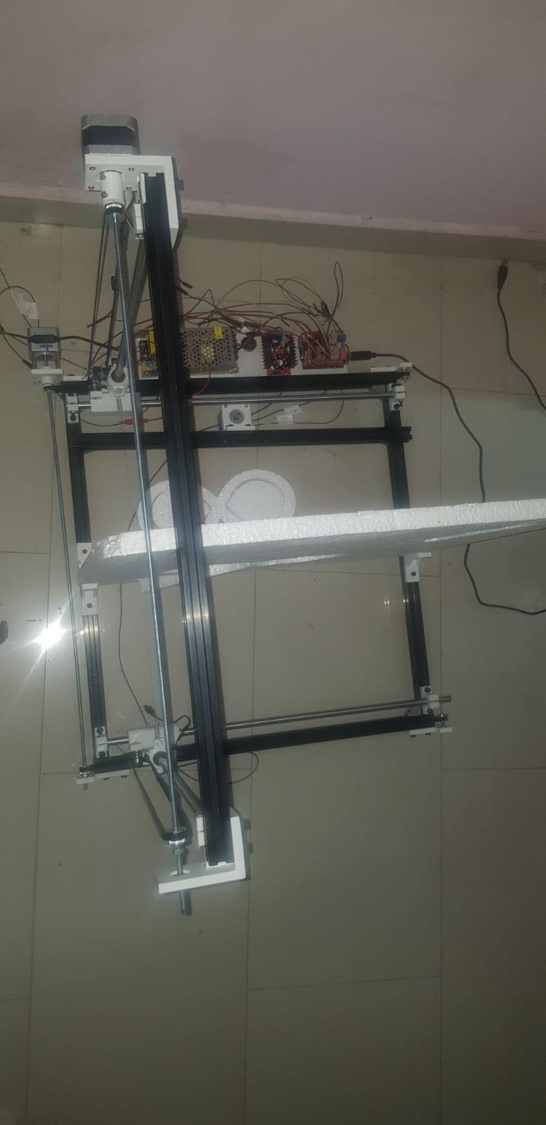
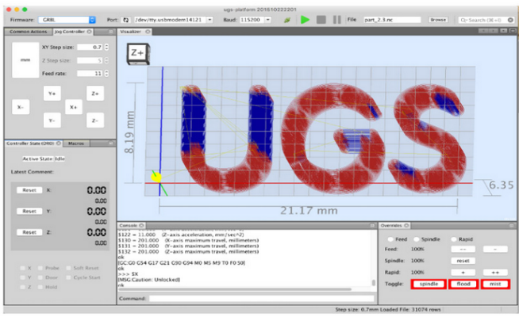
How does it work ?
Mechanical Part
Software Part

Slide 8
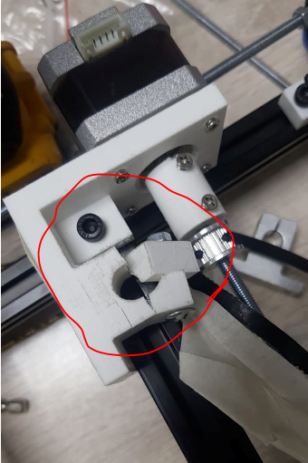
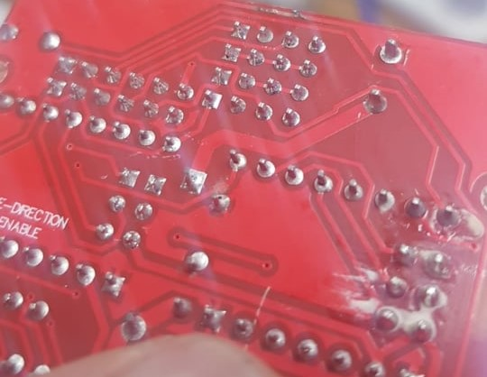
Constrains
Mechanical part .
Size of T-slot.
3D printed item is broken .
Arduino CNC Shield burned .
Corona virus .

Slide 9
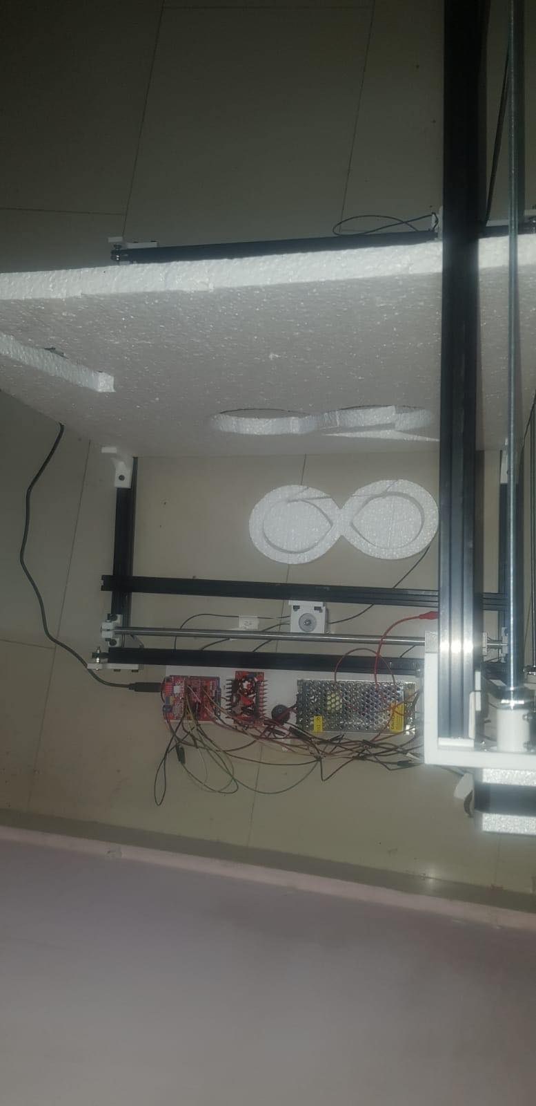
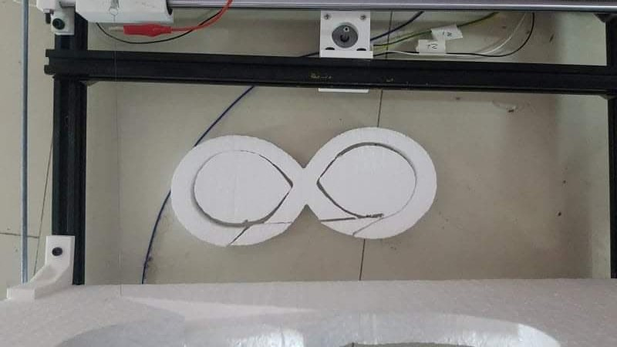

Conclusion
Finally , the project succeed ! , the following picture after its work .

Slide 10

Future Work
*financial profit
*Draw in wood

Slide 11
Thank you …. ☺

