Slide 1


Database Management System

Slide 2


Agenda
ER Model Components, ER Diagram
DBMS Keys
Generalization
Specialization
Aggregation
Relation Model
Constraints

Slide 3
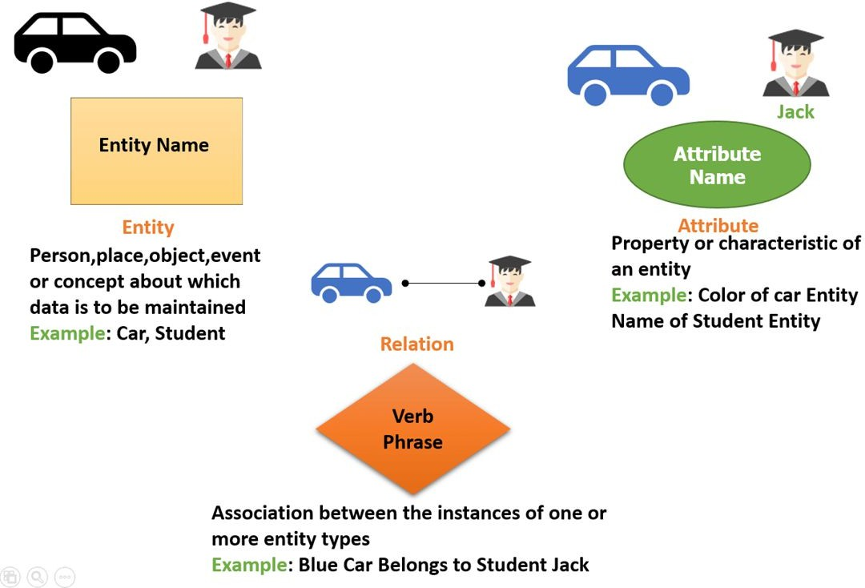
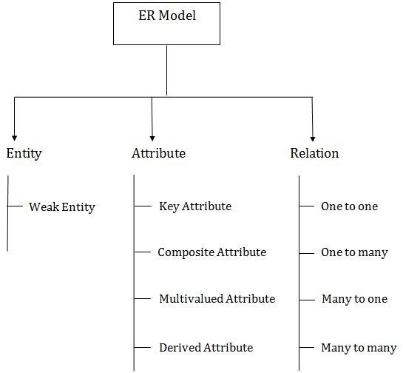
ER Model Components

Slide 4


ER Model Components
Entity:
An entity may be any object, class, person or place. In the ER diagram, an entity can be represented as rectangles.
Consider an organization as an example- manager, product, employee, department etc. can be taken as an entity.
Weak Entity:
An entity that depends on another entity called a weak entity. The weak entity doesn't contain any key attribute of its own. The weak entity is represented by a double rectangle.

Slide 5
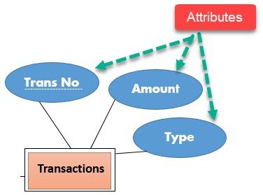
ER Model Components
Attribute:
The attribute is used to describe the property of an entity. Eclipse is used to represent an attribute.
For example, id, age, contact number, name, etc. can be attributes of a student.
Types of Attribute:
Key Attribute
Composite Attribute
Multivalued Attribute
Derived Attribute

Slide 6
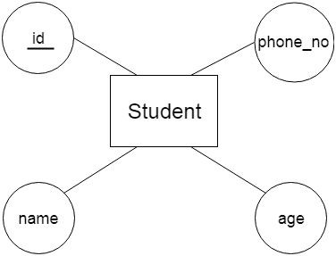
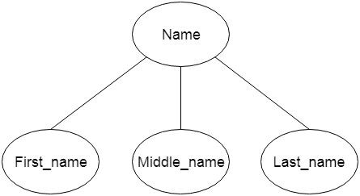
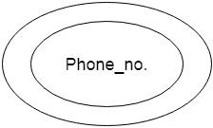
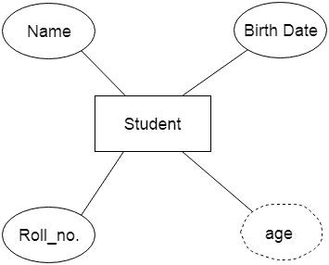
ER Model Components
Key Attribute:
The attribute is used to describe the property of an entity. Eclipse is used to represent an attribute.
For example, id, age, contact number, name, etc. can be attributes of a student.
Composite Attribute:
An attribute that composed of many other attributes is known as a composite attribute. The composite attribute is represented by an ellipse, and those ellipses are connected with an ellipse.
Multivalued Attribute:
An attribute can have more than one value. These attributes are known as a multivalued attribute.
The double oval is used to represent multivalued attribute.
For example, a student can have more than one phone number.
Derived Attribute:
An attribute that can be derived from other attribute is known as a derived attribute. It can be represented by a dashed ellipse.
For example, A person's age changes over time and can be derived from another attribute like Date of birth.

Slide 7

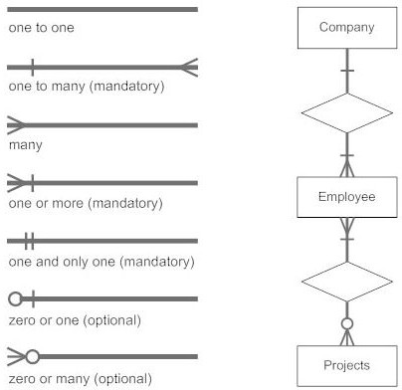
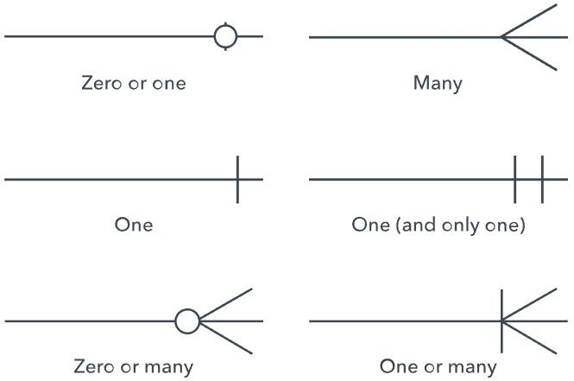
ER Model Components
Relationship:
A relationship is used to describe the relation between entities. Diamond or rhombus is used to represent the relationship.
Types of Relationship:
One-to-One Relationship
One-to-many relationship
Many-to-one relationship
Many-to-many relationship

Slide 8


ER Model Components
One-to-One Relationship:
When only one instance of an entity is associated with the relationship, then it is known as one to one relationship.For example, A female can marry to one male, and a male can marry to one female.
One-to-many Relationship:
When only one instance of the entity on the left, and more than one instance of an entity on the right associates with the relationship then this is known as a one-to-many relationship.
For example, Scientist can invent many inventions, but the invention is done by the only specific scientist.

Slide 9


ER Model Components
Many-to-one Relationship:
When more than one instance of the entity on the left, and only one instance of an entity on the right associates with the relationship then it is known as a many-to-one relationship.
For example, Student enrolls for only one course, but a course can have many students.
Many-to-many Relationship:
When more than one instance of the entity on the left, and more than one instance of an entity on the right associates with the relationship then it is known as a many-to-many relationship.
For example, Employee can assign by many projects and project can have many employees.

Slide 10
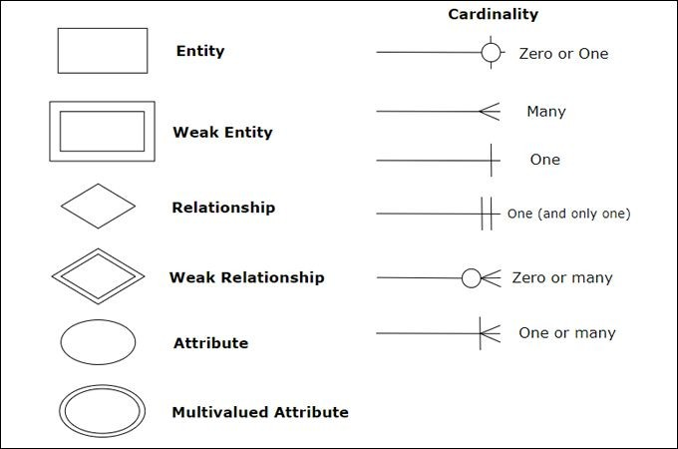
ER Model Components

Slide 11
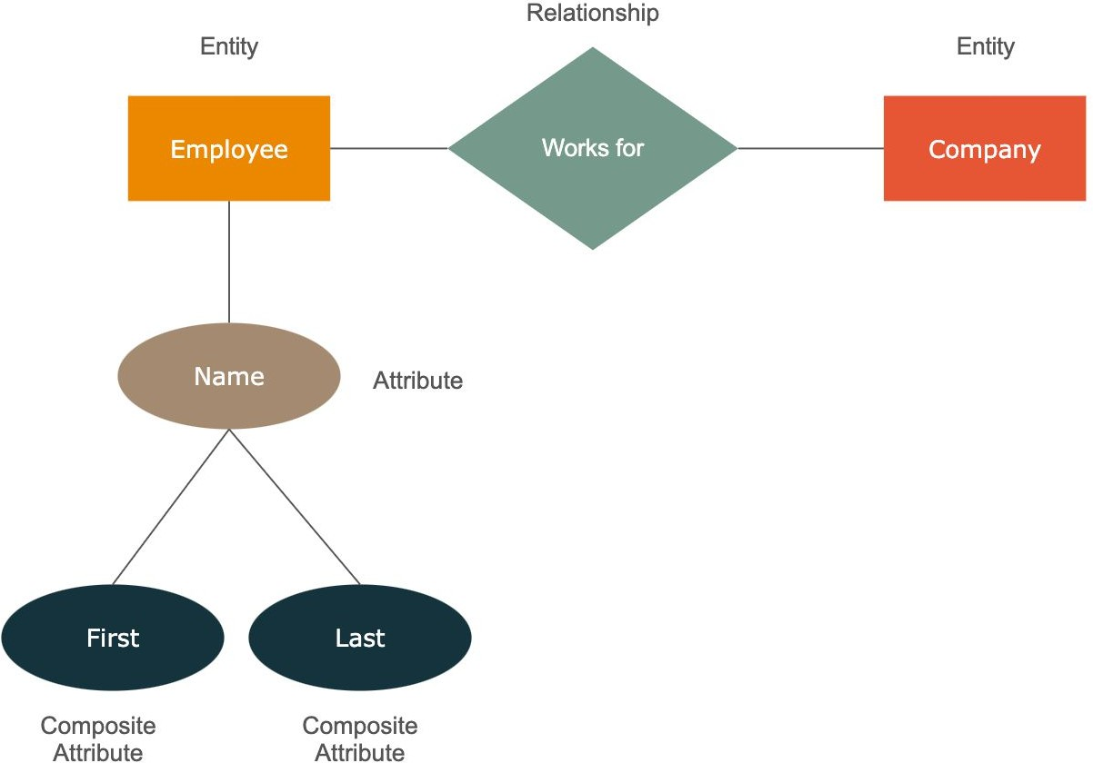

ER Diagram
We will use draw.io to draw ERD

Slide 12
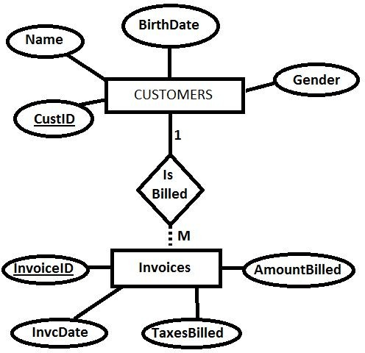
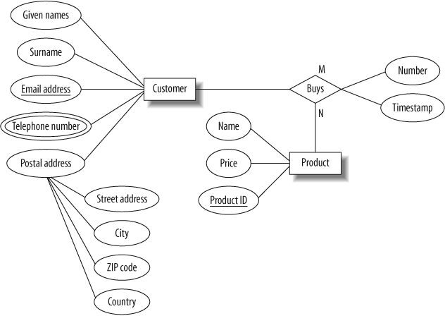
ER Diagram

Slide 13
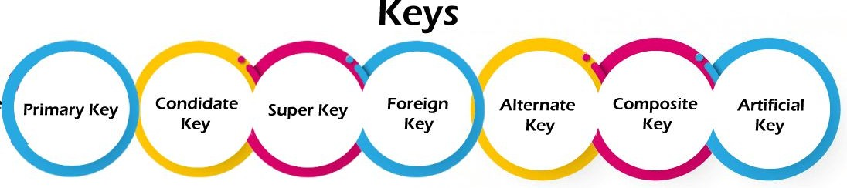
DBMS Keys
Keys play an important role in the relational database.
It is used to uniquely identify any record or row of data from the table.
It is also used to establish and identify relationships between tables.
For example, ID is used as a key in the Student table because it is unique for each student.
In the PERSON table, passport_number, license_number, etc are keys since they are unique for each person.
Types of Keys in DBMS:

Slide 14
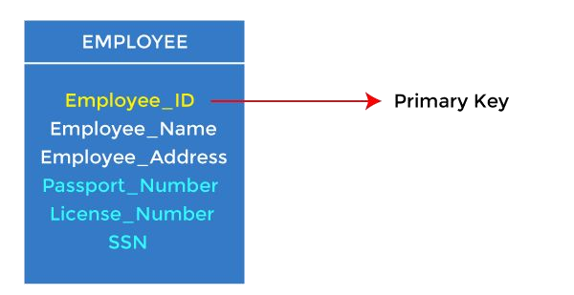
DBMS Keys
Primary Key:
It is the first key used to identify one and only one instance of an entity uniquely. An entity can contain multiple keys, as we saw in the PERSON table. The key which is most suitable from those lists becomes a primary key.
In the EMPLOYEE table, ID can be the primary key since it is unique for each employee. In the EMPLOYEE table, we can even select License_Number and Passport_Number as primary keys since they are also unique.
For each entity, the primary key selection is based on requirements and developers.

Slide 15
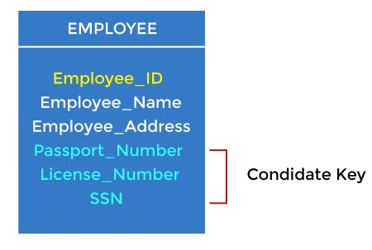
DBMS Keys
Candidate key:
A candidate key is an attribute or set of attributes that can uniquely identify a tuple.
Except for the primary key, the remaining attributes are considered a candidate key.
The candidate keys are as strong as the primary key.
For example: In the EMPLOYEE table, id is best suited for the primary key. The rest of the attributes, like SSN, Passport_Number, License_Number, etc., are considered a candidate key.

Slide 16
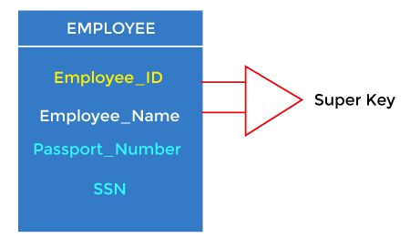
DBMS Keys
Super key:
A Super key is an attribute set that can uniquely identify a tuple.
A super key is a superset of a candidate key.
For example: In the above EMPLOYEE table, for(EMPLOEE_ID, EMPLOYEE_NAME), the name of two employees can be the same, but their EMPLYEE_ID can't be the same. Hence, this combination can also be a key.
The super key would be EMPLOYEE-ID (EMPLOYEE_ID, EMPLOYEE-NAME), etc.

Slide 17
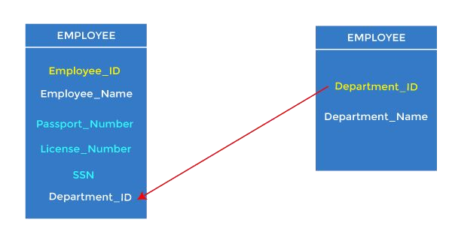
DBMS Keys
Foreign key:
Foreign keys are the column of the table used to point to the primary key of another table.
Every employee works in a specific department in a company, and employee and department are two different entities. So we can't store the department's information in the employee table.
That's why we link these two tables through the primary key of one table.
We add the primary key of the DEPARTMENT table, Department_Id, as a new attribute in the EMPLOYEE table.
In the EMPLOYEE table, Department_Id is the foreign key, and both the tables are related.

Slide 18
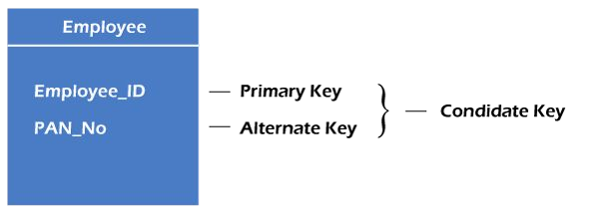
DBMS Keys
Alternate key:
There may be one or more attributes or a combination of attributes that uniquely identify each tuple in a relation. These attributes or combinations of the attributes are called the candidate keys.
One key is chosen as the primary key from these candidate keys, and the remaining candidate key, if it exists, is termed the alternate key. In other words, the total number of the alternate keys is the total number of candidate keys minus the primary key.
The alternate key may or may not exist. If there is only one candidate key in a relation, it does not have an alternate key.
For example, employee relation has two attributes, Employee_Id and PAN_No, that act as candidate keys. In this relation, Employee_Id is chosen as the primary key, so the other candidate key, PAN_No, acts as the Alternate key.

Slide 19
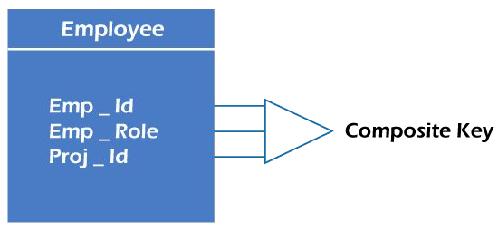
DBMS Keys
Composite key:
Whenever a primary key consists of more than one attribute, it is known as a composite key. This key is also known as Concatenated Key.
For example, in employee relations, we assume that an employee may be assigned multiple roles, and an employee may work on multiple projects simultaneously.
So the primary key will be composed of all three attributes, namely Emp_ID, Emp_role, and Proj_ID in combination.
So these attributes act as a composite key since the primary key comprises more than one attribute.

Slide 20
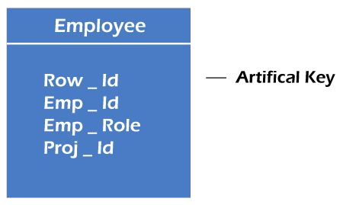
DBMS Keys
Artificial key:
The key created using arbitrarily assigned data are known as artificial keys. These keys are created when a primary key is large and complex and has no relationship with many other relations. The data values of the artificial keys are usually numbered in a serial order.
For example, the primary key, which is composed of Emp_ID, Emp_role, and Proj_ID, is large in employee relations. So it would be better to add a new virtual attribute to identify each tuple in the relation uniquely.

Slide 21
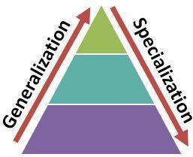
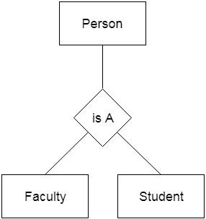
DBMS Generalization:
Generalization is like a bottom-up approach in which two or more entities of lower level combine to form a higher level entity if they have some attributes in common.
In generalization, an entity of a higher level can also combine with the entities of the lower level to form a further higher level entity.
Generalization is more like subclass and superclass system, but the only difference is the approach. Generalization uses the bottom-up approach.
In generalization, entities are combined to form a more generalized entity, i.e., subclasses are combined to make a superclass.
For example, Faculty and Student entities can be generalized and create a higher level entity Person.

Slide 22
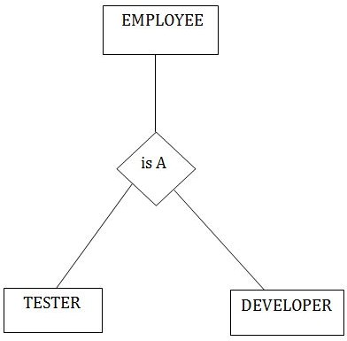
DBMS Specialization:
Specialization is a top-down approach, and it is opposite to Generalization. In specialization, one higher level entity can be broken down into two lower level entities.
Specialization is used to identify the subset of an entity set that shares some distinguishing characteristics.
Normally, the superclass is defined first, the subclass and its related attributes are defined next, and relationship set are then added.
For example: In an Employee management system, EMPLOYEE entity can be specialized as TESTER or DEVELOPER based on what role they play in the company.

Slide 23
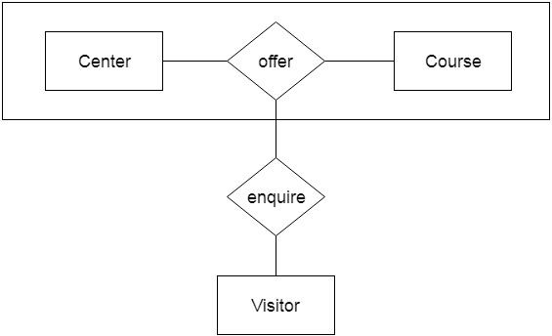
DBMS Aggregation:
In aggregation, the relation between two entities is treated as a single entity. In aggregation, relationship with its corresponding entities is aggregated into a higher level entity.
For example: Center entity offers the Course entity act as a single entity in the relationship which is in a relationship with another entity visitor. In the real world, if a visitor visits a coaching center then he will never enquiry about the Course only or just about the Center instead he will ask the enquiry about both.

Slide 24
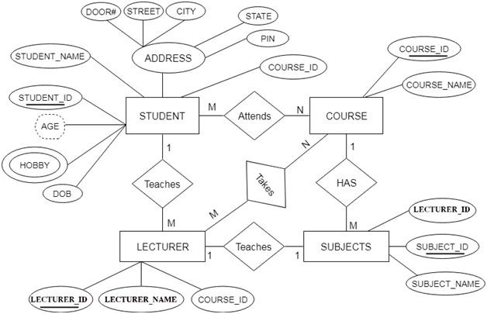
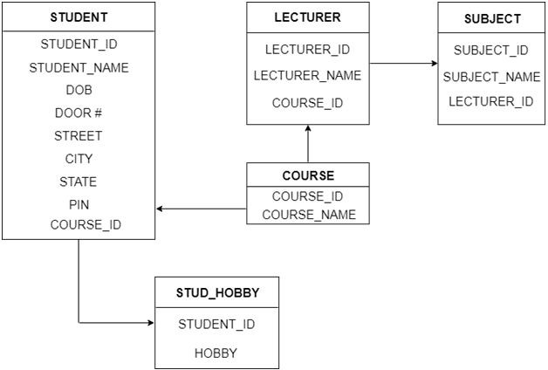
Convert ER to Table (Relational Model):

Slide 25
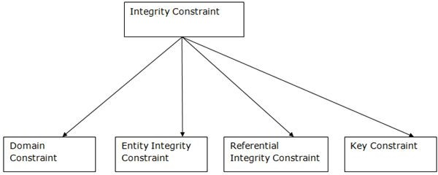
Integrity Constraints:
Integrity constraints are a set of rules. It is used to maintain the quality of information.
Integrity constraints ensure that the data insertion, updating, and other processes have to be performed in such a way that data integrity is not affected.
Thus, integrity constraint is used to guard against accidental damage to the database.
Types of Integrity Constraint:

Slide 26
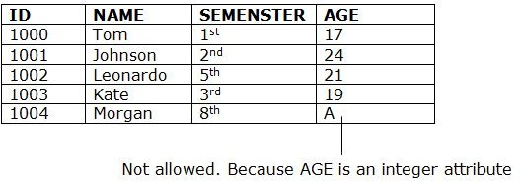
Integrity Constraints:
Domain constraints:
Domain constraints can be defined as the definition of a valid set of values for an attribute.
The data type of domain includes string, character, integer, time, date, currency, etc. The value of the attribute must be available in the corresponding domain.

Slide 27
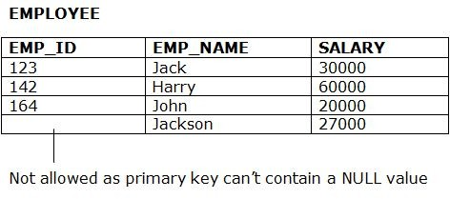
Integrity Constraints:
Entity integrity constraints:
The entity integrity constraint states that primary key value can't be null.
This is because the primary key value is used to identify individual rows in relation and if the primary key has a null value, then we can't identify those rows.
A table can contain a null value other than the primary key field.

Slide 28
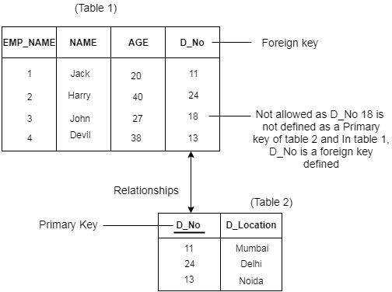
Integrity Constraints:
Referential Integrity Constraints:
A referential integrity constraint is specified between two tables.
In the Referential integrity constraints, if a foreign key in Table 1 refers to the Primary Key of Table 2, then every value of the Foreign Key in Table 1 must be null or be available in Table 2.

Slide 29
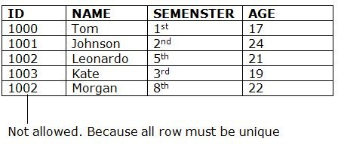
Integrity Constraints:
Key constraints:
Keys are the entity set that is used to identify an entity within its entity set uniquely.
An entity set can have multiple keys, but out of which one key will be the primary key.
A primary key can contain a unique and null value in the relational table.
29

