Slide 1
Design methodology of freeze-thaw processes towards industrial manufacturing of induced pluripotent stem cells
April 18, 2018
Lab seminar
iPS細胞の実生産に向けた凍結・解凍プロセスの設計手法
M2
Yusuke Hayashi

Slide 2





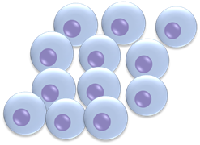



Background
Induced pluripotent stem (iPS) cells
Potential to be differentiated into all tissue and organs.
Attract much interest in disease modeling and personalized medicine.
Standardization of manufacturing process is necessary.
Cell harvest
Initialization
Freeze-thaw
Cultivation
Differentiation

Slide 3
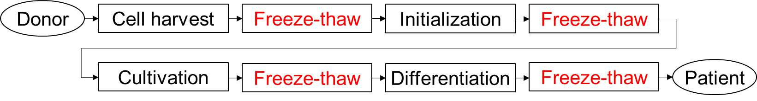
Background
Freeze-thaw process
It is required to transport and cryopreserve iPS cells.
There are many freeze-thaw processes in manufacturing.
iPS cells are known to be vulnerable to freezing and thawing[1].
Previous study
Cryoprotective agent study[2]
Experimental study[3,4]
In the freeze-thaw process, it is important to evaluate the impact of heat and mass transfer through the cell membrane.
[1] C. J. Hunt, Transfusion Medicine and Hemotherapy (2011), [2] Y. Xu, et al., Arch. Biochem. Biophys. (2014),
[3] R. Li, et al., Tissue Engineering Part C Methods (2018), [4] Y. Nishimura et al. Neuroscience Research (2016)

Slide 4
This study
Objective
Development of design methodology of freeze-thaw process for iPS cells considering heat and mass transfer
Modeling
Experiment
Simulation
Discussion and verification of results
Design methodology of freeze-thaw process

Slide 5
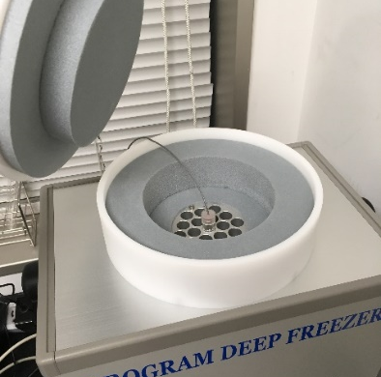
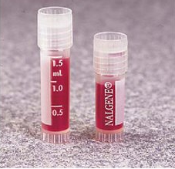
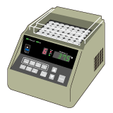
Experiment (In the future)
Program freezer (Freezing)
Cooling rate : 1 K～3 K/min
Lowest temp. : 193 K
Cryovial
Made of polypropylene
Diameter : 12 mm
Height : 48 mm
Program freezer
Cryovial[1]
Constant temperature water bath (Thawing)
Temperature : 37℃
Water bath
[1] Thermo Fisher Scientific Inc.

Slide 6
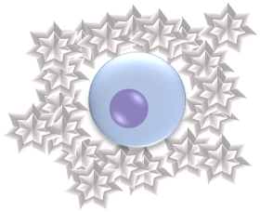
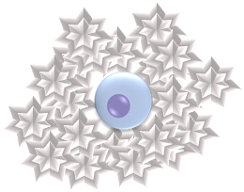
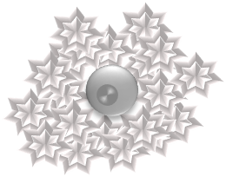
Freezing of cells
Mechanism
Extracellular water is frozen.
Water in a cell is transported by osmotic pressure.
Depression of freezing point inside a cell occurs.
The solute in a cell is frozen at the eutectic point.
Freezing completed!
Ice

Slide 7
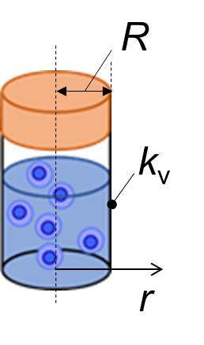

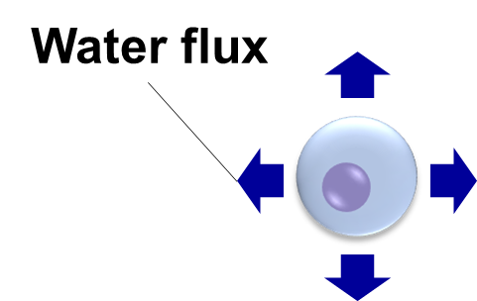

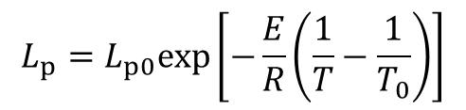

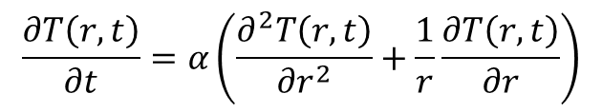
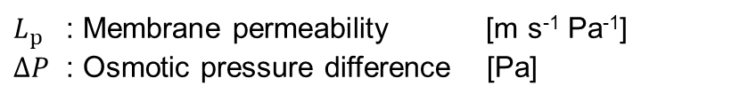
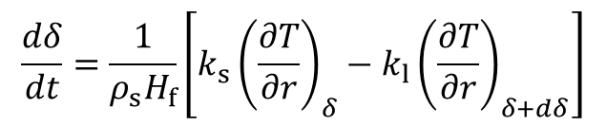
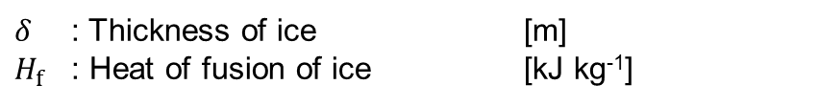
Modeling
Heat transfer
$$\frac{∂T\left(r,t\right)}{∂t}=α\left(\frac{∂^{2}T\left(r,t\right)}{{∂r}^{2}}+\frac{1}{r}\frac{∂T\left(r,t\right)}{∂r}\right)$$
$$\frac{dδ}{dt}=\frac{1}{ρ_{s}H_{f}}\left[k_{s}{\left(\frac{∂T}{∂r}\right)}_{δ}−k_{l}{\left(\frac{∂T}{∂r}\right)}_{δ+dδ}\right]$$
$δ$ : Thickness of ice [m]
$H_{f}$ : Heat of fusion of ice [kJ kg⁻¹]
Mass transfer
$$\frac{dV_{w}}{dt}=AL_{p}∆P$$
$$L_{p}=L_{p0}exp\left[−\frac{E}{R}\left(\frac{1}{T}−\frac{1}{T_{0}}\right)\right]$$
$L_{p}$ : Membrane permeability [m s⁻¹ Pa⁻¹]
$∆P$ : Osmotic pressure difference [Pa]

Slide 8
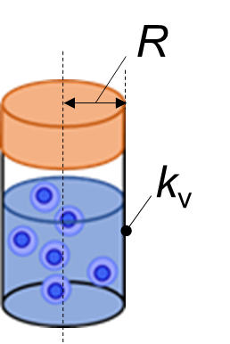
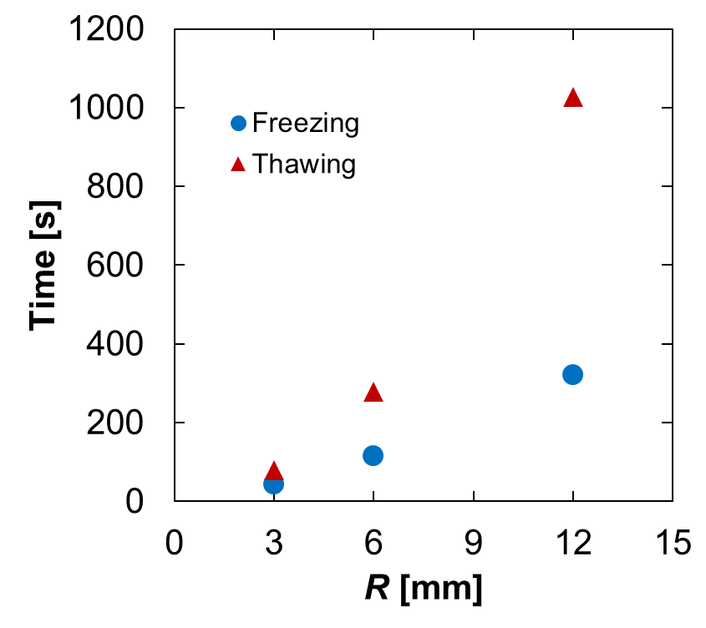
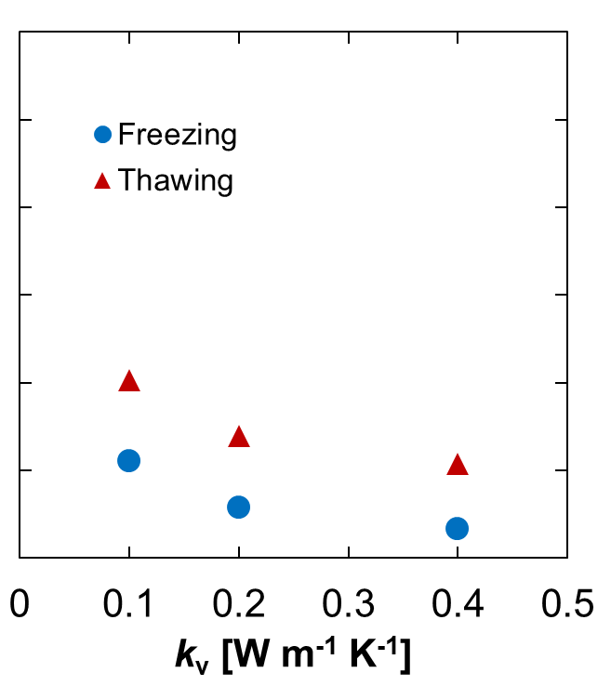
Heat transfer simulation
Assumptions
Freezer heat transfer : Natural convection
Freezer temperature : 193 K (Constant)
Initial vial temperature : 300 K
Content of the vial : Water
R and k_{v} are important design parameters.

Slide 9
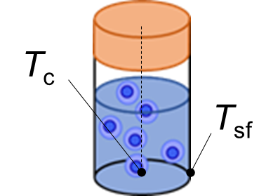
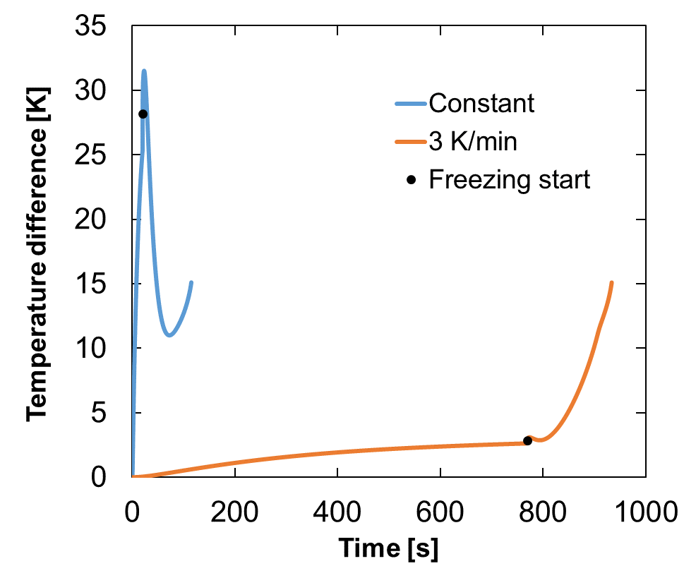

Heat transfer simulation
Freezer temperature
Constant (193 K)
‒3 K/min (From 300 K)
$$∆T=|T_{c}−T_{sf}|$$
Freezing procedure is also an important factor.

Slide 10
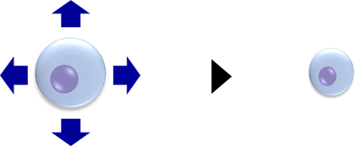
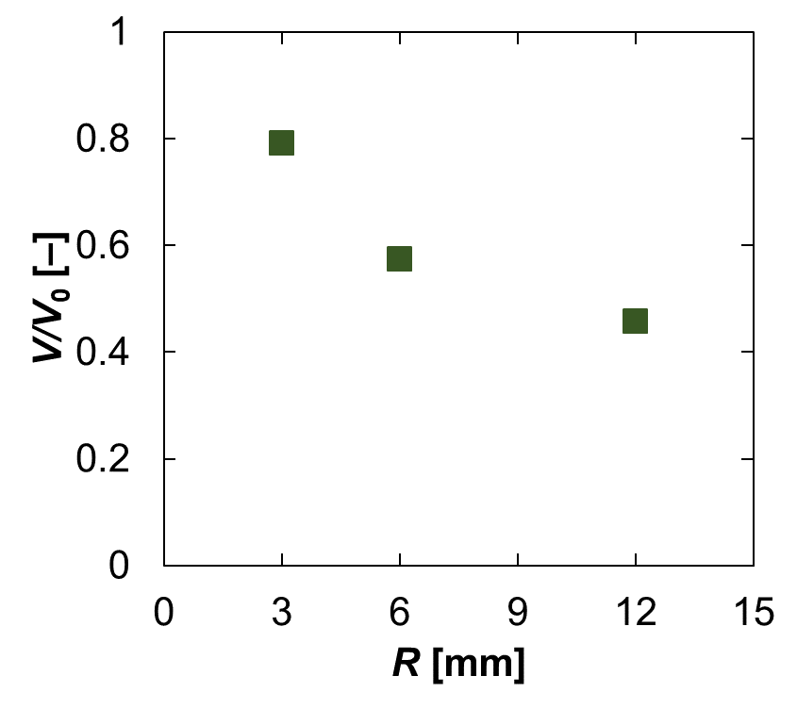
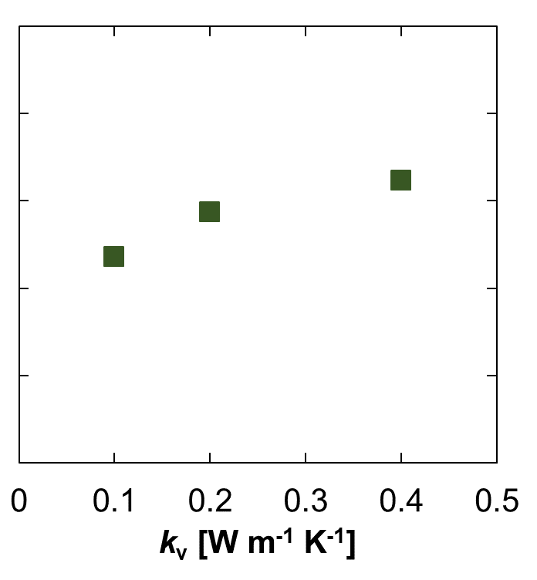
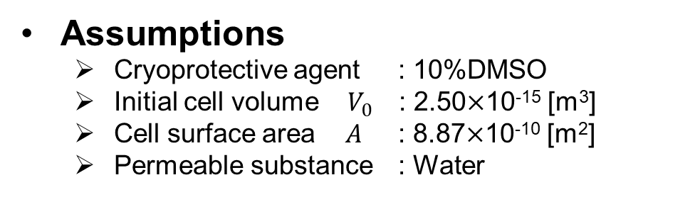
Mass transfer simulation
Assumptions
Cryoprotective agent : 10%DMSO
Initial cell volume $V_{0}$ : 2.50$×$10⁻¹⁵ [m³]
Cell surface area $A$ : 8.87$×$10⁻¹⁰ [m²]
Permeable substance : Water
R and k_{v} are important design parameters.

Slide 11
Future plan
Experiment
Survival rate after thawing
Cell membrane permeability
Effect of cryoprotective agent
Modeling & simulation
Cell damage by osmotic pressure
Intracellular ice formation
Convection in the freezer
Evaluation of the process
Survival rate
Manufacturing cost

Slide 12
Discussion
Other modeling & simulation
Other important design parameters
Evaluation method of the process

