Slide 1
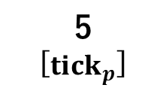
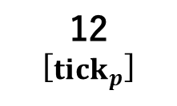
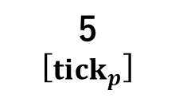
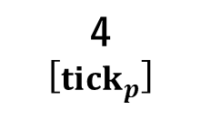
5
[$tick_{p}$]
5
[$tick_{p}$]
12
[$tick_{p}$]
4
[$tick_{p}$]
Notes:
黒がmu=0.1、青がmu=0.5

