Slide 1
All-Optical And Gate Using Photonic Crystal Quantum Dot Semiconductor Optical Amplifiers
Tokyo University of Science
Takuma Matsumoto,
Gou Hosoya, and Hiroyuki Yashima
Notes:
Thank you for your introduction.
I would like to start my presentation.
Today, I would like to talk about All-Optical Error Correcting Code using horizontal and vertical parity checks.

Slide 2
1-1. Background
All-Optical signal processing[1]
High-speed signal processing without utilizing O/E conversion
Required in the next-generation network
All-Optical devices
Required to realize all-optical signal processing
※ O/E: Optic/Electric
O-E-O transmission
Optical transmission line
O/E conversion
Electric operation
E/O
conversion
Optical transmission line
Optical transmission line
Optic
operation
Optical transmission line
All-Optical transmission
Fig 1. Transmission model of network
Notes:
Here, I’m going to talk about Background.
All-optical signal processing is High-speed signal processing without utilizing O/E conversion.
This transmission is required in the next-generation network.
Fig 1 shows transmission model of network.
Today’s network, despite Optical transmission, we work Electric operation.
This O-E-O transmission is the limitation of optical transmission speed.
So, we need the techniques of All-optical processing to overcome the speed limit.
To realize all-optical processing, all-optical devices have been developed.

Slide 3
2. Problem and Purpose
Problem
Research on all-optical error correcting code has not been promoted
Purpose
We realize all-optical error collecting code and evaluate the performance of the system
We utilize all-optical devices
We utilize vertical and horizontal parity checks
Notes:
Next, I’d like to explain purpose of this study.
As I already pointed out all-optical devices have been developed, research on all-optical error correcting code has not been promoted.
Thus, we realize all-optical error collecting code by utilizing vertical and horizontal parity checks and evaluate the performance of the system.
We utilize all-optical devices to realize the system.

Slide 4





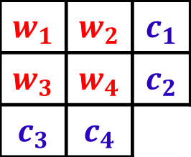
3-1. Vertical and Horizontal Parity Checks
Vertical and Horizontal Parity Checks
One of typical error correcting code
Corrects one errored bit
Encoding
Encoded code is composed of data bits ($w$) and parity bits ($c$)
Send
Encode
Receive
Decode
Fig 2. Transmission model of error correcting code
$x=\left(x_{1},x_{2},…,x_{8}\right)=\left(w_{1},w_{2},w_{3},w_{4},c_{1},c_{2},c_{3},c_{4}\right)=(w,c)$ (1)
$$c_{1}=w_{1}⊕w_{2}$$
$$w_{1}$$ | $$w_{2}$$ | $$c_{1}$$
$$w_{3}$$ | $$w_{4}$$ | $$c_{2}$$
$$c_{3}$$ | $$c_{4}$$
$$c_{2}=w_{3}⊕w_{4}$$
$$c_{3}=w_{1}⊕w_{3}$$
$$c_{4}=w_{2}⊕w_{4}$$
Notes:
In this section, I’m going to talk about previous studies.
First. I’d like to talk about vertical and horizontal parity checks.
Fig 2 shows transmission model of error correcting code.
Vertical and horizontal parity checks is the one of typical error correcting code and it corrects one errored bit.
Encoded code of vertical and horizontal parity checks is composed of data bits and parity bits.
Encoded code can be expressed as the equation one and parity bits calculate an exclusive-OR of data bits.
For example, c1 calculates an exclusive-OR of data w1 and w2.

Slide 5

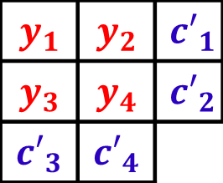


3-2. Vertical and Horizontal Parity Checks
Signal Receiving
Received signal $y$ calculates XOR of encoded code $x$ and noise $e$
Decoding
Data bits of received signal $y$ generate parity $c’$
Error pattern $s$ calculates XOR of $c$ and $c’$
Send
Encode
Receive
Decode
Fig 2. Transmission model of error correcting code
$$y_{1}$$ | $$y_{2}$$ | $${c′}_{1}$$
$$y_{3}$$ | $$y_{4}$$ | $${c′}_{2}$$
$${c′}_{3}$$ | $${c′}_{4}$$
$$y=(y_{1},y_{2},…,y_{8})$$
$$y_{i}=x_{i}⊕e_{i (i=1\sim 8)}$$
All-Optical XOR gate is required
Utilizes QD-SOA
(Quantum-dot Semiconductor Optical Amplifier)
Notes:
Next, I’m going to explain how to decode received signal.
Received signal y calculates exclusive-OR of encoded code x and noise e.
In order to decode received signal, generation of parity c’ is required, and to obtain error pattern s, error pattern s calculates exclusive OR of c and c’.
From these studies, it is assumed that all-optical XOR gate is required, and non linear optical device is required in order to construct all-optical XOR gate.

Slide 6
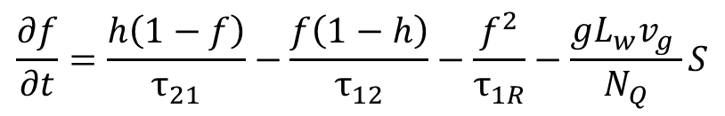
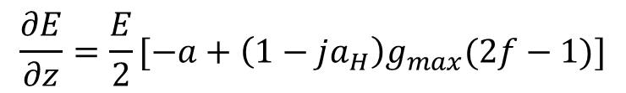
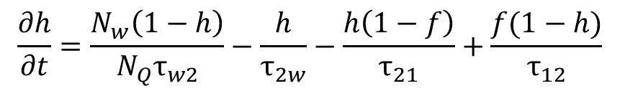
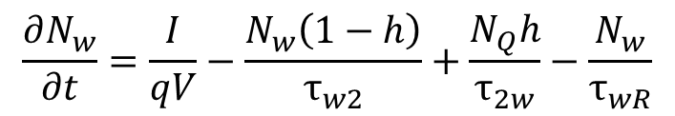
3-3. Equations of QD-SOA
Rate equations in QD-SOA[2]
WL : Wetting Layer
ES : Excited State
GS : Grand State
$$\frac{∂N_{w}}{∂t}=\frac{I}{qV}−\frac{N_{w}\left(1−h\right)}{τ_{w2}}+\frac{N_{Q}h}{τ_{2w}}−\frac{N_{w}}{τ_{wR}}$$
(2)
$$\frac{∂h}{∂t}=\frac{N_{w}\left(1−h\right)}{{N_{Q}τ}_{w2}}−\frac{h}{τ_{2w}}−\frac{h\left(1−f\right)}{τ_{21}}+\frac{f(1−h)}{τ_{12}}$$
(3)
Electron
$$\frac{∂f}{∂t}=\frac{h\left(1−f\right)}{τ_{21}}−\frac{f\left(1−h\right)}{τ_{12}}−\frac{f^{2}}{τ_{1R}}−\frac{gL_{w}v_{g} }{N_{Q}}S$$
WL
(4)
ES
GS
Wave equation in QD-SOA
$$\frac{∂E}{∂z}=\frac{E}{2}[−a+\left(1−ja_{H}\right)g_{max}(2f−1)]$$
Photon
(5)
Fig 3. The model of quantum-dot
Notes:
Here, I’d like to explain non linear optical device QD-SOA.
QD-SOA is semiconductor optical amplifier which has quantum-dot active layers and store electron to amplify photonic signal.
In order to analyze QD-SOA, we utilize rate equations which represents carrier occupancy of each layers.
The carrier occupancy of GS layer is obtained from equation no 4 and we obtain optical power from equation no 5.
Q. What parameters of equations refer to? (式の各パラメータは何を意味しているか)
I’ll show what the parameters mean. (付録にとぶ)

Slide 7






3-4. Optical Device—All-Optical XOR Gate[2][3][4]
Utilizes MZI(mach-zehnder interferometer) and XPM(cross-phase moduration)
$$φ_{A}$$
InputA ($λ_{A}$)
QD-SOA1
Clock ($λ_{CL}$)
Output ($λ_{CL}$)
QD-SOA2
: Coupler
InputB ($λ_{B}$)
$$φ_{B}$$
Fig 4. The Configuration of QD-SOA based XOR gate
Table 1. A truth table of all-optical XOR gate
InputA | InputB | Output | Reason
0 | 0 | 0 | No phase difference between upper waveguide and lower waveguide
1 | 0 | 1 | Phase difference between upper waveguide and lower waveguide
0 | 1 | 1 | Phase difference between upper waveguide and lower waveguide
1 | 1 | 0 | No phase difference between upper waveguide and lower waveguide
Notes:
Next, I want to go on to all-optical XOR gate.
Fig. 2 shows the configuration of all-optical XOR gate.
This gate utilizes mach-zehnder interferometer and cross phase moduration.
In mach-zehnder interferometer, one signal is divided into two signals and any medium changes phase of one side of signal.
If phase difference between two signals exists, two signals are coupled into second coupler and output signal is obtained.
If phase difference between two signals does not exist, two signals are cancelled each other and output signal is not obtained.
Cross phase modulation is phase modulation occurred by nonlinear optical device and pump pulse.
In Fig 2, the clock signal is fed into the first coupler and divided into two waveguides.
The QD-SOA1 and QD-SOA2 modulates the phase of clock signal by phiA and phiB, respectively.
If the power of input signal is “1”, QD-SOA modulates the phase of clock signal by half of pi.
So, if the power of InputA and InputB is different, then the phase of the signal travelling through the upper waveguide is different from that of the signal travelling through the lower waveguide.
If the phase of the upper waveguide is different from that of the lower waveguide by pi, the signals are coupled into the second coupler and the output signal is obtained as “1”.
If the phase difference doesn’t exist, the output signal is obtained as “0”.
From these things, table. 1 is obtained as a truth table of all-optical XOR gate.

Slide 8





3-5. Optical Device—All-Optical AND Gate[5]
Replaces InputB with Clock of all-optical XOR gate
$$φ_{A}$$
InputA ($λ_{A}$)
QD-SOA1
InputB ($λ_{B}$)
Output ($λ_{B}$)
QD-SOA2
: Coupler
Clock ($λ_{CL}$)
Fig 5. The Configuration of QD-SOA based AND gate
Table 2. A truth table of all-optical AND gate
InputA | InputB | Output | Reason
0 | 0 | 0 | The power of InputB is zero
1 | 0 | 0 | The power of InputB is zero
0 | 1 | 0 | No phase difference between upper waveguide and lower waveguide
1 | 1 | 1 | Phase difference between upper waveguide and lower waveguide
Notes:
Next, I want to explain all-optical AND gate.
As I already pointed out output signal is derived from the center input signal, if the power of InputB is zero, the output signal is obtained as zero.
If the power of InputB is one and the power of InputA is zero, then the phase of the upper waveguide is equal to that of the lower waveguide and the signals are coupled into the second coupler and the output signal is obtained as zero.
If the power of InputA and InputB is one, then the phase of the upper waveguide is different from that of the lower waveguide by pi and the output signal is obtained as one.
From these things, table 2 is obtained as a truth table of all-optical AND gate.

Slide 9
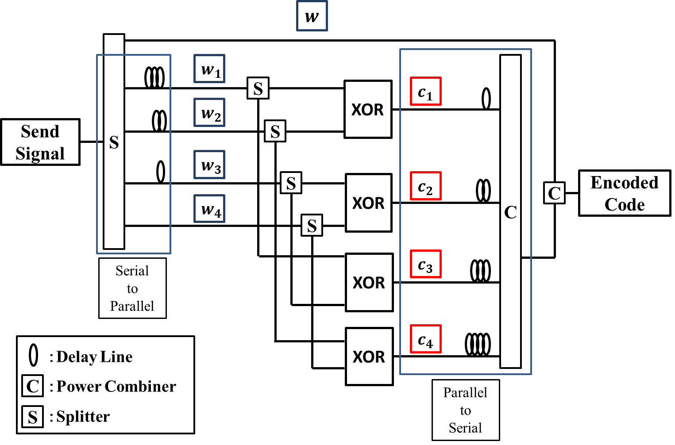
4-1. All-Optical Error Correcting Code—Encoder
All of the devices are all-optical devices
Fig 6. The Configuration of the encoder for all-optical error correcting code
Notes:
Here, I’d like to show the proposal encoder for all-optical error correcting code.
Fig. 6 shows the configuration of the proposal encoder.
All of the devices are all-optical devices.
Now, I’d explain how it works. First, the send signal is fed into splitter and divided into five waveguides.
The top waveguide (一番上の導波路を指す) is used at the last power combiner.
Other waveguides (他の導波路を指す) are used for generating parity bits. In order to generate parity bits, signals are converted to parallel signal and fed into splitter and XOR gate.
Because the parity bits are the parallel signal, the encoder utilizes delay lines and power combiner to convert to serial signal.
Finally, the send signal and the generated parity are combined by the last power combiner and the encoder generate the encoded code.

Slide 10
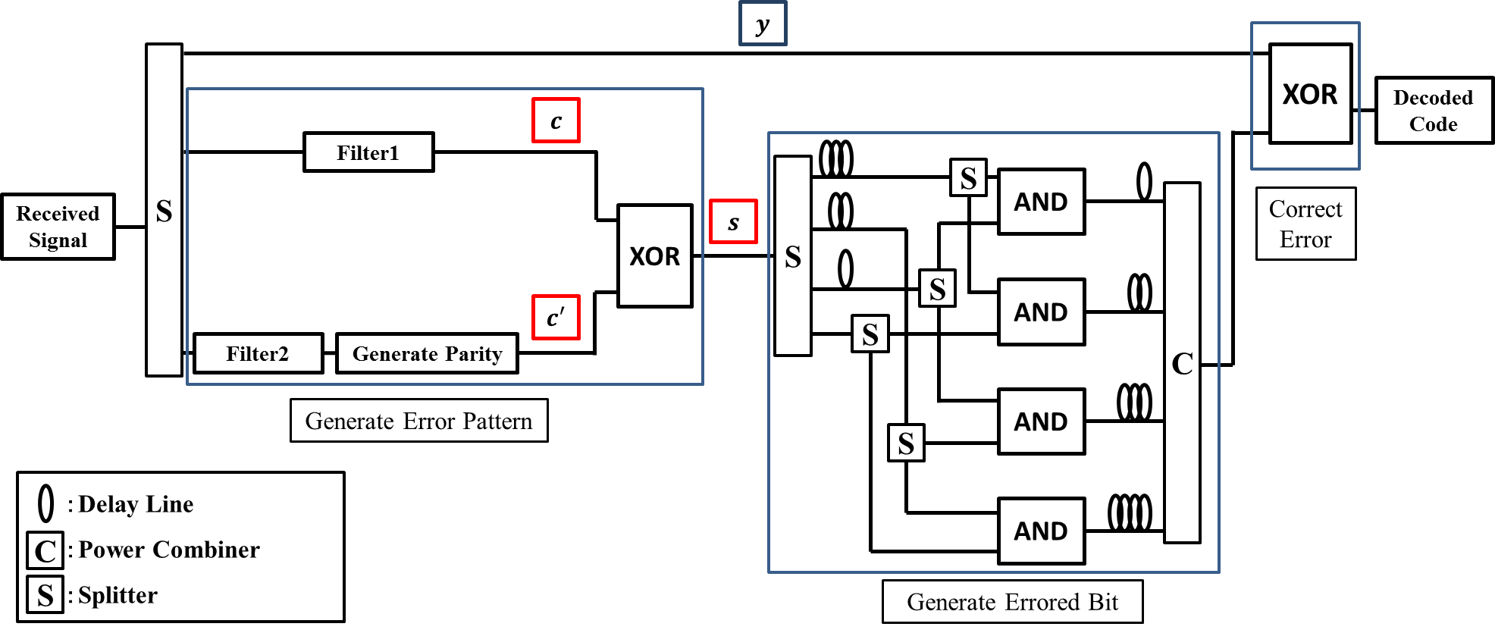
4-2. All-Optical Error Correcting Code—Decoder
All of the devices are all-optical devices
Filter1 Picks out parity bits from the received signal
Filter2 Picks out data bits from the received signal
Fig 7. The Configuration of the decoder for all-optical error correcting code
Notes:
Next, I’d like to show the proposal decoder for all-optical error correcting code.
Fig. 7 shows the configuration of the proposed model. Now, I’d explain how it works.
First, the received signal is fed into splitter and divided into three waveguides.
The parity bits in the received signal and the parity bits generated from the data bits in the received signal are required in order to generate error pattern.
So, the decoder utilizes the filter1 to pick out parity bits from the received signal travelling through the center waveguide and the filter2 is used to pick out data bits from the received signal travelling through the lower waveguide.
As well as the proposal encoder, the signals from the filter2, that is, data bits in the received signal generate parity bits.
The parity bits in the received signal and the parity bits generated from the data bits are fed into XOR gate to generate error pattern.
We can say which bit is error bit from the error pattern and to generate errored bit, the signals of error pattern are used.
Finally, the received signal and the errored bit are fed into XOR gate to generate the decoded code.
Q. I want to know how the filter 1 and 2 works.
I would show the configurations of filter 1 and 2.

Slide 11
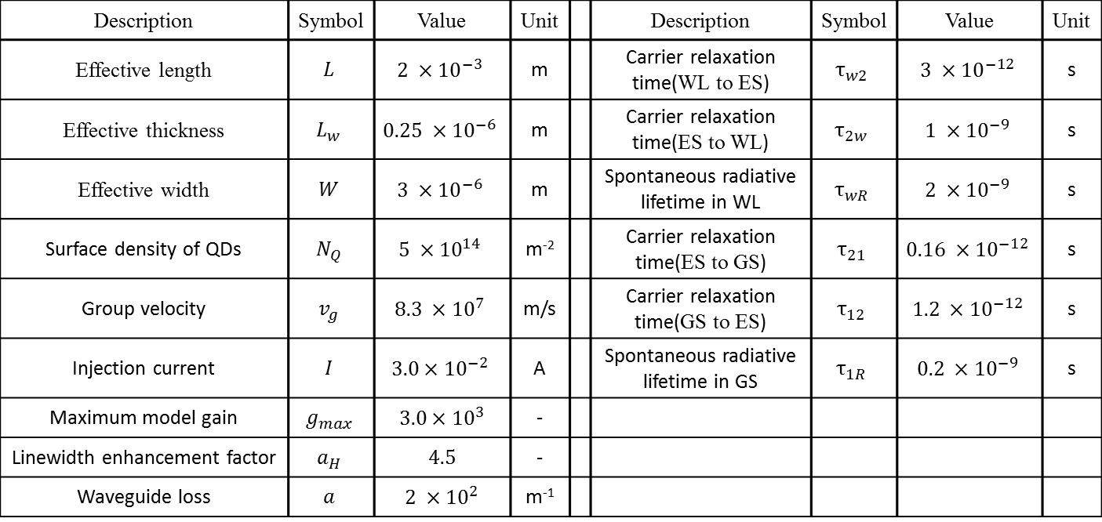
5-1. Result—Parameter
The parameter of the QD-SOA
Transmission rate : 160 Gbps
Table 3. The parameter of the QD-SOA
Description | Symbol | Value | Unit |  | Description | Symbol | Value | Unit
Effective length | $$L$$ | $$2 ×{10}^{−3}$$ | m |  | Carrier relaxation time(WL to ES) | $$τ_{w2}$$ | $$3 ×{10}^{−12}$$ | s
Effective thickness | $$L_{w}$$ | $$0.25 ×{10}^{−6}$$ | m |  | Carrier relaxation time(ES to WL) | $$τ_{2w}$$ | $$1 ×{10}^{−9}$$ | s
Effective width | $$W$$ | $$3 ×{10}^{−6}$$ | m |  | Spontaneous radiative lifetime in WL | $$τ_{wR}$$ | $$2 ×{10}^{−9}$$ | s
Surface density of QDs | $$N_{Q}$$ | $$5 ×{10}^{14}$$ | m⁻² |  | Carrier relaxation time(ES to GS) | $$τ_{21}$$ | $$0.16 ×{10}^{−12}$$ | s
Group velocity | $$v_{g}$$ | $$8.3 ×{10}^{7}$$ | m/s |  | Carrier relaxation time(GS to ES) | $$τ_{12}$$ | $$1.2 ×{10}^{−12}$$ | s
Injection current | $$I$$ | $$3.0×{10}^{−2}$$ | A |  | Spontaneous radiative lifetime in GS | $$τ_{1R}$$ | $$0.2 ×{10}^{−9}$$ | s
Maximum model gain | $$g_{max}$$ | $$3.0×{10}^{3}$$ | -
Linewidth enhancement factor | $$a_{H}$$ | $$4.5$$ | -
Waveguide loss | $$a$$ | $$2 ×{10}^{2}$$ | m⁻¹
Notes:
Now, I want to discuss the result of numerical analysis.
The parameters used for the QD-SOA are shown in Table 3 and the transmission rate is 160Gbps.
Q.What the dB means to? (dBって何？)
That is one unit of optical power. And can be convert to Wat.
For example, 0dB refers to 1Wat.

Slide 12
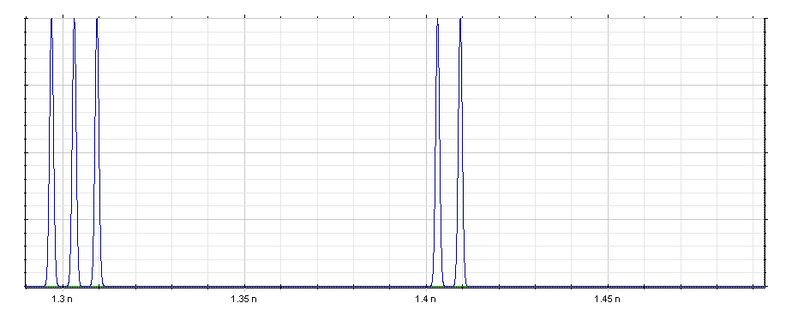
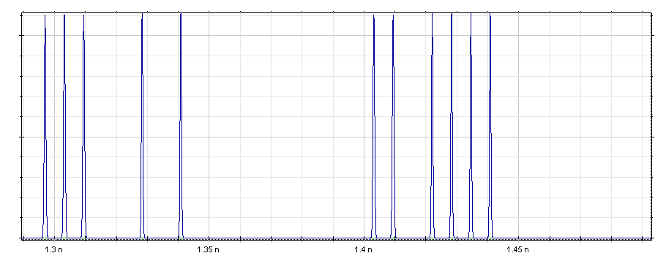




5-2. Result—Input and Output Waveforms of the Encoder
$$w_{1}w_{2}w_{3}w_{4}$$
$$w_{1}w_{2}w_{3}w_{4}$$
Normalized Power
1110
0110
1.0
0.5
0.0
1.30
1.35
1.40
1.45
Time(ns)
Fig 8. Waveforms fed into the encoder
$$w_{1}w_{2}w_{3}w_{4}c_{1}c_{2}c_{3}c_{4}$$
$$w_{1}w_{2}w_{3}w_{4}c_{1}c_{2}c_{3}c_{4}$$
Normalized Power
11100101
01101111
1.0
0.5
0.0
1.30
1.35
1.40
1.45
Time(ns)
Fig 9. Waveforms obtained from the encoder
The encoder outputs code word
Notes:
Here, I’d like to talk about input and output waveforms of the encoder.
Fig.8 represents the waveforms fed into the encoder, and fig.9 represents the waveforms obtained from the encoder. We tried two patterns.
The data bits of the first pattern are these bits(1つめのパターンを指しながら) and that of the second pattern are these bits(2つめのパターンを指しながら) as shown in Fig.8.
If these patterned signals are fed into the encoder, then patterned signals are obtained from the encoder as show in Fig.9.
This result agrees with the encoder operation.

Slide 13
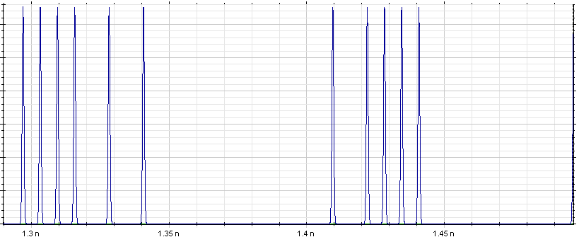
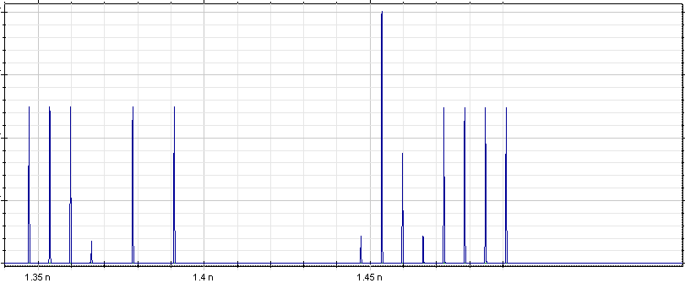




5-3. Result—Input and Output Waveforms of the Decoder
Normalized Power
$$y_{1}y_{2}y_{3}y_{4}y_{5}y_{6}y_{7}y_{8}$$
$$y_{1}y_{2}y_{3}y_{4}y_{5}y_{6}y_{7}y_{8}$$
11110101
00101111
1.0
: Errored Bit
0.5
0.0
1.30
1.35
1.40
1.45
Time(ns)
Fig 10. Waveforms fed into the decoder
$${y′}_{1}{y′}_{2}{y′}_{3}{y′}_{4}{y′}_{5}{y′}_{6}{y′}_{7}{y′}_{8}$$
$${y′}_{1}{y′}_{2}{y′}_{3}{y′}_{4}{y′}_{5}{y′}_{6}{y′}_{7}{y′}_{8}$$
Normalized Power
1.0
11100101
01101111
: Corrected Bit
0.5
0.0
1.35
1.40
1.45
Time(ns)
Fig 11. Waveforms obtained from the decoder
The decoder corrects one bit error
Notes:
Next, I’d like to talk about input and output waveforms of the decoder.
Fig.10 represents the waveforms fed into the decoder, and fig.11 represents the waveforms obtained from the decoder.
The bits of first pattern are these bits(1つめのパターンを指しながら) and that of second pattern are these bits(2つめのパターンを指しながら) as shown in Fig 10.
The first pattern has errored bit at fourth from left and the second pattern has errored bit at second from left.
If these patterned signals are fed into the decoder, then error corrected signals are obtained as shown in Fig 11.

Slide 14
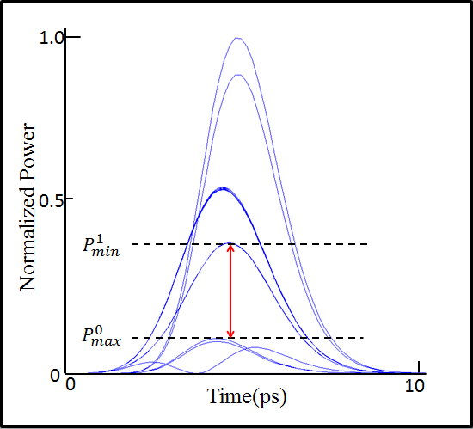
5-3. Result—Eye Diagram
Eye diagram
Created by sampling the output signal
One appropriate metric is the extinction ratio (ER)
ER > 5.23dB is sufficient value[5]
ER:5.72[dB]
Fig 12. Eye diagram
Notes:
Next, I’ll explain eye diagram.
Eye diagram is created by output signal.
One appropriate metric is the extinction ratio (ER).
By evaluating the eye diagram, we represent the availability of proposed all-optical error correcting code.
In this study, an more than five point twenty three dB ER is sufficient value.
Fig. 10 shows eye diagram of one hundred sixty giga bits rate.
This red arrow shows eye(赤い矢印を指しながら), and more eye opens, we evaluate better quality of signal.
We obtain five point seventy two dB extinction ratio at one hundred sixty giga bits rate, which is satisfactory.
Q. Why extinction ratio over the five point twenty three is sufficient? (ＥＲの評価基準ってどうやって決めたの？)
Referring the paper 6, we decide the metric.
Q. What is the wat value equivalent to five point seventy two dB?
Five point seventy two dB means three point seventy three multiples.
It means minimum power of signal as one is three point seventy three times as much as that of signal representing zero.

Slide 15
6. Conclusion
All-Optical error correcting code has been proposed
We realize by utilizing all-optical devices
We evaluate the performance by numerical analysis
We confirm waveforms and Eye diagrams
We obtain sufficiently ER (over 5.23 dB) for bit rates of 160 Gbit/s
Notes:
Finally, I conclude my presentation.
Firstly, we have proposed all-optical error correcting code.
Concretely speaking, we realize by using all-optical XOR gate and AND gate
Then, we evaluate the performance by numerical analysis.
We confirm waveforms and eye diagrams.
As a result, we obtain sufficiently ER for bit rates of one hundred sixty giga bps.

Slide 16
References
[1] Y.Ben Ezra, U.Mahlab, M.Haridim, and B.I. Lembrikov, ``Applications of All-Optical Signal Processing in Modern Optical Communications,′′ Proc. 9th International Conf. on Transparent Opt. Networks, no.Tu.B4.4, pp.328-331, Rome, The Italy, Jul. 2007.
[2] Omar Qasaimeh, ``Theory of Four-Wave Mixing Wavelength Conversion in Quantum Dot Semiconductor Optical Amplifiers,′′ IEEE Photonics Technology Letters, vol.16, no.4, pp.993-995, Apr. 2004.
[3] Y.Ben Ezra, B.I. Lembrikov, and M.Haridim, ``Ultrafast All-Optical Processor Based on Quantum-Dot Semiconductor Optical Amplifiers,′′ IEEE Journal of Quantum Electronics, vol.45, no.1, pp.34-41, Jan. 2009.
[4] Ali Rostami, Hamed Baghban Asghari Nejad, Reza Maram Qartavol, and Hassan Rasooli Saghai, ``Tb/s Optical Logic Gates Based on Quantum-Dot Semiconductor Optical Amplifiers,′′ IEEE Journal of Quantum Electronics, vol.46, no.3, pp.354-360, Mar. 2010.
[5] H.Dong, H.Sun, Q.Wang, N.K.Dutta, and J.Jaques, ``80 Gb/s All-optical logic AND operation using Mach-Zehnder interferometer with differential scheme,′′ Optics Communications, vol.265, no.1, pp.79-83, Sep. 2006.
[6] D.K. Gayen, A. Bhattachryya, T. Chattopadhyay, and J. N. Roy, ``Ultrafast All-Optical Half Adder Using Quantum-Dot Semiconductor Optical Amplifier-Based Mach-Zehnder Interferometer,′′ IEEE Journal of Lightwave Technology, vol.30, no.21, pp.3387-3393, Nov. 2012.
Notes:
References is this one

Slide 17
Thank you for your attention!
Notes:
Thank you for your attention!
Q. このハードリミッタの閾値はどのくらいなの？
A. Max power of combined signal is near 1dBm.
So, in this study, threshold value is near 1dBm.
This is dependent QD-SOA, input signal, and PS parameter.

Slide 18
○Appendix-MZI
MZI
Half Mirror 1
Input Signal
Mirror
Phase Shifter
Output Signal
Mirror
Half Mirror 2

Slide 19

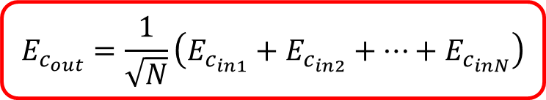


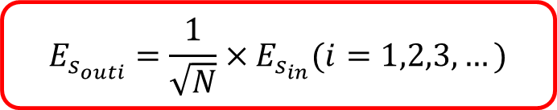
○Appendix-Power combiner and splitter
Power combiner and splitter
Power Combiner
Splitter
$$E_{c_{in1}}$$
$$E_{c_{in2}}$$
$$E_{c_{inN}}$$
$$E_{s_{out1}}$$
$$E_{s_{out2}}$$
$$E_{s_{outN}}$$
$$E_{c_{out}}$$
$$E_{s_{in}}$$
…
…
…
…
$$E_{c_{out}}=\frac{1}{\sqrt{N}}\left(E_{c_{in1}}+E_{c_{in2}}+…+E_{c_{inN}}\right)$$
$$E_{s_{outi}}=\frac{1}{\sqrt{N}}×E_{s_{in}}(i=1,2,3,…)$$

Slide 20
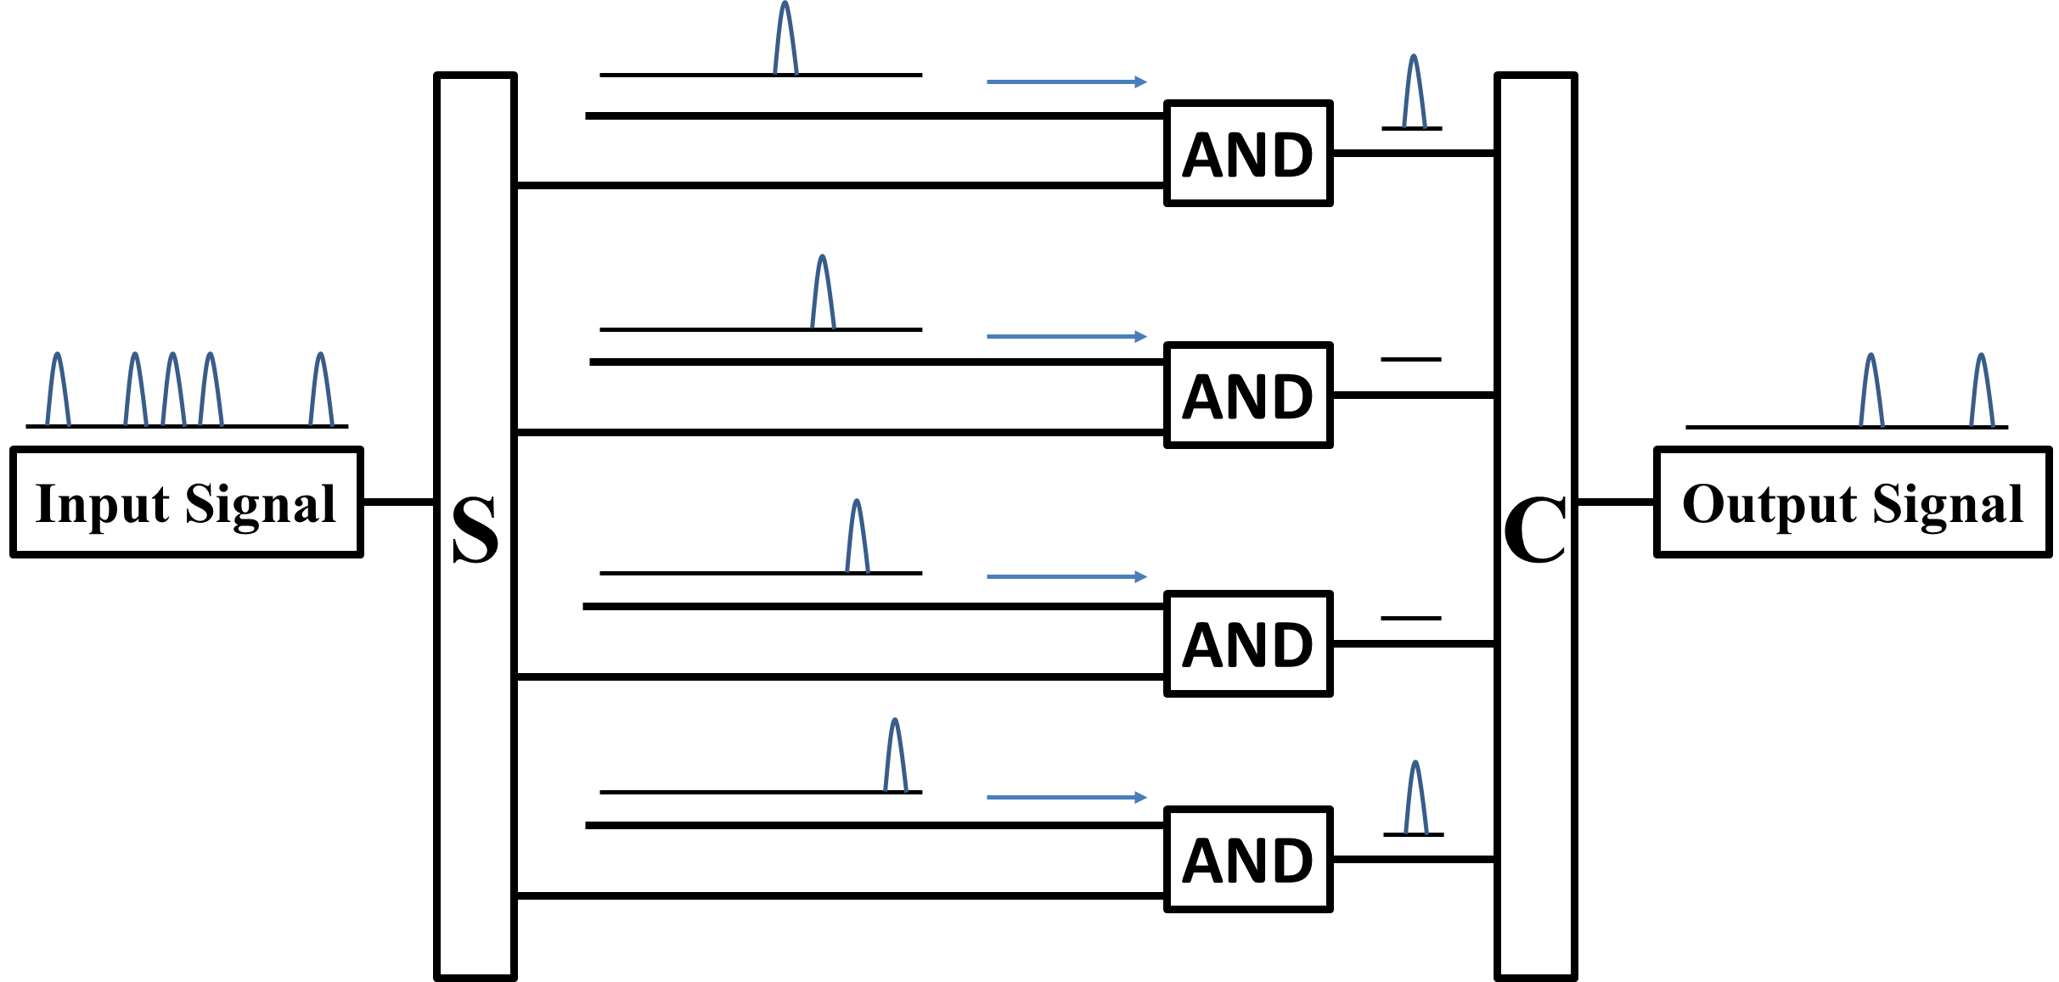
○Appendix
Filter1
Notes:
In filter1, the input signal is fed into the splitter.
In order to pick out specified bit, the signal whose specified bit is one and input signal are fed into AND gate.
For example, the top waveguide is used to pick out fifth bit of input signal from left.
After the signals are fed into AND gate, the signals are fed into power combiner.

Slide 21
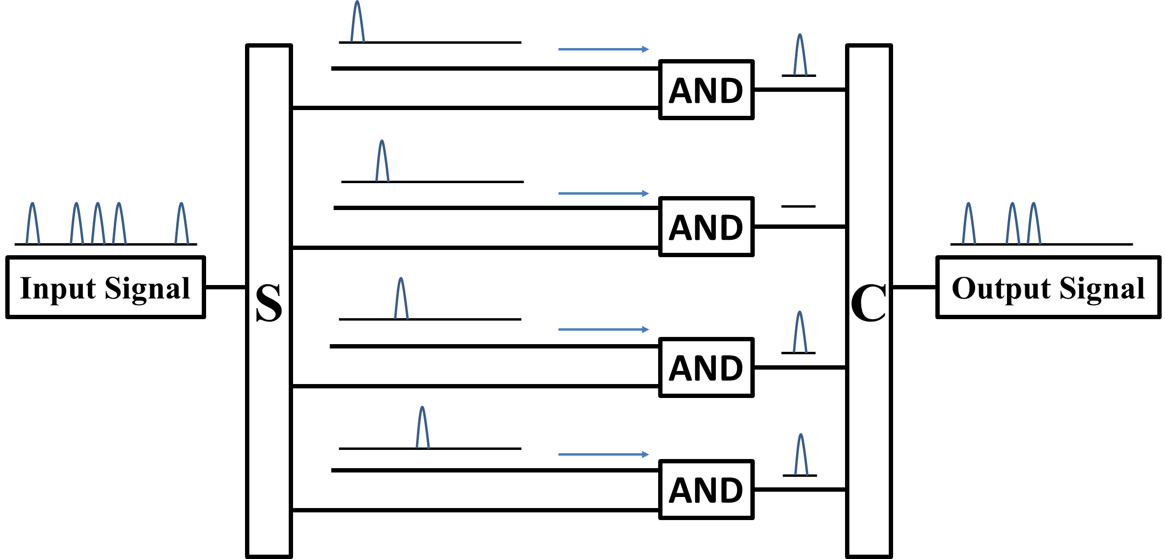
○Appendix
Filter2
Notes:
In filter2, the input signal is fed into the splitter.
In order to pick out specified bit, the signal whose specified bit is one and input signal are fed into AND gate.
For example, the top waveguide is used to pick out fifth bit of input signal from left.
After the signals are fed into AND gate, the signals are fed into power combiner.
Or
The filter2 operates as well as the filter1 does.
Filter2 picks out data bits from input signal.

Slide 22

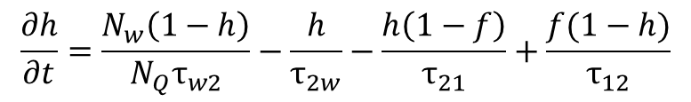
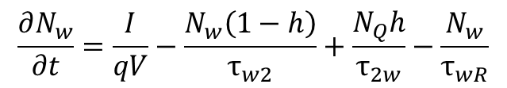
○Appendix-Rate equation
Equation represents carrier density change in WL layer
$$\frac{∂N_{w}}{∂t}=\frac{I}{qV}−\frac{N_{w}\left(1−h\right)}{τ_{w2}}+\frac{N_{Q}h}{τ_{2w}}−\frac{N_{w}}{τ_{wR}}$$
(1)
Equation represents carrier density change in ES layer
$$\frac{∂h}{∂t}=\frac{N_{w}\left(1−h\right)}{{N_{Q}τ}_{w2}}−\frac{h}{τ_{2w}}−\frac{h\left(1−f\right)}{τ_{21}}+\frac{f(1−h)}{τ_{12}}$$
(2)
Equation represents carrier density change in GS layer
$$\frac{∂f}{∂t}=\frac{h\left(1−f\right)}{τ_{21}}−\frac{f\left(1−h\right)}{τ_{12}}−\frac{f^{2}}{τ_{1R}}−\frac{gL_{w}v_{g} }{N_{Q}}S$$
(3)
(1)Equation item 1：carrier density
Equation item 2：carrier moves to ES
Equation item 3：carrier comes from ES
Equation item 4：carrier removed from QD-SOA
(2)Equation item 1：carrier comes from WL
Equation item 2：carrier moves to WL
Equation item 3：carrier moves to GS
Equation item 4：carrier comes from GS
(3)Equation item 1：carrier comes from ES
Equation item 2：carrier moves to ES
Equation item 3：spontaneous emission in GS
Equation item 4：stimulated emission in GS

Slide 23

○Appendix-3dB coupler
It divides input signal into two signals (the power of each signals are half as much as that of original)
Port1
Port3
No phase difference
Modulates -π/2
Port2
Port4

