Slide 1

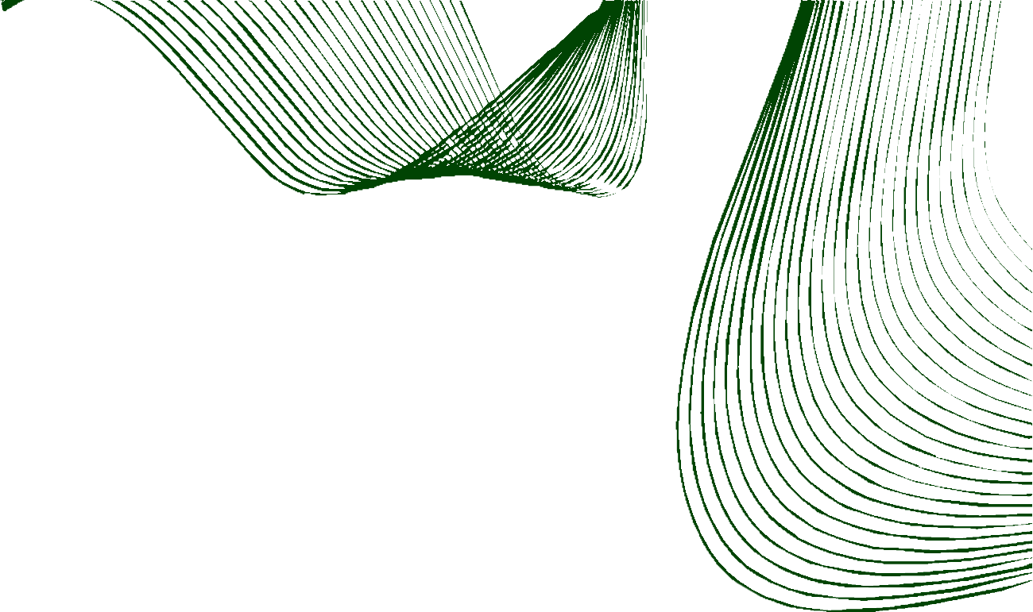

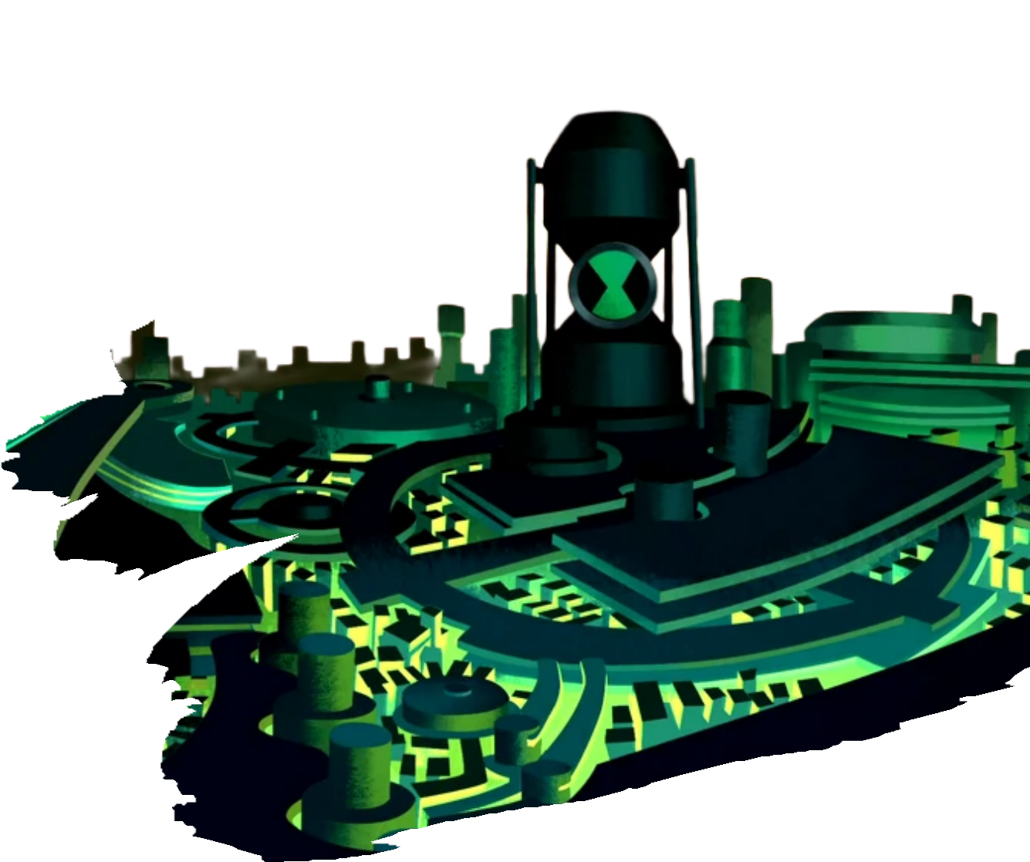


TITLE PAGE
TAKY_SPACE
Problem Statement Theme : Graph-grounded fraud investigation
Problem Statement Title : GRAVEX // Fraud Intelligence
Team Members : TAMIZHINIYAN K

Slide 2
IDEA TITLE
TAKY_SPACE
GRAVEX investigates a case over TigerGraph, records its evidence, and answers all 20 benchmark cases.
The LLM never invents a relationship - it can only interpret what the graph returned.
When evidence runs thin the system says so instead of guessing, then asks for what it needs.

Slide 3
TECHNICAL APPROACH
TAKY_SPACE
Stack: Next.js + FastAPI + LangGraph + Gemma 4 26B + TigerGraph 4.2.5 GSQL + scikit-learn RandomForest + SHAP + BGE-small-en-v1.5 GraphRAG.
Method: 8 vertex / 11 edge schema, 2,505,266 edges, then a 12-node LangGraph machine: triage, investigate, evidence, XAI, policy, recommend.

Slide 4
FEASIBILITY AND VIABILITY
TAKY_SPACE
Feasible today: all 14 architecture layers are LIVE against real artifacts, not design documents.
Risk: graph scale and LLM cost, bounded by a one-round evidence loop and a read-only tool layer.
Mitigation: five dangerous operations refused by policy and graph writes blocked by design.

Slide 5
IMPACT AND BENEFITS
TAKY_SPACE
Analysts get a decision plus its evidence chain, not a black-box score - every claim traces to an artifact.
Banks cut review time and false blocks: policy gates every action on an auto / L1 / L2 approval route.

Slide 6
VERIFIED RESULTS
TAKY_SPACE
20/20 case files PASS, 0 errors, 210 evidence items, 6 fraud, 3 legitimate, 11 uncertain, 6 SAR filed.
Agent run: 114 real tool calls, all COMPLETE, verdict match 20/20, probability match 20/20.
RandomForest, 32 features, ROC-AUC 0.9308, 10/10 GSQL queries, 7/7 MCP tools live and 5 refused.

Slide 7
SYSTEM ARCHITECTURE
TAKY_SPACE
14 architecture layers: 14 LIVE, 0 in progress, 0 architectural, each tagged by the artifact proving it.
Nine-stage pipeline: trigger, triage, graph, evidence, ML, XAI, uncertainty, policy, next best action.
Every recommendation clears a policy gate before it reaches an analyst; graph writes stay blocked.

Slide 8
RESEARCH AND REFERENCES
TAKY_SPACE
IEEE-CIS Fraud Detection dataset - Vesta Corporation, via the IEEE Computational Intelligence Society
FinCEN - SAR Narrative Guidance, SAR Filing FAQs (Oct 2025), Advisory on Account Takeover Activity
FATF - Illicit Financial Flows from Cyber-Enabled Fraud; FFIEC - BSA/AML Red Flags
TigerGraph 4.2.5 GSQL, LangGraph, Gemma, scikit-learn / SHAP, Next.js, FastAPI

