Slide 1

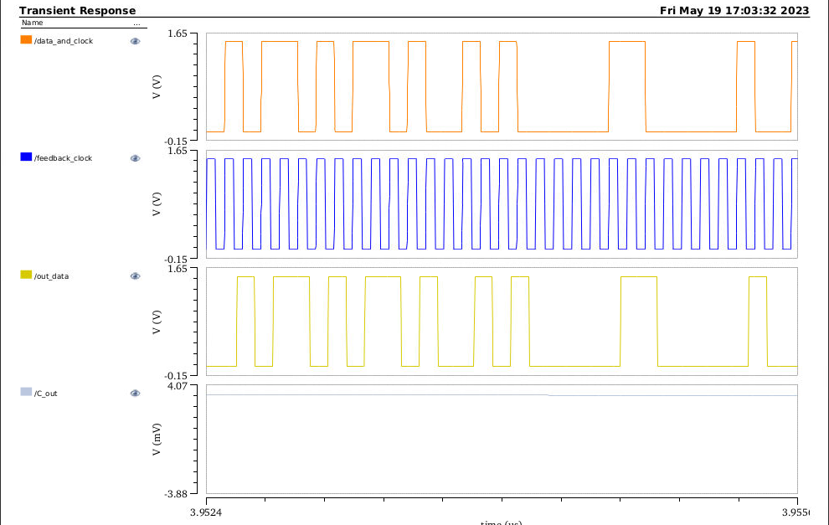
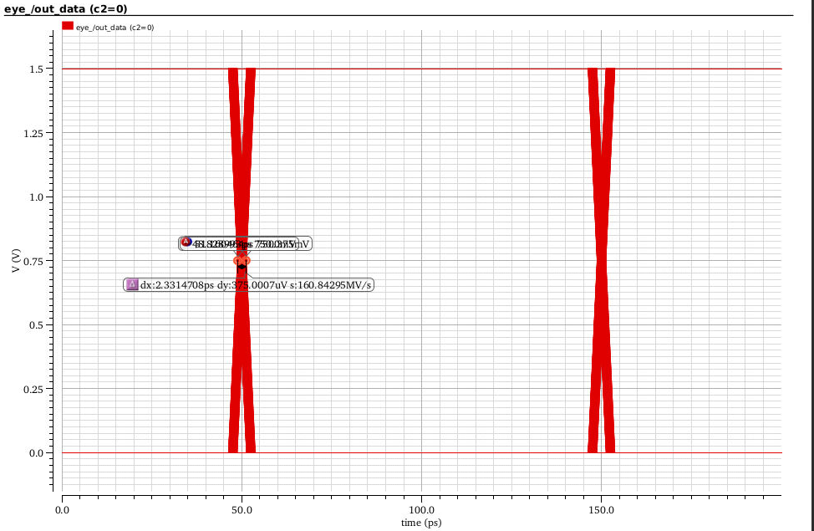
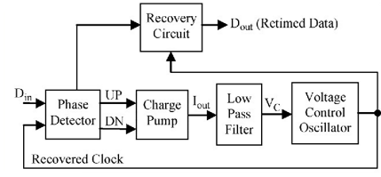
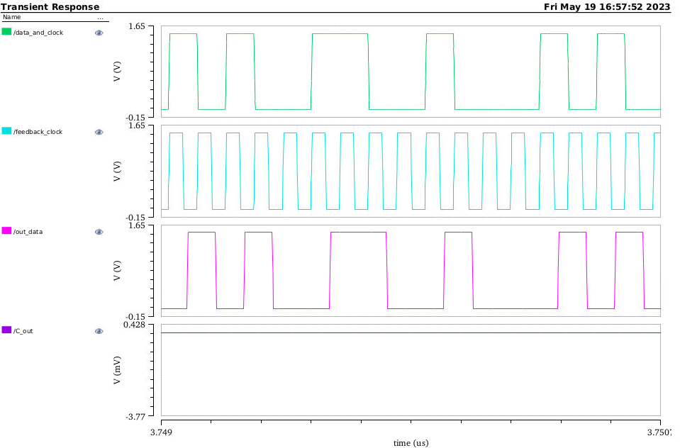
Clock And Data Recovery
Project Number: 22-1-1-2576
Names: Shahar Zarkovsky, Tal Kahlon
Advisor: Dr. Miki Moyal
Introduction This Project is focused on implementing a CDR – a closed loop control system which provide clock extracted from the received signal of clock and information combined. From the extracted clock we sample the data of the received signal. In general, CDR system is built from 3 main components: Phase Detector – The function of the phase detector is to identify a phase difference between two incoming signals. Charge Pump (CP) and Low Pass Filter (LPF) - The function of the charge pump is to convert the output voltage of the phase detector to current and the function of the low pass filter (LPF) is to convert the charge pump current into control voltage. VCO - The function of the voltage control oscillator is to generate the clock signal at its output. Motivation/Objectives Clock and Data Recovery (CDR) is a fundamental process in digital communication systems that extracts the clock signal from a transmitted data stream. In this process, timing information that may be lost due to noise, interference, or other factors is recovered to synchronize the received data. CDR utilizes techniques such as phase-locked loops (PLLs), | and other signal processing algorithms to recover the original timing information. The recovered clock signal is then used to correctly interpret the received data, making CDR an essential component of many high-speed communication systems such as Ethernet, Fiber Channel, and other data center and telecommunications applications. Methods/Implementation Our project was mainly done on Virtuoso (by Cadence). For the implementation we used 4 main parts from ahdlib,analoglib,gpdk45 libraries – the technology is 45nm. We have built the blocks using the following components: 1.phase detector – built from 4 D-FFs , inverter , 2 XOR gates. 2.charge pump – from ahdlLib. 3.LPF – second order LPF that built from 2 capacitors and a resistor. 4.VCO – from ahdlLib. On the next stage, we have built a VCO at the transistor level instead of a library component. Results & Conclusions The following graphs show the information sampled using the clock that was extracted using the circuit, the input signal the LPF capacitor’s voltage and of course the extracted clock: We can see that the capacitor stabilizes at a constant value of 0 when the system stabilizes and reaches a constant clock frequency that matches the frequency of the input signal. | By comparing the input data to the output data, we can see that the information is well sampled with 0-bit errors. The following picture shows the results for 10G+1M data rate: We can see that when the frequency changes by +- 1 MHz from the capacitor’s voltage – approx. 3.3mV which means that the CDR adapts itself to the new frequency and stabilizes properly. The following picture in an eye diagram which can show us the Jitter of the output signal: The Jitter is approx. 2ps – when the demand is less then 25 ps. Bibliography [1] https://ieeexplore.ieee.org/document/6104401 - block scheme. [2] https://ieeexplore.ieee.org/document/5603953 - PLL CDR. [3] https://ieeexplore.ieee.org/document/1011722 - 10 Gb/s CDR circuit.

