Slide 1




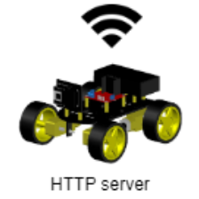

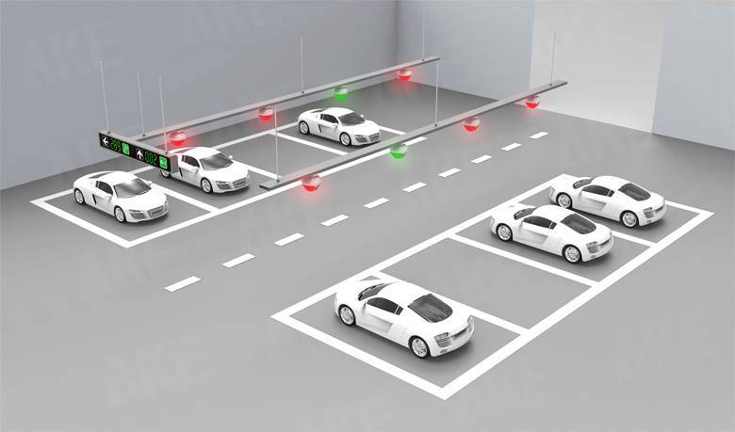



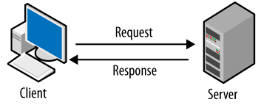
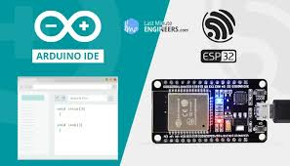
231201
Amir Kirshenzvige | Tal Aharon | Roni Shulman | Nadav Shriki Mentor: Amit Zohar
The Autonomous Car Parking System project utilizes image processing technology to simulate an autonomous car, automatically locate the nearest parking slot, and then park the RC car there.
logic
UI
Scan current state
Parse to grayscale matrix
Objects detection using OpenCV
1 | 1 | 2 | 2 | 3 | 2
4 | 10 | 7 | 6 | 15 | 19
26 | 25 | 27 | 8 | 46 | 68
27 | 32 | 40 | 26 | 67 | 115
26 | 40 | 63 | 67 | 120 | 170
48 | 66 | 112 | 150 | 200 | 220
Send moving orders to the RC car
Parse to system data structure matrix
1 | 1 | 1 | 1 | 1 | 1
1 | 1 | 1 | 3 | 2 | 2
1 | 1 | 1 | 3 | 2 | 2
1 | 1 | 1 | 1 | 1 | 1
4 | 4 | 4 | 0 | 0 | 0
4 | 4 | 4 | 0 | 0 | 0

