Slide 1




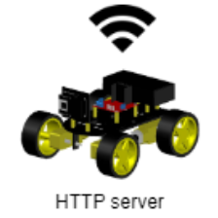


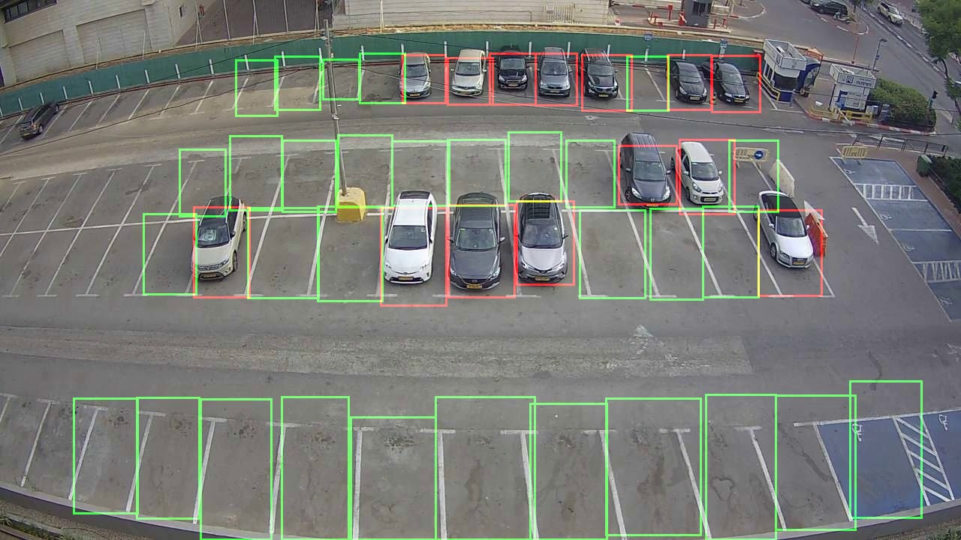




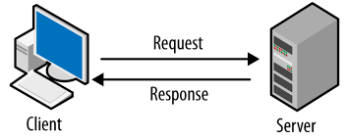
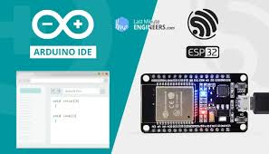
231201
Students: Amir Kirshenzvige, Tal Aharon, Roni Shulman, Nadav Shriki Mentor: Amit Zohar
The Autonomous Car Parking System project utilizes image processing technology to simulate an autonomous car and automatically locate the nearest parking slot, and then park the RC car there.
Logic
UI
Grayscale matrix
1 | 1 | 2 | 2 | 3 | 2
4 | 10 | 7 | 6 | 15 | 19
26 | 25 | 27 | 8 | 46 | 68
27 | 32 | 40 | 26 | 67 | 115
26 | 40 | 63 | 67 | 120 | 170
48 | 66 | 112 | 150 | 200 | 220
System data structure matrix
1 | 1 | 1 | 1 | 1 | 1
1 | 1 | 1 | 3 | 2 | 2
1 | 1 | 1 | 3 | 2 | 2
1 | 1 | 1 | 1 | 1 | 1
4 | 4 | 4 | 0 | 0 | 0
4 | 4 | 4 | 0 | 0 | 0

