Slide 1
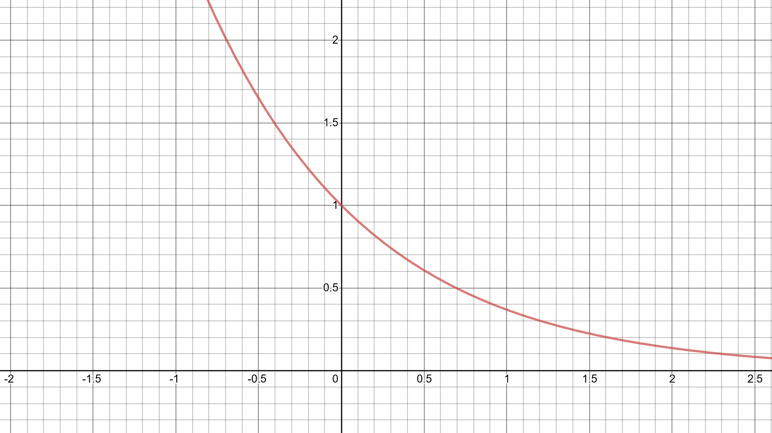



$$𝕀\{sign(f_{T}\left(x_{i}\right))≠y_{i}\}$$
$$e^{−y_{i}f_{T}(x_{i})}$$
$$f_{T}\left(x_{i}\right)y_{i}$$

