Slide 1

Loris attack on HTTP/3 (Denial of Service)
GitHub POC Testing
https://github.com/efchatz/QUIC-attacks/tree/main/quic-loris-(CVE-2022-30591)
Tal Malka & Yan Chich
HTTP/3 Attacks B.Sc. Final Project

Slide 2
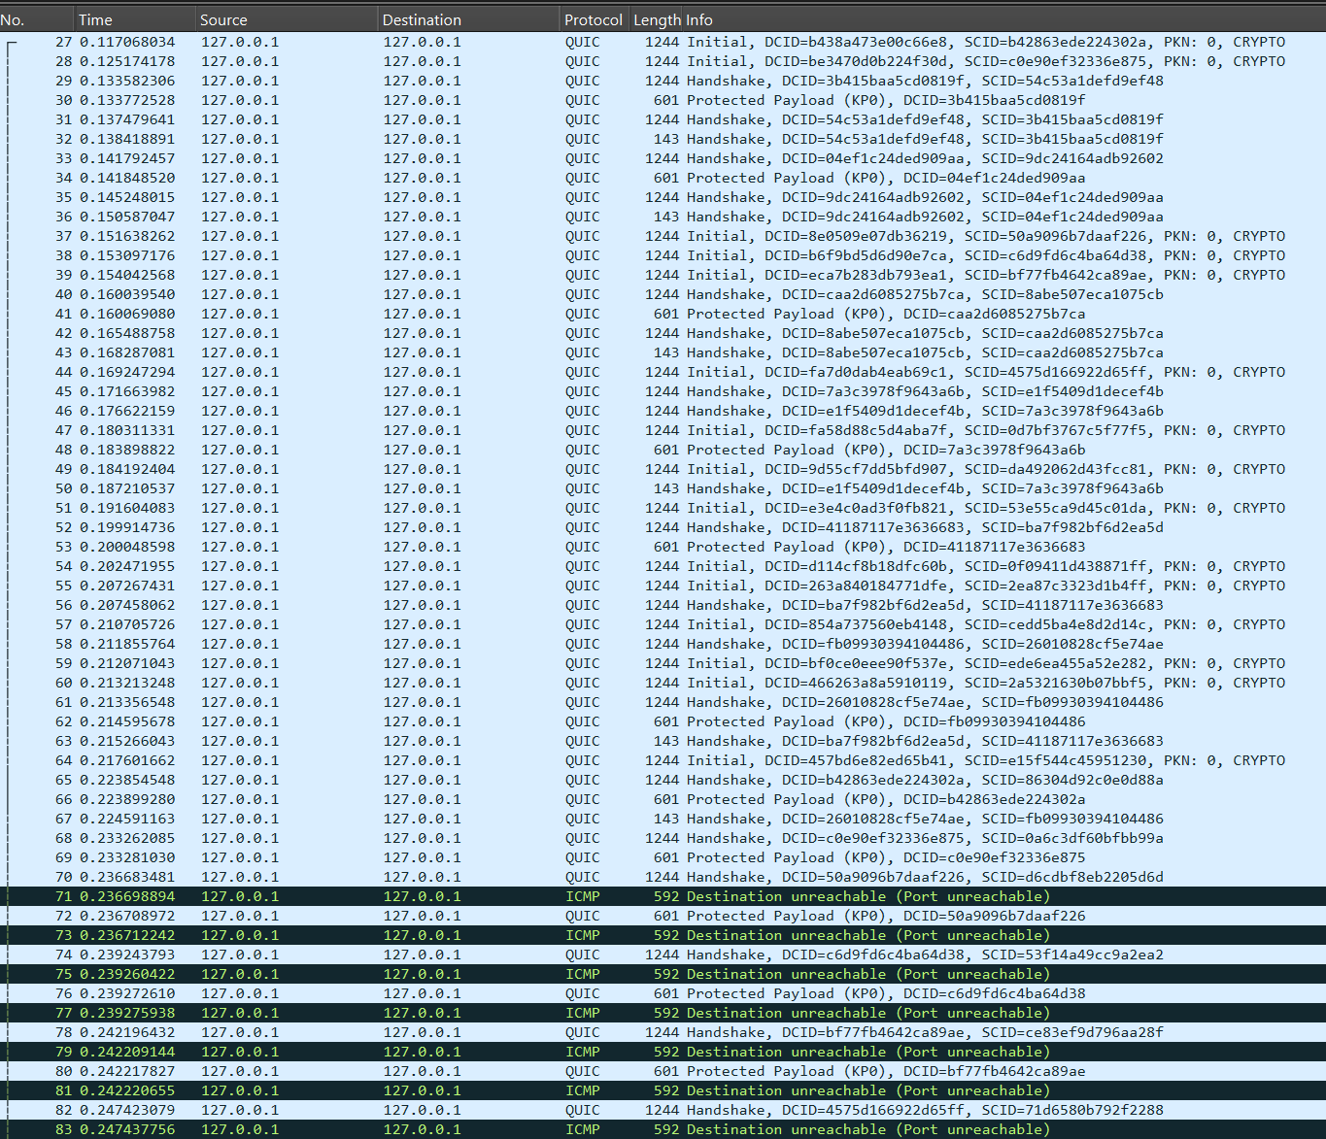
A Loris attack on HTTP/3 is a type of application-layer DoS (Denial of Service) attack that exploits the way HTTP/3 and its underlying transport protocol, QUIC, handle connections and streams. The goal of the attack is to exhaust server resources by maintaining many incomplete or long-lived connections.

Slide 3
How the Loris Attack Works: Opening Multiple Streams: HTTP/3 uses QUIC, which supports multiplexing multiple streams over a single connection. An attacker can open many streams within one QUIC connection, consuming server memory and computational resources. Slow or Partial Requests: The attacker sends very slow or partial HTTP requests across multiple streams, delaying the completion of these requests. For example, sending data one byte at a time while keeping the connection open. This forces the server to allocate resources for these requests and maintain state for long periods. Resource Exhaustion: By creating a large number of connections or streams and sending slow or incomplete data, the attacker overwhelms the server's ability to handle legitimate traffic. This can cause high CPU and memory usage, leading to degraded performance or even downtime for the targeted server.

Slide 4

Mitigation Strategies: Stream Limits: Configure maximum concurrent streams per connection to limit the number of streams an attacker can open. Idle Timeouts: Set aggressive timeouts for idle connections or streams to free up resources faster. Rate Limiting: Limit the rate of incoming data or the number of simultaneous connections from a single IP address. Anomaly Detection: Deploy intrusion detection systems (IDS) or behavior-based monitoring to identify and block suspicious traffic patterns. Load Balancers or Proxies: Use load balancers or reverse proxies to distribute traffic and handle connection limits effectively.

