Slide 1
Bypassing Drebin: Exploring Techniques to Evade Android Malware Detection
Guy Azoulay Tal Mlachi

Slide 2

INTRODUCTION
Explanation about Drebin Classifier :
Feature set (Restricted API calls, Used permissions, Suspicious API calls)
Data Set – add picture
Static Analysis
Types of detections
weak spots
Ways to exploit those weak spots.

Slide 3

METHODOLOGY
Now we attend to show you three main types of attacks, which exploit the weak spot of the classifier:
OBFUSCATION
PACKERS
FEATURES SET ATTACK
Surprised

Slide 4
OBFUSCATION
What is it ?
Obfuscation is a technique used to make the code of an application difficult to understand and reverse-engineer.
Tool we use: we utilized the "Obfuscapk" tool, a well-known tool for obfuscating Android applications, to apply obfuscation to the applications in our dataset
The full process (add picture): The process of obfuscation involved multiple steps such as renaming variables, classes, and methods, and inserting dummy code
The connection to entropy: It's worth mentioning that the entropy level of the applications changes during the obfuscation process and that's why it's important to examine the difference in entropy between benign and malicious applications
DIE – Detect It Easy: In addition, we used DIE (Detect It Easy) a free tool for analyzing obfuscated files, to analyze the obfuscated files.

Slide 5
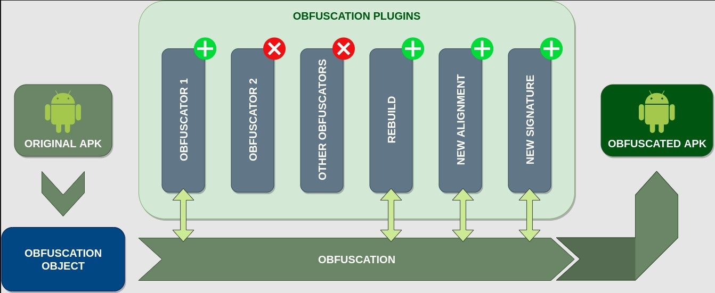

Slide 6
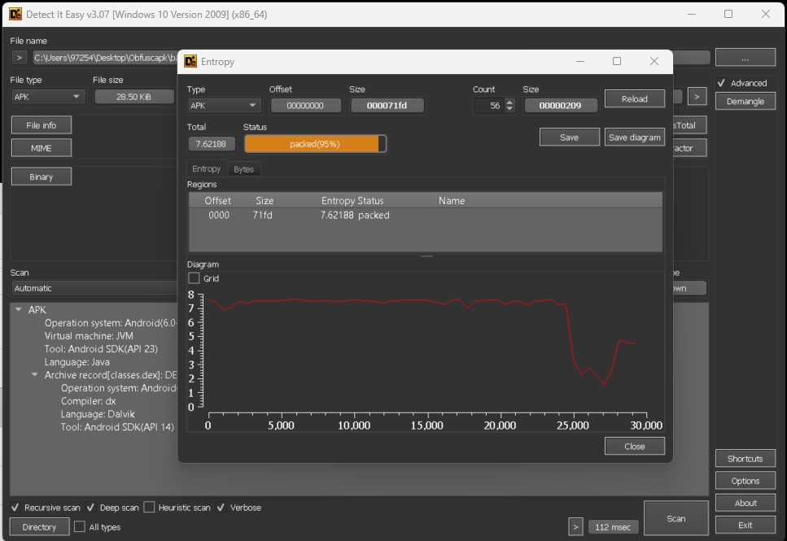
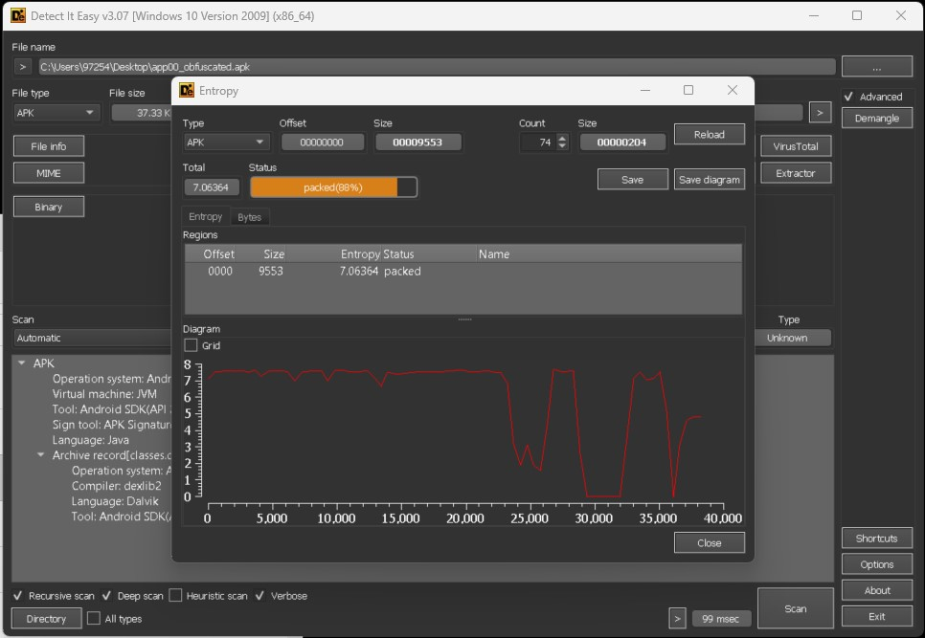
Before OBFUSCATION
After OBFUSCATION

Slide 7
PACKERS
What is it ?
Packers are software tools that are used to compress and encrypt executable files, such as mobile apps. The primary purpose of using a packer is to make it harder for reverse engineers and malware analysts to examine the code and functionality of the app. By using a packer, the code is compressed and encrypted which makes it harder to read and understand.
In our research, we used two popular packers for android apps, DashO and ProGuard. These tools are used to shrink, optimize and obfuscate code, which makes it difficult for the classifier to extract the features.
- Tool we use ?

Slide 8

FEATURES SET ATTACK
What is it? A feature set attack is a type of adversarial attack that aims to manipulate the features used by a machine learning model to make predictions, in order to cause the model to make incorrect predictions.
The process: 1. We used apktool to decompile android applications in order to extract their feature sets.
2. We then injected benign features into the malicious applications’ Manifest.xml files, in order to make it difficult for the classifier to identify them as malicious.
3. Next, we recompiled the applications using apktool, and added them to the test dataset.

Slide 9
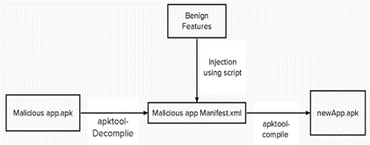

Slide 10
FEATURES SET ATTACK + OBFUSCATION
Another approach that we employed in our research was a combination of a feature set attack and obfuscation. Similar to the feature set attack, we used apktool to decompile android applications, and then injected benign features into the malicious applications’ Manifest.xml files
However, this time, we also used the Obfuscapk tool to apply obfuscation to the malicious applications, making them even more difficult to classify. - By combining the feature set attack with obfuscation, we aimed to further confuse the classifier and make it even harder to identify malicious applications.

Slide 11
RESULTS
After all the three process of the attacks we introduce before, the Drebin classifier was still able to detect those application as malicious. Interesting point that was discovered during the last approach (FEATURES SET ATTACK + OBFUSCATION) was that when we apply small amount of malicious application, we could notice that our classifier classify them as benign application.

