Slide 1
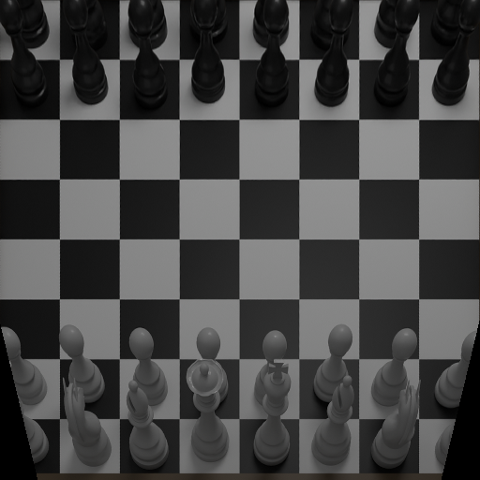
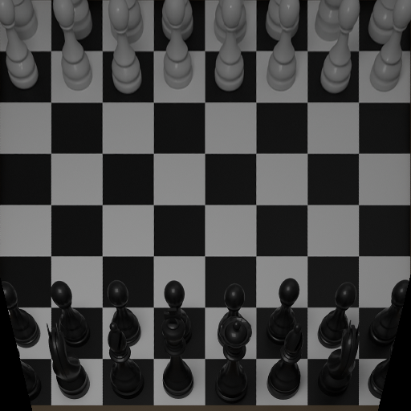
PROJECT 3 · INTRO TO DEEP LEARNING · BGU
Synthetic-to-Real
Chessboard Generation
from FEN
viewpoint = white
viewpoint = black
Blender synthetic renders
Tal Podgor · Ilay Vanunu · Ran Packler
B.Sc. Computer Science
Why we chose it: a modern, trending topic we had barely covered in class - and a real challenge.
Notes:
Good morning. We're Tal, Ilay, and Ran, third-year Computer Science students. Our project is Project 3: generating a realistic chessboard image from a FEN - a board position - and a viewpoint.
Why we chose it: image generation is a very modern, trending area that we had barely touched in the course, and it sounded like a real challenge - a chance to learn something new and ambitious.
On the right are two synthetic renders of the same position, from the white and black viewpoints - that's where we start. By the end you'll see how we turn renders like these into photorealistic boards.

Slide 2
01 · THE TASK
What we are solving
Input: a FEN position + a viewpoint
viewpoint ∈ {white, black} - which color is closest to the camera
Output: three images saved to ./results/
synthetic.png · realistic.png · side_by_side.png
The hard part: preserve the EXACT board state
a pawn can't appear on an empty square; a rook can't become a bishop
white view
black view
Same FEN, two viewpoints
Project 3 · Chessboard Generation from FEN
2
Notes:
The task, briefly - and I'll keep this short, since several groups are doing the same project.
The input is a FEN, which encodes the position, plus a viewpoint - white or black, meaning which colour sits closest to the camera. The output is three images saved to a results folder: a synthetic render, a realistic image, and a side-by-side.
The hard part - the whole challenge - is preserving the EXACT board state. It's not enough to look realistic: a pawn must not appear on an empty square, and a rook must not turn into a bishop. The position has to stay perfectly correct. On the right is the same FEN from the two viewpoints. Everything else in this talk is about making it realistic WITHOUT ever breaking that exact state.

Slide 3
02 · APPROACH
A two-stage pipeline
FEN + viewpoint
the only inputs
Blender render
synthetic + seg + depth
Paired pix2pixHD
geometry-conditioned G
Realistic image
+ side-by-side
→
→
→
Paired supervision: the model gets a direct penalty for moving a piece or inventing texture on an empty square.
Project 3 · Chessboard Generation from FEN
3
Notes:
This is the whole system at a glance, and it's all the evaluation function needs. The inputs are just a FEN and a viewpoint.
Stage one: Blender renders a clean synthetic board, plus a semantic map and a depth map. Stage two: our paired pix2pixHD generator turns that into a realistic image. We save the synthetic image, the realistic image, and a side-by-side comparison.
The key point is in the box: because training is PAIRED - against the exact matching real photo - the model is directly penalized if it moves a piece or invents texture on an empty square. That's why we did not use an unpaired method like CycleGAN.

Slide 4
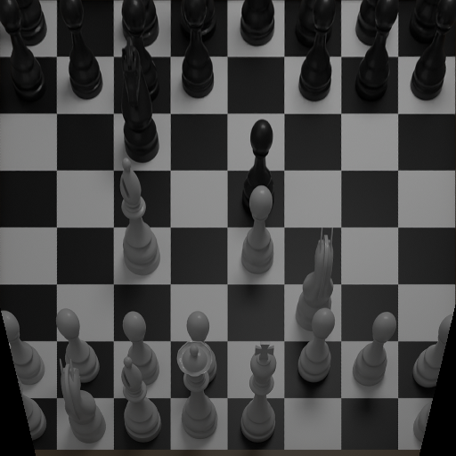
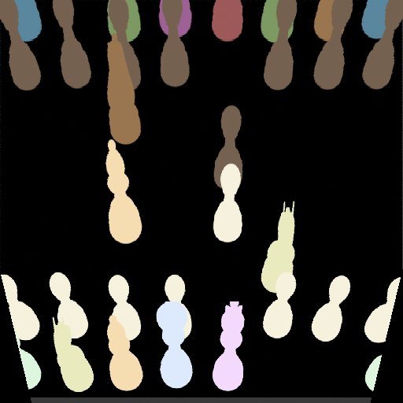
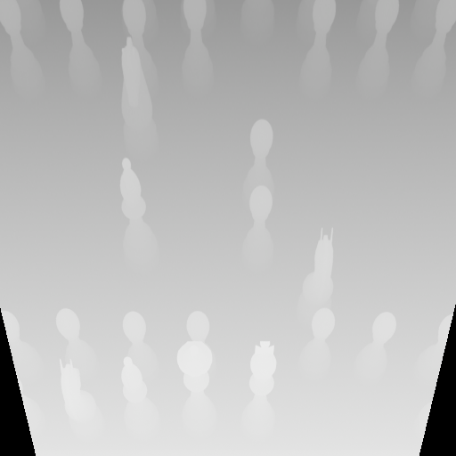
02 · APPROACH
From one FEN: three aligned renders
RGB render
what the board looks like - color, lighting, wood
Semantic silhouette
which piece type sits on every pixel - keeps the exact position
Depth
distance from the camera - the 3-D height flat RGB can’t show
Project 3 · Chessboard Generation from FEN
4
Notes:
This is what 'condition on geometry' actually means. From a single FEN, Blender renders the same board three different ways, all perfectly aligned.
One, RGB - the normal synthetic picture; this is the starting point the model transforms into a realistic photo.
Two, semantic silhouette - the same board, but every piece type painted a unique flat colour. This tells the model exactly which piece is on which square and its precise outline, so it can't turn a rook into a bishop or move a piece.
Three, depth - a grayscale map where brightness means distance from the camera. It carries 3-D information - how tall each piece is - that a flat colour image can't.
All three come from the FEN alone, with no real photo. So the same inputs exist during training and at inference.

Slide 5
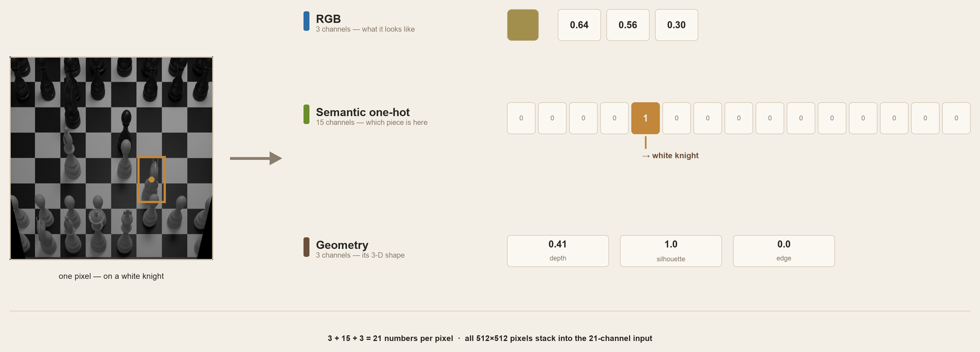
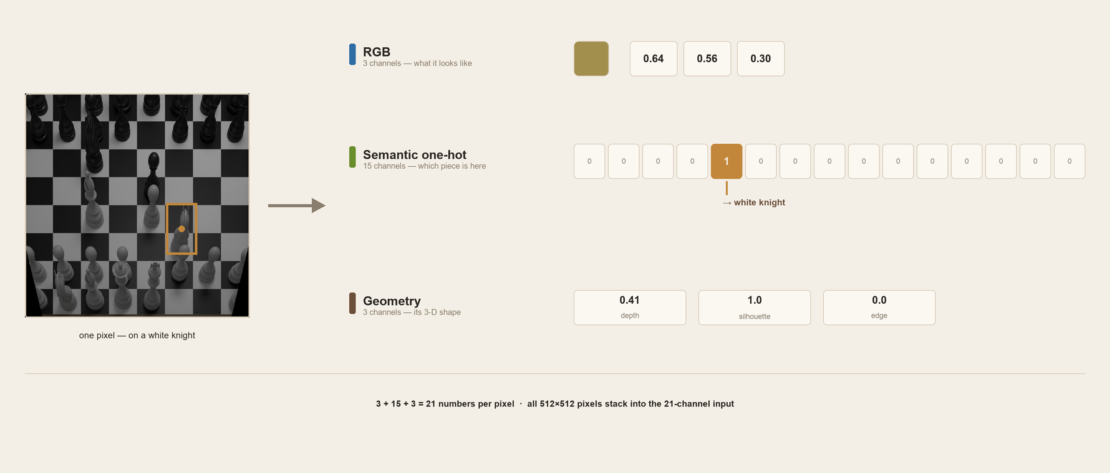
02 · APPROACH
One pixel = 21 numbers
Project 3 · Chessboard Generation from FEN
5
Notes:
Earlier we said the model gets a 21-channel input. Let me make that concrete - what does ONE pixel actually look like to the model?
Take a single pixel, say on a white knight. The model reads 21 numbers there, in three groups.
The first three are RGB - the colour of that pixel in the synthetic render; here a wood-tan colour.
The next fifteen are the semantic one-hot. There's one channel per class - empty-light, empty-dark, and the twelve piece types. Exactly one is a 1 and the rest are 0. Here the 'white knight' channel is 1 - that's how the model knows, with no ambiguity, that this pixel belongs to a white knight.
The last three are geometry: depth - how far the pixel is from the camera; silhouette - whether it's part of a piece, here 1; and edge - whether it's on a piece's outline, here 0 because it's inside the piece.
So 3 plus 15 plus 3 is 21 numbers for this one pixel. Stack that across all 512 by 512 pixels and you get the full 21-channel input - that stack is what the generator actually sees.

Slide 6
03 · WHAT IS SPECIAL
Condition on geometry, not just RGB
RGB synthetic render
3 channels
21-channel input
ResNet 9-block generator
→
Semantic one-hot - fen_silhouette
15 channels · empty + 12 piece classes
Geometry - depth · silhouette · edge
3 channels
Semantic + geometry tell the generator both what should be on each square and the true silhouette of every piece - derived at inference from the FEN alone.
Project 3 · Chessboard Generation from FEN
6
Notes:
Here's what makes our approach special. Instead of feeding the generator only the RGB render, we stack three kinds of information into a single 21-channel input.
Three channels are the RGB render. Fifteen channels are a one-hot semantic map - one channel per class, empty plus the twelve piece types - so the model knows exactly what belongs on each square. Three channels are geometry: depth, the piece silhouette, and its edge.
All of it is derived from the FEN at inference - no real photo needed. The takeaway: semantic plus geometry tell the generator both WHAT should be on each square and the true 3-D silhouette of every piece. That's how we keep the exact position while still looking realistic.

Slide 7
03 · WHAT IS SPECIAL
What makes us different
Most other approaches
CycleGAN · CUT · Diffusion
Unpaired or purely generative - strong style, but no built-in guarantee the exact position is kept.
Our approach
Paired, geometry-conditioned
A direct penalty for changing the board, plus chess-specific geometry conditioning.
Four chess-specific ingredients set ours apart - the rest of this section:
Camera-aligned
renders
Silhouette + geometry
conditioning
Per-piece
discriminator
Edge + contextual
losses
Project 3 · Chessboard Generation from FEN
7
Notes:
This is our direct answer to 'what makes you different.' Most other approaches tackled this project with CycleGAN, CUT, or diffusion models. Those are either unpaired translation or free generative models: they're good at producing a realistic-looking board, but none has a built-in guarantee that the exact position is preserved.
Our approach differs in two fundamental ways. It is PAIRED, so there is a direct penalty whenever the board changes. And it is GEOMETRY-CONDITIONED: we don't just hand the model an RGB image, we hand it the exact piece layout and the 3-D geometry.
From that core decision, four chess-specific ingredients follow, and the next slides go through them: camera-aligned renders so the synthetic geometry matches the real photos; silhouette plus geometry conditioning so the model knows what's on each square; a per-piece discriminator that grades each piece individually; and edge plus contextual losses that keep pieces crisp without forcing blur.
The headline: other approaches asked 'can we make it look real?' We asked 'can we make it look real WITHOUT ever changing the position?' - and every design choice serves that.

Slide 8
03 · WHAT IS SPECIAL
From pix2pix to pix2pixHD
pix2pix
Paired image-to-image translation
A generator learns to map an input image to its matching target; a discriminator pushes the output to look real.
pix2pixHD - what we use
Scales pix2pix to higher resolution
Adds a multi-scale discriminator and a feature-matching loss → sharper, more stable, higher-detail outputs.
→
Both are paired - trained against the exact matching photo, so the model is directly penalized for changing the board. CycleGAN-style methods are not.
Project 3 · Chessboard Generation from FEN
8
Notes:
PIX2PIX - THE BASICS
pix2pix is a conditional GAN for paired image-to-image translation. It has two networks that learn against each other.
The generator G is an encoder-decoder: it takes our input image and produces the translated output. The encoder compresses the input into a compact representation, then the decoder expands it back into a full image.
The discriminator D is a 'PatchGAN': instead of one real-or-fake score for the whole image, it outputs a grid of scores, each judging a small local patch. This makes it focus on whether local texture looks real. It is also CONDITIONAL - D sees the input and the output together, so it checks two things at once: does the output look like a real photo, AND does it actually correspond to this particular input.
HOW G AND D WORK TOGETHER
Training is a back-and-forth game. D is trained to label the real (input, target) pairs as real and the generator's (input, output) pairs as fake. G is trained to do two things at once: fool D, and stay close to the true target through an L1 reconstruction loss. The L1 term anchors the output to the correct answer; the adversarial term makes it sharp and realistic - an L1-only model produces blurry averages. As training proceeds, G gets better at fooling D and D gets better at catching G, until G's outputs are both realistic and consistent with the input.
PIX2PIXHD - TWO KEY UPGRADES
pix2pixHD keeps this setup but scales it to higher resolution with two additions.
1) Multi-scale discriminator. Instead of one discriminator, it uses two (or three) identical discriminators that look at the image at different sizes - the full-resolution image and a downsampled copy. The full-resolution one polices fine detail and texture; the downsampled one sees more of the board at once, so it polices large-scale structure and global consistency. A single discriminator cannot do both well at high resolution.
2) Feature-matching loss. We pass the real image and the generated image through the discriminator and compare their internal feature maps at several layers, pushing them to match. This is a much more stable and informative signal than the single real/fake verdict: it tells the generator to reproduce the statistics of real images inside the discriminator's feature space. It stabilizes training and clearly improves quality.
WHY NOT CYCLEGAN OR CUT (the unpaired alternatives)
Both are UNPAIRED - they translate between two unmatched piles of images, a synthetic pile and a real pile, with no one-to-one correspondence.
CycleGAN uses TWO generators (synthetic->real and real->synthetic) and a cycle-consistency loss: if you translate a synthetic image to real and back again, you should recover the original. That round-trip constraint is what loosely preserves content without pairs.
CUT is a newer, lighter method: ONE generator, and instead of the cycle it uses a patchwise contrastive loss - a patch in the output should match the corresponding patch in the input in feature space, and differ from unrelated patches. It is faster and usually better than CycleGAN.
The problem for us is the same in both: there is no matched target photo, so neither one has a direct penalty that says 'this exact square must contain this exact piece.' They only enforce domain style plus a soft content proxy - the cycle, or the contrastive term. For chess that is not enough: when we tried unpaired translation, pieces drifted to other squares and texture appeared on empty squares. Paired pix2pixHD gives a direct, pixel-level penalty for exactly those mistakes - which is why we chose it.

Slide 9
03 · WHAT IS SPECIAL
We judge every piece
Board discriminator (multi-scale)
Judges the whole image at two zoom levels - overall realism: texture, lighting and global structure.
Piece discriminator (class-conditional)
Zooms into each occupied square and asks: is this the correct piece type? Pressure exactly where blurry blobs appear.
Plus targeted losses: a silhouette-edge loss for crisp outlines and a contextual loss that tolerates 3-D parallax - keeping pieces sharp without forcing pixel-perfect blur.
Project 3 · Chessboard Generation from FEN
9
Notes:
A normal GAN has one discriminator that looks at the whole image and asks 'does this look real?' That rewards average realism - and the failure mode is that small pieces blur into vaguely-correct blobs that still pass.
We use two discriminators. The first is the standard board discriminator, but multi-scale: it judges the image at two zoom levels, catching both fine texture and large-scale structure.
The second is the special one - a per-piece discriminator. It crops out each occupied square and judges that piece on its own, and it is class-conditional: it's told which piece type should be there and checks whether the crop actually looks like that type. That puts pressure exactly where the problem is - the individual pieces - instead of letting them hide inside a globally-realistic board.
On top of the discriminators, two targeted losses help. A silhouette-edge loss keeps the outline of each piece crisp. A contextual loss compares deep features in a shift-tolerant way, so small 3-D misalignment between synthetic and real piece heads doesn't force the model to blur; we also down-weight the pixel loss on piece regions for the same reason.
Together: instead of one judge of overall realism, we have layered, piece-aware, geometry-aware pressure.

Slide 10
04 · KEY INSIGHT
Camera geometry decided everything
REJECTED
54.9° global elevation
too top-down - synthetic pieces don't match the real photos
FINAL
40.7° per-game (38–44°)
matches the real board photographs
Aligning the synthetic camera to the real photos shrank the domain gap more than any loss tuning.
Project 3 · Chessboard Generation from FEN
10
Notes:
This was our single biggest practical lever - bigger than any loss-function tweak.
The real photos were taken at a fairly oblique angle. Our first synthetic dataset used a near-top-down camera, about 55 degrees elevation. That mismatch meant the synthetic pieces simply didn't project the way the real ones did - the model was fighting a geometry gap before it even started on style.
When we re-rendered the synthetic boards with the camera angle matched to each real game - around 40 degrees on average, 38 to 44 across games - the synthetic and real boards lined up, and quality jumped.
The lesson worth sharing: in synthetic-to-real, getting the camera geometry right can matter more than any clever loss. We spent a lot of effort on losses; aligning the camera beat all of it.

Slide 11
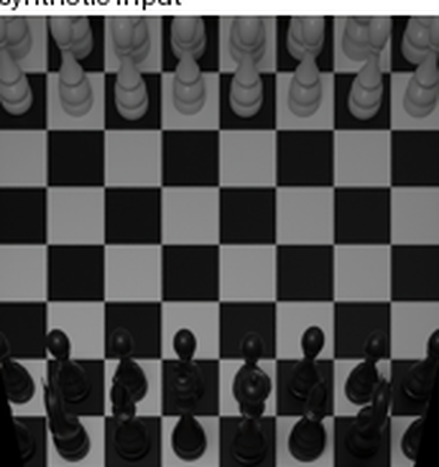
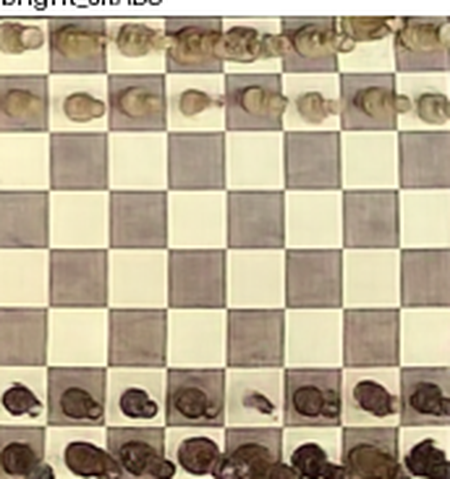
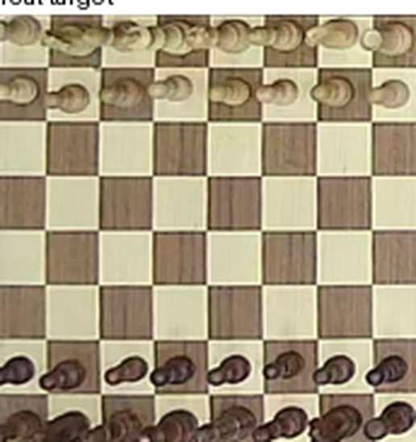
05 · RESULTS
From synthetic to realistic
Synthetic input
Our realistic output
Real photo
→
A flat grey render becomes a wooden board that matches the real photo - same pieces, same squares.
Project 3 · Chessboard Generation from FEN
11
Notes:
This is the payoff - here is what the model actually produces. On the left is the synthetic input: a flat, grey Blender render. In the middle is our model's output. On the right is the real photograph of that same position.
Notice two things. First, realism: the middle image has the wooden board, the lighting, the look of a real photo - clearly much closer to the right than to the left. Second, and more important for this task: the pieces are in exactly the same squares as the input and the real photo.
We didn't just make something that looks real - we made something that looks real AND preserves the exact position. That is the whole goal of the project, in one picture.

Slide 12
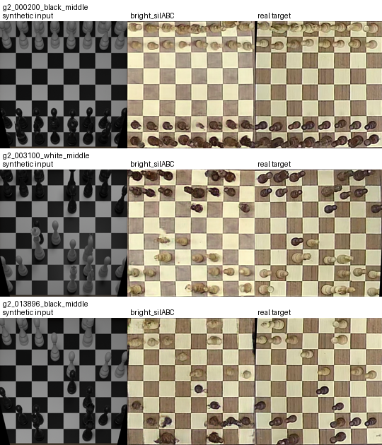
05 · RESULTS
140 held-out boards (game 2)
0.99
occupancy accuracy
0.92
square accuracy
0.80
piece-type accuracy
Selected by visual quality, not the top scalar. A merged blob can still be classified correctly - so realism was judged on visual grids + halo / double-head audits.
Project 3 · Chessboard Generation from FEN
12
Notes:
Now the numbers, measured on 140 held-out boards from game 2 - a game the model never saw in training. These come from an independent classifier we trained on real photos, so it's an objective judge, not the model grading itself.
Occupancy accuracy 0.99 - it almost never puts a piece on an empty square or drops one. Square accuracy 0.92 - the full piece-and-colour identity of each square. Piece-type accuracy 0.80 - the hardest one, the exact piece type.
The key insight is the line at the bottom: we did NOT pick the final model by the highest number. A merged blob can still be classified correctly, so a high score doesn't guarantee it looks good. We chose the final model on visual quality too - visual grids plus specific audits for halos and double-headed pieces. Numbers and eyes together.

Slide 13
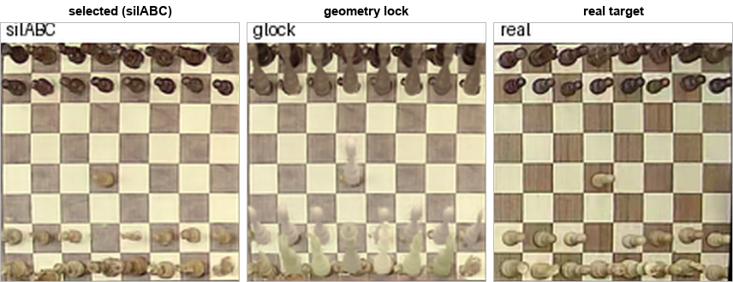
06 · ABLATION
Metrics alone mislead
Variant | Whole-board | Verdict
silABC (final) | 0.757 | realistic
geometry-lock | 0.000 | washed / milky
parallax8 | 0.450 | worse
Insight: forcing exact geometry removes double-heads but destroys the photo-like style. Each component was kept only if it was beneficial AND necessary.
Geometry-lock: structure improves, but pieces turn milky / washed-out.
Project 3 · Chessboard Generation from FEN
13
Notes:
This is why we don't trust metrics alone, and how we justified each component - the required ablation.
Look at the middle panel: that is 'geometry-lock,' a version where we forced the output to follow the synthetic geometry exactly. It actually removes double-headed pieces - but you can see the cost: the pieces go washed-out and milky, like ghosts. It looks worse even though it fixed a specific defect, and its whole-board score collapsed to zero.
Parallax8, another variant, scored 0.45 - clearly worse than our final 0.76.
The insight: forcing exact geometry can remove one defect but destroys the photo-like style. There is a real tension between clean piece shape and realistic appearance. So we kept each component only if it was both beneficial AND necessary - and we picked the variant with the best overall balance, not the best single number.

Slide 14
07 · WHAT WE LEARNED
What we learned
1 Geometry beat every loss
Aligning the synthetic camera to the real photos shrank the domain gap more than any loss change.
2 A high score is not a good image
An independent classifier can rate a blurry blob as correct - so we judged realism by eye, not only by metrics.
3 Shape vs. style: a real trade-off
Forcing exact piece geometry removes artifacts but makes pieces look milky; the two goals pull against each other.
4 Exact state needs the right framing
Paired, conditioned translation - not free generation - is what preserved the position.
Project 3 · Chessboard Generation from FEN
14
Notes:
To wrap up the results, here are the four things this project actually taught us - the insights, not just the numbers.
First, and most surprising: camera geometry beat every loss. We spent a lot of time tuning loss functions, but the single biggest jump in quality came from simply matching the synthetic camera angle to the real photos. In synthetic-to-real work, getting the geometry right can matter more than any clever objective.
Second: a high score is not the same as a good image. Our independent classifier would happily label a blurry, merged blob as the correct piece. So we learned not to trust a single metric - we judged the final model by eye too, with audits for specific artifacts.
Third, the honest research insight: clean piece shape and realistic style are in tension. Every time we forced the geometry to be exact, the pieces looked washed-out; every time we prioritized realism, some shape errors crept back. Under our current data that trade-off is a ceiling, not something one more loss term removes.
Fourth, the modeling lesson: exact state preservation needs the right framing. Treating the task as paired, conditioned translation - rather than free generation like CycleGAN, CUT, or diffusion - is what let us keep the position exact. The framing mattered more than the specific network.

Slide 15
08 · HONEST RESULTS
What didn't work & limitations
What didn't work
Main limitation
Unpaired CUT / CycleGAN - won't preserve exact state
Naive parallax stretch - exactness 0.76 → 0.45
Hard geometry-lock - pieces look milky / transparent
SAM auto-masks - fail at the 40–60 px piece scale
Real targets are homography-rectified photos of a 3D scene.
The board plane aligns, but the elevated piece heads do not - so synthetic and real shapes are slightly incompatible.
Result: blob-like pawns, weak separation between neighbours, occasional phantom texture.
Project 3 · Chessboard Generation from FEN
15
Notes:
In the spirit of honest research, here is what did NOT work - the experiments we tried and dropped - plus the core limitation that remains.
On the left, four dead ends. Unpaired CUT and CycleGAN look fine but won't preserve the exact state - that's why we moved to paired training. A naive parallax stretch of the synthetic pieces actually made things worse: exactness dropped from 0.76 to 0.45. A hard geometry-lock removed some artifacts but left pieces looking milky and transparent. And automatic piece masks from SAM failed at our tiny 40-to-60-pixel piece scale.
On the right, the main limitation, and it's fundamental. Our real targets are photos of a 3-D scene that we flatten with a homography. That flattening aligns the board PLANE, but not the raised heads of the pieces - so the synthetic and real shapes are slightly incompatible. The model is being asked to match two shapes that don't quite line up, which is where the residual blob-like pawns come from.
Note how this differs from the previous slide: that one was the lessons we take away; this one is the concrete experiments that failed, and the honest limitation we'd fix with better data.

Slide 16
CONCLUSION
Paired pix2pixHD with FEN + silhouette + depth + edge conditioning.
bright_silABC gives the best realism / state-preservation trade-off.
Honest negative result: clean piece topology vs. photographic style is a persistent trade-off under low-res automatic supervision.
Thank you - questions?
Notes:
To wrap up. Our system is a paired pix2pixHD generator conditioned on the FEN plus silhouette, depth, and edge information. The model we ship, bright_silABC, gives the best balance we found between looking realistic and preserving the exact position.
And we end on an honest note: under low-resolution, automatically-supervised data, clean piece shape and photographic style are in a persistent trade-off - you can push one, but it costs the other. Breaking that ceiling would need better data, not just more loss tuning.
Thank you - we're happy to take any questions.

