Slide 1

Building an AI-Powered Knowledge Base for NYC Community Boards
Tal Roded, NYCuriosity Author & Manhattan CB3 Member
Sarah Sachs, Block Party Founder
Major Contribution from McKay Warren
nycsodata26.sched.com #nycSOdata #opendataweek

Slide 2
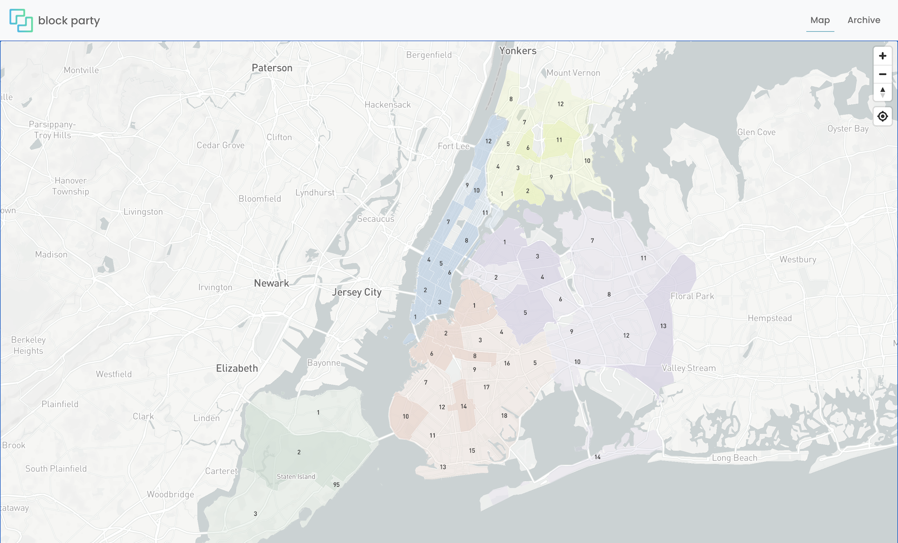
Have you ever attended a Community Board Meeting?
Most folks we ask, typically respond with a confused look...
Notes:
Have you ever attended a community board meeting?
I see some nods in the virtual crowd, it looks like some of us have attended, but maybe not as much as we would like.
while some of us have attended these meetings, why are they important?

Slide 3
Why are Community Boards important?
local
Community boards produce more structured civic data than almost any other level of government.
Notes:
Community boards discuss policies, initiatives, priorities which impact our day to day lives.
They act as the community’s voice when brokering conversations with state and local governments, non profit agencies and other organizations.
In a nutshell, they are the most local level of democracy, and making them more accessible strengthens the representation of the community.

Slide 4
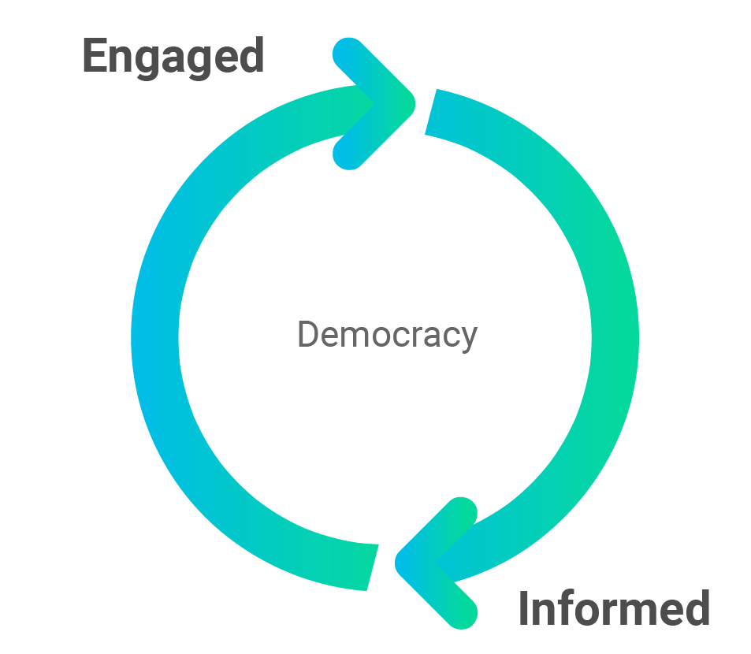
How might technology be used to help make local democracy more accessible?
Notes:
It can be said that democracy is not a spectator sport, and to become engaged in democracy we must be informed.
Encourage people to actually attend community board meetings, being informed can help be engaged - to know what is being discussed in the meetings, to speak up as a public member, or even to vote as a public member
Technology can help with this process of being informed

Slide 5

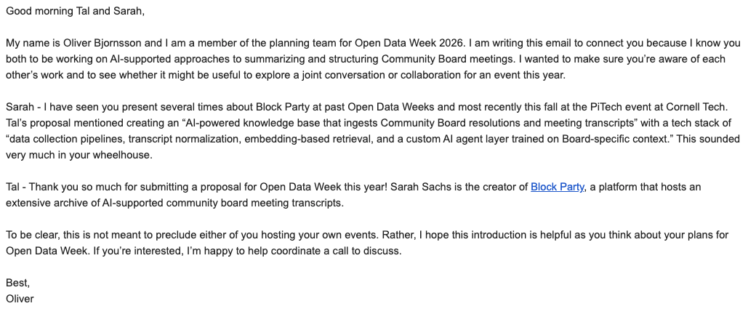


Our Story - Cheers to the NYC Civic Tech Community!
Notes:
Oliver - on NYC OTI

Slide 6
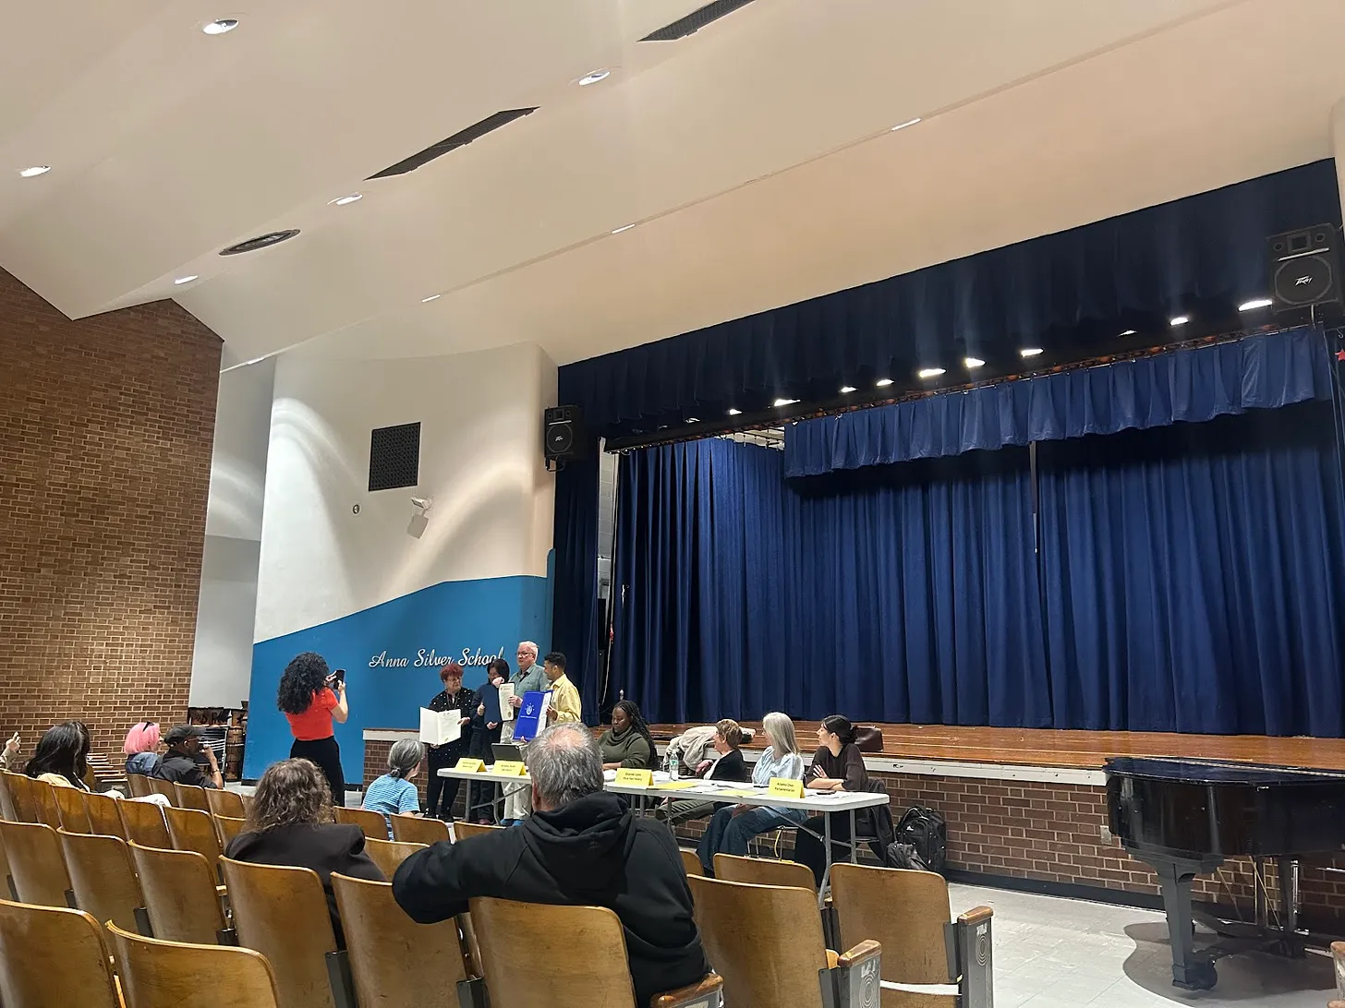
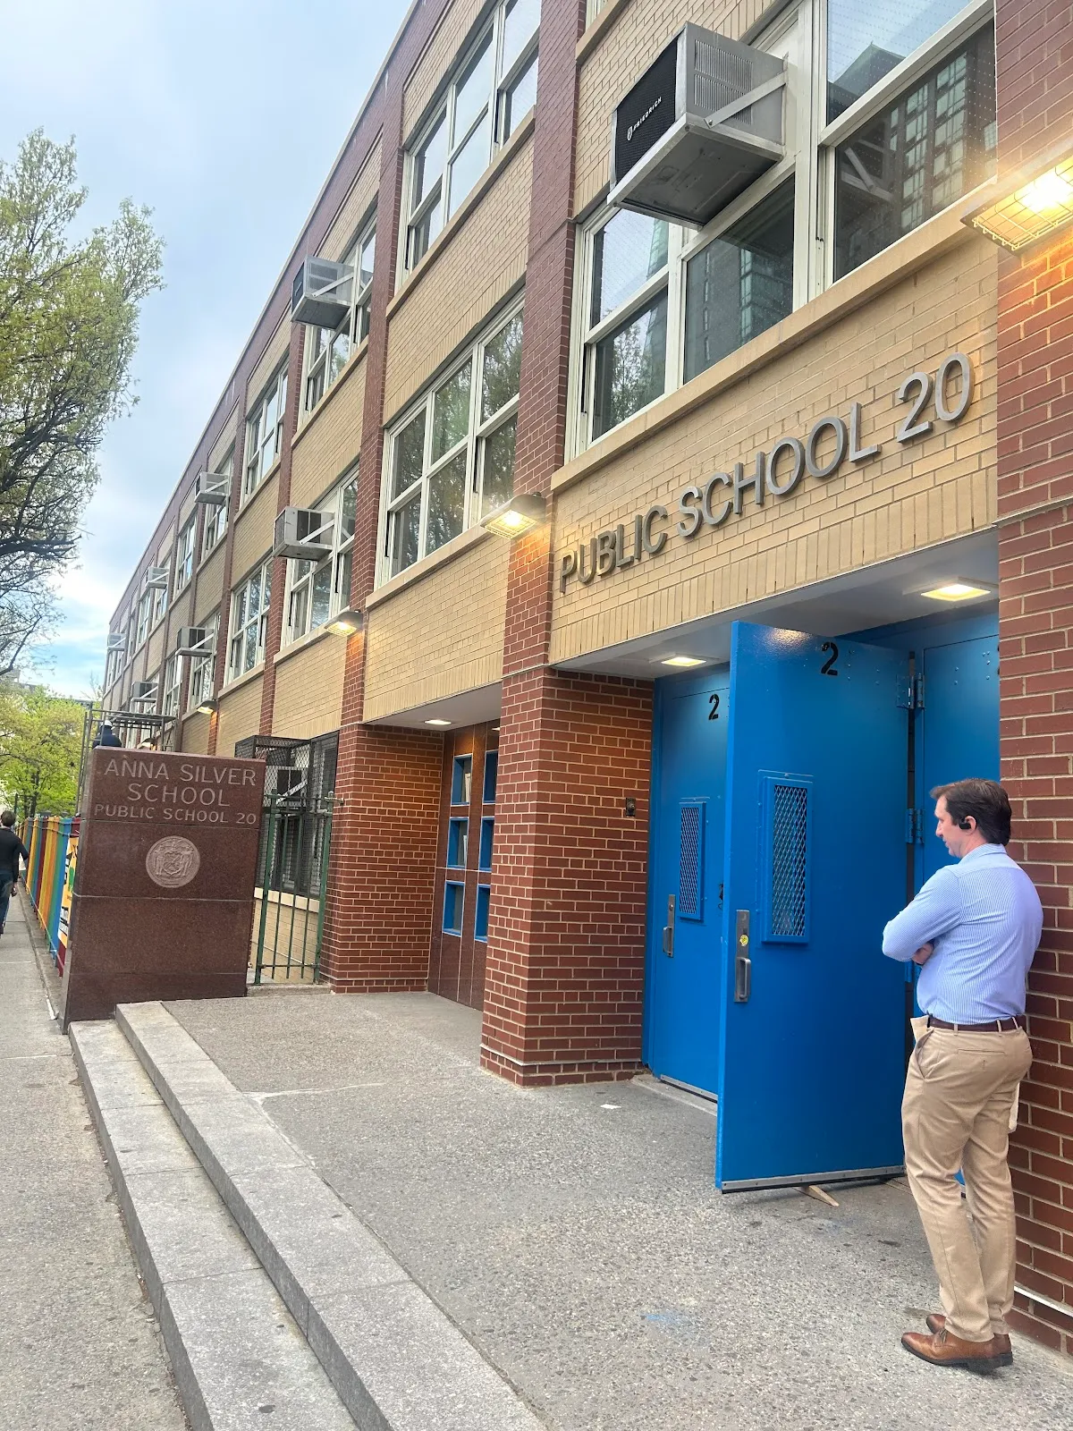

Why Manhattan Community Board 3?
MCB3 covers the Lower East Side and East Village — one of NYC’s most politically active districts.
Notes:
· Heavy docket of liquor licensing, land use, and housing issues
· Well-documented minutes going back to 2002
· No centralization or database of minutes or resolutions - individual PDFs

Slide 7

School of Data Agenda
Part 1: What are community boards and why do they matter?
Part 2: What is the opportunity for civic technology?
Demo time
Q&A

Slide 8
PART ONE
What Are NYC Community Boards and Why Do They Matter?

Slide 9
The Local Layer of NYC Government Most People Don’t Know Exists
Community boards are the ground floor of New York City politics—and most New Yorkers have never heard of them.
· 59 community boards across NYC’s 5 boroughs
· Established by the NYC Charter
· Represent a single community district — neighborhood scale
· Members are uncompensated volunteers appointed by their Borough President to serve two-year terms
· Charter Mandate: “consider the needs of the community district and advise elected officials”
The key fact: Community boards have NO formal decision-making power. Their role is advisory.
So why do they matter? →

Slide 10
Soft Power — Why “Advisory” Doesn’t Mean Toothless
▶
Resolutions on the record
Every agency and elected official sees when CB formally opposes their project. Ignoring a unanimous board vote can have political costs.
▶
District Needs Statement (DNS)
Annual priorities document filed by each CB. City agencies must respond to DNS requests in budget planning — direct budget influence.
▶
Required ULURP referrals, SLA & sidewalk cafe applications
For major land use decisions (rezonings, new developments), the city is legally required to refer applications to the CB. Recommendations become public record.
▶
Political pipeline
Many City Council members began as CB members. Relationships here open doors in elected offices and city agencies.

Slide 11
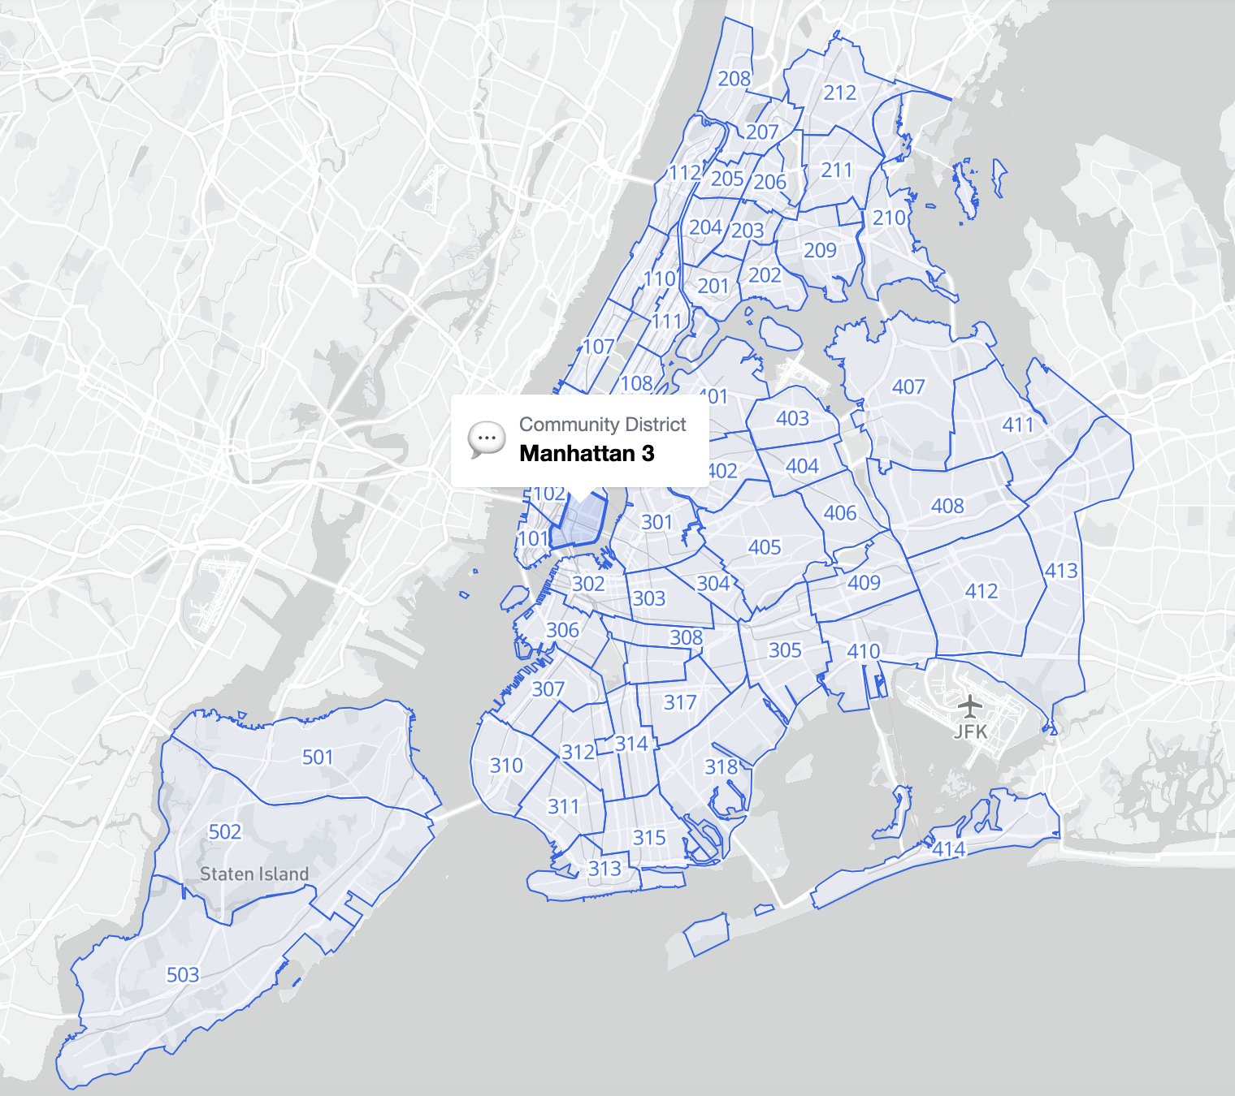
BetaNYC Boundaries Map

Slide 12
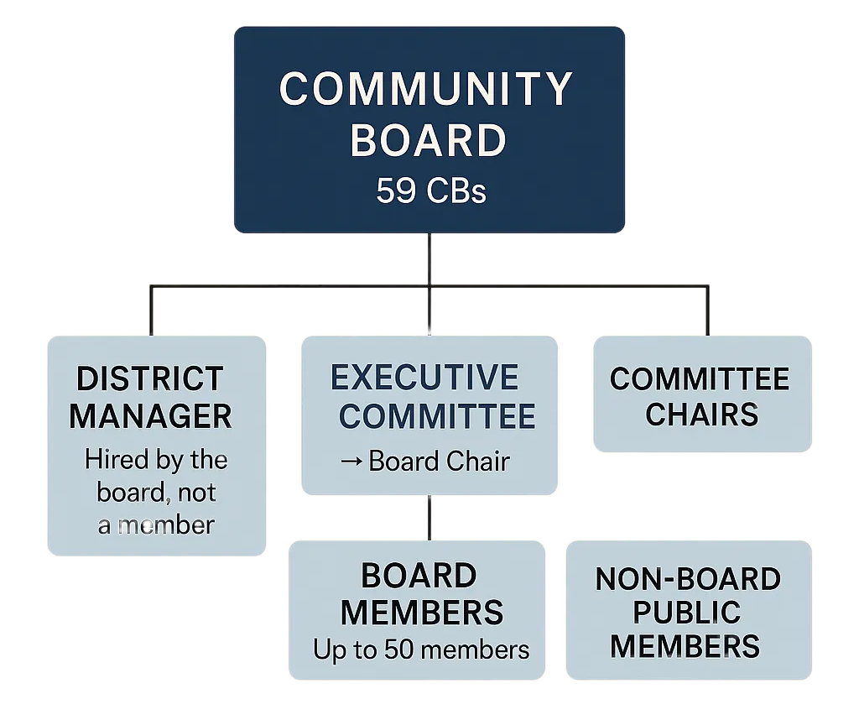
How Community Boards Are Structured
Who’s on the board:
· Up to 50 volunteer members
· 2-year terms (max 4 consecutive)
· No salary, no formal qualifications
· Only requirement: Must live, work, or have significant interest in the district
Leadership & staff:
· Chair, Vice-Chairs, Secretary, Treasurer (elected by members)
· One paid District Manager, optional additional non-member staff
Subject-matter Committees:
· Transportation · Parks · SLA
· Land Use · Landmarks · Housing
· Health · Youth & Education

Slide 13
What Is a Resolution?
Resolutions are official, written, public positions on a local issue.
MCB3 votes on:
Standard resolution format:
TITLE: One-sentence summary
WHEREAS, [context and reasoning]...
WHEREAS, [additional context]...
THEREFORE, BE IT RESOLVED,
that Community Board 3 [action]...
· Bar & restaurant liquor licenses
· Traffic safety improvements
· Real estate developments
· City agency requests (repaving, tree planting…)
· City-wide policy positions
Notes:
tee up the tool here - but they're not accessible...

Slide 14
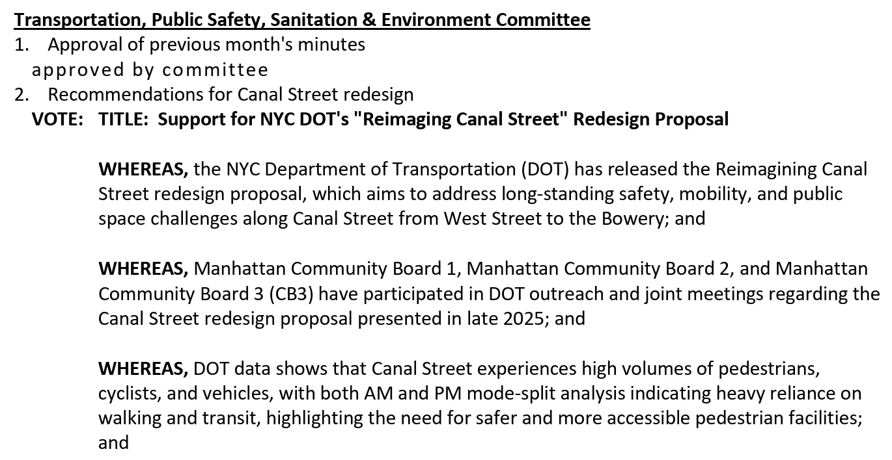
Partial text of a Manhattan CB3 resolution from the Transportation Committee. Note the succinct title and series of WHEREAS clauses (which continue past the end of this image). [source]

Slide 15
Two Kinds of Community Board Meetings
Committee Meetings
Full Board Meetings
(Usually) Monthly · (Usually) Open to the public
Monthly · Open to the public
· Agencies present project details
· Resolutions drafted and debated by committees
· Where advocacy is most effective
· Where the real work happens
· Public comment period (~2 min per person)
· Elected officials give reports
· Committees report resolutions
· Full Board votes on resolutions
Advocate insight: By the time a resolution reaches the full board, the debate is mostly over. Show up to committee meetings.

Slide 16
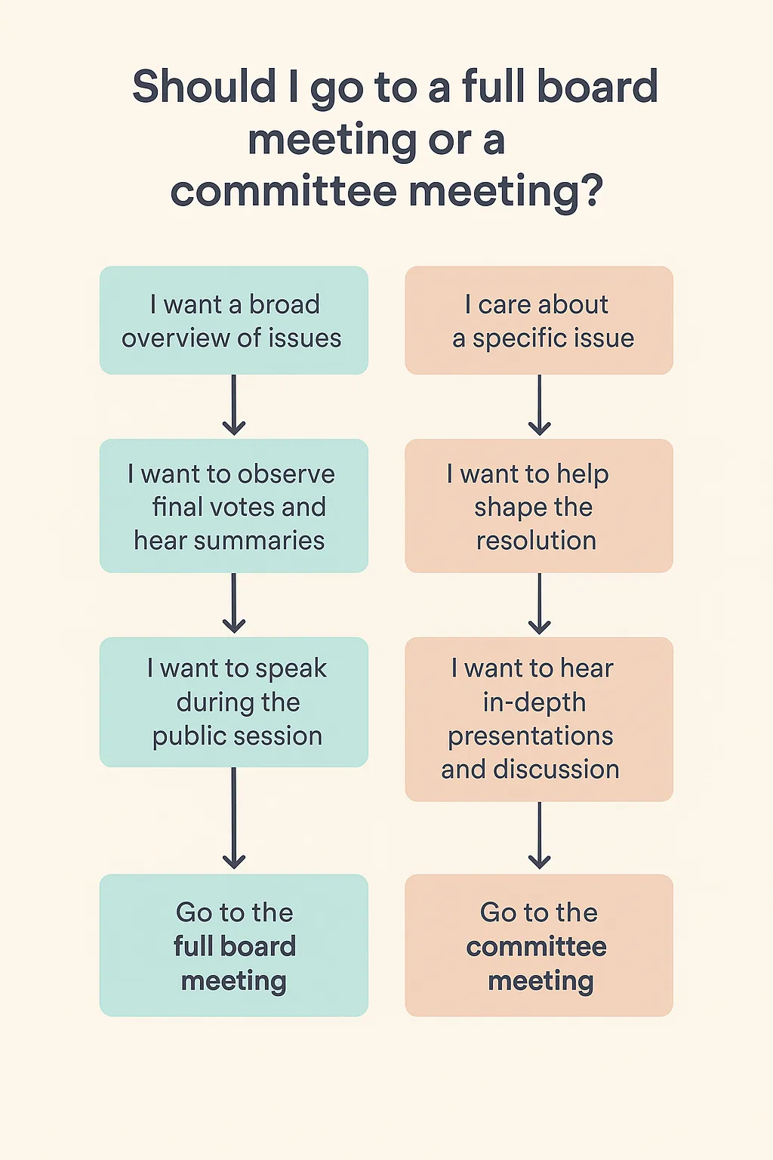

Slide 17
The Information Problem
Community boards are officially transparent — but practically opaque.
✅ What exists
❌ What’s missing
· All meetings open to the public
· All resolutions and votes recorded publicly
· Minutes posted as PDFs or on Airtable on individual community board websites
· PDFs (for MCB3) go back to 2002
· No structured database
· No search across resolutions
· No way to track a topic or location across 20 years of minutes
· No way to identify contested issues
· 268 siloed PDFs (for MCB3)

Slide 18
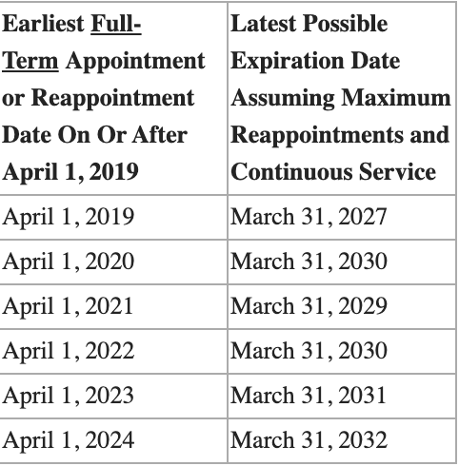
Community Board Term Limits
Table from the Office of the Manhattan Borough President
Community Board member term limits begin in 2027 - is local government prepared for the significant loss of institutional knowledge?
This is a problem Block Party can help solve.

Slide 19
PART TWO
What is the Opportunity for Civic Technology?
Notes:
Now transitioning into the civic tech part of our presentation, where we will share how we leveraged technology to help make this information more accessible.

Slide 20
Community Board Meetings can be inaccessible.
Notes:
As Tal has eluded to, community board meetings can be inaccessible, whether it is attending a meeting or staying informed on local policy decisions. This was always the idea behind block party, when community board meetings became virtually accessible on YouTube during the Covid pandemic, I thought it would be cool to use technology to create a summary and full transcript from the meeting conversation.
Block party has continued to evolve over the years and continues to serve the community because most folks don’t have the time to attend the many hours of meeting conversations
or know what was discussed.

Slide 21
Community Board 3 meetings on average last 02:07:38
Notes:
For community board 3 the typical meeting lasts about 2 hours and occur a few times per week.
Across community boards in the block party meeting transcript archive,

Slide 22
The longest community board meeting in our archive lasted 07:22:17
Notes:
The longest community board meeting from the on record was 7 hours, 22 minutes, and 17 seconds. It was from Manhattan CB2 February 11, 2025 - Outdoor Dining Working Group Meeting
This is evidence that A LOT is discussed at these meetings, but unless you’re really plugged in - it’s hard to stay informed or engage. This is really the ethos behind Block party

Slide 23
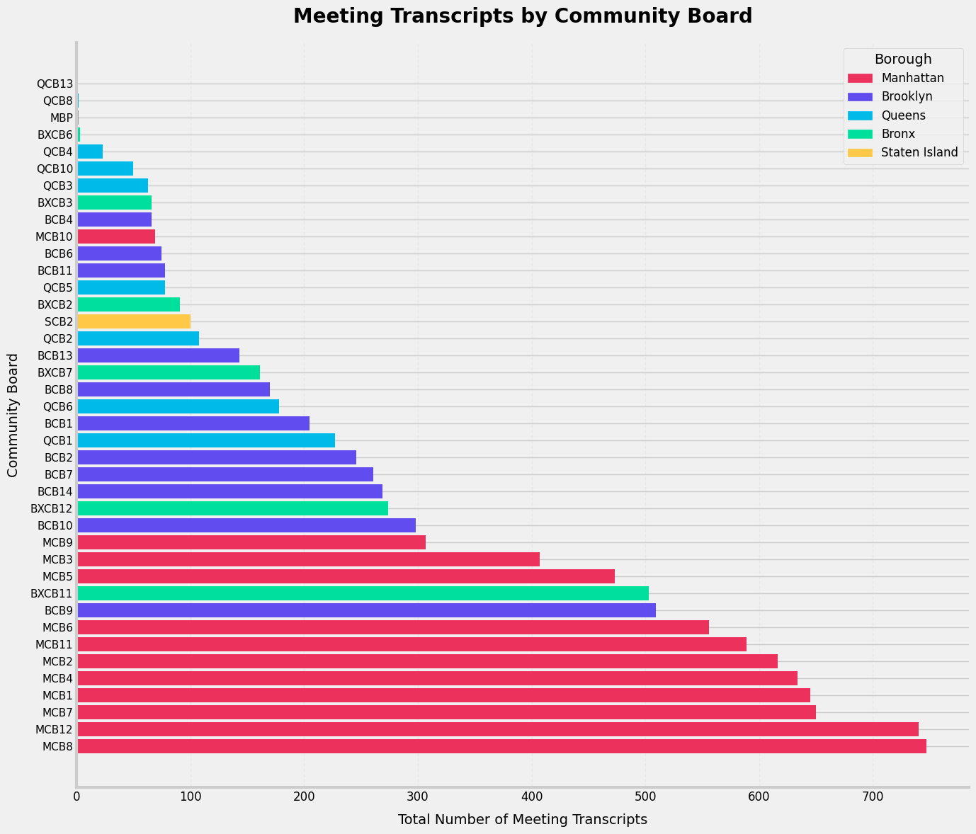
Notes:
Where over the past 6 years we have collected hundreds of meeting transcripts across districts representing each borough.

Slide 24
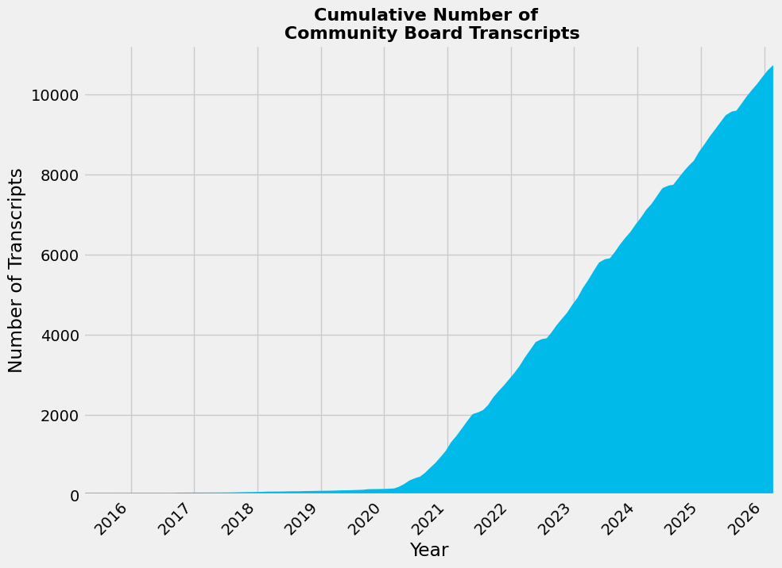
Block Party’s Archive has 11,986 Community Board Meeting Transcripts dating from 2015 to yesterday
Notes:
Since the start of the pandemic CB meetings have been publishing their meetings to Youtube, digitizing the information for archive, and public access. And the volume of meetings published continues to grow.

Slide 25
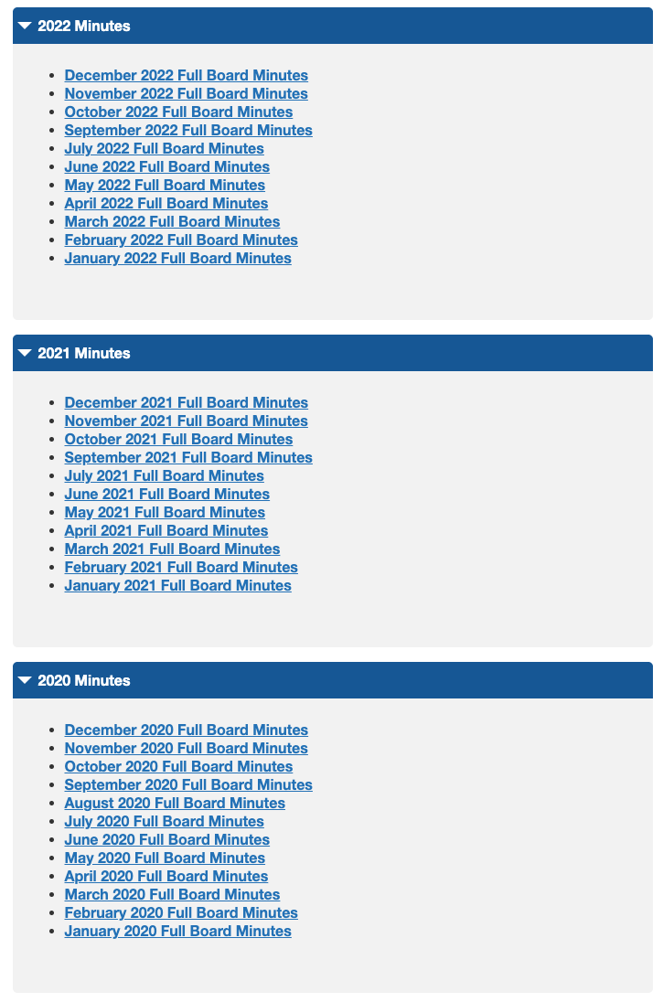

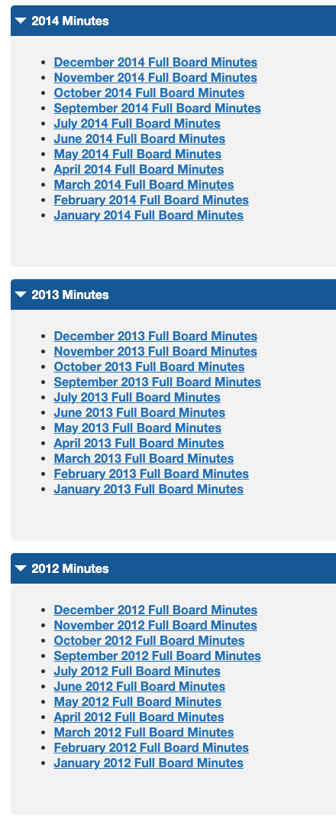
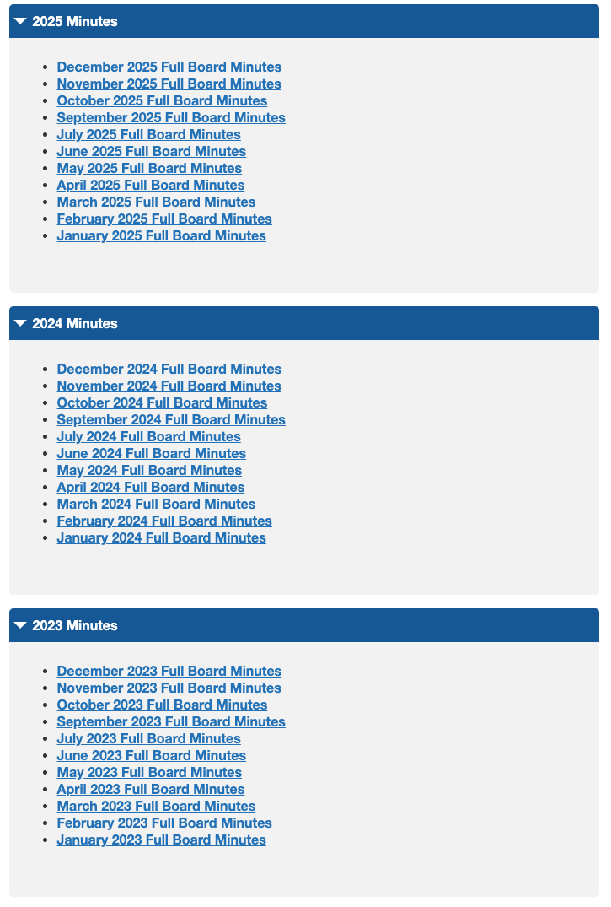
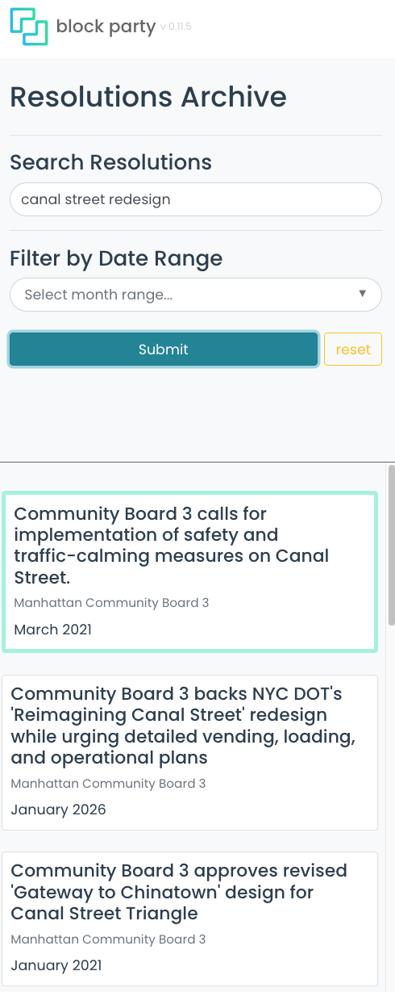
The Information Problem
Notes:
Now here is what we did for resolutions. The rest of this presentation will be about Block party’s newest feature where we developed a searchable archive for community board 3 resolutions.
You would have had to click through 17 years of resolutions. Who is going to do that? This makes it searchable.
information but would take forever to read
268 meeting PDfs you have to look through manually, within those.

Slide 26
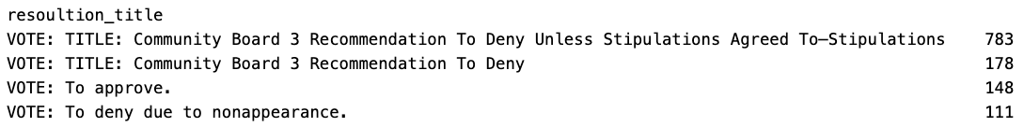
Database Overview — What Does MCB3 Vote On?
26.9
6,511
21,593
Avg resolutions per meeting
Total resolutions
Paragraph clauses
Keyword frequency across 6,511 resolution titles:
Deny
2,546 (39.1%)
Approve/Approval
1,526 (23.4%)
Recommend
1,336 (20.5%)
Support
718 (11.0%)
Request
Typically they Deny!
(unless stipulations agreed to)
471 (7.2%)
Oppose
42 (0.6%)
Notes:
Above 6500 resolutions that each have their own context and action. Within those are nearly 2M words, which is about 3.3 War and Peace novels. There is so much text, but no way to search across resolutions. There is no way to Ctr-F to find all resolutions.
So CB3 tends to approve the denial of resolutions accounting for 39% of all resolutions — which seem to stem from their liquor license docket.
The board’s default posture is to deny or set conditions (“Deny Unless Stipulations Agreed To”) rather than give unconditional approval.

Slide 27
When Key Community Decisions Become More Accessible
Analytics Opportunity
Civic Accountability
Taking it Further with AI
With NLP / Embeddings
Search thousands of resolutions by address, business name, or topic
Track a community board’s position on recurring issues over 20+ years
Compare contested vs. unanimous votes by topic area
Identify patterns on controversial issues
Flag if city agencies ignore a resolution
Track liquor license denial → approval
Explore how community boards respond to the needs of their district
Knowledge base linking resolutions to the meeting discussion
Semantic search: ‘Find all resolutions about outdoor dining’
Cluster resolutions by topic or location
Detect shifts in sentiment and language over time
Compare positions across community boards
Notes:
· What a database unlocks: Longitudinal analysis: “how has MCB3’s posture on liquor licensing changed?”
· Pattern detection: what gets denied vs. approved?
· Semantic search by address, business, or policy topic
Use case possibilities:
Extract locations that are discussed to search by business name, address, agency, permit type

Slide 28

When Key Community Decisions Become More Accessible
Analytics Opportunity
Civic Accountability
Taking it Further with AI
With NLP / Embeddings
Search thousands of resolutions by address, business name, or topic
Track a community board’s position on recurring issues over 20+ years
Compare contested vs. unanimous votes by topic area
Identify patterns on controversial issues
Flag if city agencies ignore a resolution
Track liquor license denial → approval
Explore how community boards respond to the needs of their district
Knowledge base linking resolutions to the meeting discussion
Semantic search: ‘Find all resolutions about outdoor dining’
Cluster resolutions by topic or location
Detect shifts in sentiment and language over time
Compare positions across community boards
Particularly with term limits, access to institutional knowledge is even more important!
Notes:
· What a database unlocks: Longitudinal analysis: “how has MCB3’s posture on liquor licensing changed?”
· Pattern detection: what gets denied vs. approved?
· Semantic search by address, business, or policy topic
Use case possibilities:
Extract locations that are discussed to search by business name, address, agency, permit type
Now we transition into Block Party’s newest feature and what we built:

Slide 29
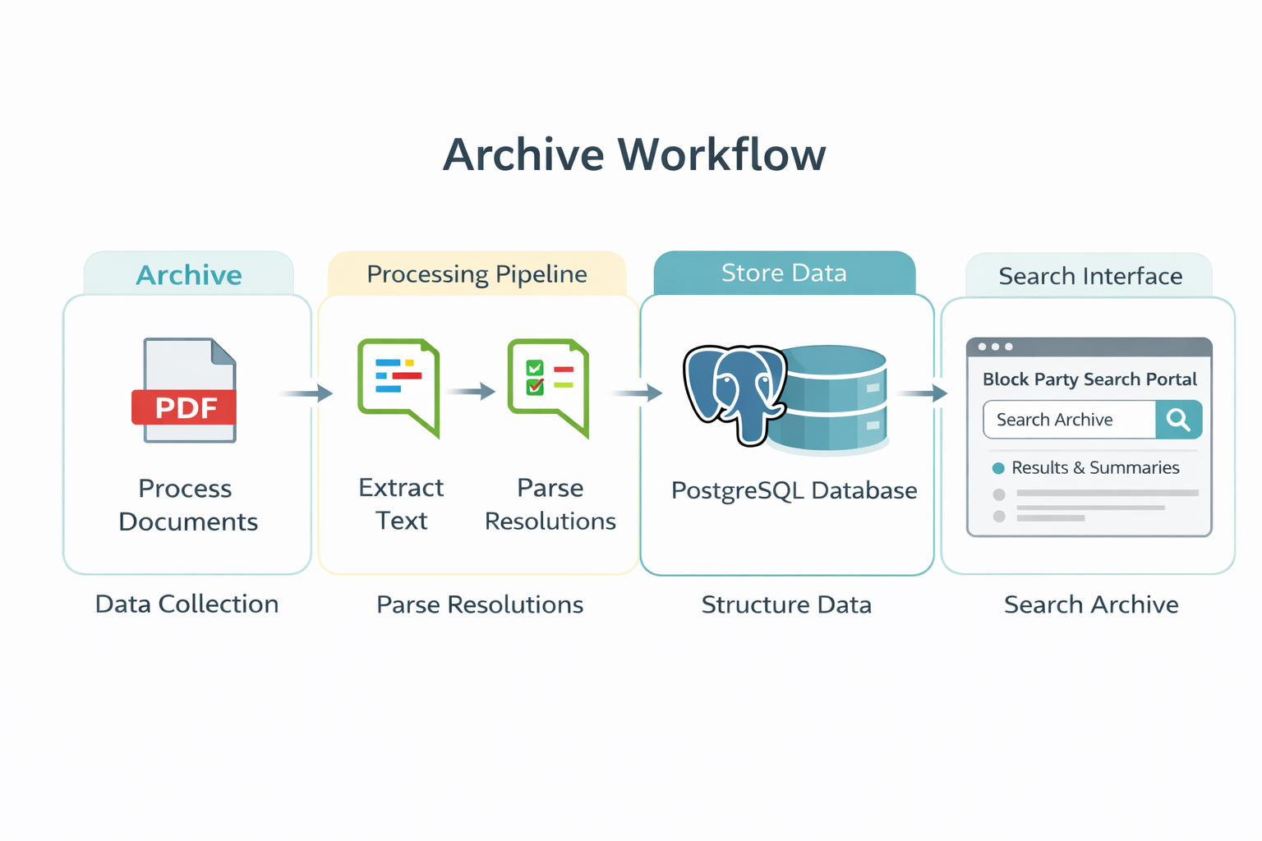
Here is How We Built It
Create Vector Embedding
Generate Summary
Notes:
First we

Slide 30
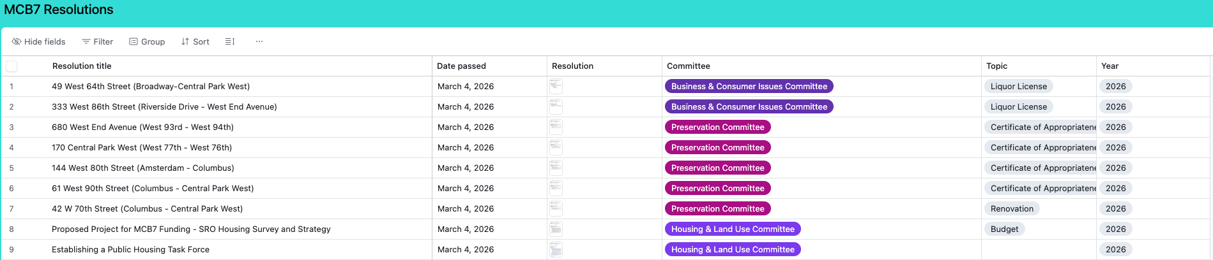
The Source Data — Community Board Website PDFs
MCB3 posts meeting minutes and vote records publicly — but in three different URL formats across eras.
2021 – present
manhattancb3/downloads/minutes/YYYY/minutesYYYY-MM.pdf
2004 – 2020
manhattancb3/downloads/minutes/minutesYYYY-MM.pdf
2002 – 2003
manhattancb3/cb3docs/reso-archive/MM-Name-YYYY-Resolutions.pdf
Challenge: each era has different PDF formatting, vote tally conventions, and resolution structure.
It’s exciting to see some community boards have adopted solutions like Airtable!

Slide 31
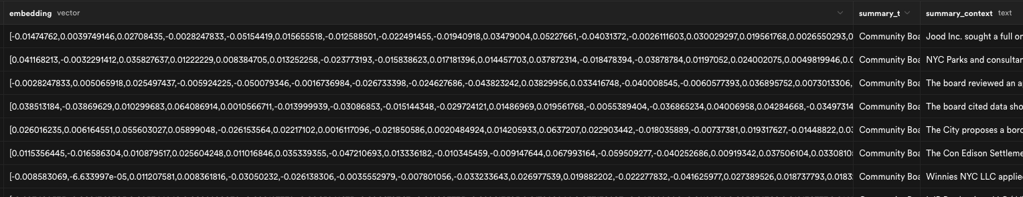
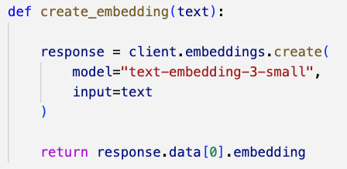
How the Extractor Works — Three-Step Pipeline
1
Fetch PDF
2
Extract text
3
Parse & store
HTTP request to nyc.gov
Processed in memory—no files saved
pdfplumber reads all pages
Concatenates raw text string
Regex splits text:
Find resolution chunks (VOTE:)
Split by markers TITLE: WHEREAS: THEREFORE:
→
→
Create Vector Embedding
Notes:
Pause to ask if folks are familiar with vector embeddings

Slide 32
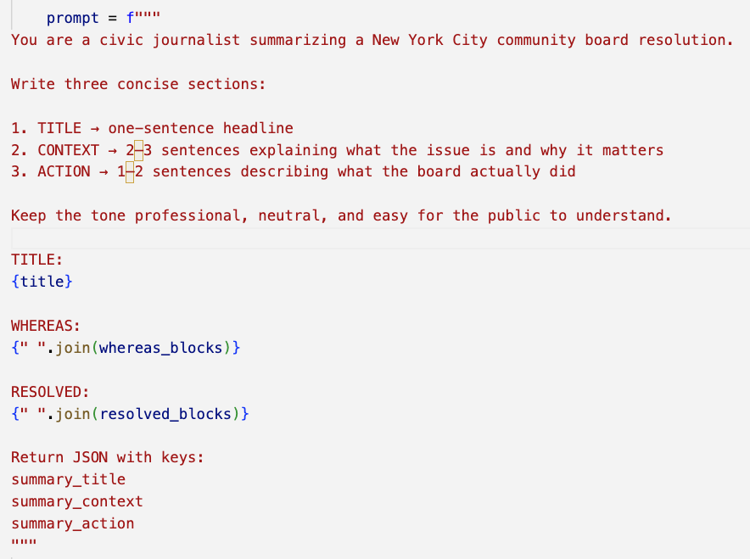
Generate Summary
Group text chunks by each section of the resolution
Send to a prompt
Specify the output structure

Slide 33
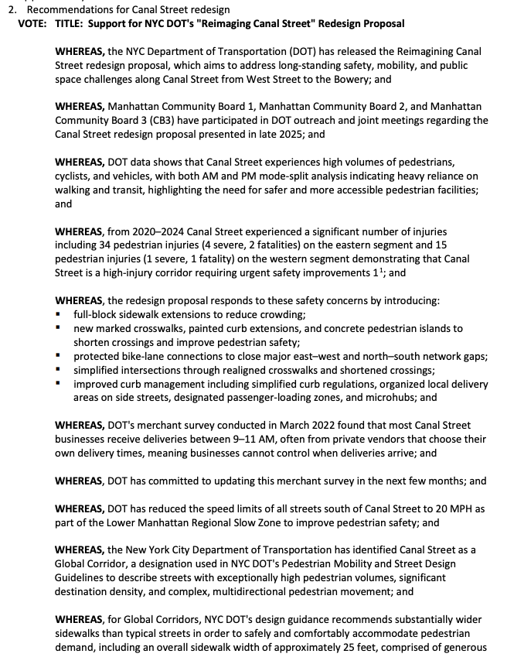
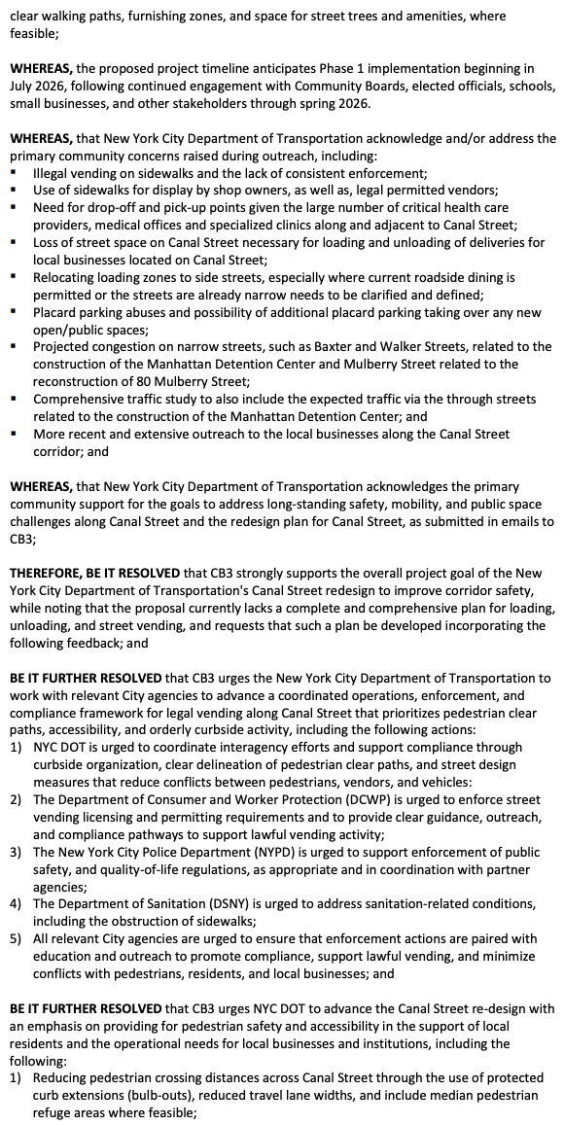
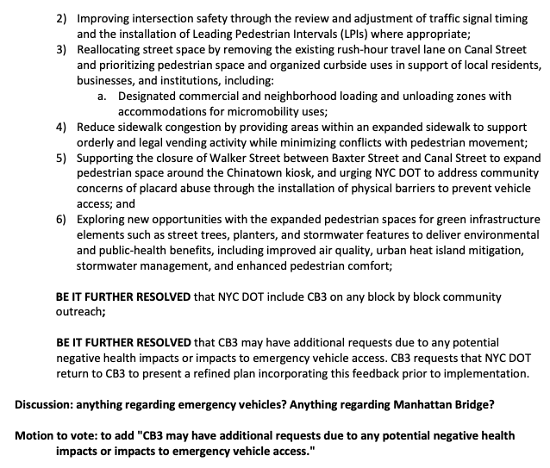
Notes:
Who wants to read this?

Slide 34
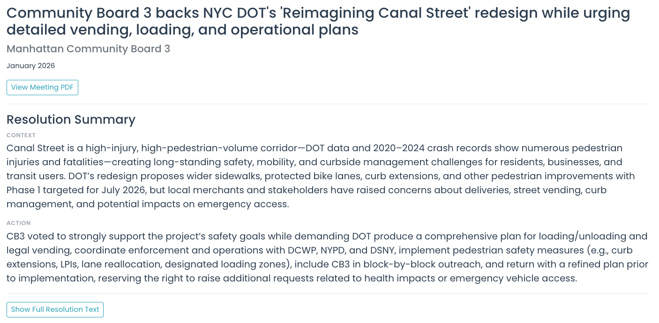
Resolutions as a Data Source
Reliable data points
Community concerns
Next steps
Locations
Entities
Topics
Notes:
We created a summary from the full resolution text in order to make the information more accessible. Here is what the full resolution looked like

Slide 35
What if we could dive into the meeting discussion?

Slide 36
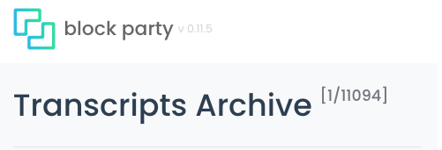
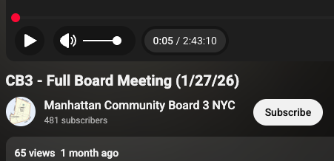
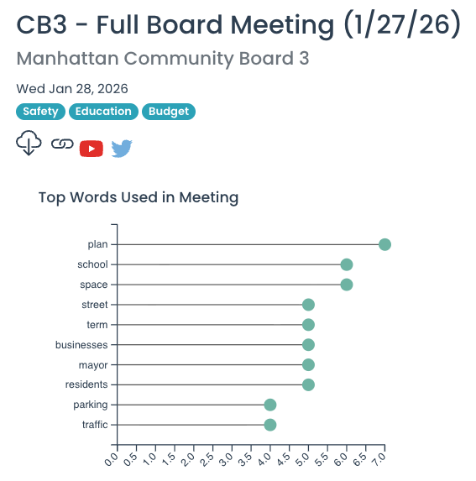

“Our main concern is that, all parking spaces on Canal Street from Broadway to East Elizabeth Street will be removed under the new DOT plan to widen the sidewalks. This will create major problems for truck delivery to local businesses and for seniors and patients with mobility impairments, who rely on ambulance or call service to reach the doctor's offices. Especially, since there are about 200 medical providers and two large radiology center on Canal Street.”
Link to Full Transcript

Slide 37
“Our main concern is that, all parking spaces on Canal Street from Broadway to East Elizabeth Street will be removed under the new DOT plan to widen the sidewalks. This will create major problems for truck delivery to local businesses and for seniors and patients with mobility impairments, who rely on ambulance or call service to reach the doctor's offices. Especially, since there are about 200 medical providers and two large radiology center on Canal Street.”
What if we could search across all 59 community boards?
Link to Full Transcript

Slide 38
Join the Party! There are More Questions to Explore
16 / 16
?
A Tool for Civic Inquiry
What happens next. Did the agency comply? Did the developer get approved?
?
Extend to all 59 Community Boards
How might we generalize the pipeline? Each board formats their minutes differently.
?
Connect to the Committee Layer
Real deliberation happens in committees — can we connect conversation context to resolutions?
?
More Accessible
How might we improve how the key information can be extracted, summarized, digested?
Read more @ NYCuriosity. Join @ Committee Meeting. Subscribe @ Block Party.
Please share your thoughts/feedback/ideas with us!
Notes:
Please look through it and give us ideas, and
Sign up for email - subscribe
Read Tal’s substack! He writes about newsletters about Community Boards
Go to a committee meeting!

Slide 39
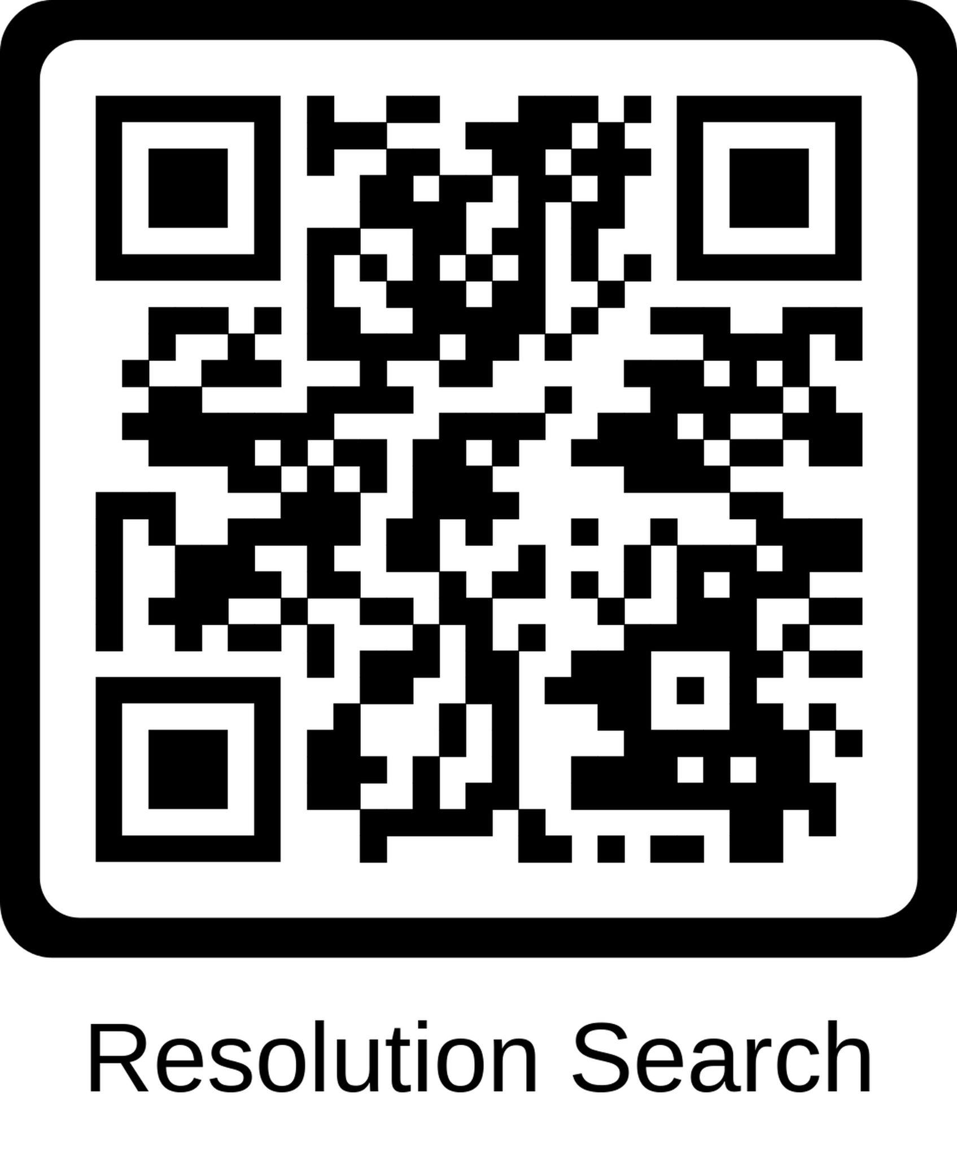
Join the Party!
blockparty.studio blockparty.meeting@gmail.com
https://www.linkedin.com/in/sarahjunesachs/
https://www.linkedin.com/in/tal-roded/
Notes:
We would love to connect - come join the party and sign-up to stay updated on conversations happening in your community board, or search through our archive mode for stories and insight.

Slide 40

Thank you!
Stay in touch at beta.nyc/links
nycsodata26.sched.com #nycSOdata #opendataweek

Slide 42
Curious about a particular topic? initiative? challenge?
Community Board Knowledge Base
Local Government Memory
Notes:
You would have had to click through 17 years of resolutions. Who is going to do that? This makes it searchable.

Slide 43
Curious about a particular topic? initiative? challenge?
You would’ve needed to search across 17 years of resolution PDFs
Explore the history of an initiative
Knowledge base for community
Analyze trends
Community Board Knowledge Base
Local Government Memory
Notes:
Unless you’ve been on the CB for 17 years, you wouldn’t know that the CB has been talking about the redesign for ages.

Slide 44
Curious about a particular topic? initiative? challenge?
You would’ve needed to search across 17 years of resolution PDFs
Explore the history of an initiative
Knowledge base for community
Analyze trends
Community Board Knowledge Base
Local Government Memory
Particularly with term limits, access to institutional knowledge is even more important!

