Slide 1
STATE CAPACITY ECOSYSTEM
The people helping government deliver find each other here.
statecapacityecosystem.com

Slide 2
THE PROBLEM
Good policy fails because the people fixing government work in silos.
State capacity is government's ability to do what it sets out to do: issue the permit, deliver the benefit, keep the trains running. Many people care about it. Few know who else is out there or how to help.
MISSION
VISION
Map the ecosystem. Put technologists and practitioners in the same room and turn what they build into something government can use. Expand the community. Repeat.
A visible, connected ecosystem enabling a government with the talent, tools, and operating capacity to deliver for the people it serves.
Framing after Jennifer Pahlka, Recoding America (2023).
State Capacity Ecosystem

Slide 3
HOW IT WORKS
The ecosystem feeds events. Events create community. Community grows the ecosystem.
Ecosystem
Events
Community
We map who does what
We run the room
We keep people connected
We're building a flywheel. The ecosystem feeds events, events create community, and community drives ecosystem growth.
State Capacity Ecosystem

Slide 4
PILLAR 1 · ECOSYSTEM
We’re building the ecosystem’s connective tissue.
1
329
50+
1,763
Search
Organizations
Connect
Affinity Map
Say who you are and what you need. It finds the match across organizations and people.
Working on state capacity and how. Filter by segment, geography, problem.
People, problems and opportunities. Practitioners add problems here.
What organizations have in common: shared problems, shared funders.
Source: directory.csv and connect_submissions.csv, September 2026. Search in beta.
State Capacity Ecosystem

Slide 5
PILLAR 2 · EVENTS
We’re putting technologists and practitioners in the same room to build together.
Hackathons
Demo nights
Salons and meet-ups
Agencies and judges bring problems, practitioners and technologists build together, and every team demos running software.
Teams show what they built to the people who can put it to use. Where a prototype meets its agency.
Speaker nights, small-group discussions, monthly office hours. Where the community forms between builds.
EVERY EVENT
A government decision-maker with real authority in the room. No decision-maker, no event.
A path to adoption: every tool public within 48 hours, and agency partners who might just take that project on.
State Capacity Ecosystem

Slide 6
PILLAR 3 · COMMUNITY
We’re expanding the community.
Slack
Substack
The conversation between events. Team matchmaking happens here before every hackathon.
The case for the field, in writing. Eight posts and counting.
Playbooks
Proof Points
Run the format without us in the room. Operating handbooks that take you from curious to fieldbuilder.
Every tool built through SCE, tagged by event and problem area, free to open and reuse.
State Capacity Ecosystem

Slide 7
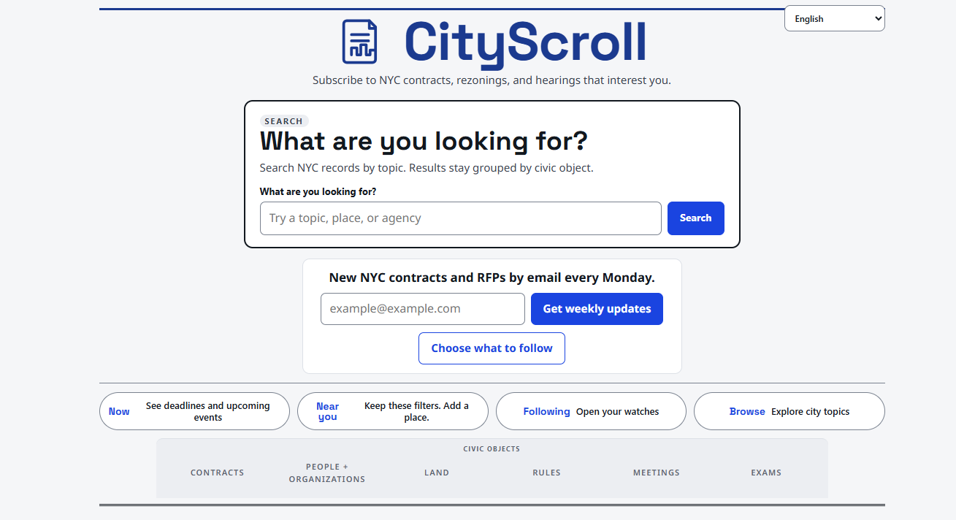
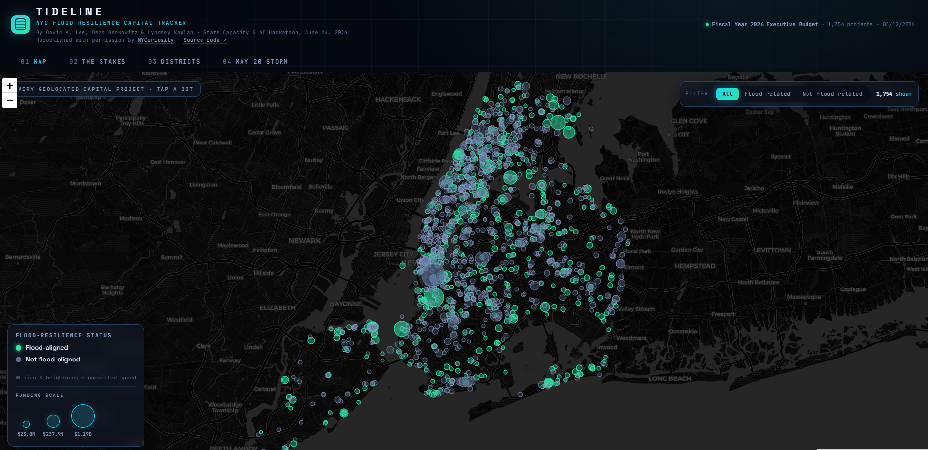
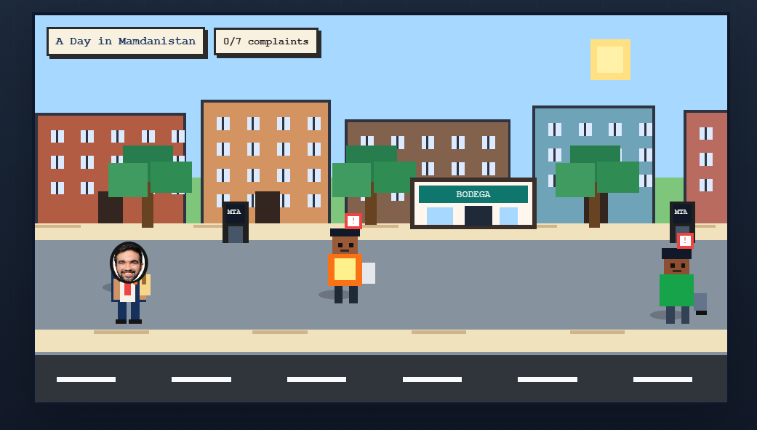
PROOF
One night. 80+ builders. 20+ tools built.
City Scroll
Tideline
A Day in Mamdanistan
Real-time search across NYC contracts, rezonings, and hearings. Makes procurement legible to anyone.
An interactive map of 1,754 capital projects, scored against flood-resilience status citywide.
A playable satire of everyday bureaucratic friction, tracking complaints as a citizen navigates city systems.
State Capacity Hackathon: A Civic Tech Build Night, NYC, June 24, 2026. Download count from npm, September 2026.
State Capacity Ecosystem

Slide 8
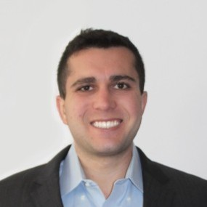



TEAM
Who's building this.
Henry Grunzweig
Tal Roded
Jeremie Ponak
Sourabh Chakraborty
Leads SCE's vision and partnerships. Previously consulting and startups.
Data and technology lead. Built SCE's data hub. Runs NYCuriosity Data; Manhattan CB3.
Policy & program lead, including hackathons and benchmarking. Working in responsible AI on special projects at ROOST.
Builds tools and contributes to SCE thought leadership and community. Software engineer and government practitioner.
State Capacity Ecosystem

Slide 9
PARTNER WITH US · SPONSORS
Two ways to sponsor.
Lead Sponsor
Cosponsor
YOU PROVIDE
YOU PROVIDE
Identifies the partner agency. Shapes the problem statements. Names judges. Funds food and drink.
Supports space, food, logistics. Amplifies through your network. Nominates roaming experts.
YOU GET
YOU GET
Logo and credit on all materials. Named in "Hosted By." Kickoff and closing statements. Early view of problem statements and prototypes. Option to host in your space.
Logo and credit on all materials. Named in "Hosted By." Social amplification credit. Inclusion in the recap.
Full responsibility matrix: statecapacityecosystem.com/events/sponsors-checklist/
State Capacity Ecosystem

Slide 10
PARTNER WITH US · GOVERNMENT
Bring a problem. Leave with a working prototype and a path to adopt it.
1
2
3
Bring a problem
Watch it get built
Take it home
One operational bottleneck, the data behind it, and someone with authority to act. We help you write it.
Technologists build against your problem with your practitioners at the table. You judge what is useful.
Every tool is public within 48 hours. We own the follow-through: a demo, a working session, an introduction.
No cost to the agency. No procurement. Prototypes are built in the open and belong to their builders.
State Capacity Ecosystem

Slide 11
PARTNER WITH US · CHAPTERS
Run it where you are.
YOU GET
YOU COMMIT TO
The playbook, the checklist, and the launch bible
A channel in the SCE Slack and our matchmaking process
Your tools in Proof Points under your event name
Promotion through SCE channels and the website
A government decision-maker in every room
Wide tent principles
No partisan or campaign affiliation
Every tool captured and posted within 48 hours
No application. Start with a conversation.
State Capacity Ecosystem

Slide 12
APPENDIX · HOW WE RUN HACKATHONS
The decision-maker seat is the difference between a hackathon and a proof point.
EVERY EVENT HAS
WE SAY NO WHEN
A group of technologists building tools for government
At least one government person with real decision-making power in the room
No decision-maker will commit to attending
The problem is political, not technical
State Capacity Ecosystem

Slide 13
APPENDIX · WHY IT WORKS
Visibility is the precondition. Three things move government.
1
2
3
Proof
Method
Network
Working software, built by technologists and practitioners together, that shows government what is possible.
A reusable playbook, so the next room does not need us in it.
A standing group of people that keeps producing without our time as the bottleneck.
State Capacity Ecosystem

