Slide 1







Monte-Carlo - distance sampling
The computer generates random numbers, distributed uniformly:
The survival probability given the total cross-section is:
The cumulative probability F(s) is defined:
“Knowing” ξ can solve for the distance s that event occurred:
Or simply:

Slide 2









Monte-Carlo - Probability Density Function (PDF)
Given cross section
And distance element:
Probability of event in ds:
Probability of event in ds:
Probability to reach P(s+ds)
Probability to reach P(s)
Probability of NOT doing event in ds
Arranging:
yields:
Solving:
Differentiating:
yields:

Slide 3

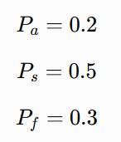


Monte-Carlo - Events sampling
Once event was sampled in s using Σ_{t}, the type of event is sampled via the different cross-sections for capture, scattering or fission:
For example:
Capture probability
Scattering probability
Fission probability

Slide 4




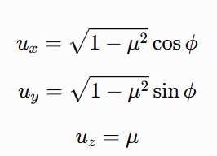
Monte-Carlo - Direction sampling
For sampling isotropic 3D direction, we need to cover the unit sphere isotopically.
Naively:
But that’s, would be wrong!
Thus, we have to sample to independent random variables, ξ₁ and ξ₂:
Polar angle:
Azimuthal angle:
The Cartesian unit-size directions:

Slide 5
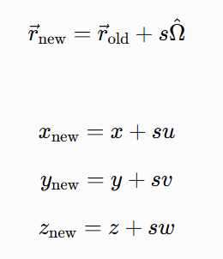
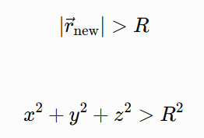
Monte-Carlo - Advancing Particles
Ones the distance for iteration s and direction Ω were sampled, the new position of each particle is determined:
If the new position is greater than the system size (for example R in a bare sphere), the particle leaks (vanishes):
In multi-zones problem, if the new position is greater than the surface between the zones, approach particle to surface and sample s again considering the dt spent in previous zones.

Slide 6






Monte-Carlo - Inverse Cumulative Density Function
Cumulative probability:
Inverse cumulative probability:
For simple constant “one-zone” PDF:
Yields:
It is east do define the inverse distribution:

Slide 7


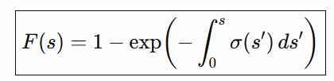

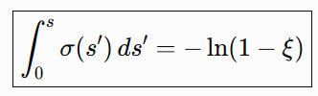


Monte-Carlo - Multi-Zones problem
For complex “multi-zone” PDF:
For simple constant “one-zone” PDF:
Cumulative probability:
sampling ξ can solve for the distance s but now through integral:
Yields:
Or:
Usually done by separating each different distance in each zone (cell-by-cell optical depth):

