Slide 1
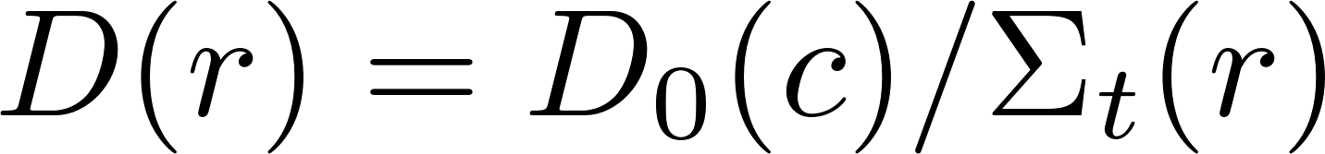
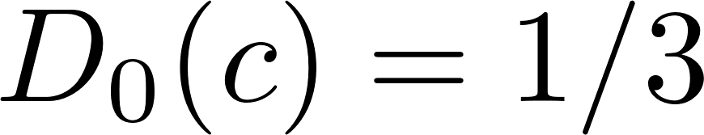
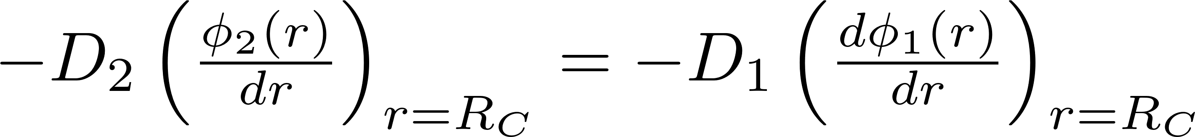
Diffusion Theory
The diffusion equation:
The diffusion coefficient is:
Dimensionless diffusion coefficient
In classic diffusion:
Consistent with flux and current continuity:

Slide 2
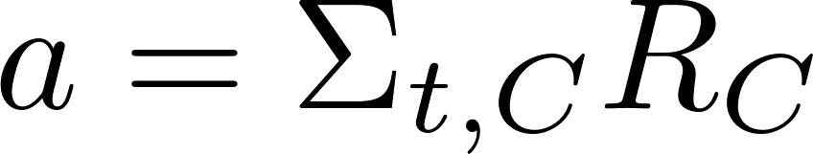
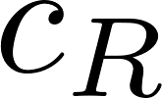
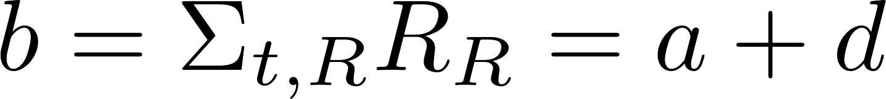
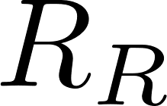
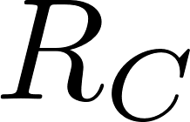
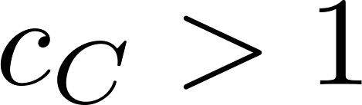
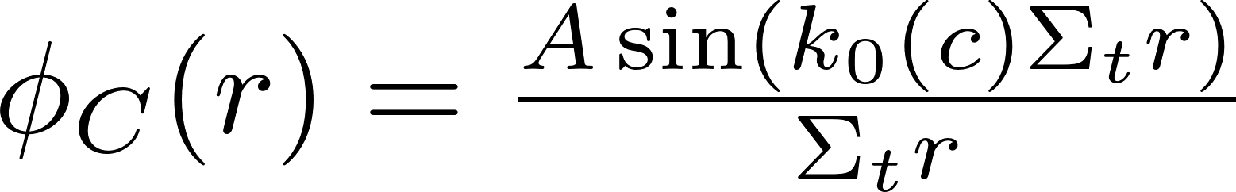
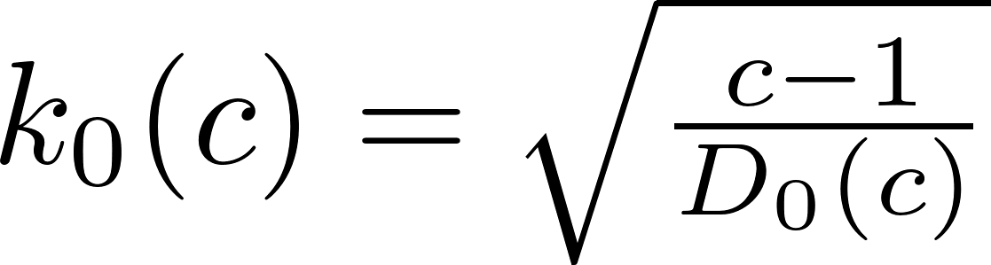
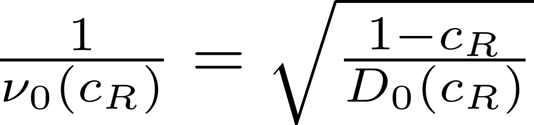
Reactor-reflector problem
Dimensionless core radius:
Dimensionless reflector radius:
Dimensionless reflector width:
Solution in core:
Solution in reflector:

Slide 3
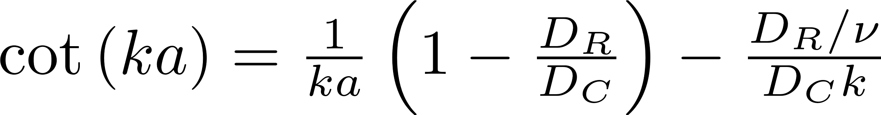
Reactor-reflector criticality equation
Imposing the continuity restrictions for the scalar flux and current:
Infinite reflector:
Finite-size reflector:
The well-known one-velocity spherical criticality equations for reflected spheres.
Lamarsh & Baratta, 2001, Greenspan, Kelber & Okrent, 1968.

Slide 4

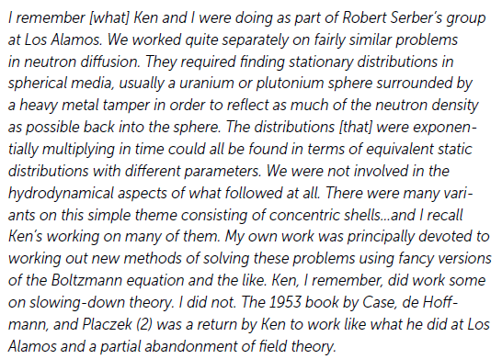
Two-region Milne problem
Kenneth M. Case, Biographical Memoir by Paul F. Zweifel & Norman J. McCormick
The Manhattan Project, Los-Alamos: By his office partner, Nobel laureate Roy Glauber:

Slide 5
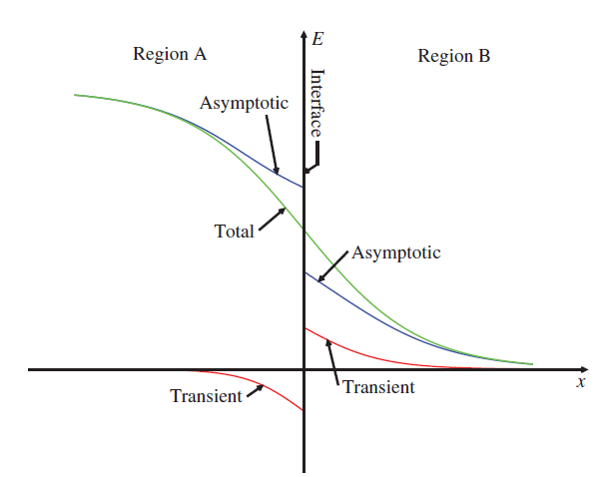

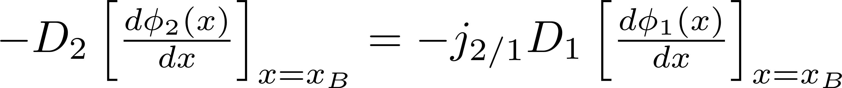
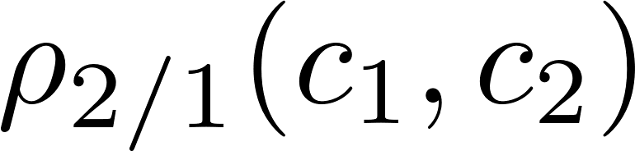
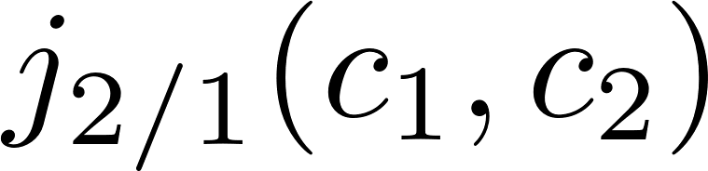
Two-region Milne problem
The asymptotic part of the exact solution has both scalar flux and current discontinuities - gives rise to a discontinuous asymptotic diffusion theory
Full solution is of course, continuous.
Function of the media properties

Slide 6
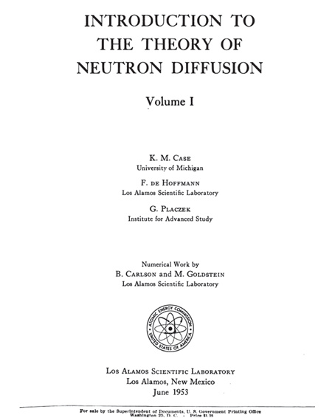
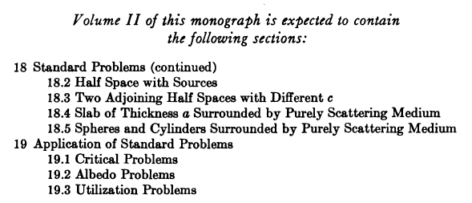
Let’s re-visit the 1953 book…
Volume II is exactly what we need, it focuses mainly in the two-region Milne problem!
Unfortunately, volume II wasn’t published until today…

Slide 7
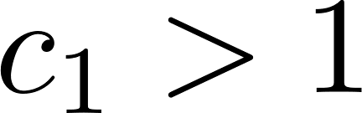
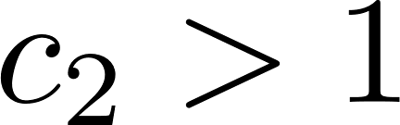
Volume II eventually was “published” - the “McCormick trilogy”
N. J. McCormick, “Neutron transport for anisotropic scattering in adjacent half-spaces. I. Theory”, NSE, 37, 243, 1969.
N. J. McCormick, R. J. Doyas, “Neutron transport for anisotropic scattering in adjacent half-spaces. II. Numerical results”, NSE, 37, 252 , 1969.
R. J. Doyas, N. J. McCormick, “Transport-corrected boundary conditions for neutron diffusion calculations”, UCRL-50443, Lawrence Livermore Laboratory, 1968.
The trilogy consists a full solution to the linearly anisotropic two-region Milne problem, including multiplying medium, .
The UCRL report consist tabulation for and .
There is no solution for and .

Slide 8
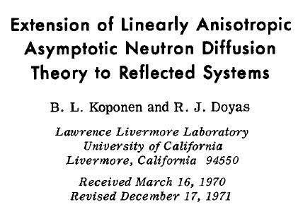
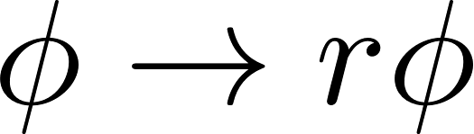
Discontinuous asymptotic diffusion theory- The curvature fixup
In curvilinear coordinates, one must fix and via the curvature of the system.
In spherical symmetry:
Fixed jump conditions:
Koponen & Doyas, NSE, 1972.

Slide 9

Reactor-reflector problem - discontinuous asymptotic diffusion theory criticality equation
Without correcting the jump conditions - wrong:
With correcting the jump conditions - correct (and again, simpler…):

Slide 10
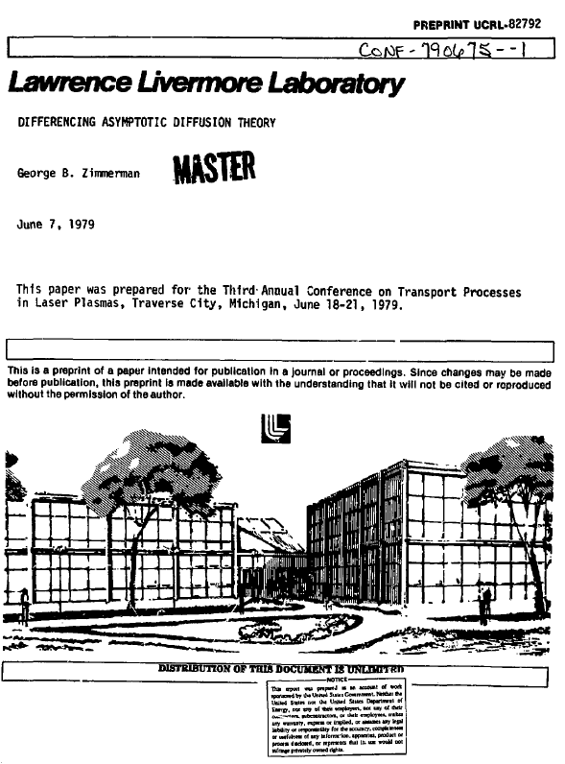
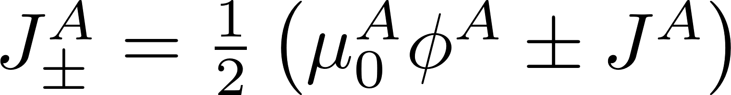
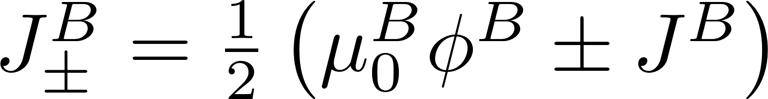
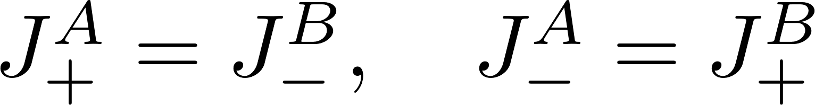
The Two-region Marshak-like approximation of George Zimmerman, simple though genius, 1979
The exact McCormick jump conditions are still hard to evaluate.
There is no solution for and .
As the Marshak-like is an approximation to the exact Milne (semi-infinite half space),
Zimmerman is the two-region Marshak-like approximation to the exact McCormick solution.
What integrality comes out from one region, enters to the other region, and vise-versa…

Slide 11
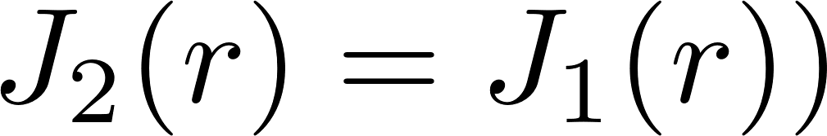
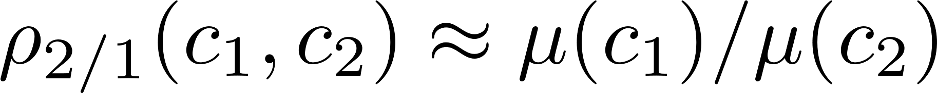
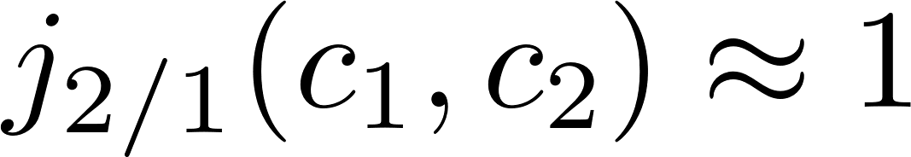
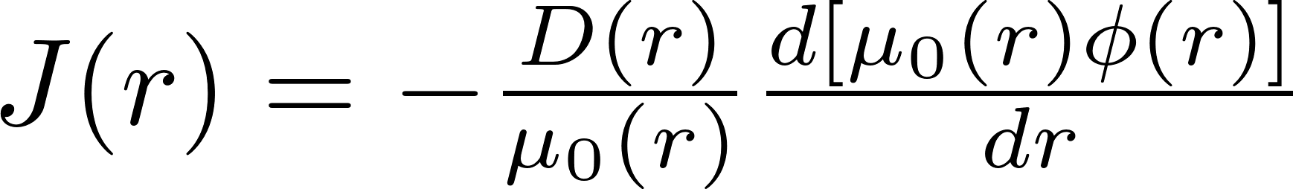
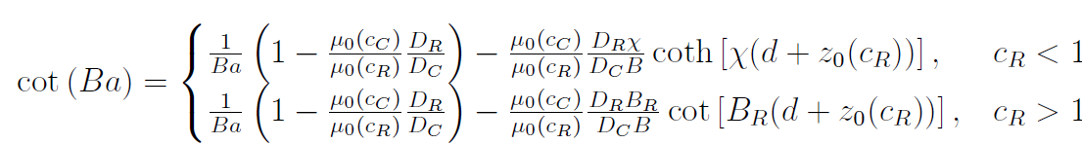
The Two-region Marshak-like approximation of George Zimmerman, simple though genius, 1979
These conditions leads to Zimmerman’s jump conditions:
Which gives rise to this modified Fick’s law:
Which consistent with this “wrong” criticality equation:

Slide 12
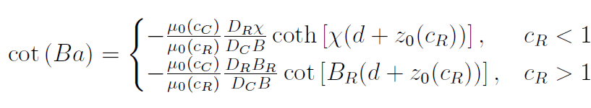
Zimmerman approximation with fixing the curvature correction
Zimmerman’s curvature-fixed approximation (red lines) yields high accuracy agreement to the exact McCormick (red dots)
Also valid for hybrid systems!

