Slide 1
Heuristic Derivation of the
Integro-Differential Neutron Boltzmann Equation
Choice of the neutron description
+ Quantum mechanical description
- Subatomic particle-uncertainty principle
- Baryon class particle (Fermions of spin ½)
- Possess the strong nuclear force.
+ Relativistic description
- Can travel near light speed
- Mass changes with speed
+ Maxwell’s wave description
- Wave/particle duality
- Neutron has a wavelength
+ Classical particle description

Slide 2
Neutron behavior can be described by all of above
+ Quantum mechanical description
- On collision, neutron interacts with all
nucleons of a nucleus to determine its fate
+ Relativistic description
- High energy Galactic Cosmic Rays (GCRs)
- In a reactor rarely above 0.2c
+ Maxwell’s wave description
- Ultra low energy neutrons (< 3 × 10⁻⁷ [1ev=1.602177310⁻¹⁹J]
- Quantized gravitational states
+ Classical particle motion
- Between scattering collisions

Slide 3
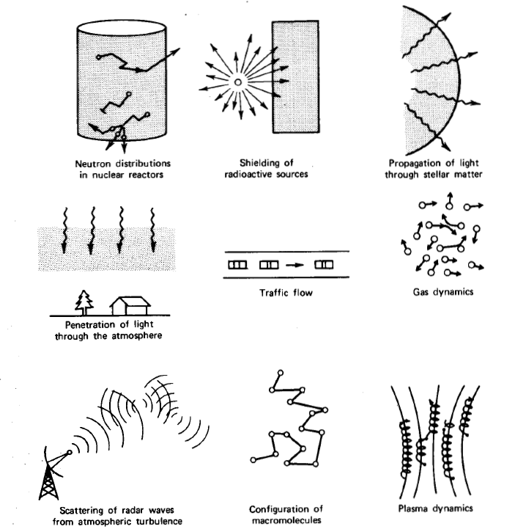
Examples of Transport Processes

Slide 4


Diffusion Approximation Modeling Transport
Diffusion Equation:
How is this equation is derived?
What are the physical assumptions? Limitations?
What is D?

Slide 5
Assumption 1
Collisions considered separately from ballistic
motion between collisions
+ classical particle description between
collisions
+ quantum mechanical description at collision
(origin of nuclear data)
Assumption 2
Duration and spatial extent of collision neglected
Assumption 3
Neutron-neutron collisions neglected

Slide 6
Independent Variables
Ω
r
Total of 4π steradians
Configuration coordinates Velocity coordinates
r is the neutron position
Ω is the neutron direction
= independent variables
Neutron
Mass
Equivalence:

Slide 7
r
Direction vector
differential solid angle (sr)
O

Slide 8
Dependent Variables
P defines the neutron phase space with a differential
volume element
O
Phase space volume element

Slide 9
Assumption 4
Sufficiently large neutron population such that
statistical averaging over the phase space
volume element makes physical/mathematical
sense
+ i.e., Expectation value or mean of a population has
physical/mathematical meaning
+ Must integrate over a large enough phase space
or over a sufficiently large duration

Slide 10
Abstract phase space volume element
is the number of neutrons per phase
element [n/cm³-sr-MeV]
Number of neutrons in ΔP
+ Dependent variable based on phase
space volume element

Slide 11
HEURISTIC DERIVATION
Consider volume Δr after Δt
Neutrons passing through A move into Δr during Δt
≡
Number of neutrons passing through A
(of ) during Δt and which are in
Angular current vector
+ Dependent variable based on physical
phase space area
11

Slide 12
Rate of neutrons passing through per area
oriented in direction per MeV-sr-cm²
Angular flux

Slide 13
Total track length/s of all
neutrons in
Notation:
Scalar flux

Slide 14
Distribution Function
Transformation of a distribution:
From:
is a physical quantity based
on the phase space element
of
To:
is a physical quantity related
to the phase space element
of

Slide 15
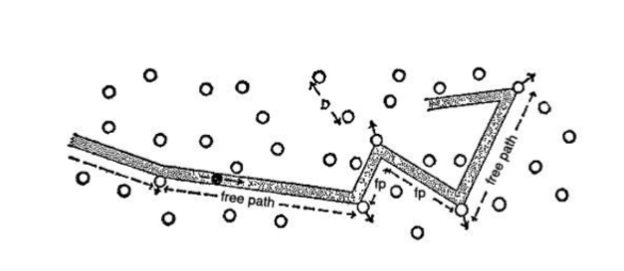

Nuclear Data
Macroscopic Cross Sections
Fractional probability of independent neutron
interactions i with nuclide j per path length of travel
Reaction rate for interaction i with nuclide j
Note: Gives the connection between point-particle physics
and continuum physics
Total cross section:

Slide 16



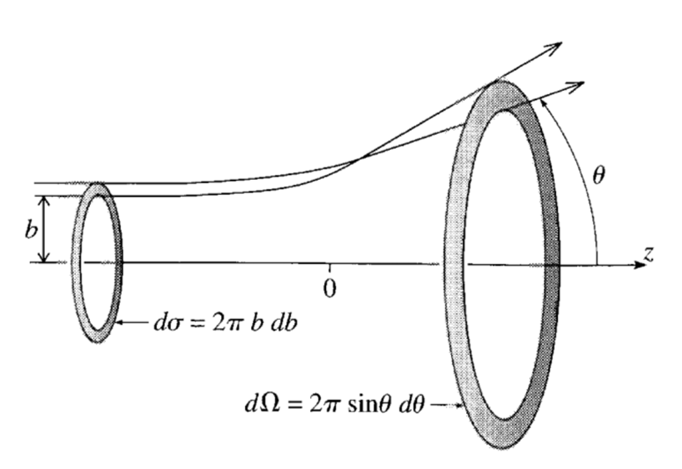
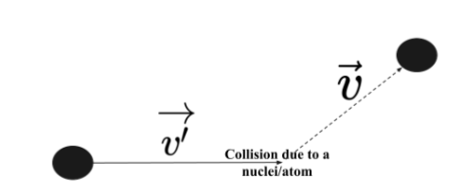
Nuclear Data - Cross Sections

Slide 17



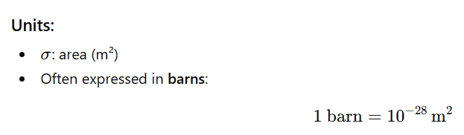



Nuclear Data - Cross Sections
Integral (microscopic) cross-section

Slide 18
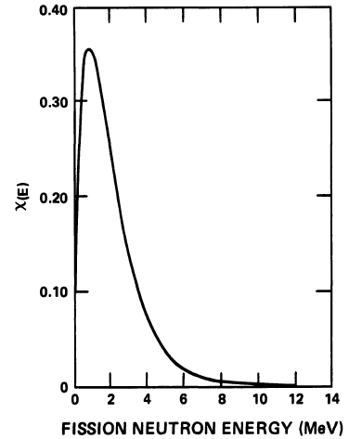
Scattering Law
Fractional probability of scattering from direction
and energy to direction range and
energy range
(differential scattering law)
Assume rotational invariance
isotropic emission on fission
Fission Law
Fractional probability of a fission neutron isotropically
appearing in the direction range and energy
range

Slide 19
Contributions to the Total Neutron Balance
during Δt
Medium in and
absorbing environment
V
For a fixed :
Number in
at
Number in
at
+
=
Number gained in
during
Number lost in
during
−
+

Slide 20
Number in
at
=
Number in
at
=
Note: dr = d(volume) = dV

Slide 21
Number scattering from any
Probability of these reaching
Number gained in from scattering during
=

Slide 22
Number of fission neutrons at any
average number of neutrons per fission
Probability of these appearing in
Number gained in from fission during
=
Assume no delayed neutrons at this point

Slide 23
Number lost through absorption
in during
Can show that:
Number scattering out of
1

Slide 24
V
Number lost through surface dA of V
Number lost through entire surface
of during
=
Note application of the divergence theorem

Slide 25
Neutron balance equation in V as
Re-definition of data

Slide 26
Gives the time dependent neutron transport equation (NTE)
without delayed neutrons
Include external source

Slide 27
Summary:
+ Neutron transport equation is a balance of number of
neutrons in a phase element
+ Natural separation of straight-line neutron motion and
interaction physics (Xsecs, Σ_{s,c,f,t})
+ Neutron angular flux (volume dependent variable) gives neutron
density and is the
neutron tracklength/s in
+ Neutron angular current (surface
dependent variable) giving # neutrons/s passing through an
area dA with unit normal n as
+ Σ represents the probability of interaction per neutron tracklength
and is rate of interactions in dP

Slide 28
Summary(con’t)
Neutron balance gives time dependent neutron transport equation
(NTE) without delayed neutrons (only prompt neutrons)
Change of neutron population in time
Gain from scattering
Streaming in space (straight-line motion)
Gain from fission
Loss from scattering and absorption
Gain from external source

Slide 29
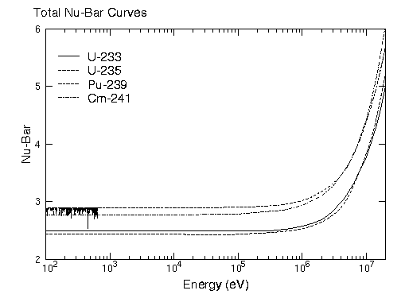
A word on ν
+ ν represents the average number of neutrons per fission
- Prompt neutrons appear within 10⁻¹⁹ s of the fission
- Delayed neutrons within seconds to minutes of fission
+ Not an integer since fission can produce any two or three from
about 200 isotopes giving zero to 3 or more neutrons per fission
- ν is a weighted average over the possible fission fragment
configurations

Slide 30
Some discussion:
+ When solved have the neutron angular density in the form of the flux
and rates of reactions over all neutron directions
fissions/s-Mev-cm³
Scatterings/s-Mev-cm³
Absorptions/s-Mev-cm³
+ Regional heating rates

Slide 31
Additional discussion:
+ Stationary NTE is an integro-differential equation
+ Requires boundary conditions (and initial condition)
+ NTE -- 6-dimensions (plus time)
+ Full (general) 3D time dependent analytical/numerical
solutions for reactor configurations do not currently exist
+ 1D analytical solutions do exist
+ 2/3D numerical solutions stretch today’s computational
resources
+ Infinite medium 3D analytical solutions do exist

Slide 32
+ Further considerations
Called a fixed source transport eqn
- External source is present
- System is subcritical

Slide 33
Called a “critical” transport eqn
- No external source is present
- System is homogeneous
- k_{eff} is the first eigenvalue (gives a positive flux)
- If k_{eff} = 1 then system is actually critical (self-sustaining)
- If k_{eff} > 1 the system made stationary by external means

Slide 34
HEURISTIC DERIVATION
+ TE in E becomes for all prompt neutrons

Slide 35
HEURISTIC DERIVATION
+ TE in V and neutron density becomes
Note

Slide 36
HEURISTIC DERIVATION
- Note
- Multiply by
- On substitution

Slide 37
HEURISTIC DERIVATION
- On cancellation
Now TE in terms of neutron density

