Slide 1
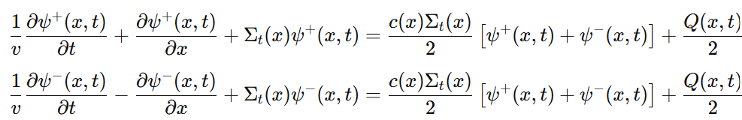





1D Cartesian Boltzmann Equation - Exact
The albedo - mean number of secondary particles - no fission = scattering ratio
The albedo - mean number of secondary particles - with fission
Scalar flux and current:

Slide 2
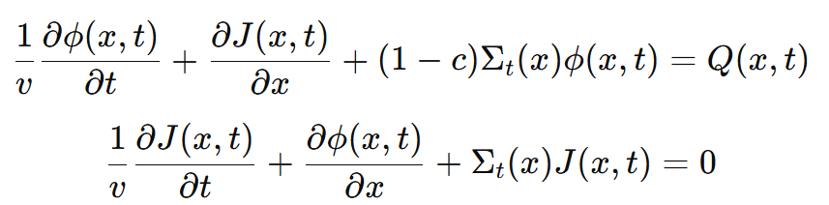
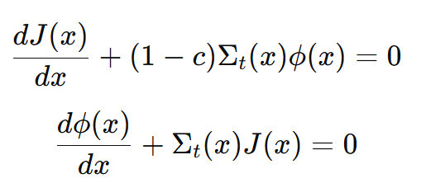
1D Cartesian Boltzmann Equation - Exact
Summing and subtracting the tow equation yields:
Time-independent version:

Slide 3
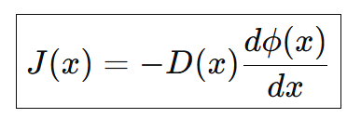
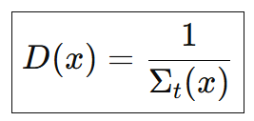
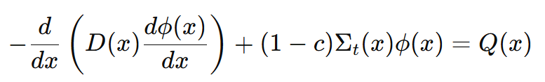
1D Cartesian Boltzmann Equation – Time-independent = Diffusion Equation
Fick’s law:
Diffusion coefficient:
Diffusion equation (with absorbing term) – “reaction-diffusion”:

Slide 4
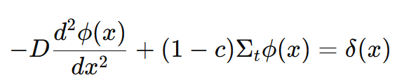
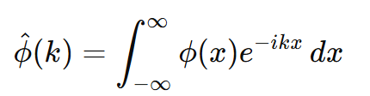
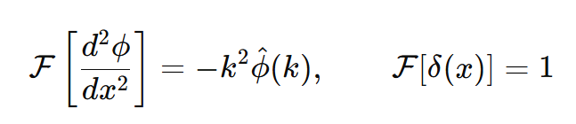
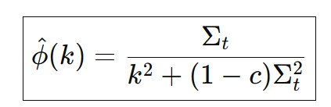
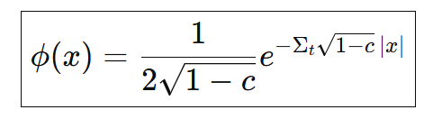
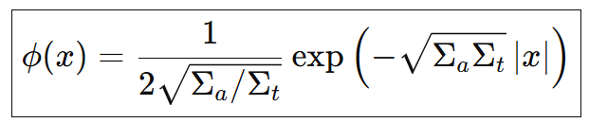
1D Diffusion Equation – Green function
Fourier transform:
Second derivative Fourier transform:
Algebraic Solution in Fourier domain:
Applying inverse Fourier transform:
=

Slide 5
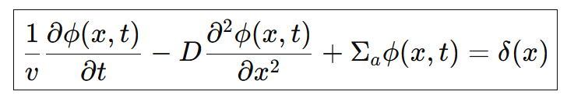
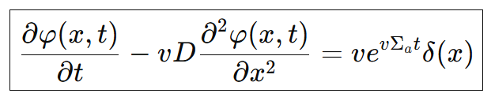

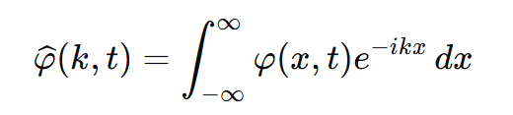
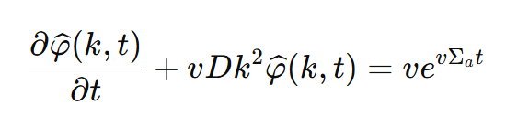
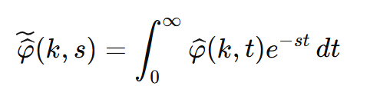
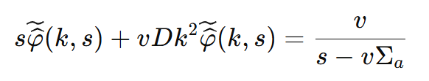
Diffusion Approximation Time-dependent
Parabolic equation – breaks causality
Convenient transformation:
yields:
Fourier transform in space:
yields:
Laplace transform in time:
yields:

Slide 6
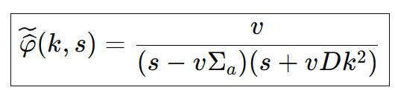
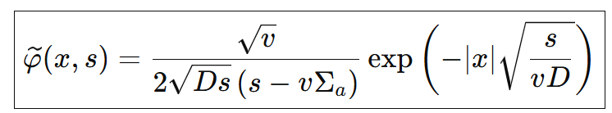
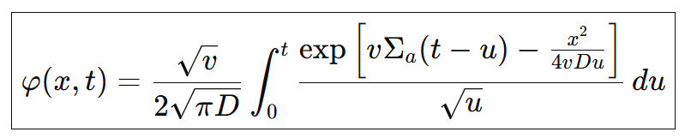
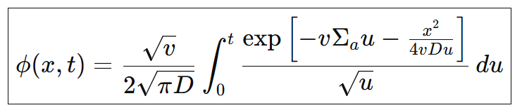

Diffusion Approximation Time-dependent
Algebraic Solution in Fourier-Laplace domain:
Applying inverse Fourier transform:
Applying inverse Laplace transform:
“Inverse Convenient transformation”:

Slide 7

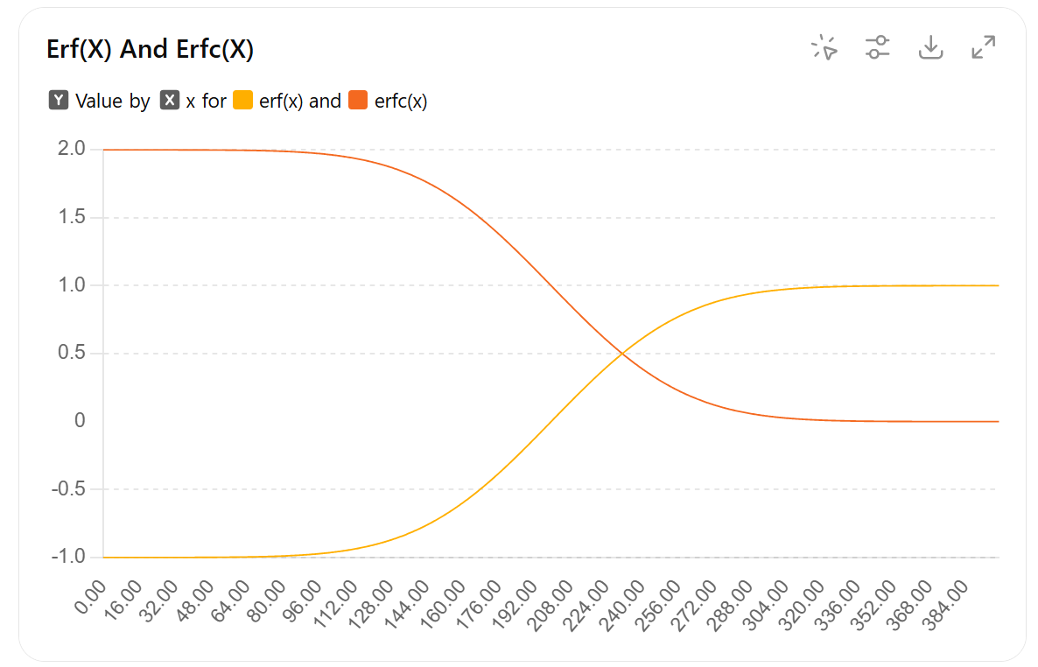
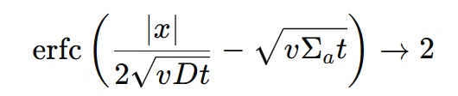
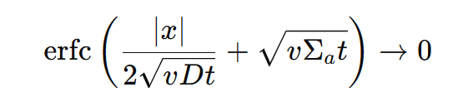
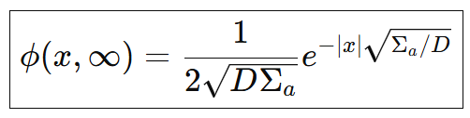
Diffusion Approximation Time-dependent
breaks causality
Long times limit yields the familiar expression

Slide 8
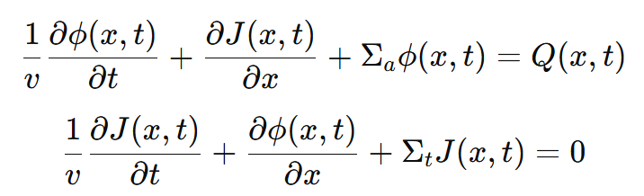
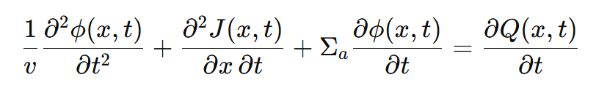
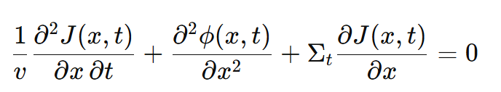
1D Cartesian Boltzmann Equation - Exact
Returning to the time-dependent exact (non-diffusive) homogeneous-medium equations:
Derive the first equation with respect to time and second with respect to space yields:

Slide 9
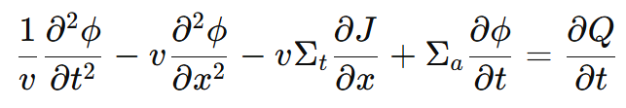
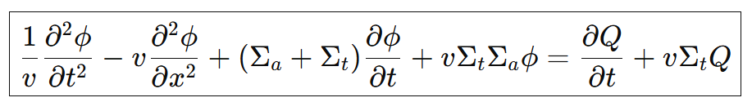
1D Cartesian Boltzmann Equation - Exact
Subtracting the tow equation yields:
Using the first equation again yields a
Telegrapher’s-like equation (wave + diffusion):
Hyperbolic equation – doesn’t breaks causality

Slide 10
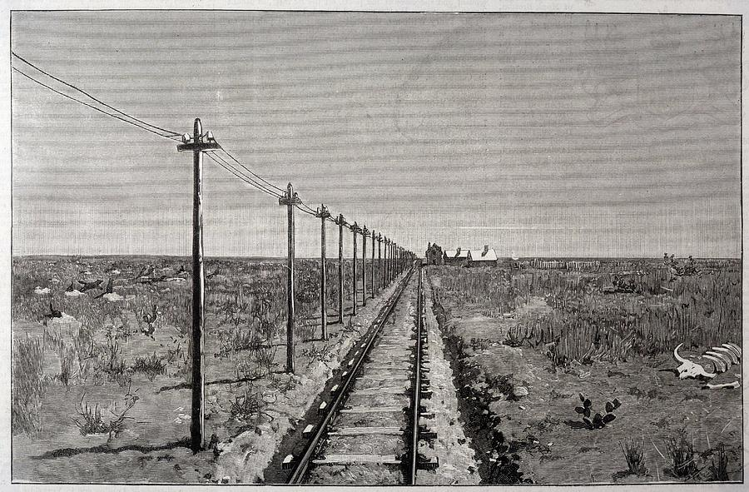
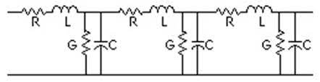
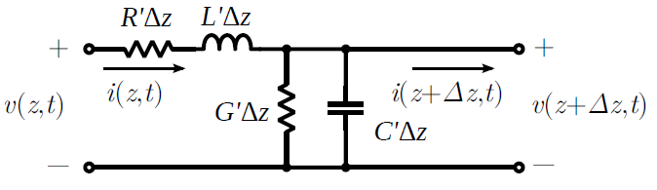

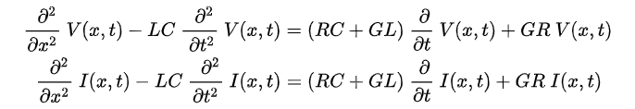
The Telegrapher’s Equation
The Kirchhoff model of Telegraph line:
“P₁ equations”
Telegrapher’s equation

Slide 11

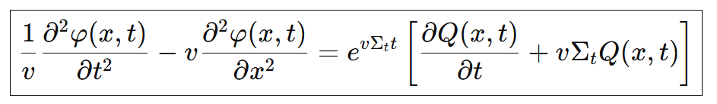
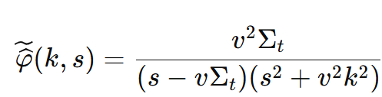
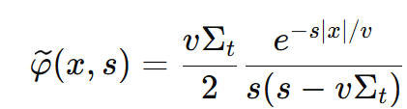
The Telegrapher’s Equation – Purely absorbing media Green function
Convenient transformation:
Yields inhomogeneous wave-equation:
Algebraic Solution in Fourier-Laplace domain:
Applying inverse Fourier transform:

Slide 12
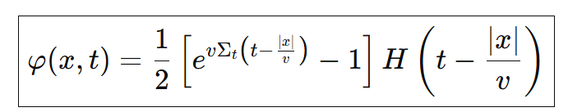
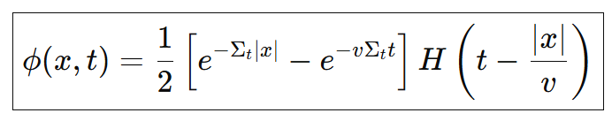
The Telegrapher’s Equation – Purely absorbing media Green function
Applying inverse Laplace transform:
“Inverse Convenient transformation”:

Slide 13
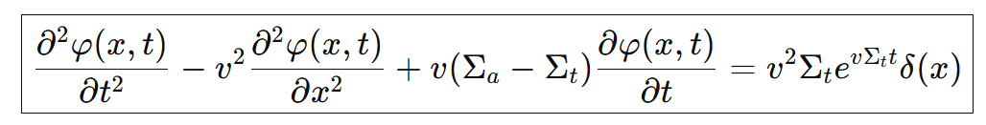
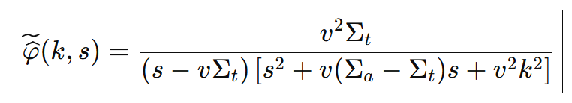
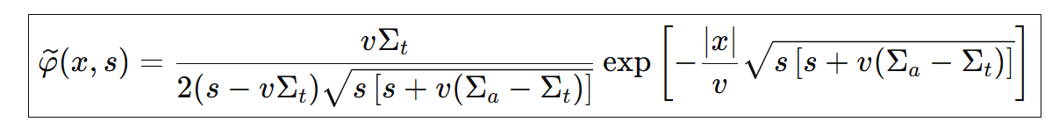
The Telegrapher’s Equation – General media Green function
Convenient transformation:
yields:
Algebraic Solution in Fourier-Laplace domain:
Applying inverse Fourier transform:

Slide 14
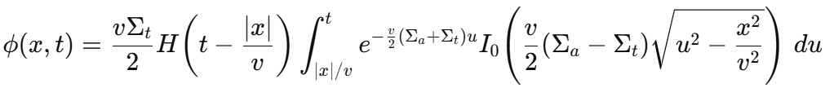

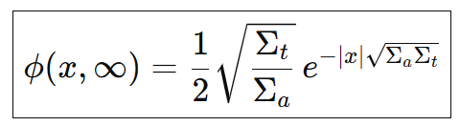
The Telegrapher’s Equation – General media Green function
Applying inverse Laplace transform:
“Inverse Convenient transformation”:
Using
Long times limit yields the familiar expression

Slide 15


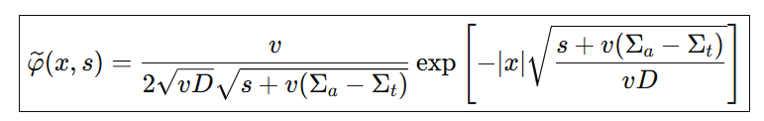
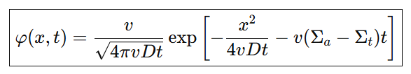
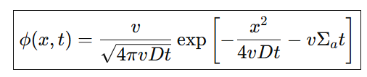
Diffusion Approximation – Full Green function
Convenient transformation:
Algebraic Solution in Fourier-Laplace domain:
Applying inverse Fourier transform:
Applying inverse Laplace transform:
“Inverse Convenient transformation”:

Slide 16
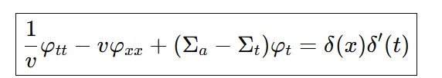
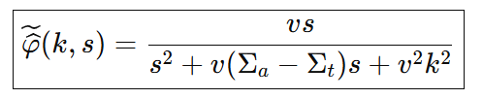

Telegrapher’s Equation – Full Green function
Convenient transformation:
yields:
Algebraic Solution in Fourier-Laplace domain:
Applying inverse Fourier transform:

Slide 17
Telegrapher’s Equation – Full Green function
Applying inverse Laplace transform:
“Inverse Convenient transformation”:

Slide 18



Full 1D Transport Problem
In the Green function problem, ‡:
Using asymptotic expressions for the modified-Bessel functions:
Yields the diffusion solution at late times, far from the ballistic tail at .
‡ S. Goldstein, Quarterly J. Mech. Appl. Math., 4, 129, 1951.

Slide 19



Full 1D Transport Problem
At early times, the parabolic diffusion “breaks causality”, propagating faster then the speed of the particles.
Full P₁, or Telegrapher’s equation solution has a knee-sharp solution near .
The asymptotic expansion yields good approximation for and excellent for .

