Slide 1
REMINDER WEBSITE
Tariq Alshamary - 24825454
Team name: The elite six
Team Leader: Tariq Alshamary - 24825454
Quality Controller: Adam Emam - 25898823
Product Owner: Tala Alzoabi - 24817396
Team member: Rizwan Baig - 24809749
Team member: Abdullah Ramzan - 24769334
Team member: Mohammed Danish - 24815446
The Vision: A central information system that connects and helps academic requirements with student wellbeing.
Presentation Goal: To show how a digital workspace can help students keep track of key dates, improve focus, success and support university lie.

Slide 2
AIMS OF REMINDER WEBSITE
Rizwan Baig
Team Roles
Help students manage their time better
Allow students to set reminders for assignments,deadlines and events
To help students stay organised with a simple calender system
To reduce stress by helping students keep track of important tasks and events
To help students balance study time and social acitivites
Team leader – Tariq Alshamary - Organised team meetings and managed sprint retrospectives ​
Team Members – Rizwan Baig, Abdullah Ramzan, Mohammad Danish - Contributed to design, research and development of the project​
Product Owner – Tala Alzoabi - Defined project requirements and prioritised features​
Quality Controller – Adam Emam - Reviewed work and ensured quality and testing​
Roles helped us stay organised, share responsibility and work efficiently as a team

Slide 3
Problem Domain: Current University system
Tala Alzoabi
Missed deadlines and opportunities
Poor time management and organisation
Student stress and lack of confidence leading to low engagement with university activities
Students unaware of events and support
Students using insecure third-party apps to track university schedules and personal data

Slide 4

The impact of the problem
Tariq Alshamary - 24825454
Academic Impact: Missing deadlines can result in capped marks, late penalties and in some cases, students withdrawing from their courses.
Missed Opportunities: Students May also miss internships, networking events and social activities that are important for career development and wellbeing.
Information Overload: First year and international students often face information overload with important updates which spread across emails, portals and different platforms.
Security Risk: Many Students turn to unverified third-party apps to track deadlines which could expose their MMU credentials and personal data to security risks.

Slide 5
Team Approach
Rizwan Baig
Solution: A web-based Student Planner which allows students to create accounts and manage academic tasks
This design will improve organisation and productivity by structuring time views( daily, weekly, monthly, yearly).
How Our Solution Addresses the problem?
Helps students track deadlines in one place
Improves time management and organisation
Reduces missed deadlines and confusion
Flexible viewing options (day, week, month, year)
Provides a clear and structure overview of tasks
Keeps student data within a trusted platform instead of insecure third-party apps

Slide 6
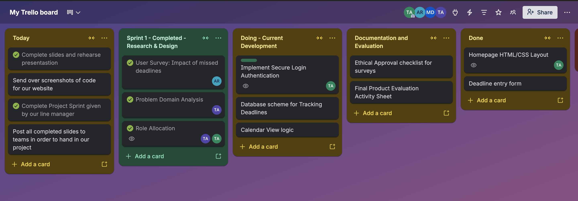
Team Activity and Working process
Tala alzoabi
Green to highlight we have completed this taskboard
Held weekly meetings to track progress and plan next steps
Task were divided based on individual strengths and roles
Used group chats for better communication
Used Trello board to organise tasks and track the process
Used GitHub to manage and share code collaboratively
Yellow to highlight high priority to the team
Assigned Initial next to individual tasks to help create sense of urgency for each individual

Slide 7

User Testing And Results
Abdullah Ramzan
Abdullah Ramzan
We surveyed students to understand whether a planner would help them manage deadlines and reduce their stress
These results show a clear demand for a centralised system to help students manage deadlines and stay organised.

Slide 8
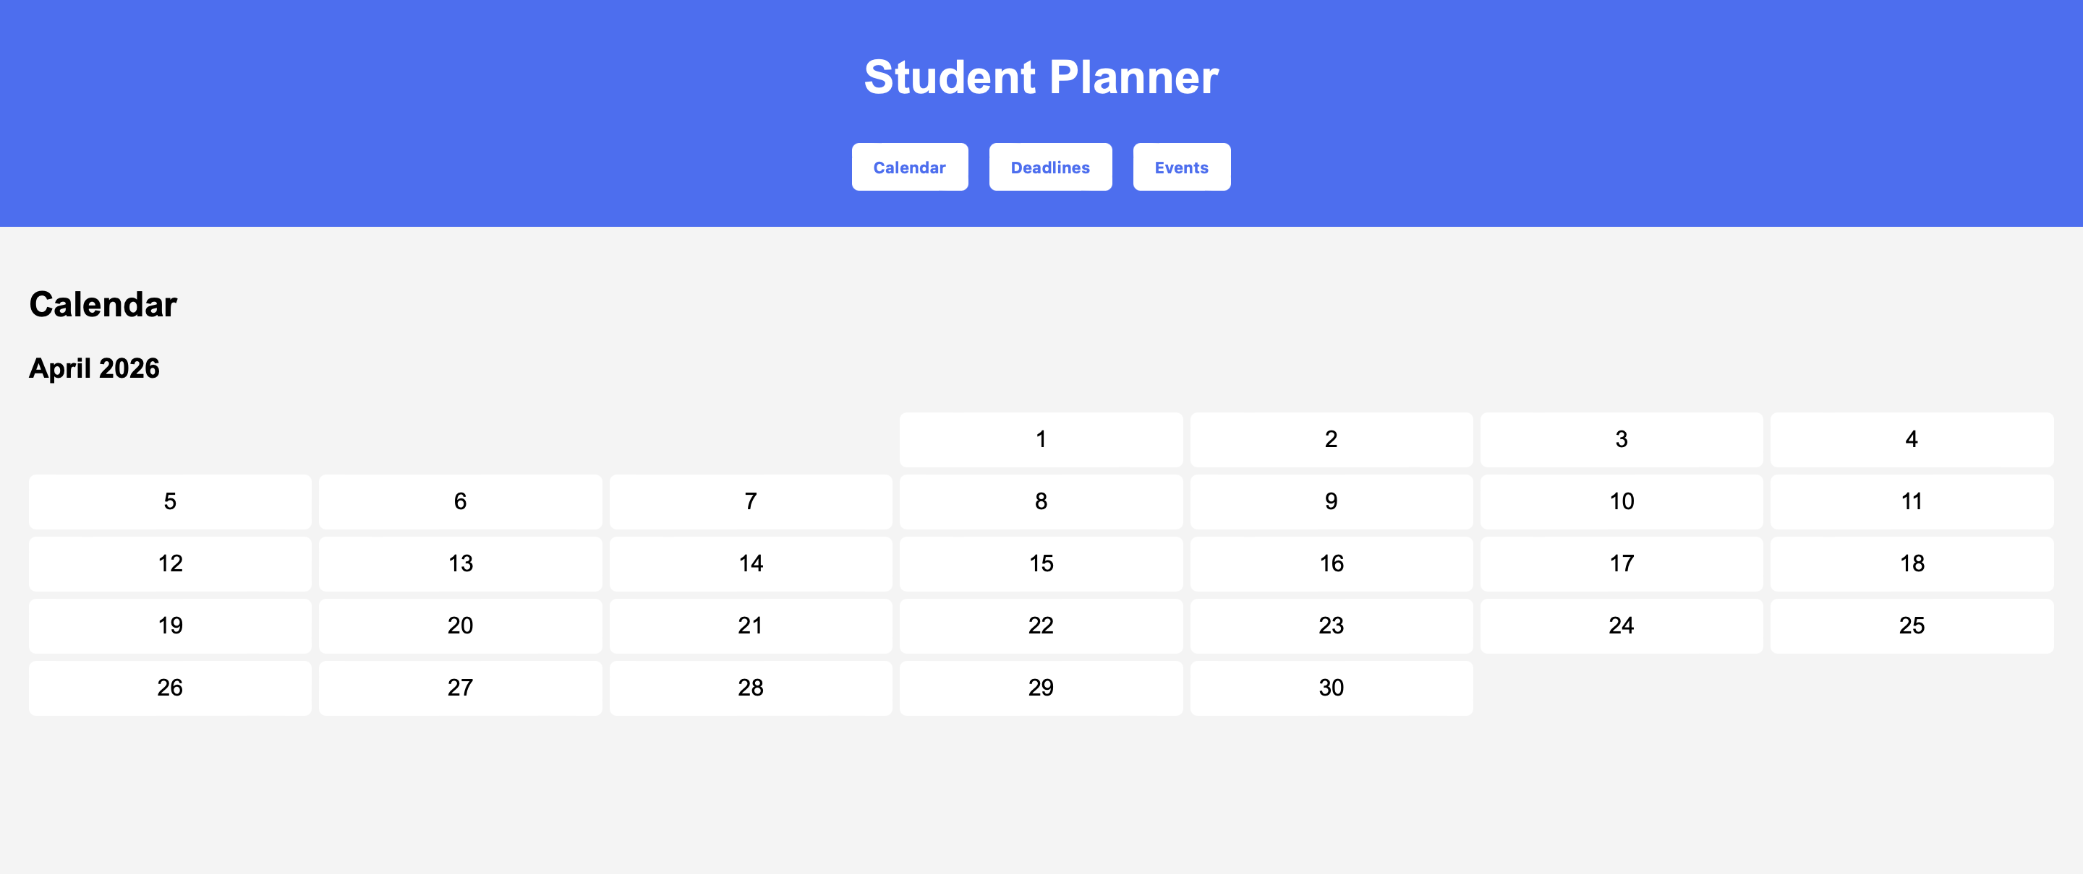
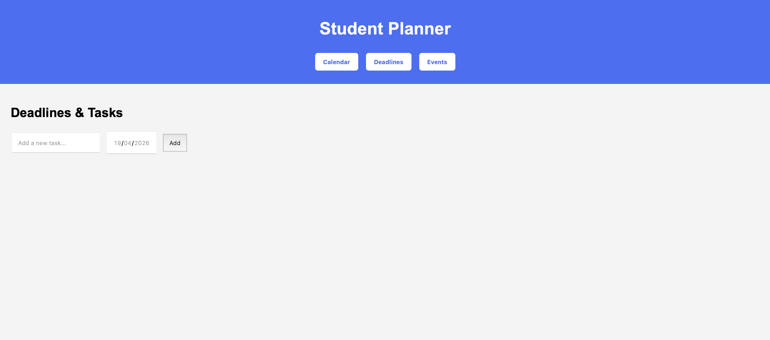
Project Implementation
Abdullah Ramzan
Event button for student wellbeing
Inputting deadlines and/or tasks
Calender to help show if students have deadlines due

Slide 9

Evaluation
Mohammad Danish
Benefits
Fewer missed deadlines → improved academic performance
Reduced stress from forgetting important tasks
Clear and organised calendar interface
Helps students stay focused and manage time effectively
Limitations
Students may become dependent on the system
Too many reminders could lead to notification fatigue
Requires internet access
Task may be added and not completed

Slide 10
What we learnt & Improvements
What we
learnt
Adam Emam
What we learnt:
Clear communication is essential for effective teamwork
Importance of managing time and meeting deadlines as a group
Adapting to challenges
Working with different ideas and perspectives
Collaborating improves the overall quality of the project
How we could improve:
Improve the communication consistency across the team
Plan the workload more evenly between team members
Improve individual time management on assigned tasks
Communicate earlier when an issue arises
Although we worked well as a team, we recognised that improving communication and time management would make us even more efficient in future projects

Slide 11
Conclusion
Mohammad Danish
What we delivered 🚚
A well-rounded planner that helps with academics while considering students' well-being
No more missed deadlines, student anxiety, and messy schedules
A data-safe platform for students to use and an alternative to unverified third-party apps/websites
Track tasks daily, weekly, monthly, or yearly
Future Work 🎯
Using the help of AI to suggest study plans based on deadlines
Track students' well-being based on their workload schedule
Utilise an achievement system which will help students stay motivated and on track

Slide 12

Thank you for your time
Adam Emam

