Slide 1
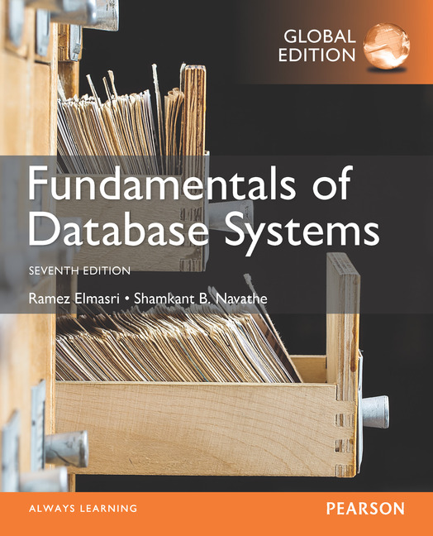

Slide 2
CHAPTER 27
Enhanced Data Models:
Introduction to Active,
Temporal, Spatial, Multimedia,
and Deductive Databases

Slide 3
26.1 Active Database Concepts and Triggers
An active Database is a database consisting of a set of triggers.
Database systems implement rules that specify actions automatically triggered by certain events
Triggers
Technique for specifying certain types of active rules
A database trigger is procedural code that is automatically executed in response to certain events on a particular table or view in a database. The trigger is mostly used for maintaining the integrity of the information on the database.
Commercial relational DBMSs have various versions of triggers available
Oracle syntax used to illustrate concepts

Slide 4
Active Database Concepts and Triggers
Types of SQL Triggers
DDL Triggers. The Data Definition Language (DDL) command events such as Create_table,
DML Triggers. DML triggers fire when we manipulate data with commands like INSERT , UPDATE , or DELETE . ...
DCL , DQL and TCL .

Slide 5
Active Database Concepts and Triggers
What is the difference between a constraint and a trigger?
Constraints in SQL define rules for data integrity (e.g., foreign keys, unique values) at the table level, preventing invalid data entry. Triggers, however, are specialized procedures that automatically execute in response to specific data modification events (e.g., INSERT, UPDATE, DELETE).

Slide 6
Generalized Model for Active Databases and Oracle Triggers
Event-condition-action (ECA) model
Event triggers a rule
Usually database update operations
Condition determines whether rule action should be completed
Optional
Action will complete only if condition evaluates to true
Action to be taken
Sequence of SQL statements, transaction, or external program

Slide 7
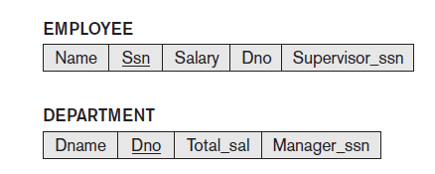
Example
Events that may cause a change in value of Total_sal attribute
Inserting new employee
Changing salary
Reassigning or deleting employees
Figure 26.1 A simplified COMPANY database used for active rule examples

Slide 8
Example (cont’d.)
Action to be taken
Automatically update the value of Total_sal

Slide 9
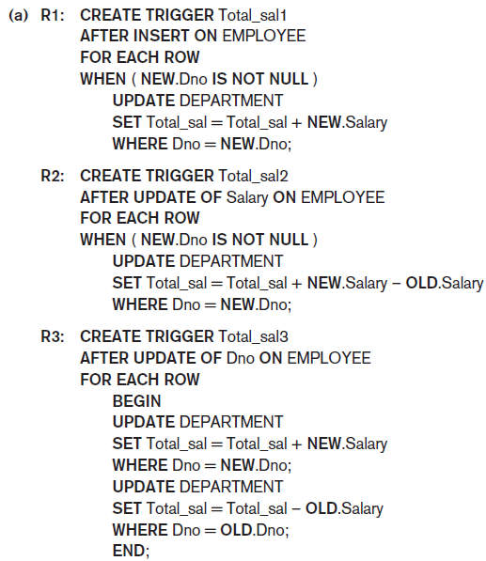
Figure 26.2 Specifying active rules as triggers in Oracle notation (a) Triggers for automatically maintaining the consistency of Total_sal of DEPARTMENT

Slide 10
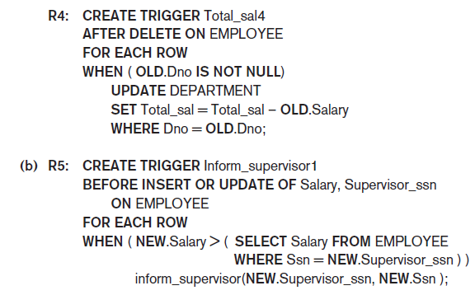
Figure 26.2 (cont’d.) Specifying active rules as triggers in Oracle notation (b) Trigger for comparing an employee’s salary with that of his or her supervisor

Slide 11
Design and Implementation Issues for Active Databases
Deactivated rule
Will not be triggered by the triggering event
Activate command
Makes the rule active again
Drop command
Deletes the rule from the system
Approach: group rules into rule sets
Entire rule set can be activated, deactivated, or dropped

Slide 12
Design and Implementation Issues for Active Databases (cont’d.)
Timing of action
Before trigger executes trigger before executing event that caused the trigger
After trigger executes trigger after executing the event
Instead of trigger executes trigger instead of executing the event
Action can be considered separate transaction
Or part of same transaction that triggered the rule

Slide 13
Design and Implementation Issues for Active Databases (cont’d.)
Rule consideration
Immediate consideration
Condition evaluated as part of same transaction
Evaluate condition either before, after, or instead of executing the triggering event
Deferred consideration
Condition evaluated at the end of the transaction
Detached consideration
Condition evaluated as a separate transaction

Slide 14
Design and Implementation Issues for Active Databases (cont’d.)
Row-level rule
Rule considered separately for each row
Statement-level rule
Rule considered once for entire statement

Slide 15
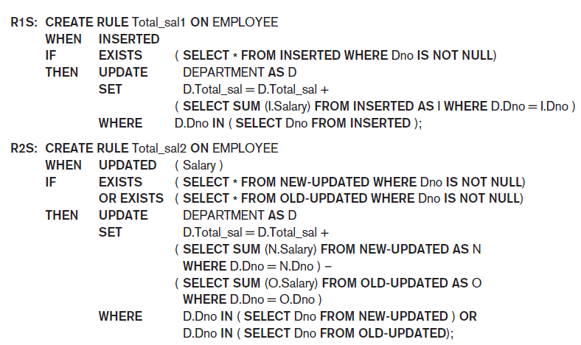
Examples of Statement-Level Active Rules in STARBURST
Figure 26.5 (continues) Active rules using statement-level semantics in STARBURST notation

Slide 16
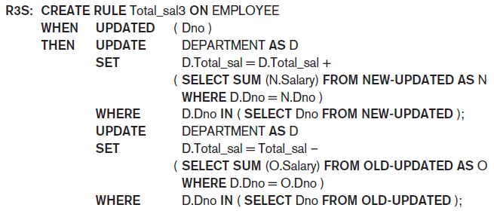
Examples of Statement-Level Active Rules in STARBURST (cont’d.)
Figure 26.5 (cont’d.) Active rules using statement-level semantics in STARBURST notation

Slide 17
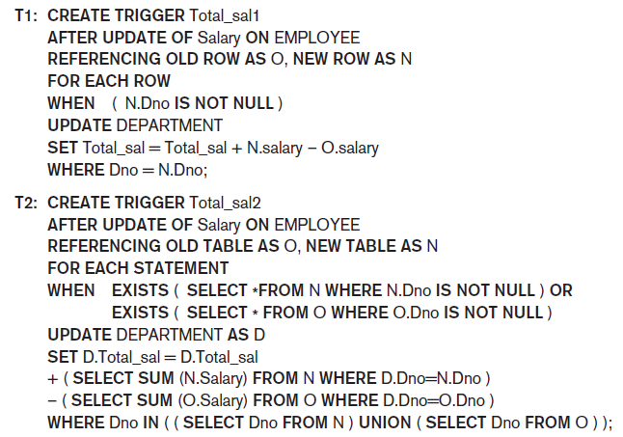
Triggers in SQL-99
Figure 26.6 Trigger T1 illustrating the syntax for defining triggers in SQL-99

Slide 18
Temporal Database Concepts
Chronon
Term used to describe minimal granularity of a particular application
Reference point for measuring specific time events
Various calendars

Slide 19
Temporal Database Concepts
Temporal databases require some aspect of time when organizing information
A temporal database is a database that needs some aspect of time for the organization of information.
In the temporal database, each tuple in relation is associated with time. It stores information about the states of the real world and time

Slide 20
Applications of Temporal Databases
Finance: It is used to maintain the stock price histories.
It can be used in Factory Monitoring System for storing information about current and past readings of sensors in the factory.
Healthcare: The histories of the patient need to be maintained for giving the right treatment.
Banking: For maintaining the credit histories of the user.

Slide 21
There are various terminologies in the temporal database:
Valid Time: The valid time is a time in which the facts are true with respect to the real world.
Example: If a person was born on January 1, 1990, and the record states that they are 33 years old as of August 15, 2023, the valid time for that age is from January 1, 2023, to December 31, 2023.

Slide 22
Transaction Time: The transaction time of the database is the time at which the fact is currently present in the database.
Example: If the age of the person was updated in the database on August 1, 2023, the transaction time for that record would start from August 1, 2023, and continue until the record is deleted or modified again.

Slide 23
Key Differences
Perspective: Valid time focuses on the real-world applicability of the data, while transaction time focuses on the history of the data within the database.
Usage: Valid time is useful for applications that need to track the real-world state of entities, A single unique object in the real world that is being mastered. Examples of an entity are a single person, single product, or single organization. Entity type. A person, organization, object type, or concept about which information is stored whereas transaction time is important for auditing and versioning within the database.

Slide 24
Decision Time: Decision time in the temporal database is the time at which the decision is made about the fact.
A company reviews sales data every Monday to decide on weekly promotions.
On May 6, 2025, they review the data and decide to discount Product X.
The decision time is May 6, 2025, even though the data used might be from May 5 or earlier.

Slide 25
Temporal databases use a relational database for support. But relational databases have some problems in temporal database, i.e. it does not provide support for complex operations. Query operations also provide poor support for performing temporal queries.

Slide 26
Temporal Relation
A temporal relation is defined as a relation in which each tuple in a table of the database is associated with time, the time can be either transaction time or valid time.

Slide 27
Types of Temporal Relation
There are mainly three types of temporal relations:
1. Uni-Temporal Relation: The relation which is associated with valid or transaction time is called Uni-Temporal relation. It is related to only one time.

Slide 28
2. Bi-Temporal Relation: The relation which is associated with both valid time and transaction time is called a Bi-Temporal relation. Valid time has two parts namely start time and end time, similar in the case of transaction time.
3. Tri-Temporal Relation: The relation which is associated with three aspects of time namely Valid time, Transaction time, and Decision time called as Tri-Temporal relation.

Slide 29
Features of Temporal Databases
The temporal database provides built-in support for the time dimension.
Temporal database stores data related to the time aspects.
A temporal database contains Historical data instead of current data.
It provides a uniform way to deal with historical data.

Slide 30
Challenges of Temporal Databases
Data Storage: In temporal databases, each version of the data needs to be stored separately. As a result, storing the data in temporal databases requires more storage as compared to storing data in non-temporal databases.

Slide 31
Schema Design: The temporal database schema must accommodate the time dimension. Creating such a schema is more difficult than creating a schema for non-temporal databases.
Query Processing: Processing the query in temporal databases is slower than processing the query in non-temporal databases due to the additional complexity of managing temporal data.

Slide 32
Spatial Database Concepts
Spatial databases support information about objects in multidimensional space
Examples: cartographic databases, geographic information systems, weather information databases
Spatial relationships among the objects are important
Optimized to query data such as points, lines, and polygons
Spatial queries

Slide 33
A spatial query is a special type of database query supported by geodatabases and spatial databases. • It allows for the use of geometry data types such as points, lines and polygons and that these queries consider the spatial relationship between these geometries.

Slide 34
Introduction
The section major functionality extension in a spatial database is the addition of spatial capabilities to the query language (e.g., ); these give the spatial database the same that are available in traditional GIS software. In most relational database management systems, this functionality is implemented as a set of new functions that can be used in SQL SELECT statements. Several types of operations are specified by the standard:

Slide 35
Spatial Database Concepts (cont’d.)
Spatial queries
Range queries
Example: find all hospitals with the Metropolitan Atlanta city area
Nearest neighbor queries
Example: find police car nearest location of a crime
Spatial joins or overlays
Example: find all homes within two miles of a lake

Slide 36
Spatial Database Concepts (cont’d.)
Spatial data mining techniques :
Spatial Data Mining Techniques are specialized methods used to extract useful patterns, relationships, and knowledge from spatial data—data that has a geographical or location-based component. Here's an explanation of the three main techniques listed in your image:
Spatial classification
Spatial association
Spatial clustering

Slide 37
1. Spatial Classification
Definition: Assigns spatial objects to predefined categories or classes based on both their attributes and spatial relationships.
Example: Classifying regions of a satellite image into categories like urban, forest, or water based on pixel values and surrounding land use patterns.

Slide 38
Applications:
Land cover mapping
Predicting disease outbreaks by region
Zoning in urban planning

Slide 39
2. Spatial Association
Definition: Identifies rules or patterns that describe relationships between spatial features.
Example: Discovering that areas with high rainfall are often associated with dense vegetation.

Slide 40
Applications:
Market basket analysis with geographic context (e.g., customers in coastal areas often buy sunscreen)
Environmental pattern discovery

Slide 41
3. Spatial Clustering
Definition: Groups similar spatial objects based on location and attribute similarity without predefined labels.
Example: Clustering crime locations to identify hotspots.

Slide 42
Applications:
Urban development and planning
Identifying areas of similar soil types
Wildlife habitat identification

