Slide 1



Cause And Effect FDR
By:
Keith Adler
Matthew Brannick
Tomin Kozhimala
William Vennes

Slide 2
Summary
Problem:
Users not taking advantage of functionality on their phones.
Android Application
Create Rules
Cause Triggers
Effect Actions

Slide 3
User Needs
Simple and effective UI
Rules Engine
Compatible with all devices and tablets
Extensible to third parties
Rules need to be sharable
Must include Wi-Fi and location based rules

Slide 4
Current Backend Structure
GUI
Database
Broadcast Receiver
Rules Engine
Action Executer
Application Service

Slide 5
Screen Flow Diagram
GUI
DB
Menu
BR
RE
AE
My Rules
Help
Share
Settings
Edit Rule
NFC
General
Edit Cause
Security
Edit Effect
About

Slide 6
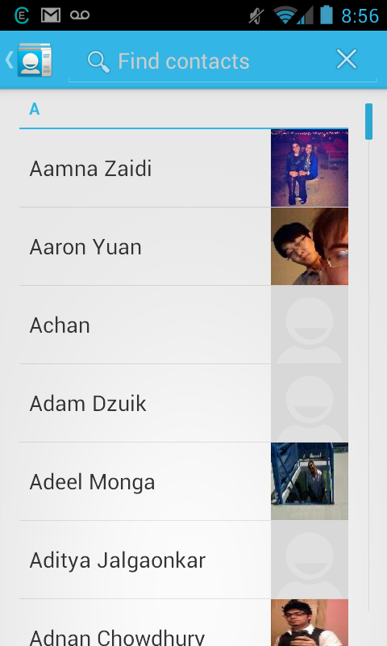
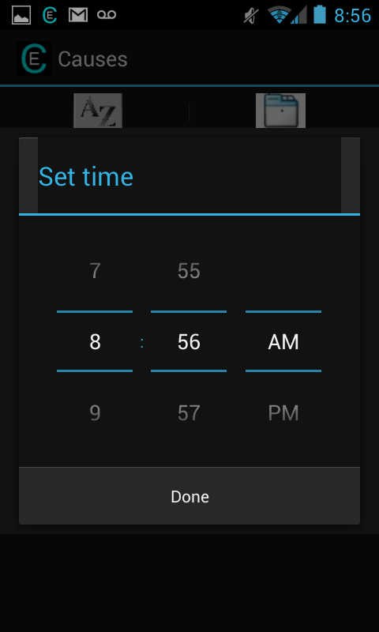
Editing Causes and Effects
GUI
DB
New activity:
More full experience
Can be distracting or confusing and sever the flow
Stack does not create new instance for existing activity
Pop-up:
Allows for brief, less distracting experience
Only for quick actions
May not always be an option
BR
RE
AE
Notes:
Pros, cons, screenshots of popup and activity approaches, etc

Slide 7
Database
GUI
DB
SQLite
5 Tables: Rules, rCauses,
Causes, rEffects, Effects
Purpose is to hold all of the information that the android is not currently using.
Must return quickly with necessary data and be small enough on the phone to conserve space.
BR
RE
AE

Slide 8
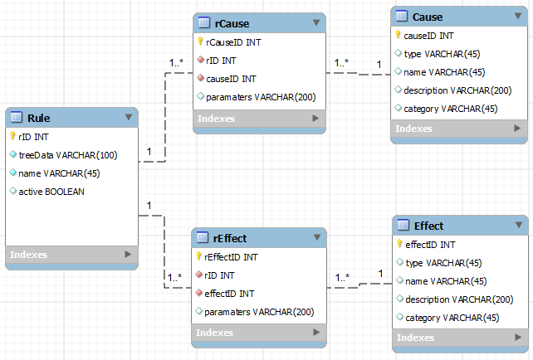
Database (cont.)
GUI
DB
BR
RE
AE

Slide 9
Application Service
GUI
DB
Backend as a separate service
Data retention
Smooth cause evaluation
Separates background processes from the main UI process
BR
RE
AE
Service

Slide 10
Broadcast Receiver
GUI
DB
Registered on the service
Receives messages
Android OS
External Services
Lightweight
BR
RE
AE

Slide 11
Rules Engine
GUI
DB
Called by the broadcast receiver
Purpose is to request rules
from database related to
trigger and evaluate whether
the rule is active or not.
Each cause associated with a rule has its own “isTrue” method which returns whether the cause is currently true or not.
Rule evaluation utilizes Android AsyncTask.
If rule is true, send an effects list to Action Executer object.
BR
RE
AE

Slide 12
Rules Engine – Causes
GUI
DB
Stored in the database
Each rule has unique causes
associated with them.
Rules engine makes calls to the database to receive causes and to build a cause tree for evaluation.
BR
RE
AE

Slide 13
Rules Engine – Cause Trees
RETURN
GUI
DB
(1234 & 1551) + (1656 & 1847)
OR
BR
RE
AE
AND
AND
1234
1551
1656
1847
Stored in DB as “1234,1551,&,1656,1847,&,+$”
Expression tree, evaluated recursively

Slide 14
Action Executer
GUI
DB
Purpose is to carry out the
actions associated with a
evaluated rule in a lightweight class
Passed the application context and list of effects to be executed
Each action is given a unique parameter to be interpreted by the constructor
BR
RE
AE

Slide 15
Sharing
Device 1
Rule 1
Device 1
Rule 1
Device 2
Rule 2
Device 2
Rule 2
Rule 1
Currently, rules can be shared via Android Beam (NFC)
Users can touch their devices together to share rules with each other.

Slide 16
Cause and Effect API
API of Objects
Allows for plug-in system
New Causes and Effects
Cause plug-ins
Effect plug-ins
3rd Party Developers

Slide 17
Risk Assessment
Device fragmentation
Account security (using OAuth 2.0)
Unavailable team members
Requirements changes
Schedule is underestimated or not met
Inefficient algorithms
Insufficient testing devices

Slide 18
Work Schedule
11 Iterations
Each 2 weeks in length
5 Fall Iterations
6 Spring Iterations

Slide 19
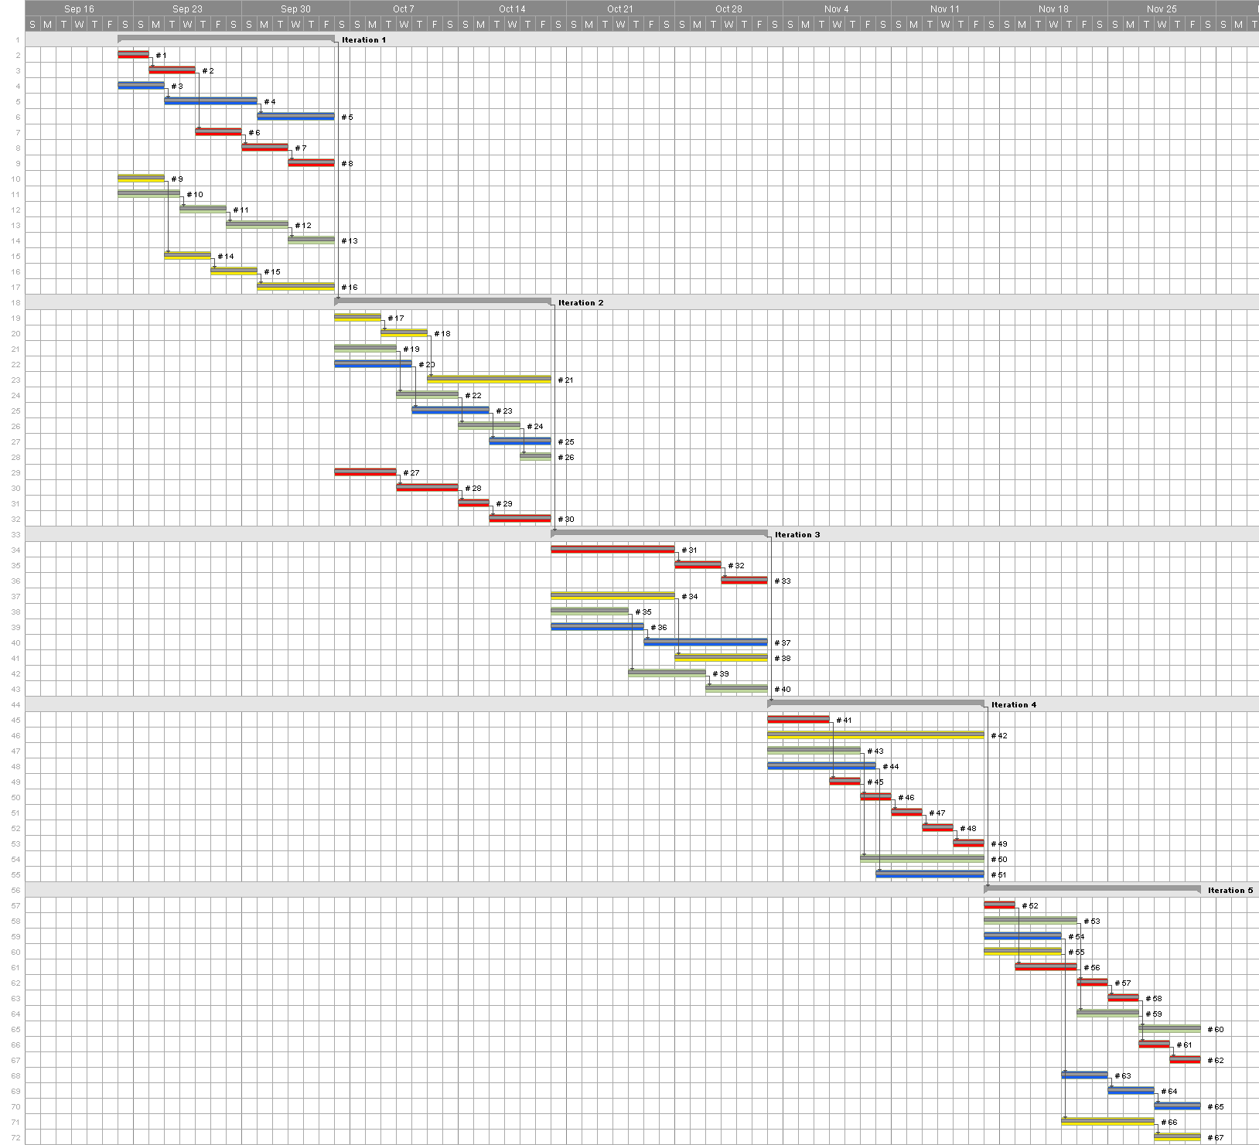
Gantt Chart – Fall

Slide 20
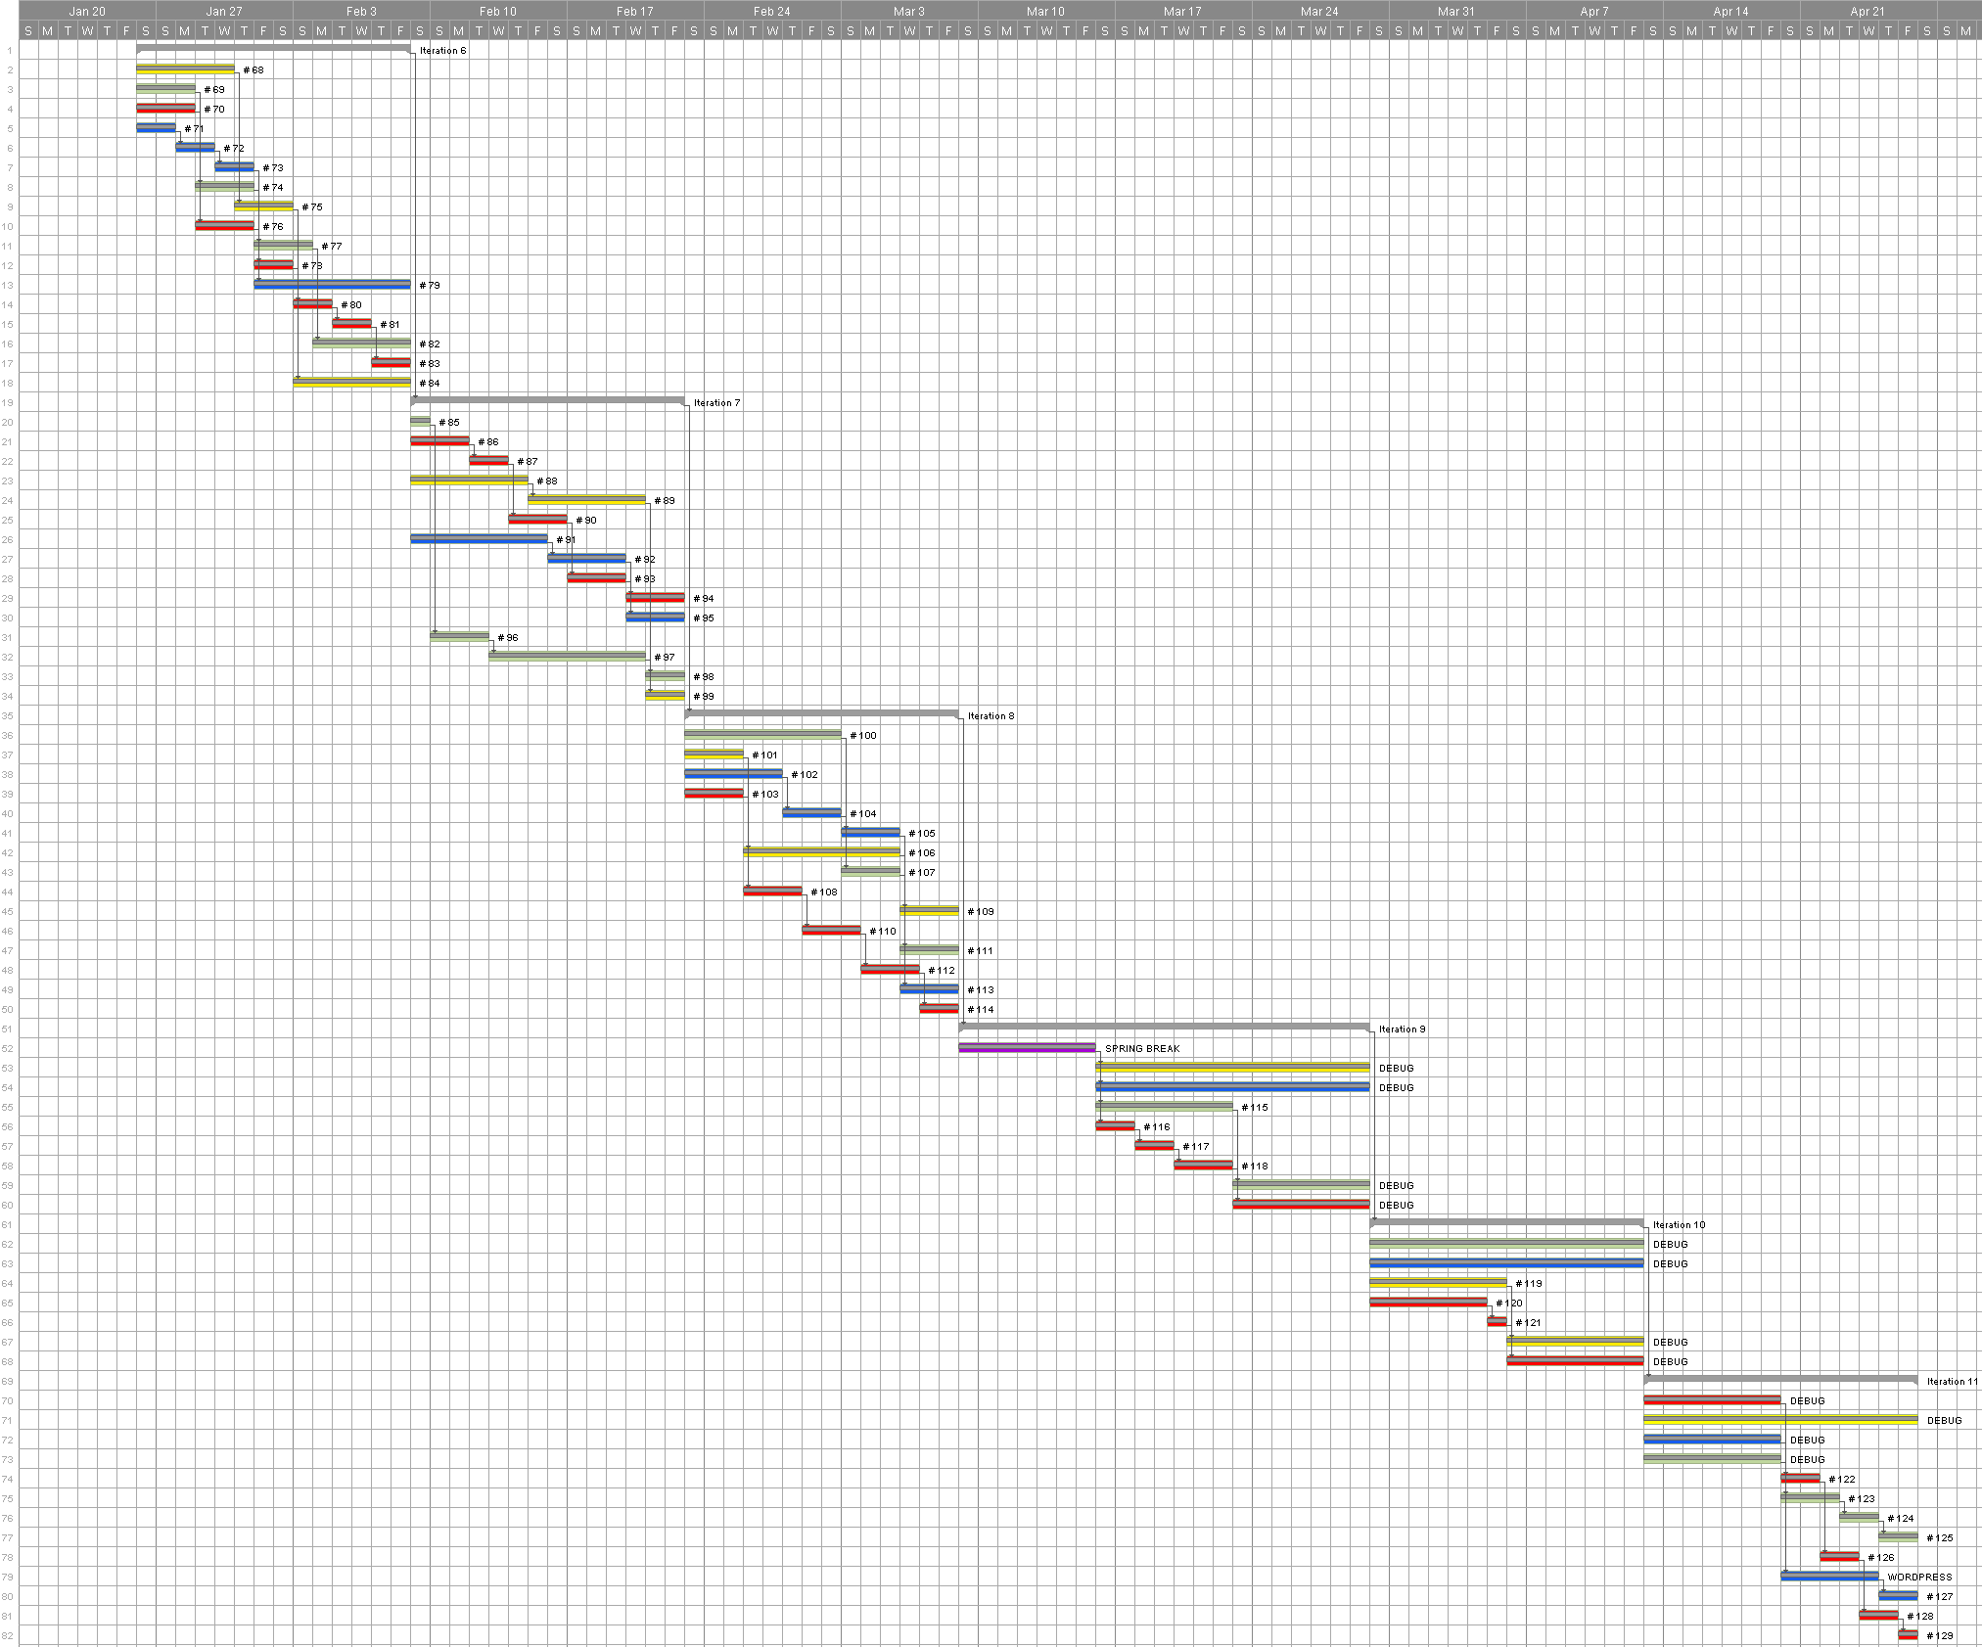
Gantt Chart – Spring

Slide 21
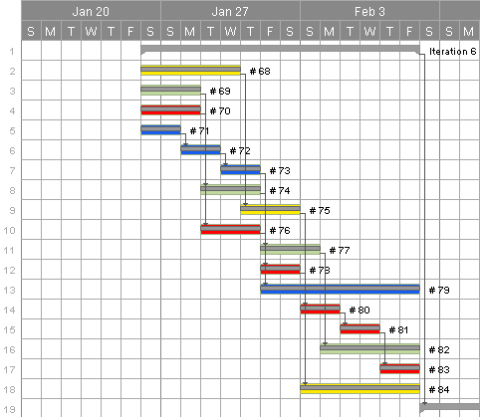
Gantt Chart – By Iteration

Slide 22
Condensed Budget
Employee Salaries and Benefits – $66,385.00
Equipment on loan from Samsung Mobile
3 smartphones – $0.00
1 tablet – $0.00
Software, free and open source
Eclipse and Android SDK – $0.00
Bitbucket repository – $0.00
Mercurial source control – $0.00
Contingency (20%) – $0.00
Printing – $78.41
Total Cost – $78.41

Slide 23
Lessons Learned
Agile/Scrum
Source Control – Mercurial
SQL
Continuous Learning

Slide 24
Future Plans
Turnover to Samsung
New causes and effects
OAuth 2.0
User interface
3rd party plug-in integration

Slide 25

Discussion
Questions before the demo?

Slide 26
Demo

