Slide 1
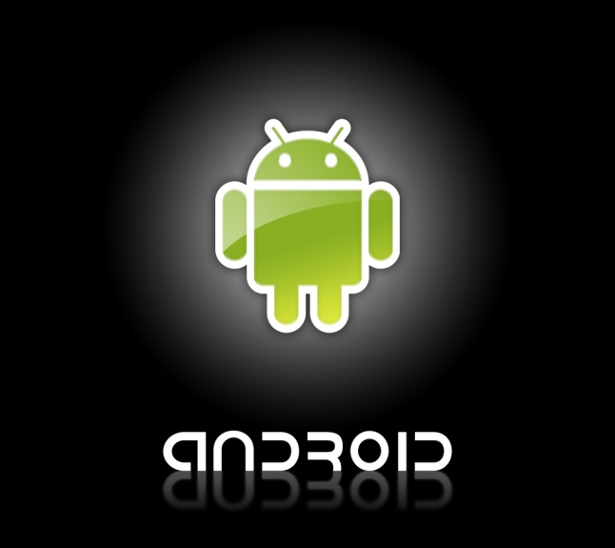
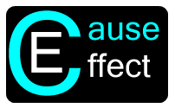

Cause And Effect IDR
By:
Keith Adler
Matthew Brannick
Tomin Kozhimala
William Vennes

Slide 2
Vision Statement Summary
Android Application
Automates user tasks using user defined “rules”
Allows users to take advantage of their phone’s capabilities
Notes:
I think I will just write this on a notecard and read it… But I still feel like I need to put some explanation on the slide. The issue is that the format of a vision statement is supposed to be this: Cause And Effect: For people wanting to make their smart devices truly intelligent. Today, smart phones are overly complex and jammed pack with functionality. Despite having the power to do so many spectacular things, smart devices lack the ability for users to take control and put the phone to work for them. Cause and Effect is a software solution that let users easily program their smart devices to respond to a set of rules with a chosen effect. With Cause and Effect, smart devices will become more intelligent and make user’s lives easier by intuitively automating tasks, gathering information, displaying information, etc. Unlike other rule based software, Cause and Effect will provide more functionality and a better user interface to allow any type of user to take control of their phone.

Slide 3
User Needs
Rules Engine
Fluid user interface
Automation of Tasks
Shareable Rules
Intuitive Rule Creation Process

Slide 4
Design Ideas
Several ideas tossed around for app design:
Drag and Drop Rule creation
Help/Tutorial Screens
“Rule Lists”
Planned account integrations
Google, Facebook, Twitter, etc.

Slide 5
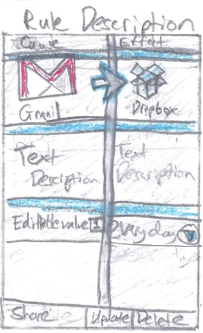
Design Ideas Cont.
Paper Designs

Slide 6
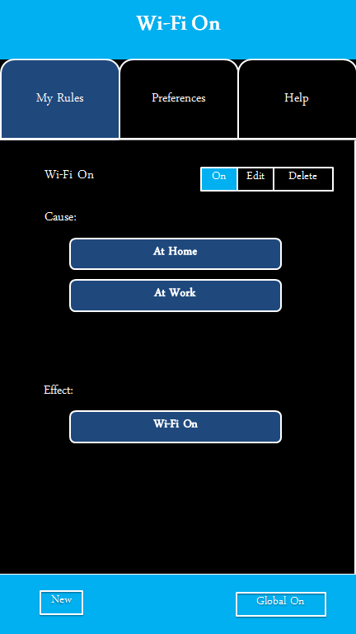
Design Ideas Cont.
Digital Designs

Slide 7
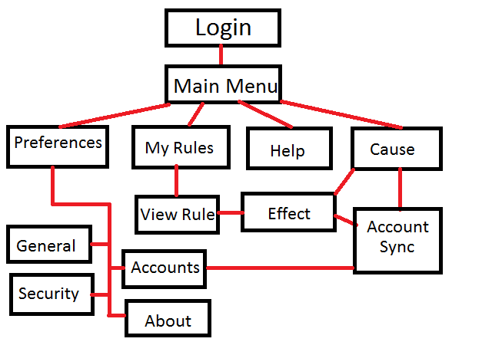
Screen Flow Diagram
Notes:
Should I remake this neater and rescan? Do it digitally?

Slide 8
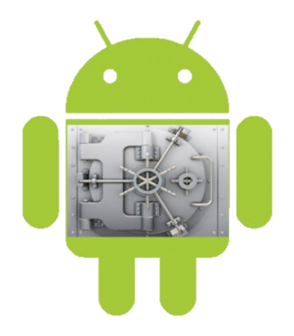
Risks - Android Security
Device fragmentation
Lack of data encryption
Lost Android devices
Account security

Slide 9
Proposed Budget
Current Proposed Budget: $0.00
Equipment: Free
4 Android devices borrowed from Samsung
Software: Free, Open Source
Eclipse IDE
Bitbucket https://Talador12@bitbucket.org/Talador12/ceandroid (Follow us!)
Mercurial Source Control
Android Open Source Project
Notes:
Our project depends largely more on immaterial elements rather than material ones
Our current proposed budget is $0.
How do we plan on taking on such an ambitious project without
By taking advantage of the free resources at hand.
Firstly, our equipment was provided to us by our client, Samsung Mobile.
We received four devices, including three smartphones and one tablet.
Out software environment is make up of a platter of free programs.
Eclipse Integrated Development Environment,
Bitbucket hosting for our repository
Mercurial Source Control tool
Android Open Source Project allows for all Android source code to be viewed, studied, and analyzed for our needs for this project

Slide 10

Discussion
Questions?

