Slide 1



Cause And Effect PDR
By:
Keith Adler
Matthew Brannick
Tomin Kozhimala
William Vennes

Slide 2
Summary
Problem:
Users not taking advantage of functionality on their phones.
Android Application
Create Rules
Cause Triggers
Effect Actions

Slide 3
User Needs
Simple and effective UI
Rules Engine
Compatible with all devices and tablets
Extensible to third parties
Rules need to be sharable
Must include Wi-fi and location based rules

Slide 4
Current Backend Structure
GUI
Database
Broadcast Receiver
Rules Engine
Action Executer

Slide 5
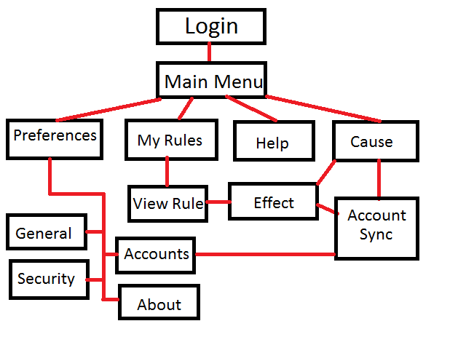
Screen Flow Diagram
GUI
DB
BR
RE
AE

Slide 6
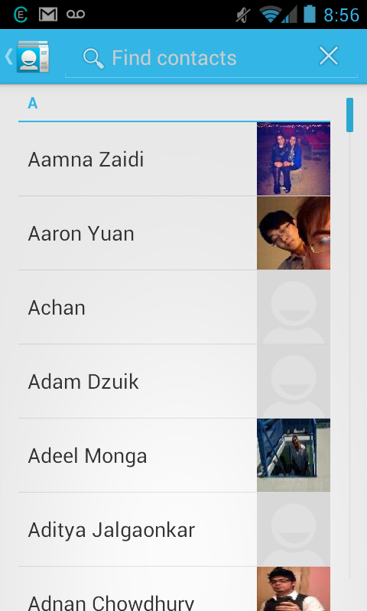
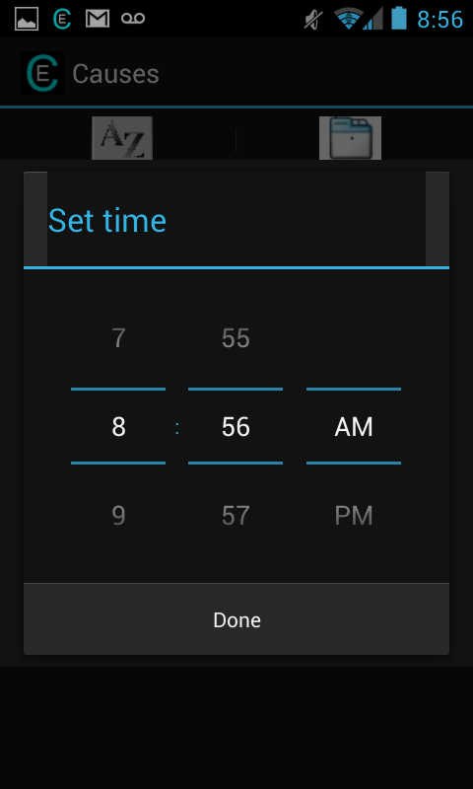
Editing Causes and Effects
GUI
DB
New activity:
Allows for more full experience
Can be distracting or confusing and sever the flow
Taxing on memory and time
Pop-up:
Allows for brief, less distracting experience
Only for quick actions
May not always be an option
BR
RE
AE
Notes:
Pros, cons, screenshots of popup and activity approaches, etc

Slide 7
Database
GUI
DB
SQLite
6 Tables: Rules, rCauses,
Causes, rEffects, Effects, Accounts
Purpose is to hold all of the information that the android is not currently using.
Must return quickly with necessary data and be small enough on the phone to conserve space.
BR
RE
AE

Slide 8
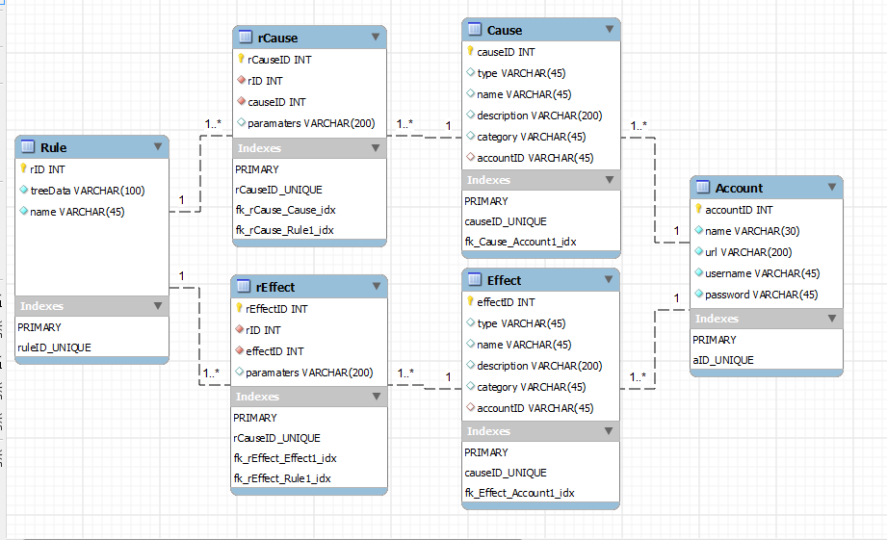
Database (cont.)
GUI
DB
BR
RE
AE

Slide 9
Broadcast Receiver
GUI
DB
Receives messages
Android OS
External Services
Lightweight
BR
RE
AE

Slide 10
Rules Engine
GUI
DB
Called by the broadcast receiver
Purpose is to request rules
from database related to
trigger and evaluate whether
the rule is active or not.
Each cause associated with a rule has its own “isTrue” method which returns whether the cause is currently true or not.
Rule evaluation utilizes Android AsyncTask.
If rule is true, send an effects list to Action Executer object.
BR
RE
AE

Slide 11
Rules Engine – Cause Trees
RETURN
GUI
DB
(1234 & 1551) + (1656 & 1847)
OR
BR
RE
AE
AND
AND
1234
1551
1656
1847
Stored in DB as “+:&:1234@:1551@@:&:1656@:1847$”
Expression tree, evaluated recursively

Slide 12
Action Executer
GUI
DB
Called by the Rules Engine
Purpose is to carry out the
actions associated with a
evaluated rule in a lightweight class
Passed the application context and list of effects to be executed
Each action is executed in its own thread as an AsyncTask for parallelization
Each action is given a unique parameter to be interpreted by the constructor
BR
RE
AE

Slide 13
Risk Assessment
Device fragmentation
Account security
Unavailable team members
Requirements changes
Schedule is underestimated or not met
Inefficient algorithms
Insufficient testing devices

Slide 14
Work Schedule
11 Iterations
Each 2 Weeks in Length
5 Fall Iterations
6 Spring Iterations

Slide 15
Condensed Budget
Employee Salaries and Benefits – $66,385.00
Equipment on loan from Samsung Mobile
3 smartphones – $0.00
1 tablet – $0.00
Software, free and open source
Eclipse and Android SDK – $0.00
Bitbucket repository – $0.00
Mercurial source control – $0.00
Contingency (20%) – $0.00
Total Cost – $0.00

Slide 16
What’s Next?
Winter Break
Backlog User Stories
Spring
6 Iterations

Slide 17
Demo

Slide 18

Discussion
Questions?

