Slide 1

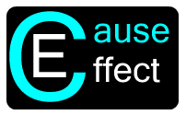

Cause And Effect PDR
By:
Keith Adler
Matthew Brannick
Tomin Kozhimala
William Vennes

Slide 2
Summary
Problem:
Users not taking advantage of functionality on their phones.
Android Application
Create Rules
Cause Triggers
Effect Actions

Slide 3
User Needs
Simple and effective UI
Rules Engine
Compatible with all devices and tablets
Extensible to third parties
Rules need to be sharable
Must include Wifi and location based rules

Slide 4
Current Backend Structure
GUI
Database
Broadcast Receiver
Rules Engine
Action Executer

Slide 5
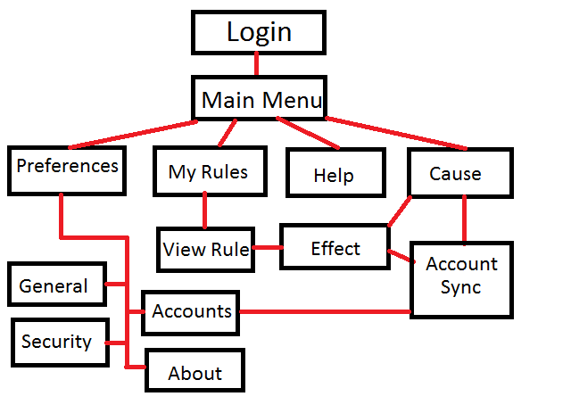
Screen Flow Diagram

Slide 6
Broadcast Receiver
Receives messages
Android OS
External Services
Lightweight

Slide 7
Database
SQLite
6 Tables: Rules, rCauses, Causes, rEffects, Effects, Accounts
Purpose is to hold all of the information that the android is not currently using.
Must return quickly with necessary data and be small enough on the phone to conserve space.

Slide 8
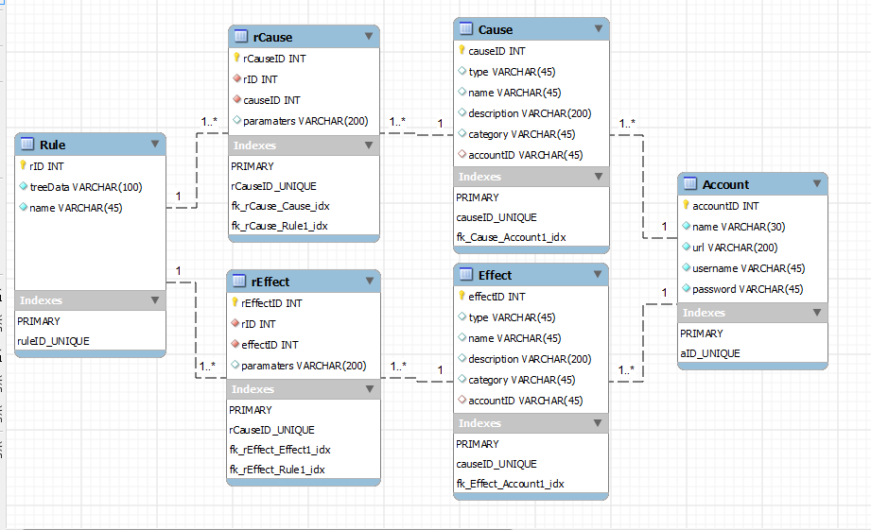
Database (cont.)

Slide 9
Rules Engine
Called by the broadcast receiver
Purpose is to request rules from database related to trigger and evaluate whether the rule is active or not.
Each cause associated with a rule has its own “isTrue” method which returns whether the cause is currently true or not.
Rule evaluation utilizes Android AsyncTask.
If rule is true, send an effects list to Action Executer object.

Slide 10
Rules Engine – Cause Trees
RETURN
(1234 & 1551) + (1656 & 1847)
OR
AND
AND
1234
1551
1656
1847
Stored in DB as “+:&:1234@:1551@@:&:1656@:1847$”
Expression tree, evaluated recursively

Slide 11
Action Executer
Called by the Rules Engine
Purpose is to carry out the actions associated with a evaluated rule in a lightweight class
Passed the application context and list of effects to be executed
Each action is executed in its own thread as an AsyncTask for parallelization
Each action is given a unique parameter to be interpreted by the constructor

Slide 12
Risk Assessment
Device fragmentation
Account security
Unavailable team members
Requirements changes
Schedule is underestimated or not met
Inefficient algorithms
Insufficient testing devices

Slide 13
Work Schedule
11 Iterations
Each 2 Weeks in Length
5 Fall Iterations
6 Spring Iterations

Slide 14
Condensed Budget
Employee Salaries and Benefits – $66,385.00
Equipment on loan from Samsung Mobile
3 smartphones – $0.00
1 tablet – $0.00
Software, free and open source
Eclipse and Android SDK – $0.00
Bitbucket repository – $0.00
Mercurial source control – $0.00
Contingency (20%) – $0.00
Total Cost – $0.00

Slide 15
What’s Next?
Winter Break
Backlog User Stories
Spring
6 Iterations

Slide 16
Demo

Slide 17

Discussion
Questions?

