Slide 1
Combinational Logic schematic
In this project was designed the 5-bit adder/subtractor with two 5-bit
inputs A4A3A2A1A0 and B4B3B2B1B0 and the 1-bit input for the Mode and 6 –bit output (S5S4S3S2S1S0).
Project steps:
1- Show detailed gate level for the 5-bit adder/subtractor. The gate level (Using
AND/OR/INV gates) design should show all inputs and outputs.
2- Show the transistor level design of the 5-bit adder/subtractor. In your design you have the full freedom to arrange the transistors to implement the 5-bit adder/subtractor functionality.
3- Size all the transistors to make sure that the rise and the fall delays are the same.
4- For the implemented design draw the input waveforms such that all the possible combinations are tested.
5- Report the adder worst case delay.

Slide 2
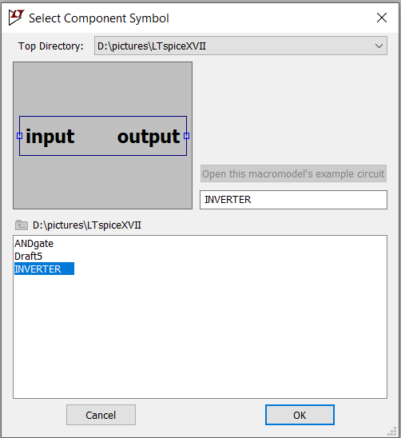
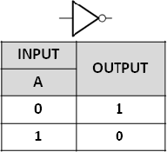
INVERTER

Slide 3
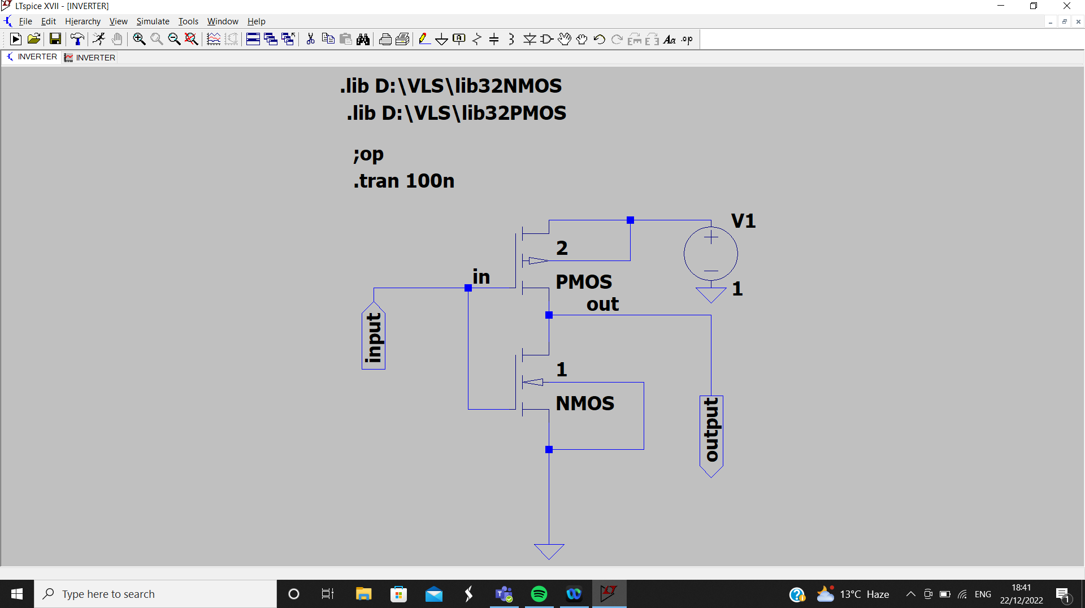

Slide 4
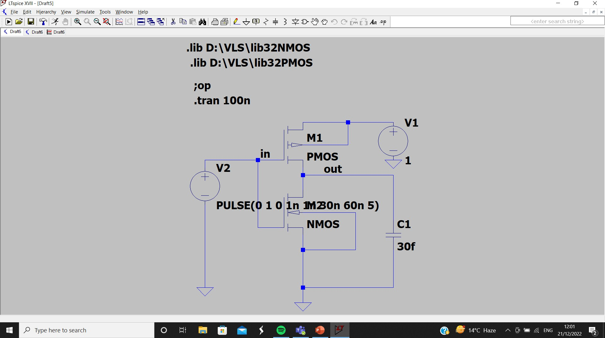

Slide 5
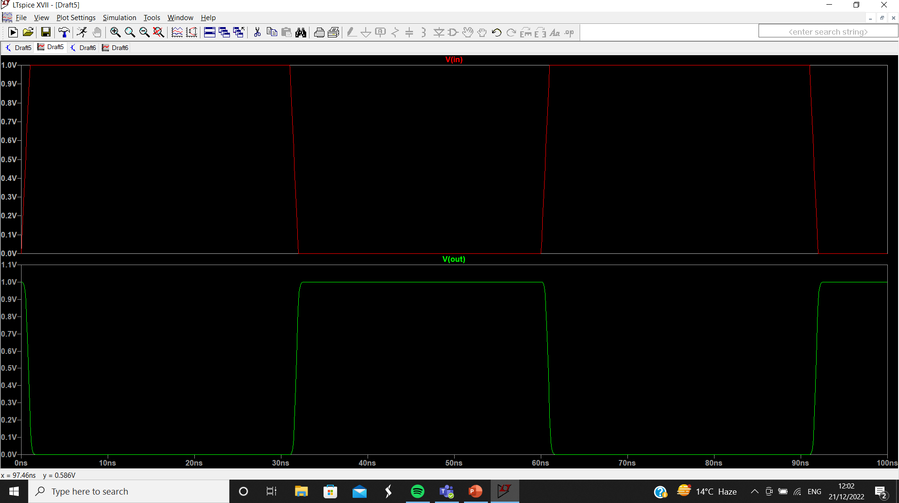

Slide 6
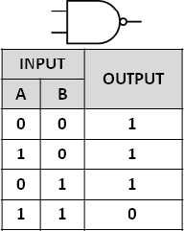
NAND GATE

Slide 7
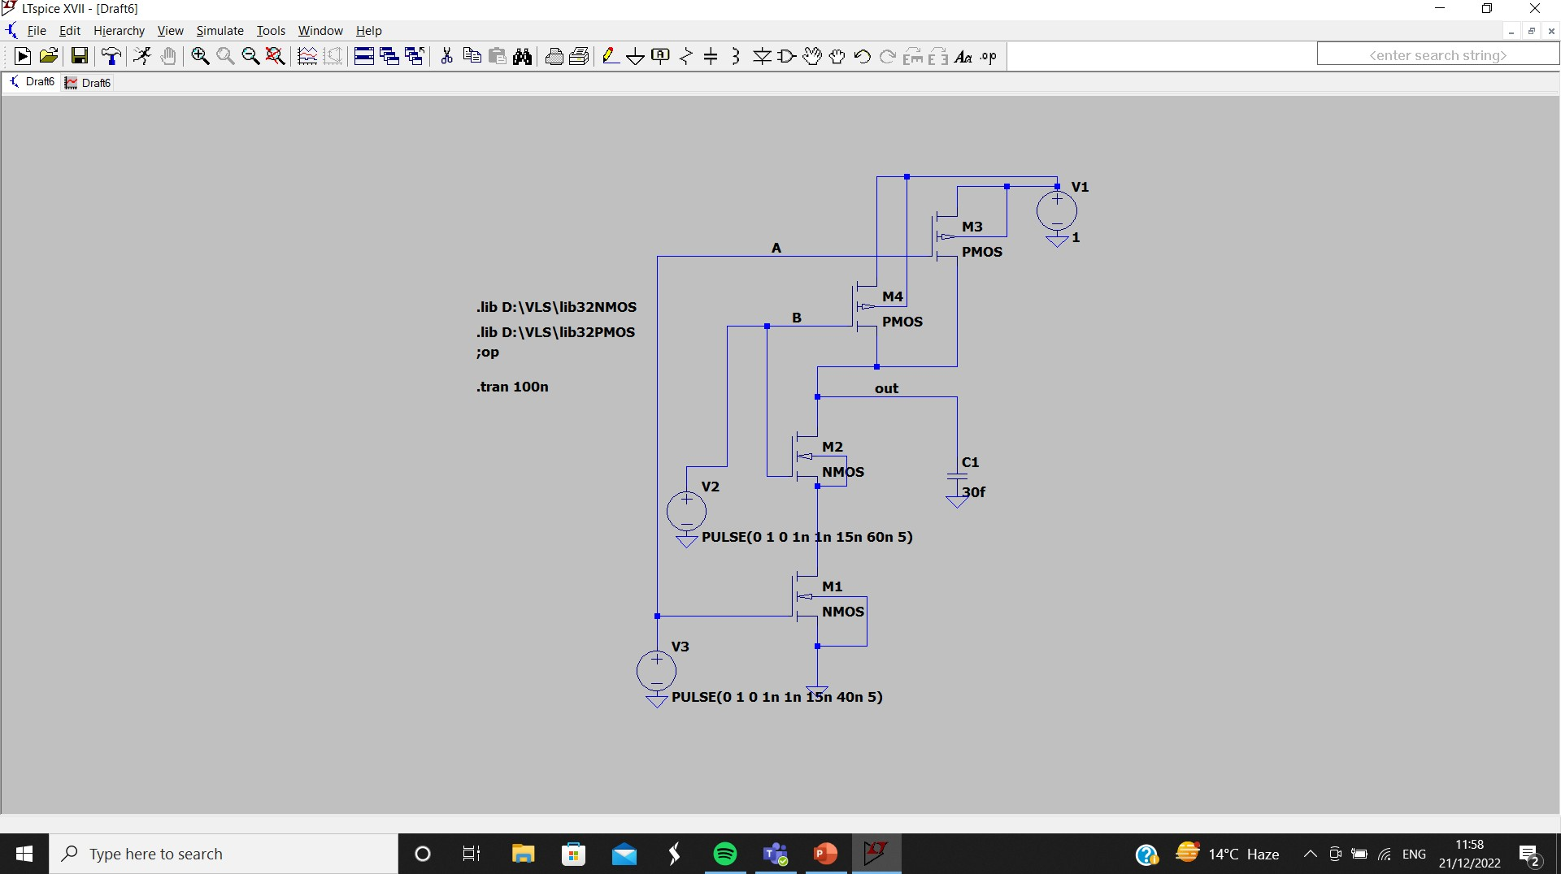

Slide 8
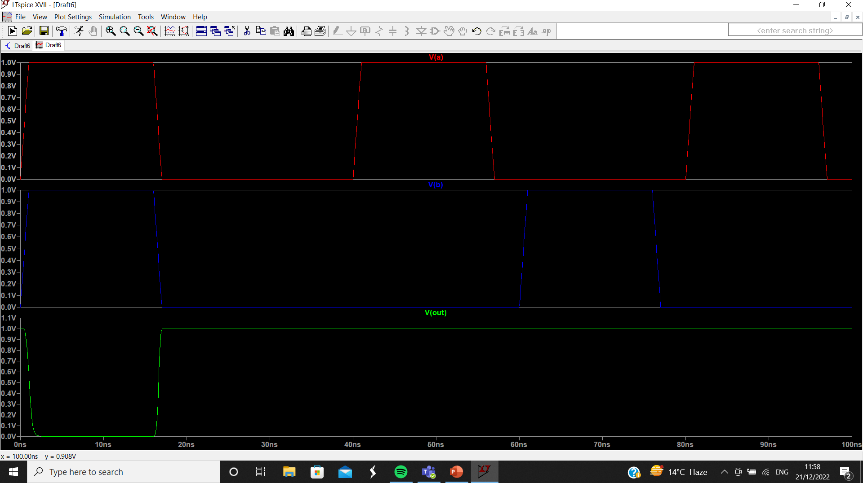

Slide 9
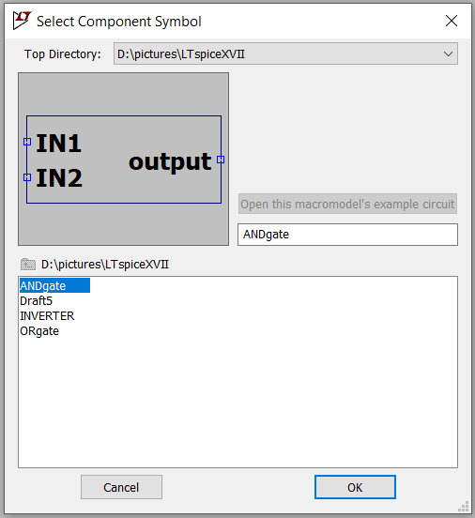
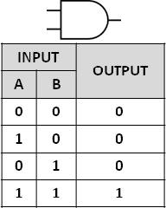
AND GATE

Slide 10
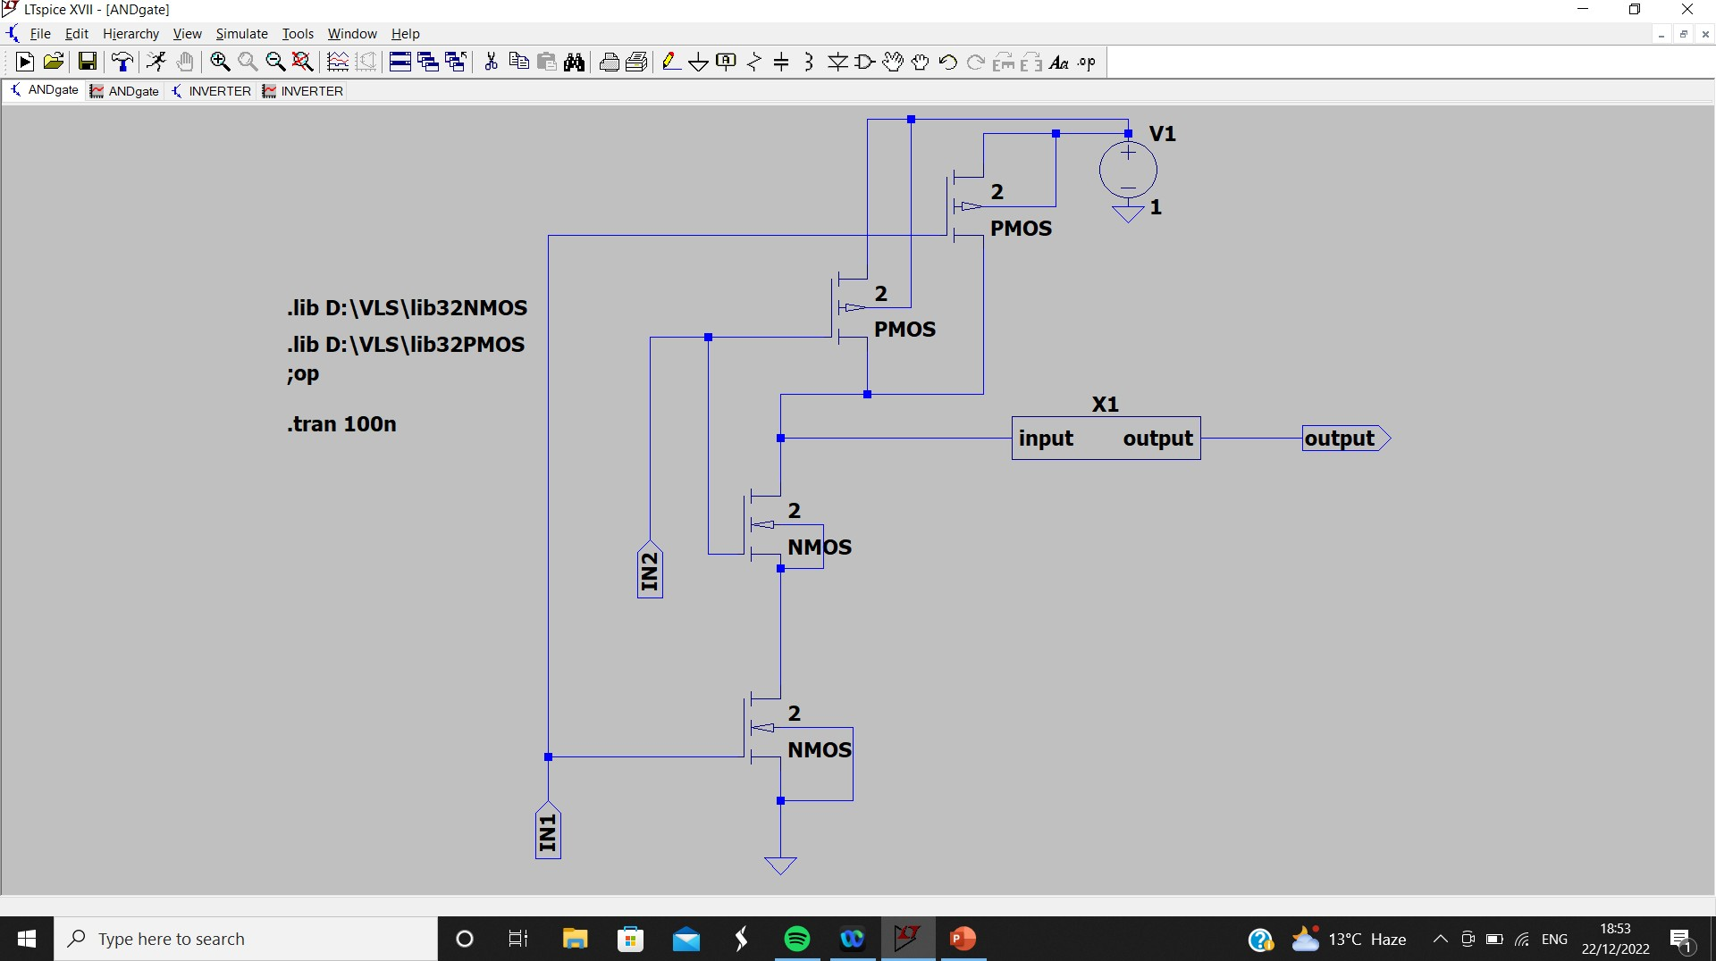

Slide 11
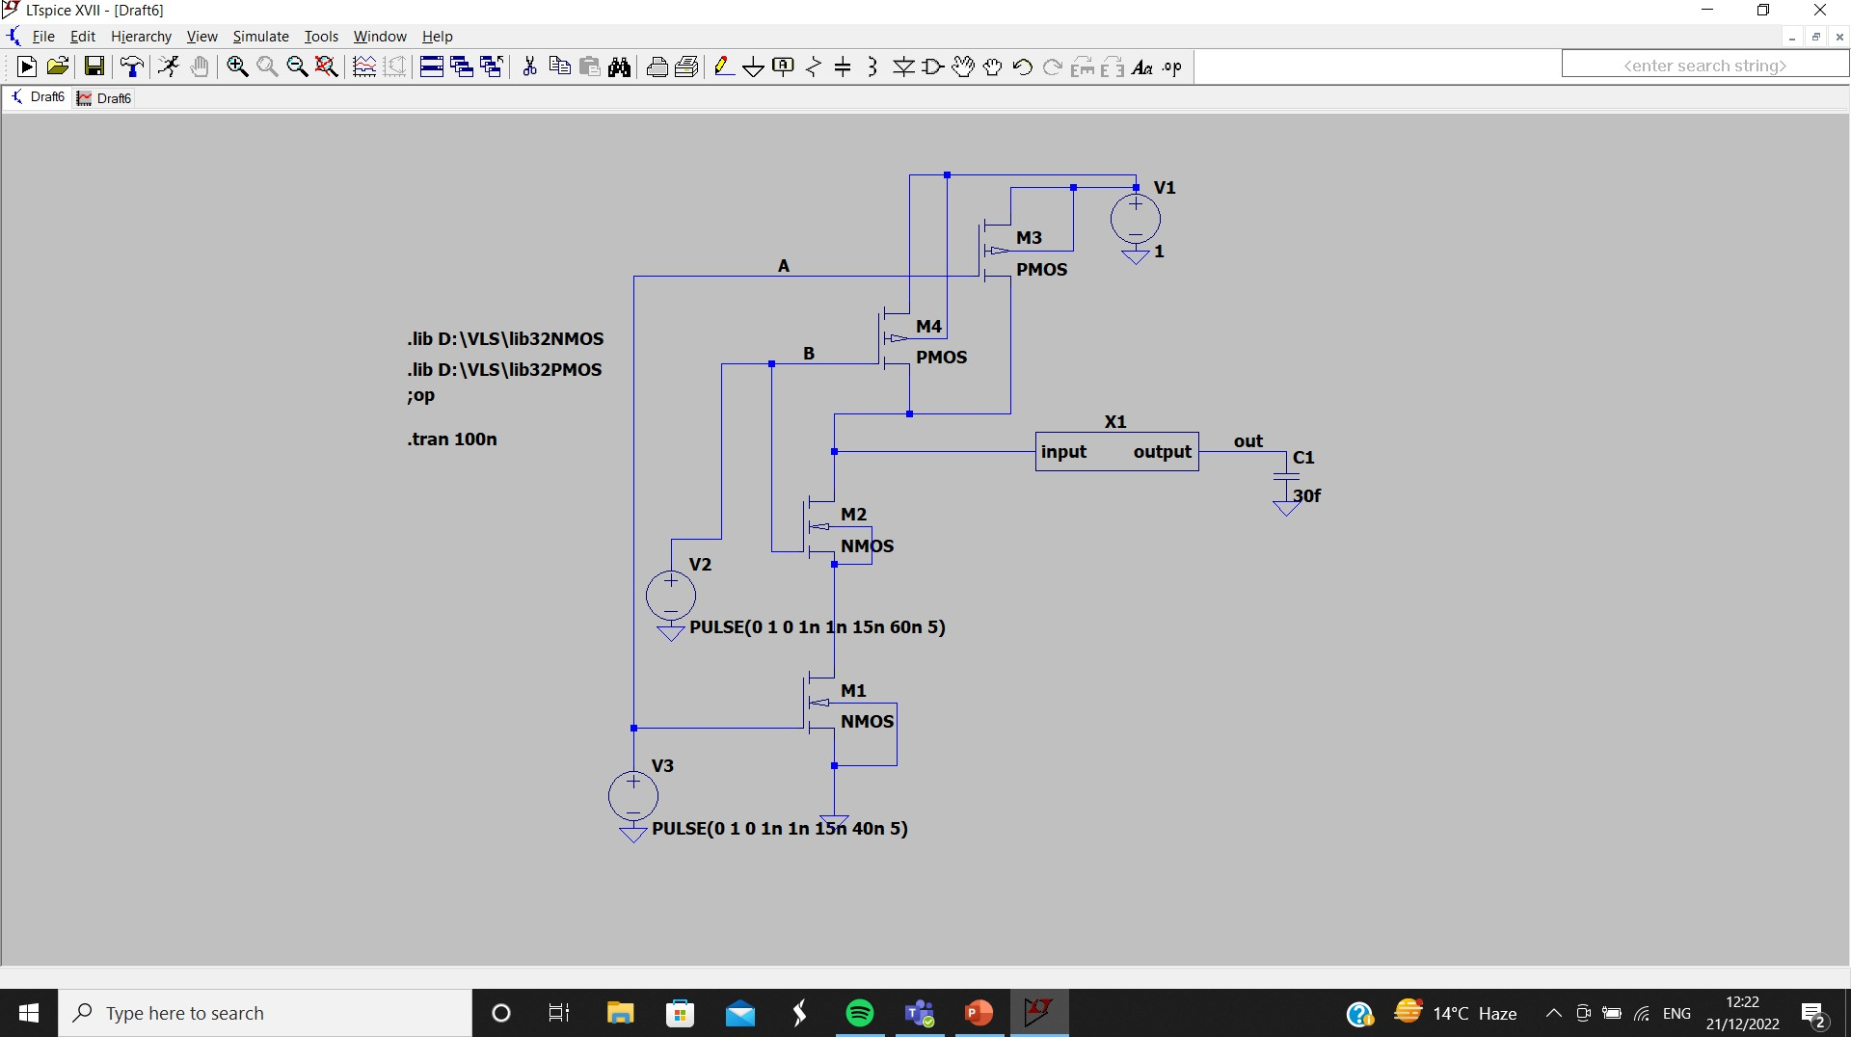

Slide 12
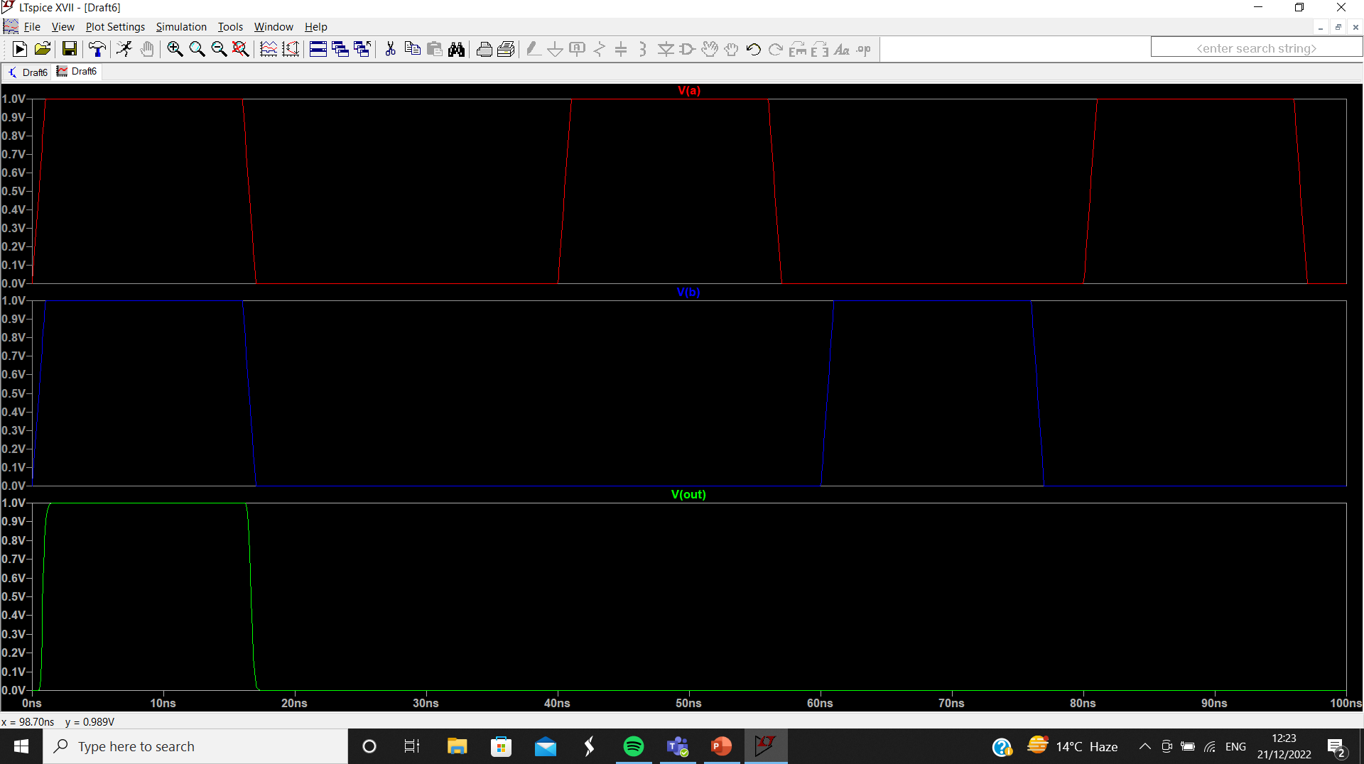

Slide 13
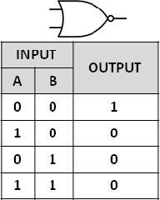
NOR GATE

Slide 14
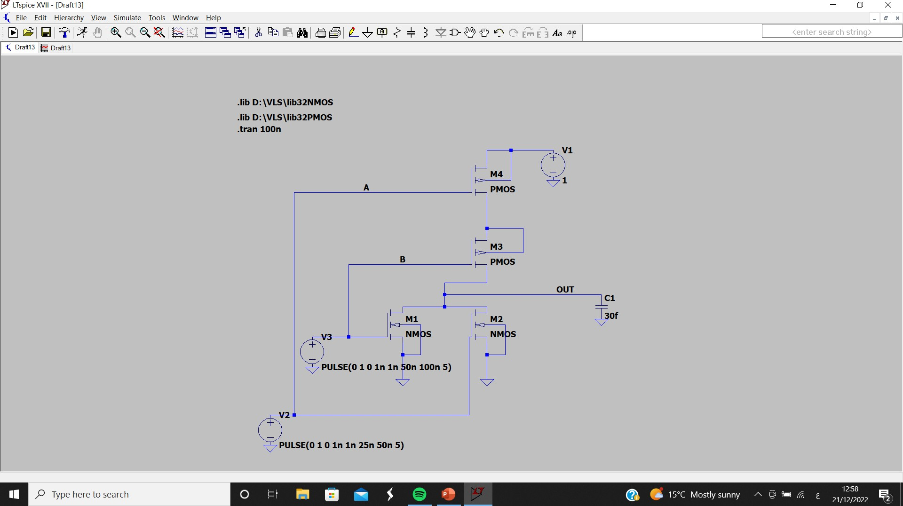

Slide 15
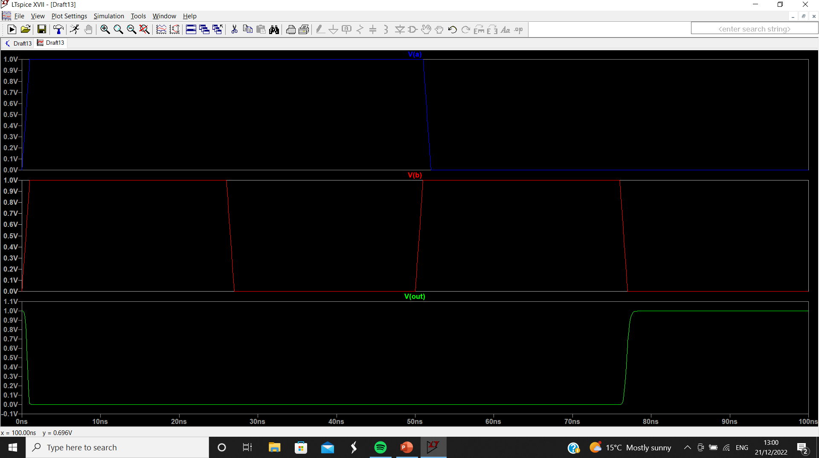

Slide 16
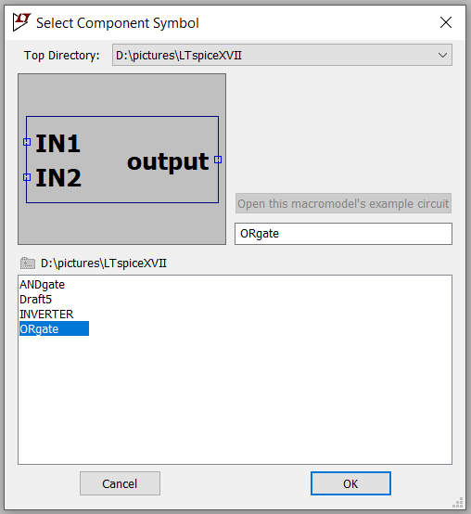
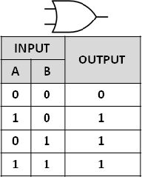
OR GATE

Slide 17
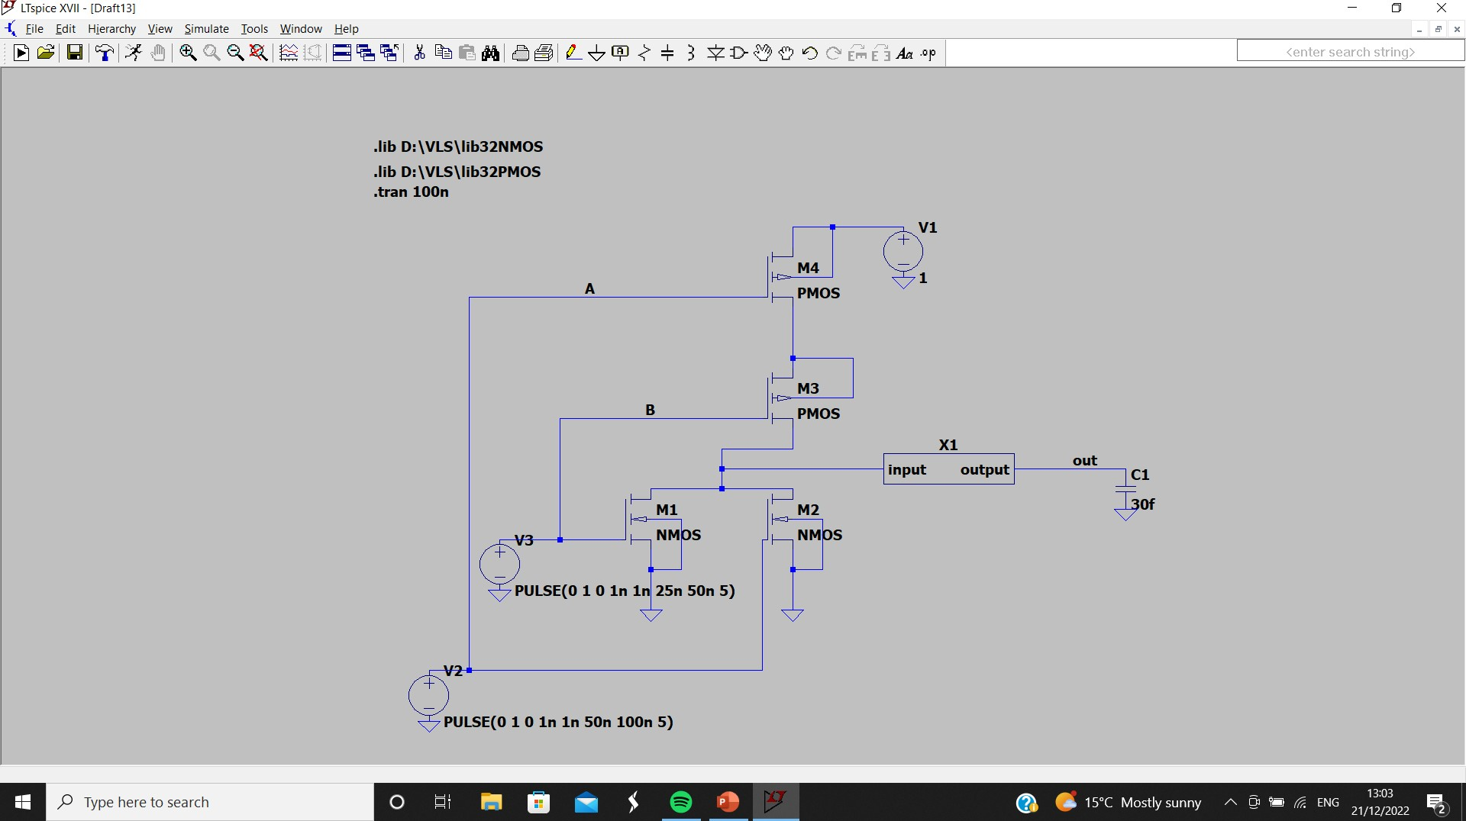
4
4

Slide 18
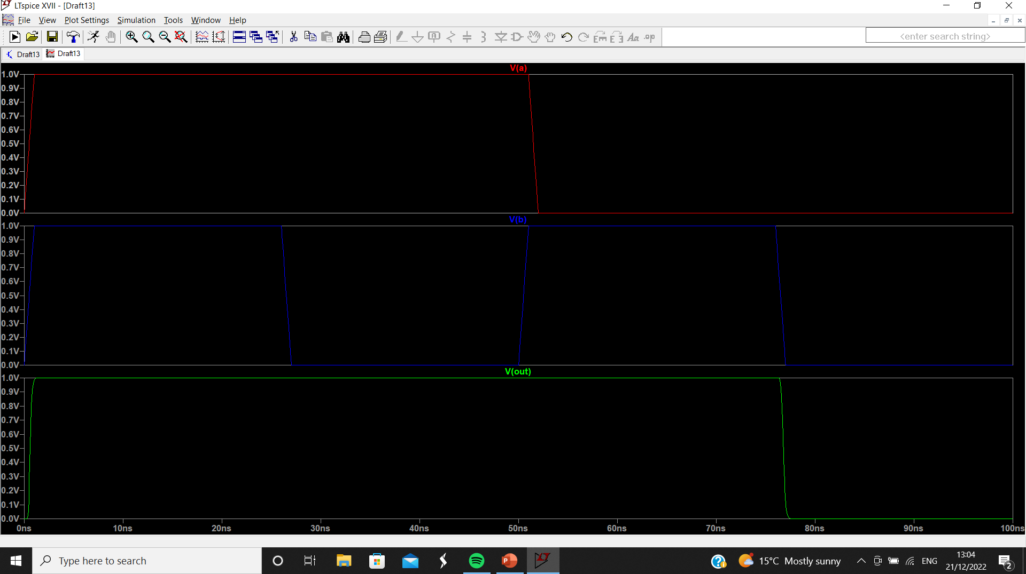

Slide 19

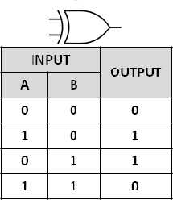
XOR GATE

Slide 20
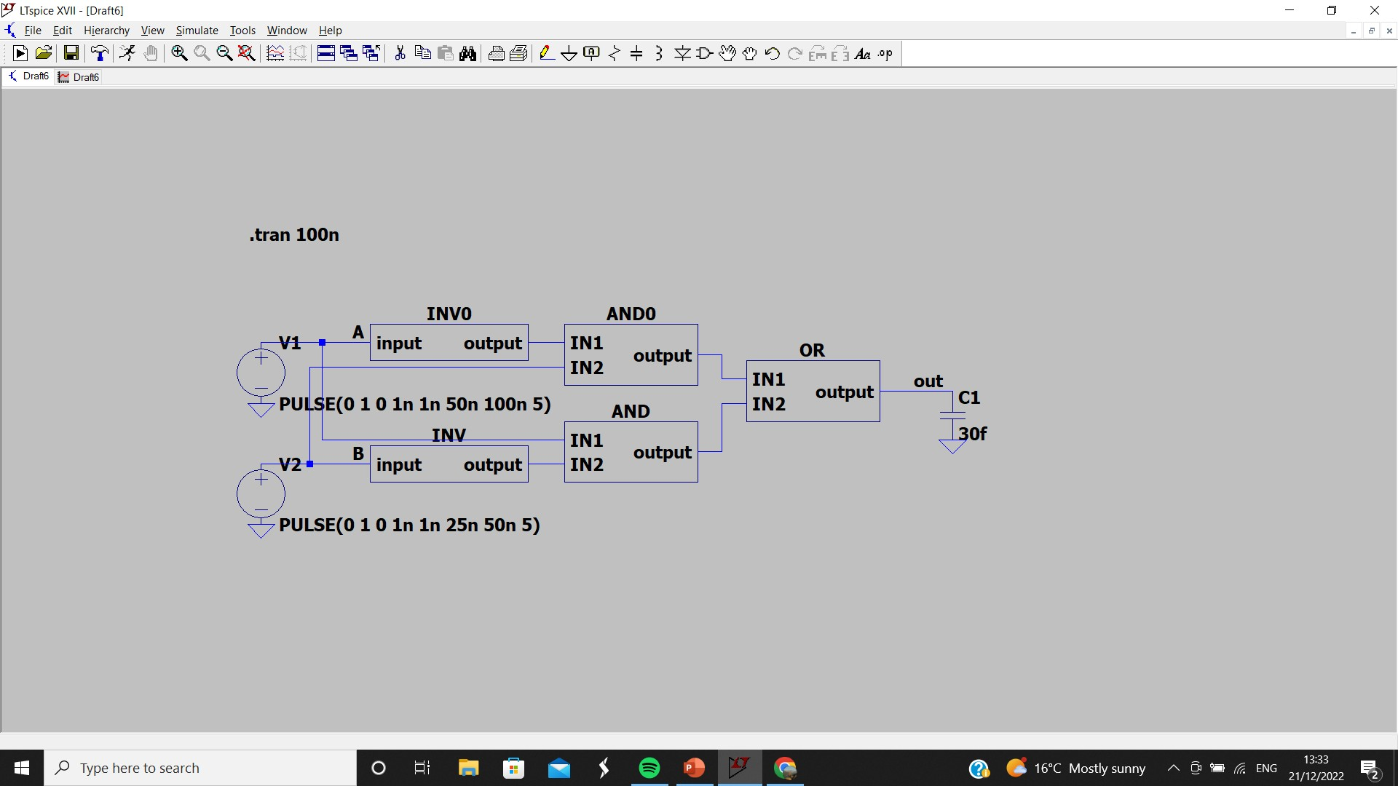
XOR GATE

Slide 21
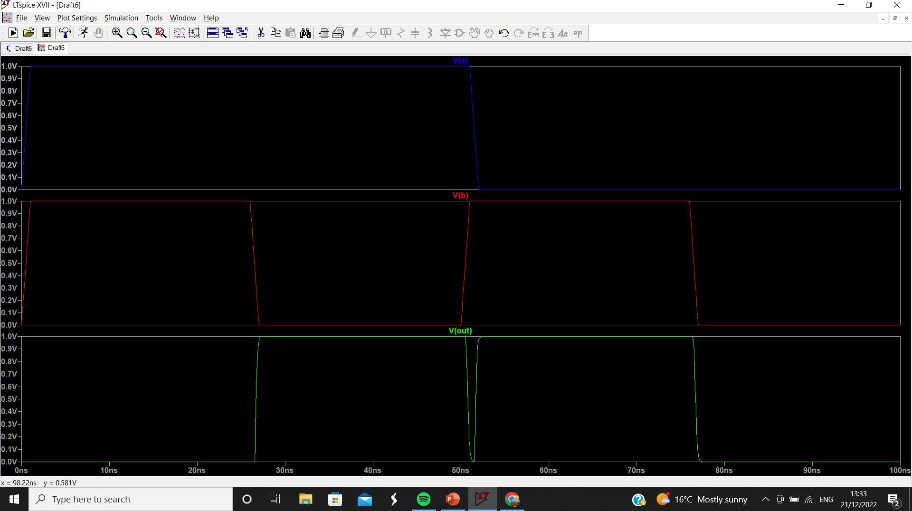

Slide 22
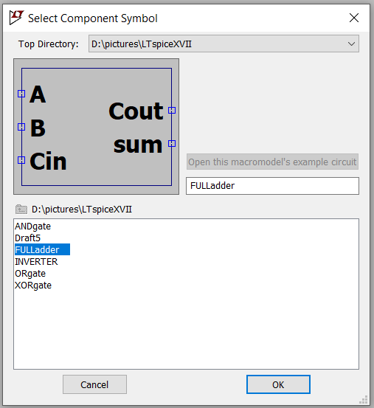
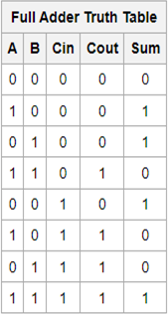
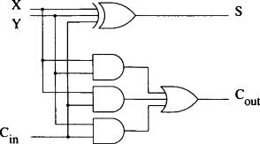
FULL ADDER
A B

Slide 23
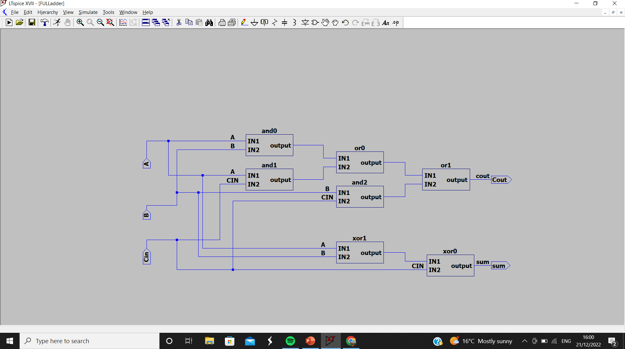

Slide 24
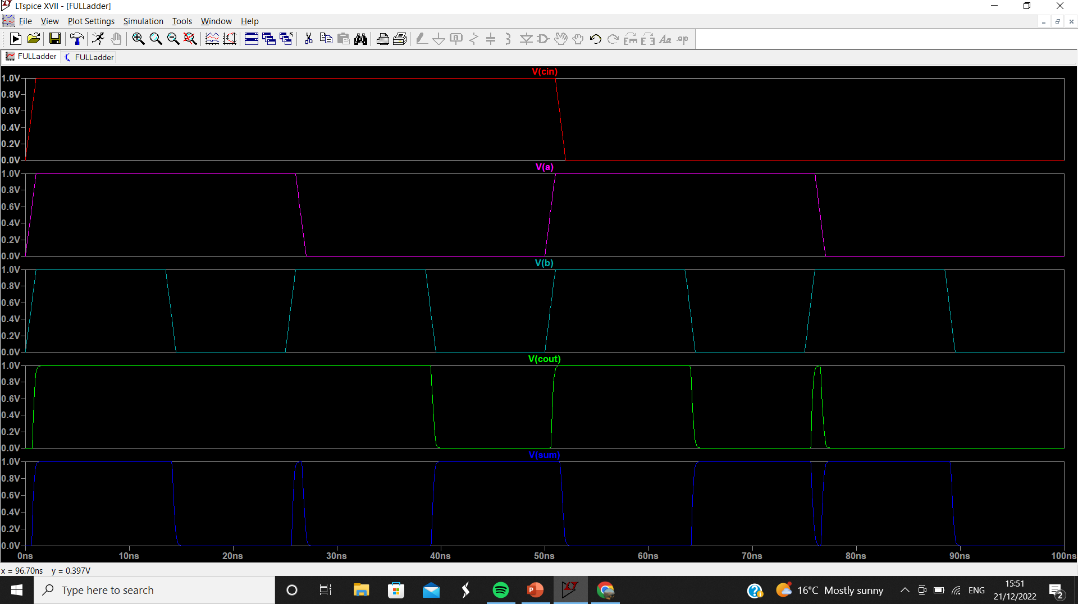

Slide 25
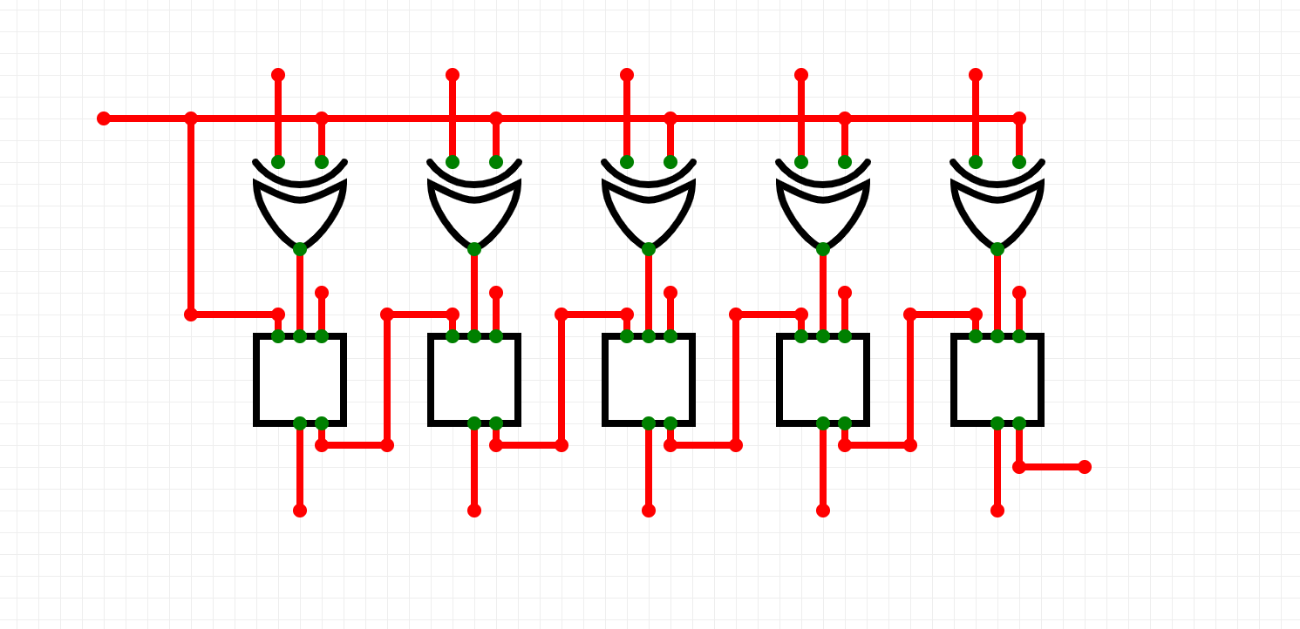

Full adder subtractor
B0 B1
B2
B3
B4
CIN
A0
A1
A2
A3
A4
FA
COUT
S0
S1
S2
S3
S4

Slide 26
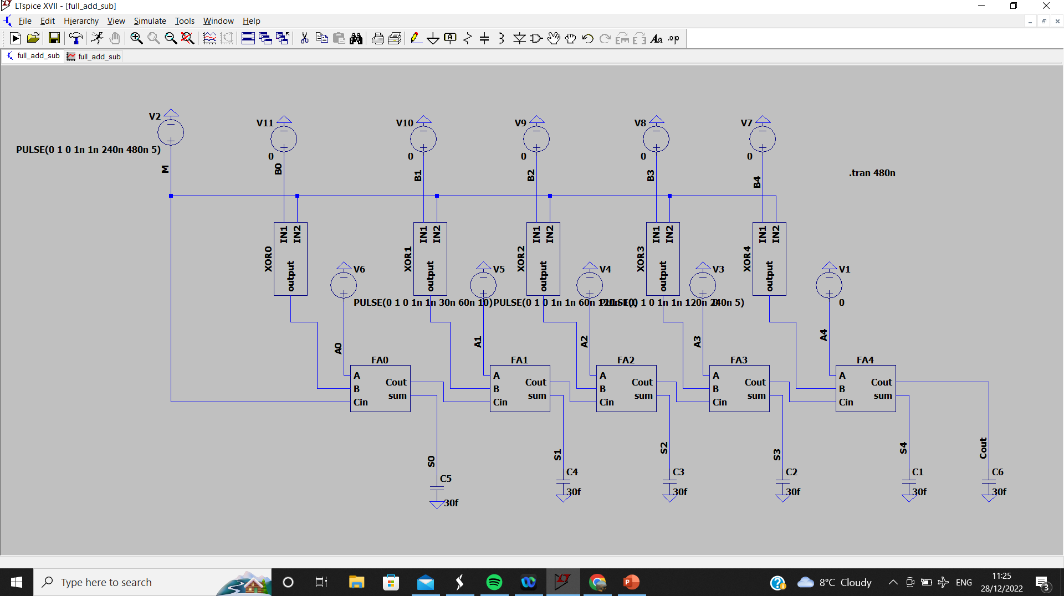

Slide 27
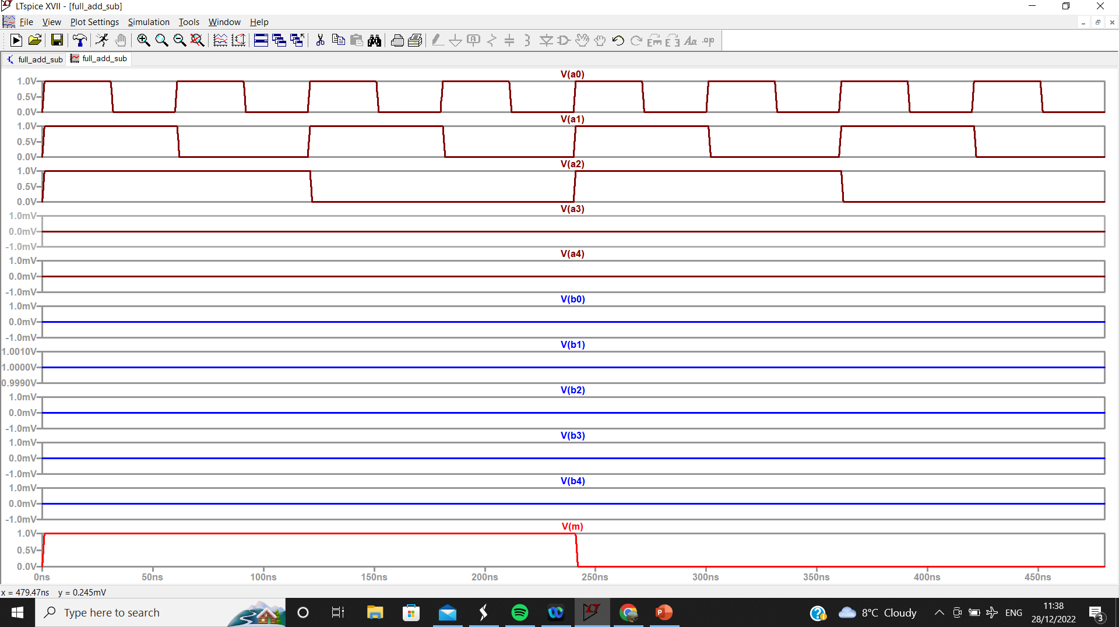

Slide 28
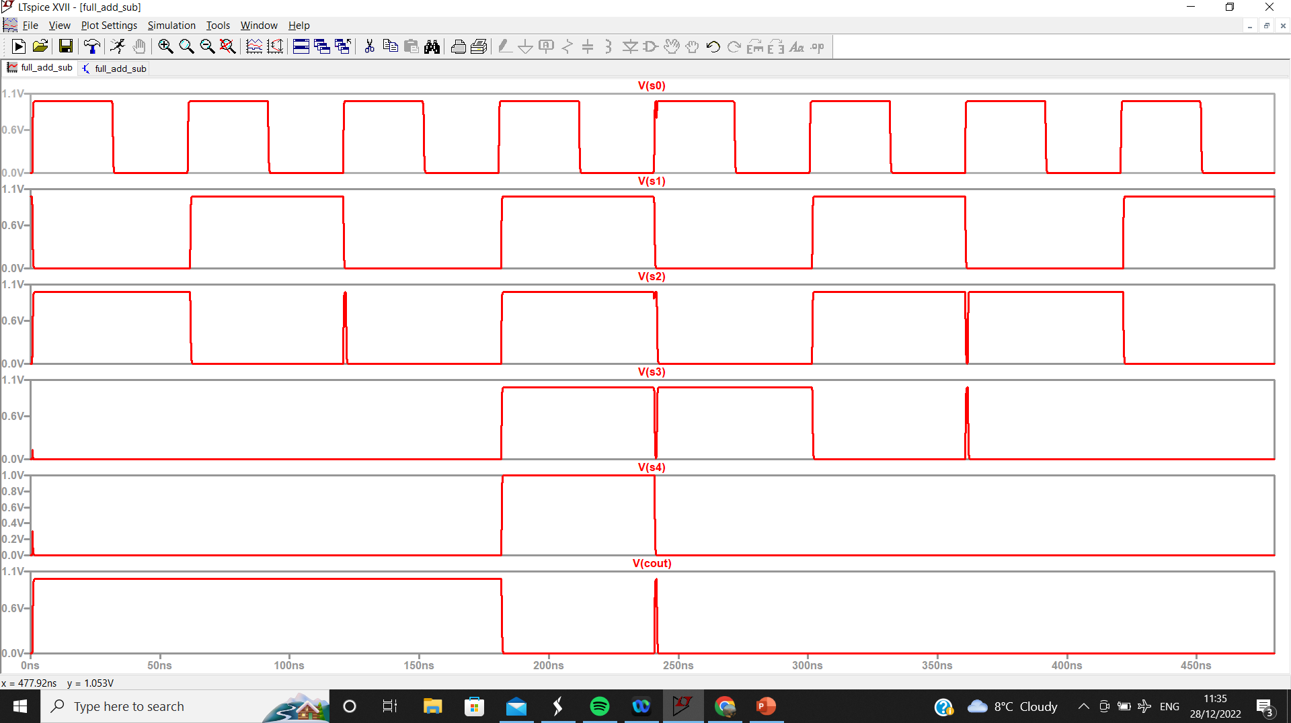

Slide 29
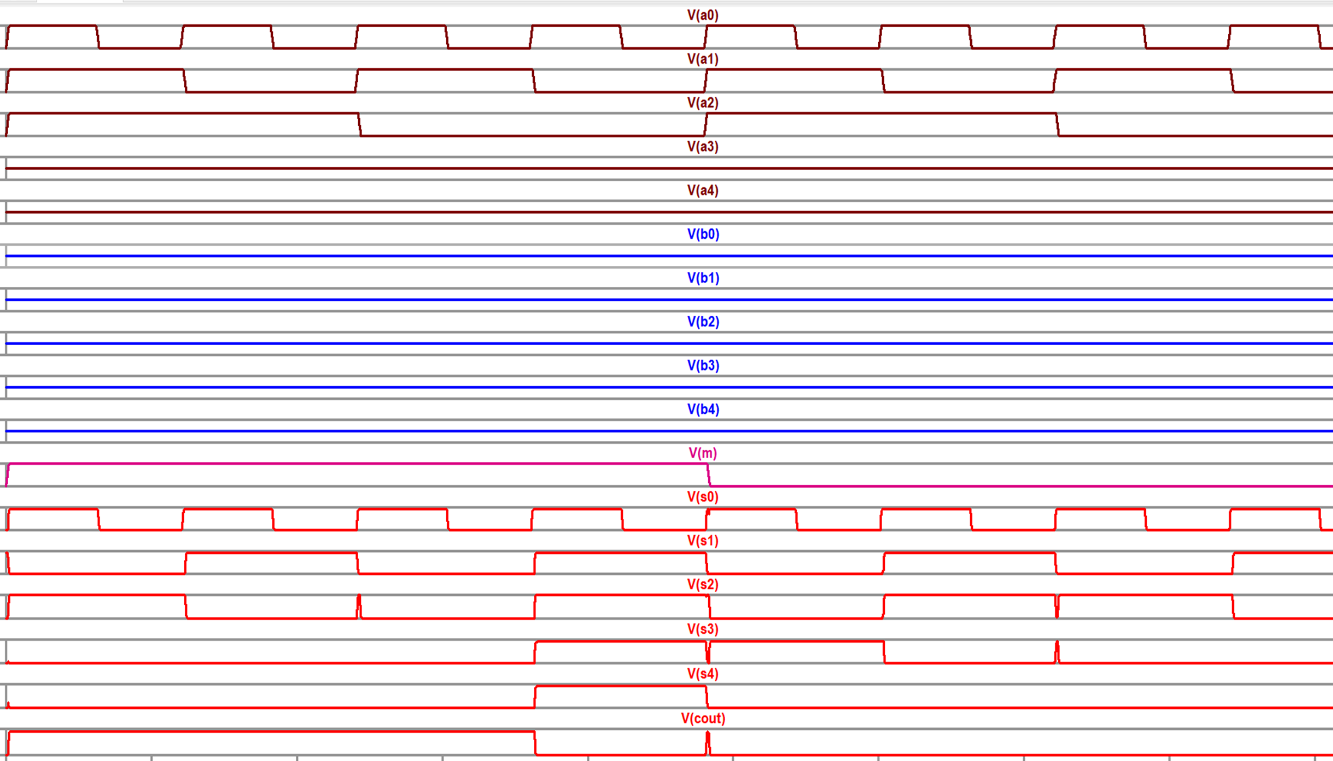
6 + 2 = 8
3 + 2 = 5
7 – 2 = 5
4 – 2 = 2
1 – 2 =-1

Slide 30
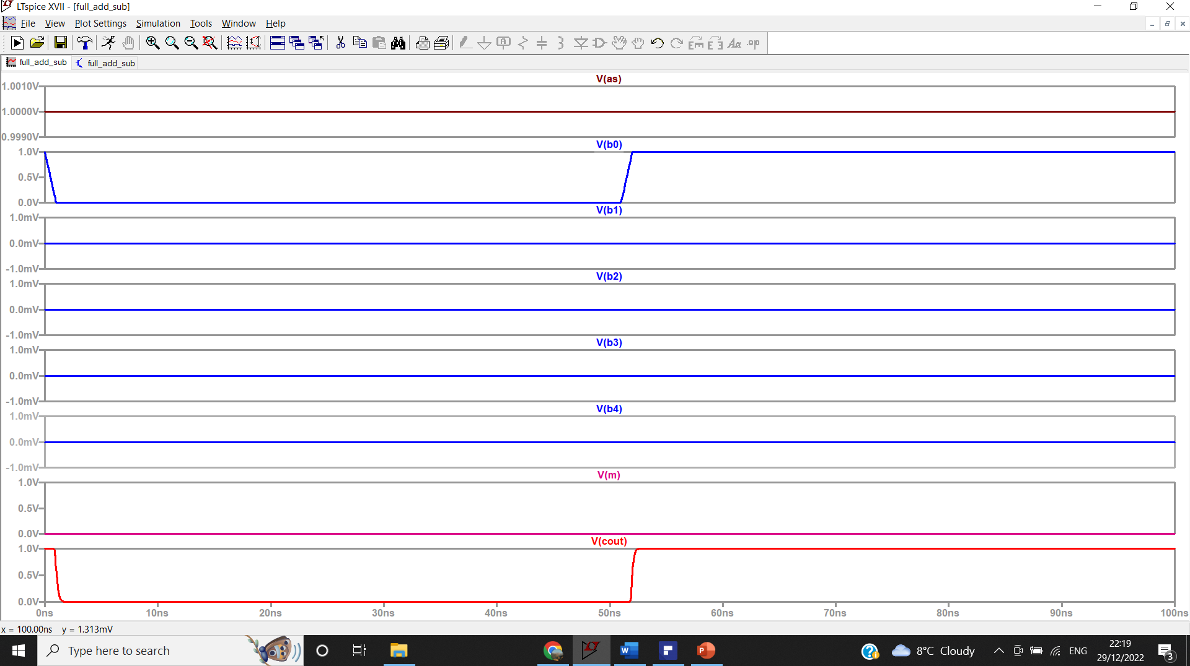

Slide 31
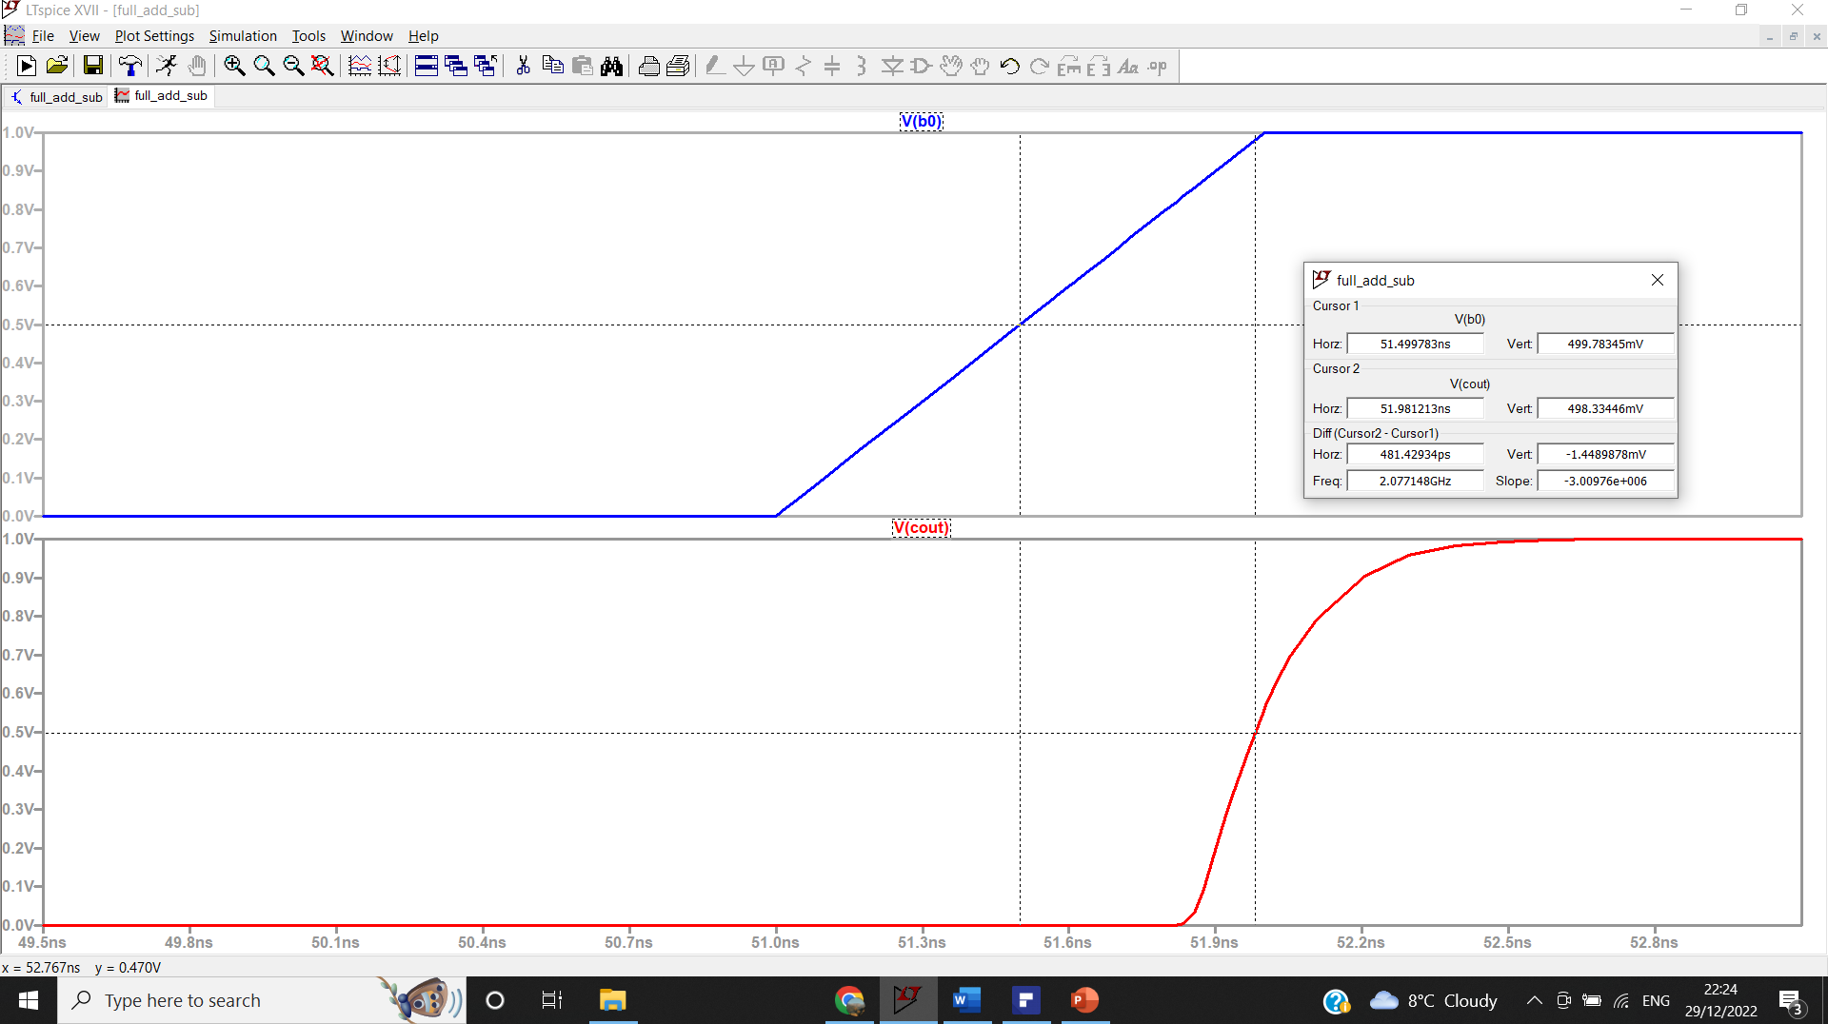
the adder worst case delay :
481.42 PS

