Slide 1

Date Fruit Image Classification
Talal Aloushan
CSC462 - Machine Learning
Nov 2024

Slide 2

Contents
1. Project Overview
2. Problem Description and Importance
3. Platform and Dataset
4. CNN Approach Overview
5. Approach 1: Custom CNN Model
6. Approach 2: Transfer Learning with EfficientNetB0
7. Approach 3: YOLOv11n-cls Model
8. Conclusion

Slide 3

Project Overview
This presentation covers a machine learning project focused on classifying date fruit varieties. The aim is to solve the challenge of sorting dates quickly and accurately using computer vision, ensuring quality control, accurate pricing, and proper sorting in the agricultural industry.

Slide 4

Problem Description and Importance
In today's fast-paced agricultural industry, distinguishing different types of dates quickly and accurately is challenging. Manual sorting is time-consuming and error-prone. By using computer vision to categorize dates automatically, the process can be streamlined. This technology ensures consistent quality control, fair pricing, and proper sorting, benefiting farmers, processors, and consumers.

Slide 5
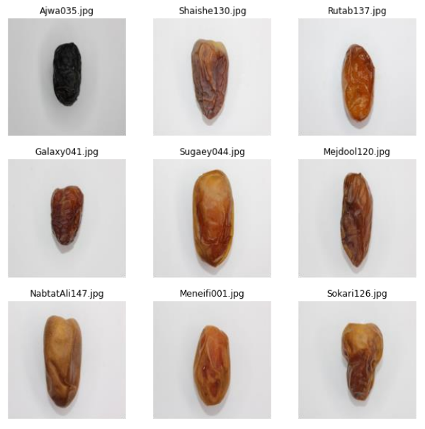
Dataset
1. Training Set
1156 samples
2. Validation Set
502 samples
3. Image Size
600x400

Slide 6
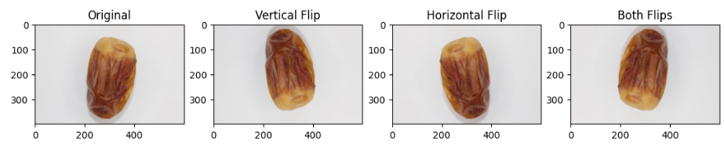
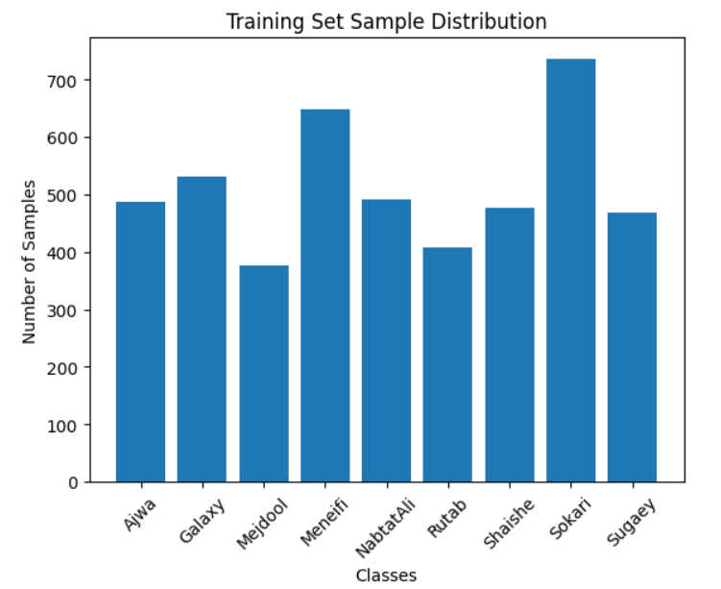
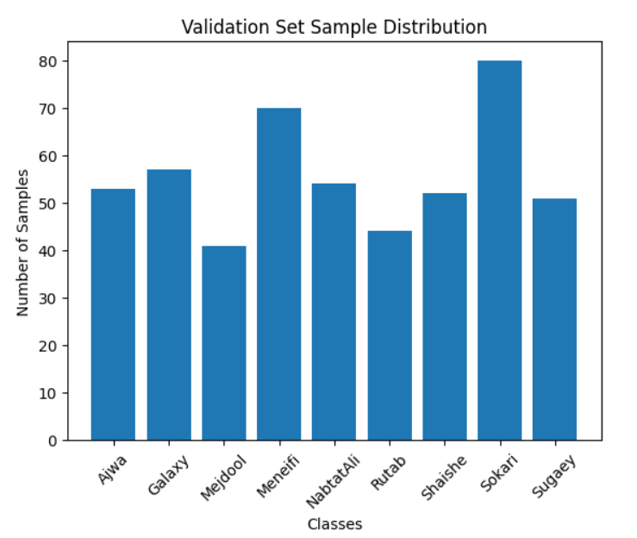
Dataset
After Augmentation
4624 samples for training.

Slide 7
CNN Approach Overview
Three approaches were explored for training a CNN model:
1. Custom CNN model using TensorFlow
2. Transfer learning with EfficientNetB0
3. Fine-tuning YOLOv11n-cls model

Slide 8
Approach 1: Custom CNN Model
Model Architecture and Training
Data Preprocessing
Architecture
┏━━━━━━━━━━━━━━━━━━━━━━━━━━━━━━━━━┳━━━━━━━━━━━━━━━━━━━━━━━━┳━━━━━━━━━━━━━━━┓
┃ Layer (type) ┃ Output Shape ┃ Param # ┃
┡━━━━━━━━━━━━━━━━━━━━━━━━━━━━━━━━━╇━━━━━━━━━━━━━━━━━━━━━━━━╇━━━━━━━━━━━━━━━┩
│ conv2d_9 (Conv2D) │ (None, 196, 196, 32) │ 2,432 │
├─────────────────────────────────┼────────────────────────┼───────────────┤
│ max_pooling2d_9 (MaxPooling2D) │ (None, 98, 98, 32) │ 0 │
├─────────────────────────────────┼────────────────────────┼───────────────┤
│ conv2d_10 (Conv2D) │ (None, 96, 96, 32) │ 9,248 │
├─────────────────────────────────┼────────────────────────┼───────────────┤
│ max_pooling2d_10 (MaxPooling2D) │ (None, 48, 48, 32) │ 0 │
├─────────────────────────────────┼────────────────────────┼───────────────┤
│ conv2d_11 (Conv2D) │ (None, 46, 46, 32) │ 9,248 │
├─────────────────────────────────┼────────────────────────┼───────────────┤
│ max_pooling2d_11 (MaxPooling2D) │ (None, 23, 23, 32) │ 0 │
├─────────────────────────────────┼────────────────────────┼───────────────┤
│ flatten_3 (Flatten) │ (None, 16928) │ 0 │
├─────────────────────────────────┼────────────────────────┼───────────────┤
│ dense_6 (Dense) │ (None, 256) │ 4,333,824 │
├─────────────────────────────────┼────────────────────────┼───────────────┤
│ dropout_3 (Dropout) │ (None, 256) │ 0 │
├─────────────────────────────────┼────────────────────────┼───────────────┤
│ dense_7 (Dense) │ (None, 9) │ 2,313 │
└─────────────────────────────────┴────────────────────────┴───────────────┘
Total params: 4,357,065
- Batched data into 32 batches
- Scaled pixel values to [0,1]
- Resized images to 200x200
Optimizer and Epochs:
- Adam with learning rate 0.00001
- Epochs: 300
- Loss Function: Categorical Crossentropy
- Metrics: Accuracy

Slide 9
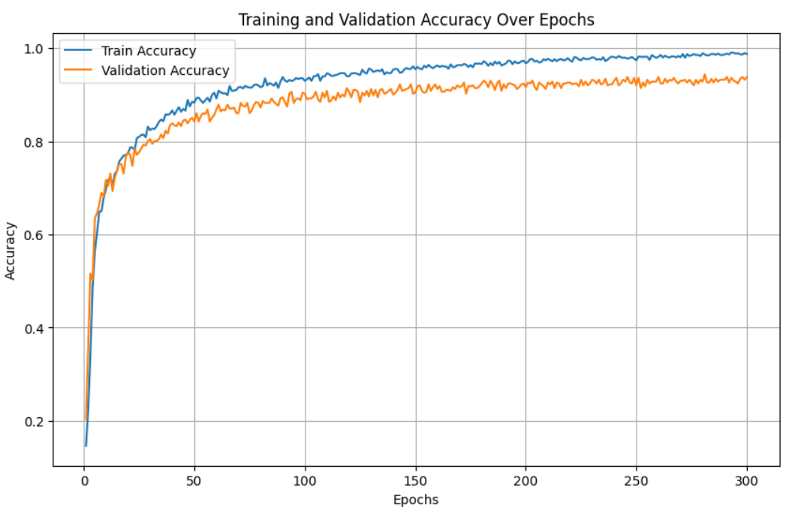
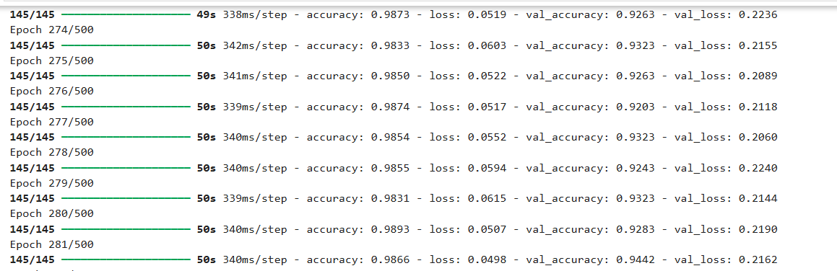
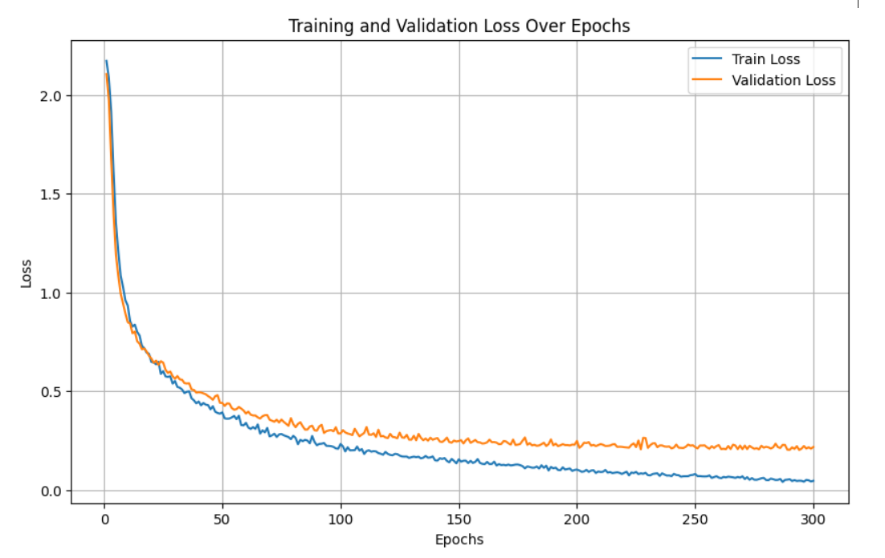
Approach 1: Custom CNN Model
Model Architecture and Training
Performance
Achieved 94% accuracy

Slide 10
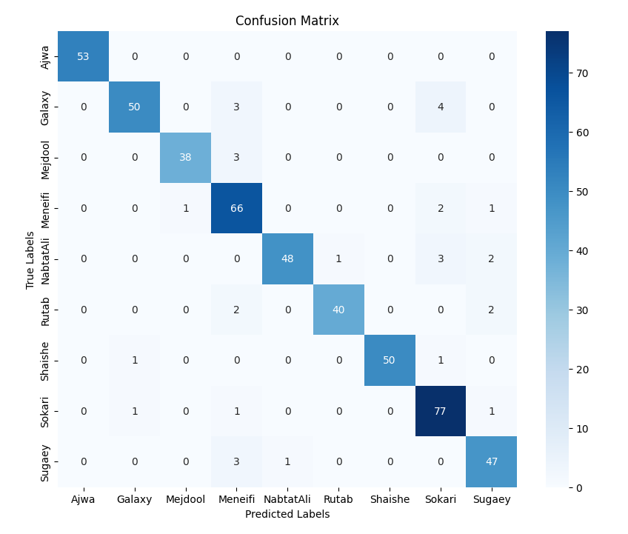
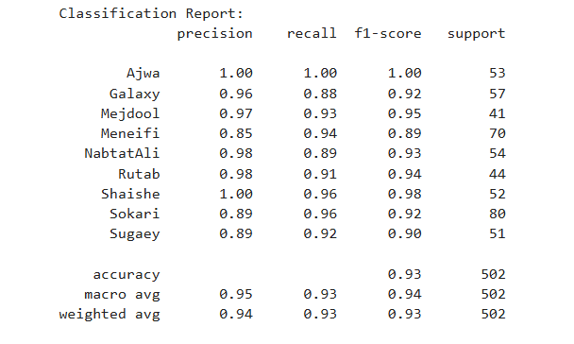
Approach 1: Custom CNN Model
Model Architecture and Training

Slide 11

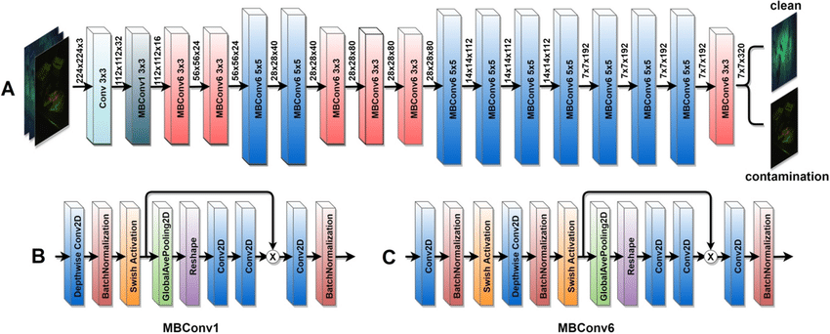
Approach 2: EfficientNetB0
Frozen Model
Data Preprocessing
- Batched data into 32 batches
- Scaled pixel values to [0,1]
- Resized images to 224x224
Architecture
Layer (type) ┃ Output Shape ┃ Param # ┃
┡━━━━━━━━━━━━━━━━━━━━━━━━━━━━━━━━━╇━━━━━━━━━━━━━━━━━━━━━━━━╇━━━━━━━━━━━━━━━┩
│ efficientnetb0 (Functional) │ (None, 7, 7, 1280) │ 4,049,571 │
├─────────────────────────────────┼────────────────────────┼───────────────┤
│ global_average_pooling2d │ (None, 1280) │ 0 │
│ (GlobalAveragePooling2D) │ │ │
├─────────────────────────────────┼────────────────────────┼───────────────┤
│ dropout (Dropout) │ (None, 1280) │ 0 │
├─────────────────────────────────┼────────────────────────┼───────────────┤
│ dense (Dense) │ (None, 9) │ 11,529 │
└─────────────────────────────────┴────────────────────────┴───────────────┘
Total params: 4,061,100
Trainable params: 11,529

Slide 12
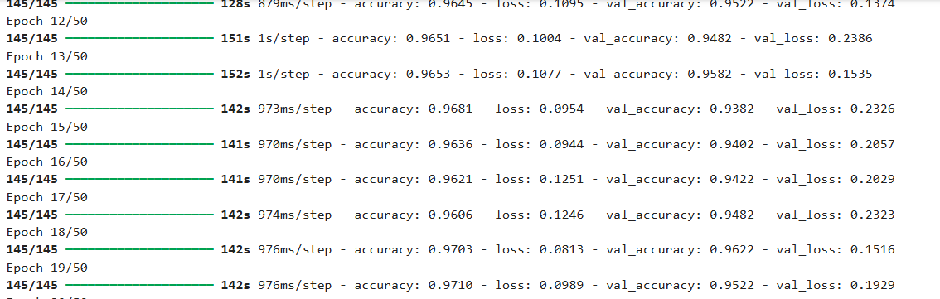
Approach 2: EfficientNetB0
Frozen Model
Optimizer and Epochs
- Adam with learning rate = 0.01
- Loss Function: Categorical Crossentropy
- Metrics: Accuracy
- Epochs: 20
Performance
Achieved 96% accuracy

Slide 13
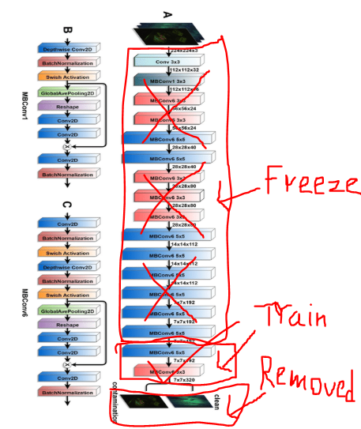
Approach 2: EfficientNetB0
Unfrozen Model
Data Preprocessing
- Batched data into 32 batches
- Scaled pixel values to [0,1]
- Resized images to 224x224
Architecture
Layer (type) ┃ Output Shape ┃ Param # ┃
┡━━━━━━━━━━━━━━━━━━━━━━━━━━━━━━━━━╇━━━━━━━━━━━━━━━━━━━━━━━━╇━━━━━━━━━━━━━━━┩
│ efficientnetb0 (Functional) │ (None, 7, 7, 1280) │ 4,049,571 │
├─────────────────────────────────┼────────────────────────┼───────────────┤
│ global_average_pooling2d │ (None, 1280) │ 0 │
│ (GlobalAveragePooling2D) │ │ │
├─────────────────────────────────┼────────────────────────┼───────────────┤
│ dropout (Dropout) │ (None, 1280) │ 0 │
├─────────────────────────────────┼────────────────────────┼───────────────┤
│ dense (Dense) │ (None, 9) │ 11,529 │
└─────────────────────────────────┴────────────────────────┴───────────────┘
Total params: 4,084,160
Trainable params: 1,354,297
Non-trainable params: 2,706,803

Slide 14
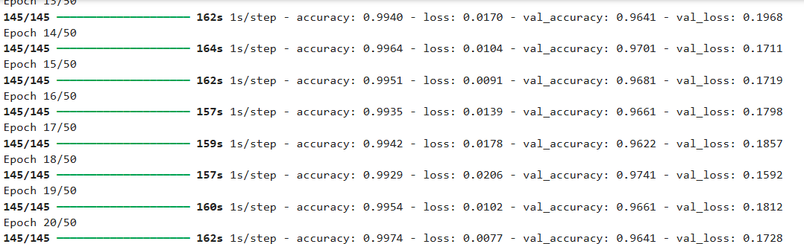
Approach 2: EfficientNetB0
Unfrozen Model
Optimizer and Epochs
- Adam with learning rate = 0.0001
- Loss Function: Categorical Crossentropy
- Metrics: Accuracy
- Epochs: 20
Performance
Achieved 97% accuracy

Slide 15
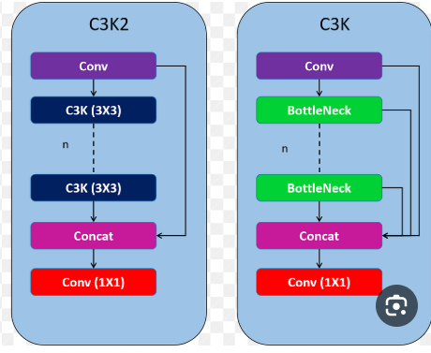
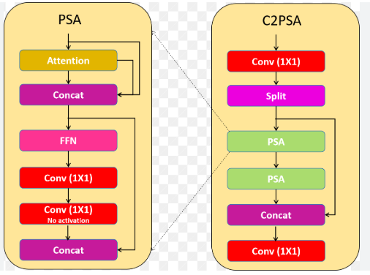
Approach 3: YOLOv11n-cls Model
Data Preprocessing
- Batched data into 16 batches
- Scaled pixel values to [0,1]
- Resized images to 224x224
Architecture
from n params module arguments
-1 1 464 ultralytics.nn.modules.conv.Conv [3, 16, 3, 2]
-1 1 4672 ultralytics.nn.modules.conv.Conv [16, 32, 3, 2]
-1 1 6640 ultralytics.nn.modules.block.C3k2 [32, 64, 1, False, 0.25]
-1 1 36992 ultralytics.nn.modules.conv.Conv [64, 64, 3, 2]
-1 1 26080 ultralytics.nn.modules.block.C3k2 [64, 128, 1, False, 0.25]
-1 1 147712 ultralytics.nn.modules.conv.Conv [128, 128, 3, 2]
-1 1 87040 ultralytics.nn.modules.block.C3k2 [128, 128, 1, True]
-1 1 295424 ultralytics.nn.modules.conv.Conv [128, 256, 3, 2]
-1 1 346112 ultralytics.nn.modules.block.C3k2 [256, 256, 1, True]
-1 1 249728 ultralytics.nn.modules.block.C2PSA [256, 256, 1]
-1 1 357141 ultralytics.nn.modules.head.Classify [256, 21]
YOLO11n-cls summary: 151 layers, 1,558,005 parameters, 1,558,005 gradients, 3.3 GFLOPs

Slide 16
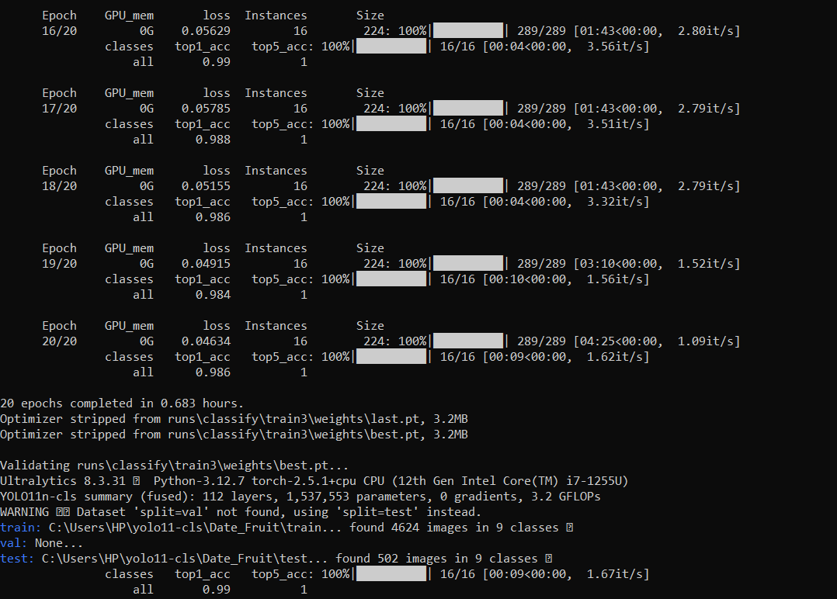
Approach 3: YOLOv11n-cls Model
Optimizer and Epochs
- AdamW with learning rate = 0.000714
- Loss Function: Categorical Crossentropy
- Metrics: Accuracy
- Epochs: 20
Performance
Achieved 99% accuracy

Slide 17
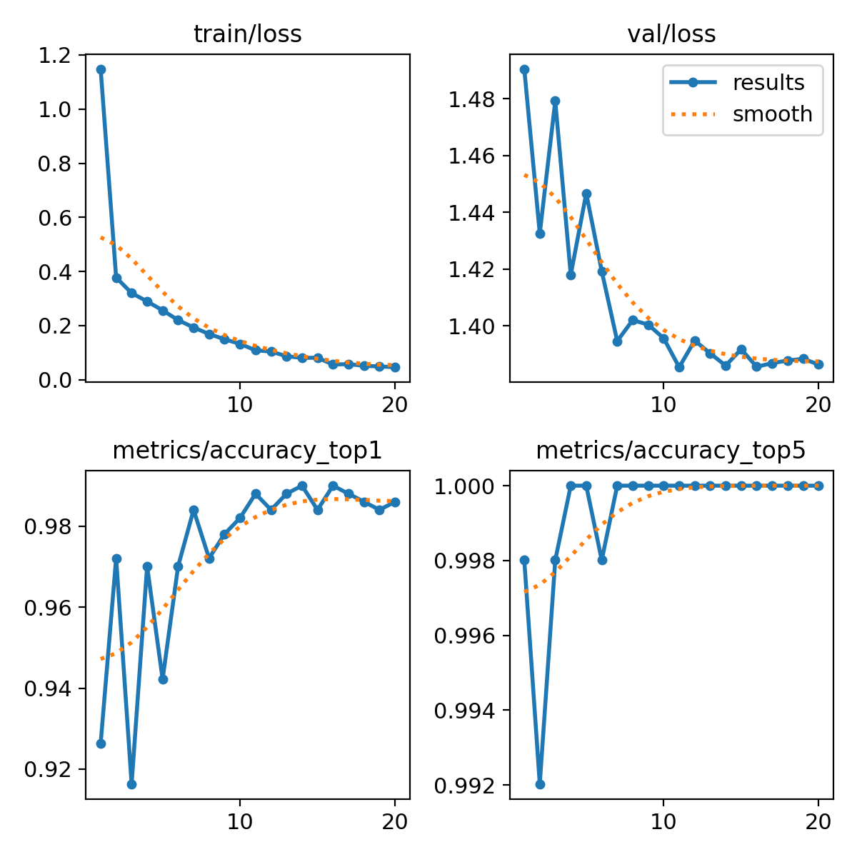
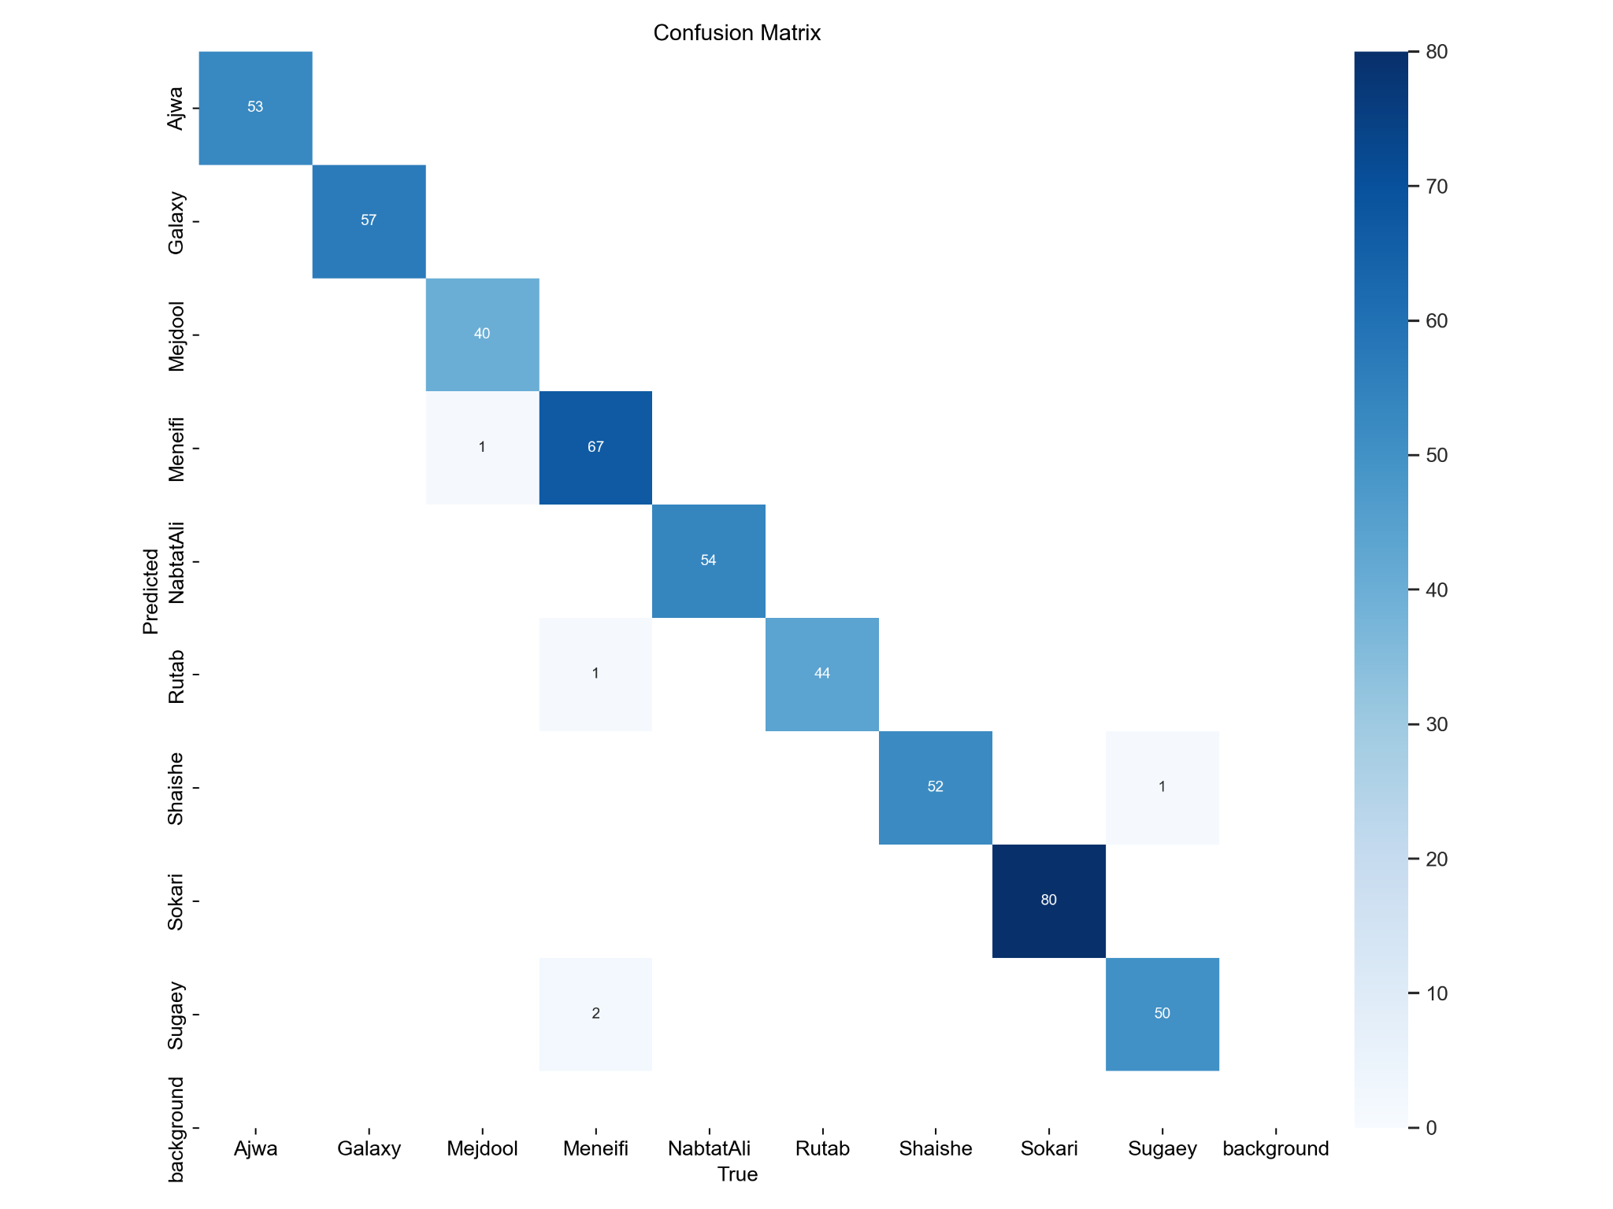
Approach 3: YOLOv11n-cls Model

Slide 18
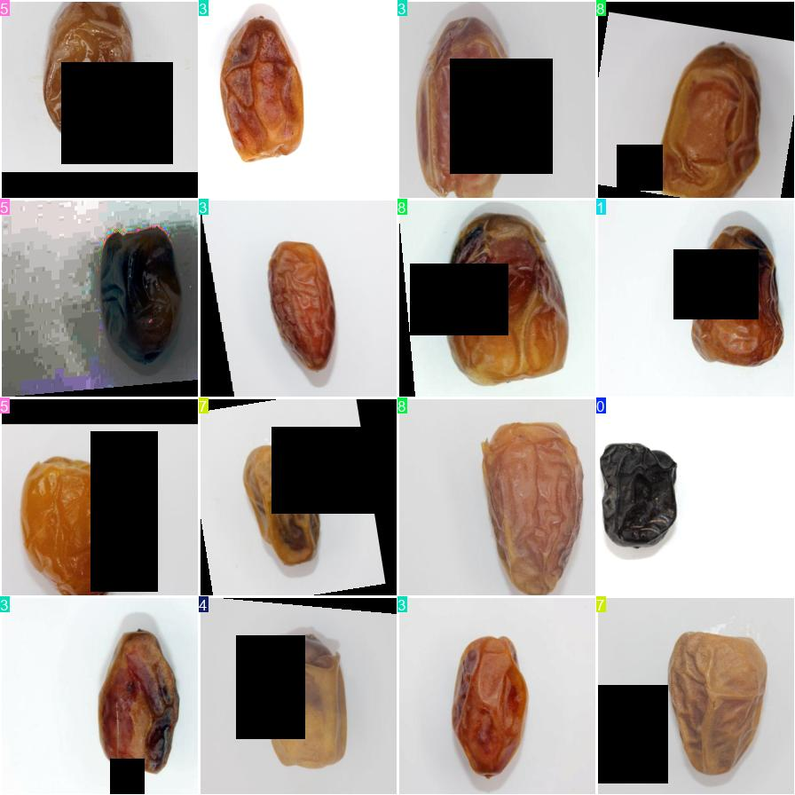
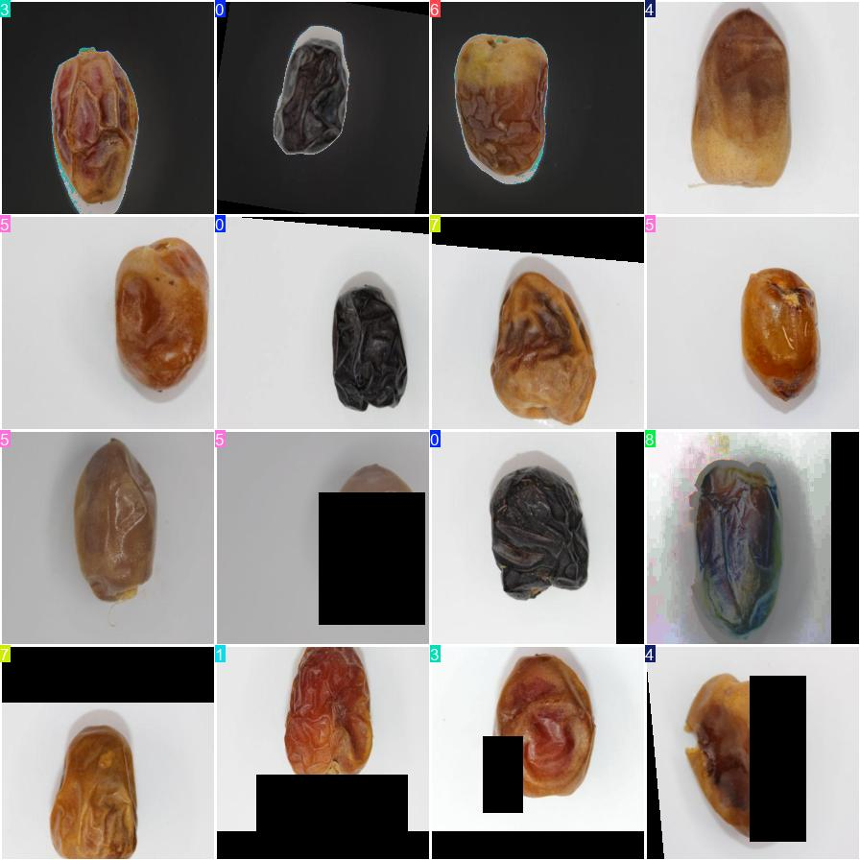
Approach 3: YOLOv11n-cls Model
YOLOv11-cls default random augmentations during training

Slide 19
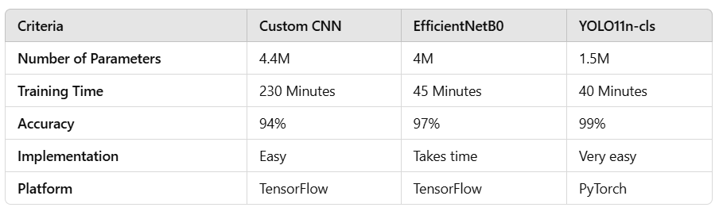
Comparison

Slide 20
Challenges
One of the challenges i had is the training time, when i was creating the custom CNN at first, i was having a very long time in each epoch so i reduced the model sized, also in EffecientnetB0 i tried to unfreeze 50% of the model but i got a long training time, so i decided to unfreeze 10% only, however i was using a cpu, if i used a gpu that would be a different case

Slide 21
Conclusion
In the project i successfully developed and trained models to classify date fruits with high accuracy. The custom CNN model achieved 94% accuracy, transfer learning with EfficientNetB0 reached up to 97%, and the YOLOv11n-cls model achieved 99% accuracy. This work demonstrates the potential of using computer vision in agriculture to improve sorting processes and quality control.

