Slide 1
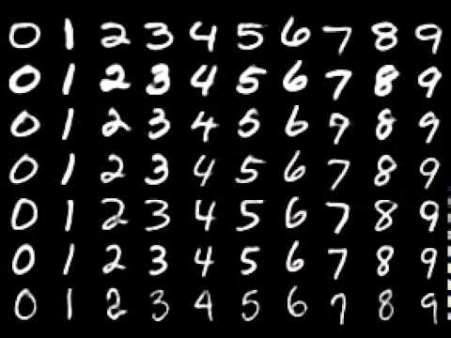
Deep Neural Networks for Hand-Written Digits Recognition
PS-Today

Slide 2
Artificial Intelligence
The Big Picture
Weak AI: Simulate some aspects of human intelligence (Narrow, Non-Sentient, Non-Conscious)
Strong AI: Simulate real human intelligence (Machine’s capabilities become equal to the human brain)

Slide 3
AI Approaches
Old: The majority of techniques depend on search algorithms (Playing Chess) and rule-based inference.
New: Statistical Models (Supervised, Unsupervised, and Reinforcement Learning)

Slide 4
Deep Neural Networks
(Supervised Learning)
Pros:
General Purpose
Very Effective (Surprisingly)
Cons:
Needs a large amount of data
Depends on the quality of the data
(Garbage In → Garbage Out)
Training takes a long amount of time

Slide 5
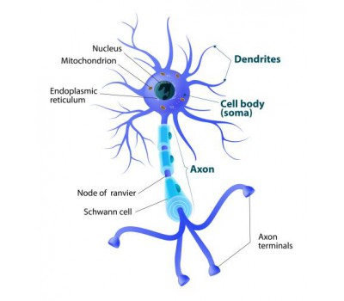
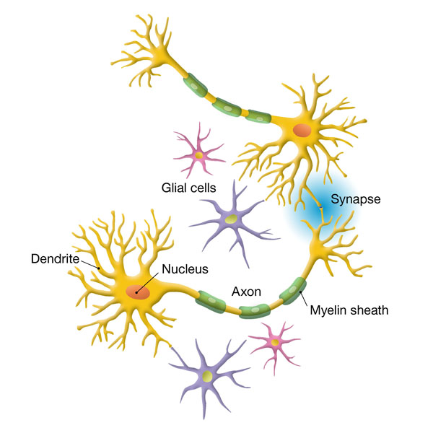
Inspired by Human Biology
(Human brain contains 100 billion Neuron)

Slide 6
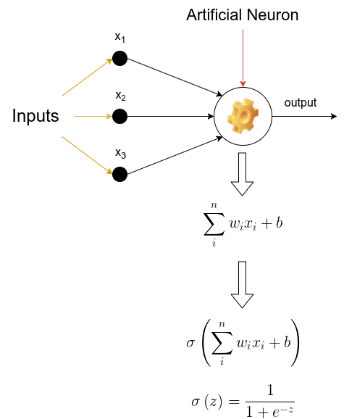
A Mathematical Reductionist Approach to the Problem of AI

Slide 7
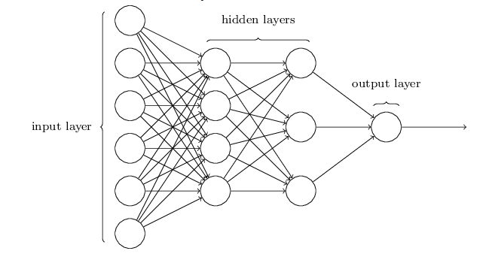

Slide 8
