Slide 1
COMP 472
Assignment 1 Presentatio n

Slide 2
Contributers:
Talal Bazerbachi (ID: 40023278)
Hani Sabsoub (ID: --)

Slide 3
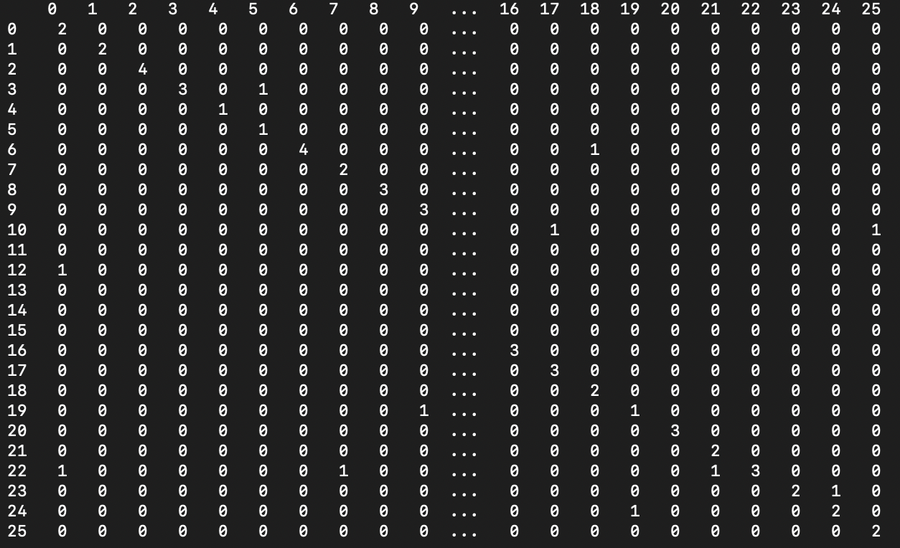
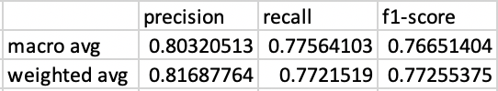
Preceptron
Data Set 1
Confusion Matrix
Metrics Report

Slide 4
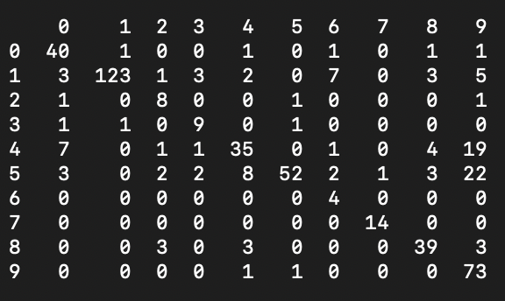
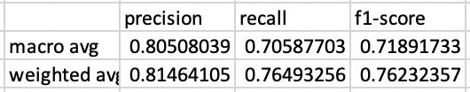
Preceptron
Data Set 2
Confusion Matrix
Metrics Report

Slide 5
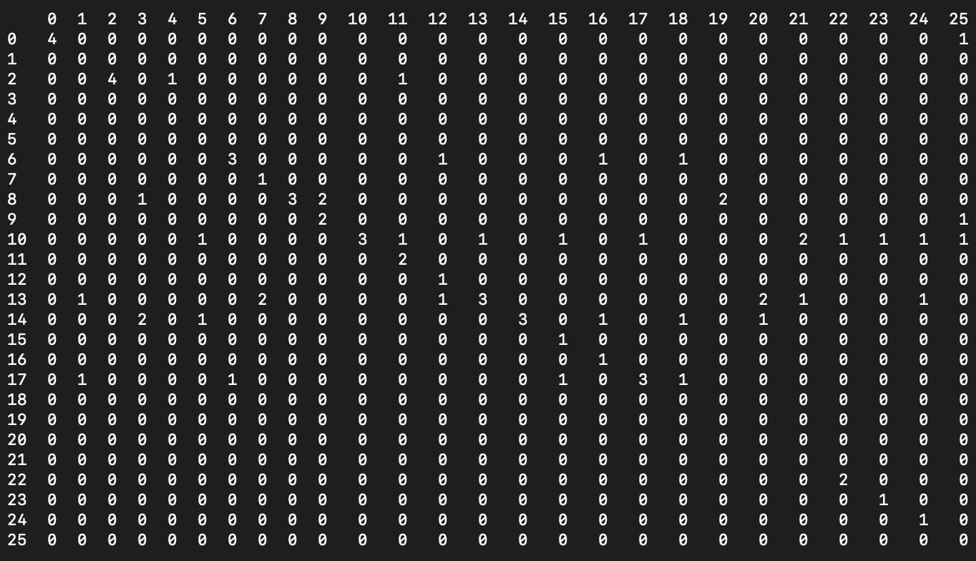
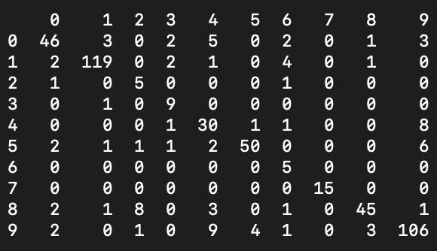
Base MLP
Confusion Matrix
Data Set 1
Data Set 2

Slide 6
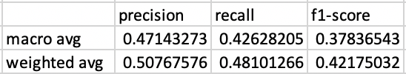
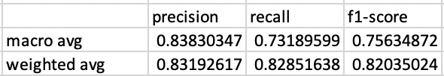
Base MLP
Data Set 1 Metrics Report
Data Set 2 Metrics Report

Slide 7
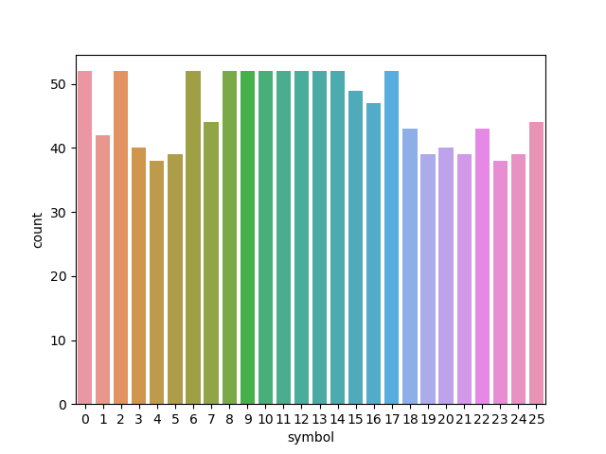
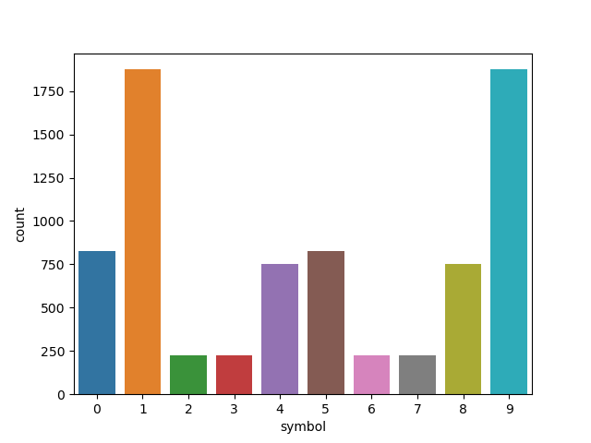
Base MLP
Data Set 1
Data Set 2

Slide 8
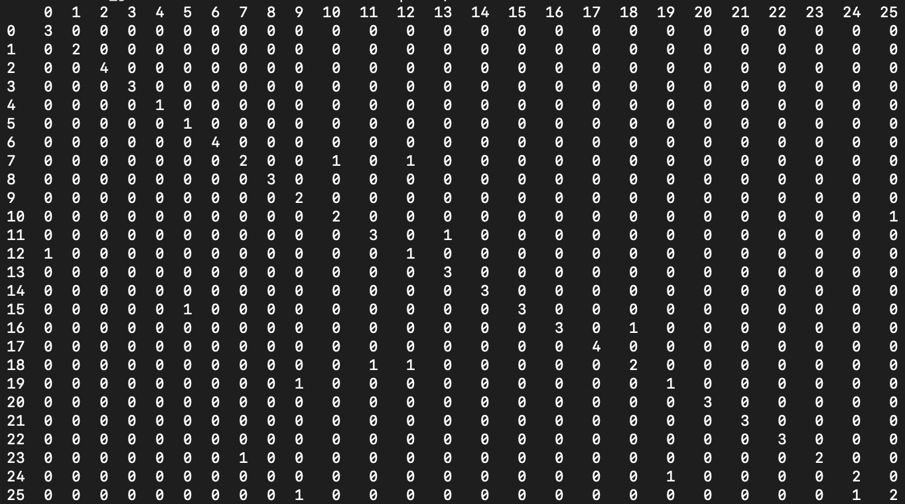
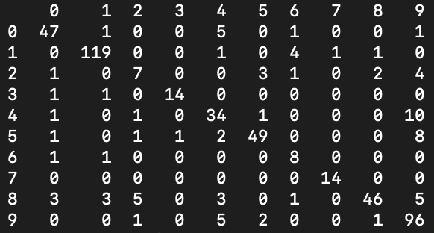
Best MLP
Confusion Matrix
Data Set 1
Data Set 2

Slide 9
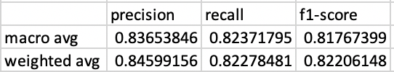
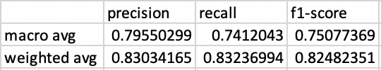
Best MLP
Metrics Reports
Data Set 1
Data Set 2

Slide 10
Best MLP
Data Set 1
Data Set 2

