Slide 1
Bank Customers Churn Classification

Slide 2
Table of contents
01
Introduction
02
Methodology
03
Classification
04
Conclusion

Slide 3
01
Introduction

Slide 4
Introduction
In this work the purpose is to build a model that predicts if a customer will churn form the bank (or not) given various data points and information from historical data:
Goals:
Predicting if a customer will leave or not.
Banks will be able to predict the risk of the customer on whether they will leave or not.

Slide 5
02
Methodology

Slide 6
Methodology
-Outliers
-Dummy Variables
Feature Engineering
Data Extraction
-Data from Kaggle
-10000 Row
-14 Columns
-Data Wrangling
-Data Cleaning
-Visualization
EDA
Models
-Model Preprocessing
-Building Models

Slide 7




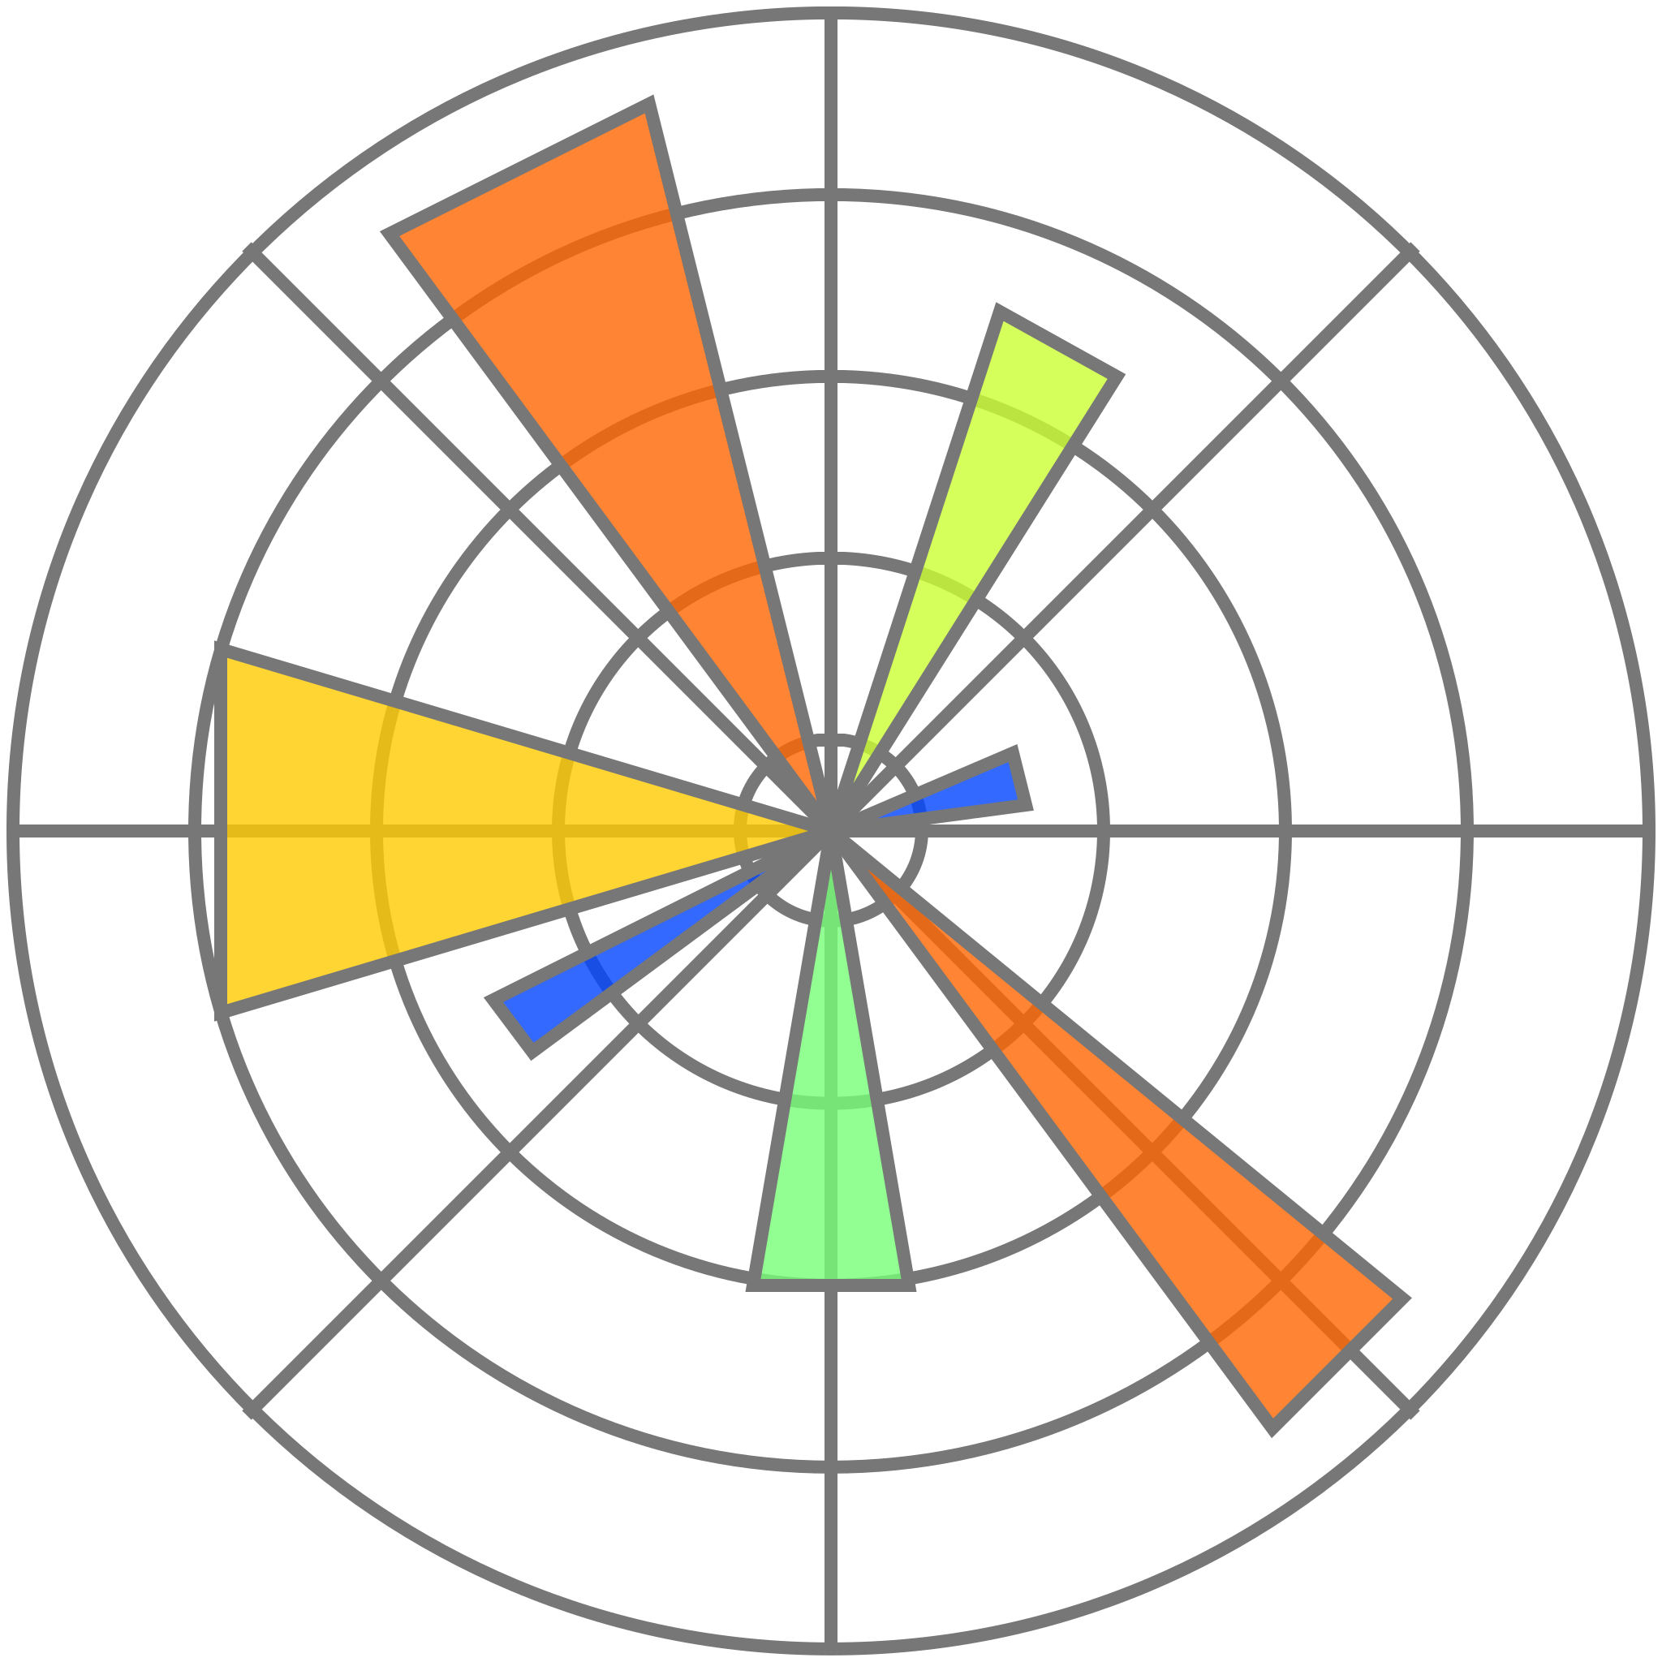


Tools
Jupyter Notebook
Pandas
Seaborn
Matplotlib
Sklearn
NumPy
Dabl

Slide 8
Data Split
20%
20%
60%
Test
Validation
Training

Slide 9
Exploratory Data Analysis
Data Cleaning
Same size after cleaning
No extreme values
Imbalanced data

Slide 10
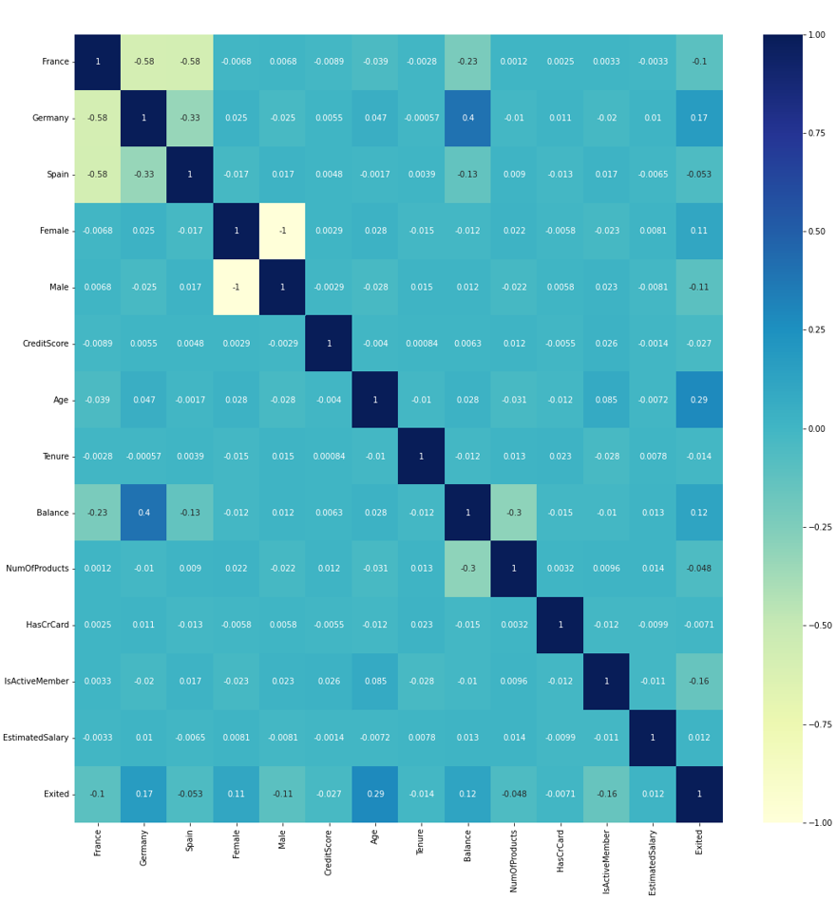
Heatmap
Features that has big correlation with exiting the bank:
Age (29%)
Customers in Germany (17%)
Female customers (11%)

Slide 11
03
Data Preprocessing

Slide 12
Feature Engineering
Steps:
Feature selection using LASSO and Recursive Feature Elimination
Dummy variables
Outliers

Slide 13
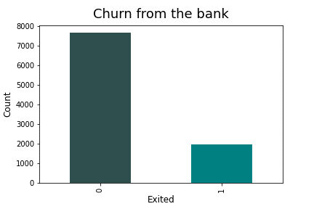
Data Imbalance
Solved using RandomOverSampler (ROS)

Slide 14
04
Models

Slide 15
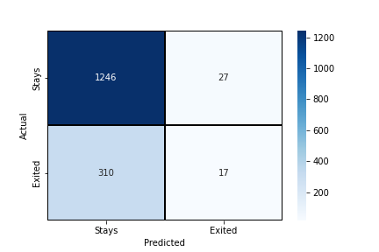
Baseline Model: Logistic Regression
Score | Training | Validation
Accuracy | 0.6659 | 0.6641
Precision | 0.6636 | 0.6636
Recall | 0.6800 | 0.6801
F1 | 0.6717 | 0.6718

Slide 16
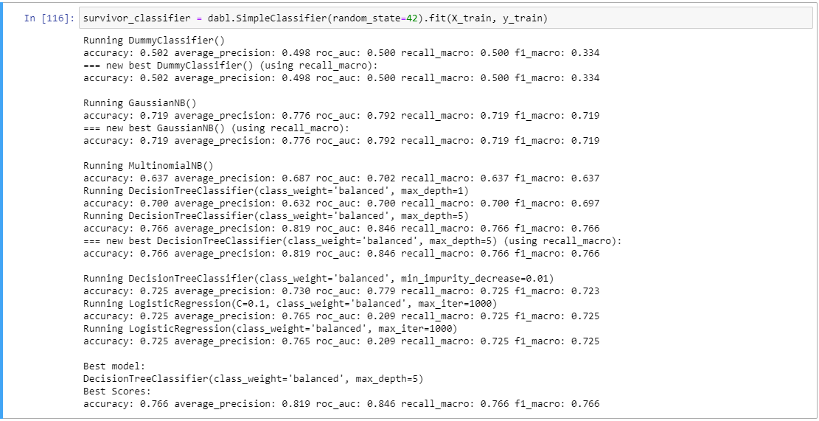
DABL Modeling

Slide 17
Classification Models
Model | Accuracy | F1-Score
Logistic Regression | 0.7468 | 0.7461
KNN | 0.8702 | 0.8781
Random Forest | 0.8812 | 0.8881
Gaussian Naïve Bayes | 0.7444 | 0.7411
SVM | 0.7424 | 0.7372
Decision Tree | 0.8751 | 0.8830
XGB | 0.8221 | 0.8236

Slide 18
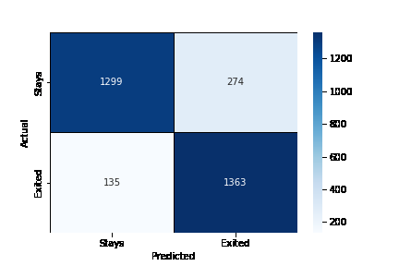
Ensemble: Max Voting Classifier
Training Accuracy: 0.9438
Testing Accuracy: 0.8668

Slide 19
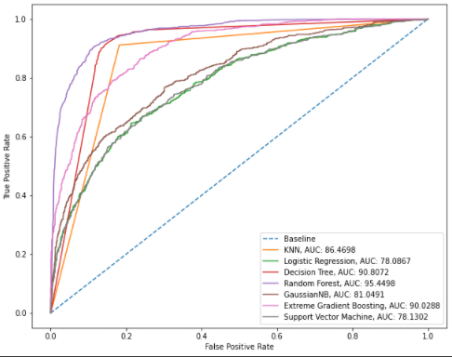
ROC Curve Graph

Slide 20
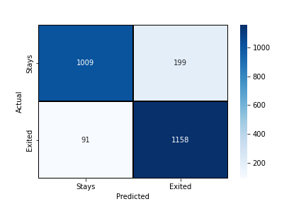
Best Model: Random Forest
RF | Training | Valid | Testing
Accuracy | 0.9619 | 0.8799 | 0.8828
Precision | 0.9658 | 0.8497 | 0.8411
Recall | 0.9580 | 0.9279 | 0.9366
F1 | 0.9619 | 0.8871 | 0.8863

Slide 21
Conclusions
The best model to predict is Random Forest.
Highest validation accuracy.

Slide 22
Thanks!
Do you have any questions?

