Slide 1
IMDB Movies Gross Prediction

Slide 2
Table of contents
01
02
03
04
Introduction
Methodology
Data preprocessing and Analysis
Conclusion

Slide 3
01
Introduction

Slide 4
Introduction
Objective:
IMDB Movies gross prediction
Using multiple regression models.
Finding the best regression model.

Slide 5
02
Methodology

Slide 6
Methodology
Exploratory Data Analysis
Regression
-Cleaning (nulls, duplicates, spacing)
-Data Analysis
Linear
K-fold
Polynomial
Ridge
01
02
03
04
Data Extraction
Data Preprocessing
Web scraping using Beautiful Soup. 1000 records and 8 features

Slide 7
Tools
Jupyter Notebook
Pandas
Matplotlib
BeautifulSoup
NumPy
Seaborn

Slide 8
Data Preprocessing
Steps:
Feature Selection.
Data Splitting.
Regression models ( K-fold , Ridge, Linear , Polynomial).

Slide 9
Data Splitting
20%
20%
60%
Validation
Test
Train

Slide 10
Regression Models
 | Regression Models | Training Score | Validation Score
 | Normal LR | 0.474546437 | 0.338569574
 | K-fold LR | 0.474546438 | 0.459359399
 | Polynomial Regression | 0.53764559 | 0.44003267
 | Ridge Regression | 0.47454317 | 0.33885845
 | RR Cross-Validation | 0.474492806 | 0.459387872

Slide 11
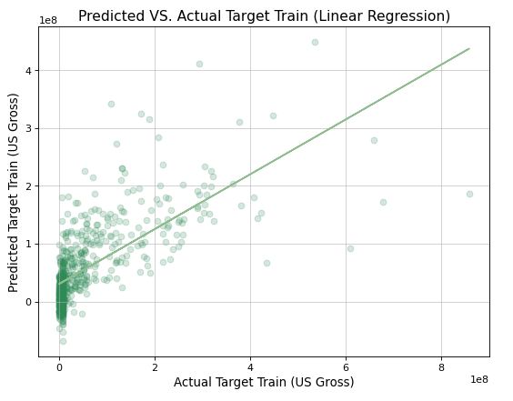
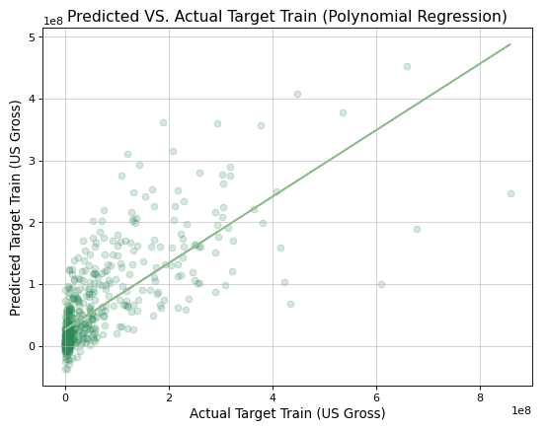
Analysis
Testing Score:0.58248222

Slide 12
Conclusion
Polynomial Linear Regression
After testing multiple models.
Polynomial Regression is the best model for IMDB movies gross prediction

Slide 13
Thanks
Please keep this slide for attribution

