Slide 1

University of Management and Future Technologies
Fundamental fanlar kafedrasi
Fan: Algoritmlarni loyihalashtirish va tahlil qilish
Mavzu: Algoritmlarning bajarilish vaqtini baholash.
Ma’ruzachi: Umarov Muhriddin
Toshkent - 2023

Slide 2
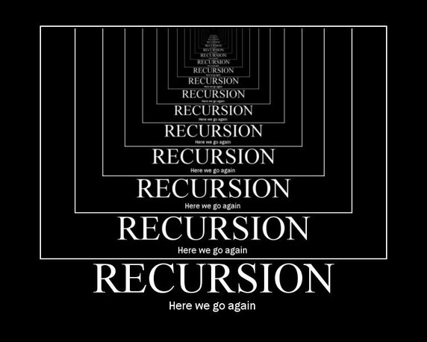

Slide 3
Mathematical Recurrences
Recurrences are used to represent the runtime of a recursive function
Cost of a recursive algorithm is equal to the cost of non-recursive part plus the recursive call on smaller input size.
We will be spending time looking at recurrences of the form
a is the number of times a function calls itself
b is the factor by which the input size is reduced
f(n) is the runtime of each function usually expressed in terms of Θ.

Slide 4
Recurrence Example
Factorial (n)
{
if (n == 1)
return 1;
else
return (n * Factorial(n-1));
}
The expression:
is a recurrence.

Slide 5
Recurrence Example: n^{Y}
Power (n, y)
{
if (y == 0)
return 1;
else
return (n * Power(n, y-1));
}
The expression:

Slide 6
// C++ program to find
// factorial of given number
#include <iostream>
using namespace std;
// Function to find factorial
// of given number
unsigned int factorial(unsigned int n)
{
if (n == 0 || n == 1)
return 1;
return n * factorial(n - 1);
}
// Driver code
int main()
{
int num = 5;
cout << "Factorial of "
<< num << " is " << factorial(num) << endl;
return 0;
}

Slide 7
Recurrence Examples

Slide 8
Running Time of Recurrence Equation
Algorithm min1(a[1],a[2],…,a[n]):
1. If n = = 1, return a[1].
2. m ← min1(a[1],a[2],…,a[n-1] );
3. If m > a[n], return a[n], else return m
Now, let’s count the number of comparisons.
Steps 1 and 3 will run in constant time Θ(c).
Step 2 will run time recurrence on an input of size n-1
T(n) = T(n -1) + Θ(c);
T(1) = 1;

Slide 9
Binary Search
BinarySearch(A,low,high,key)
if (low >high)
return (–1)
mid ← (low + high)/2
if (key=A[mid])
return mid
else if ( key>A[mid])
BinarySearch(A,mid+1,high,key)
else
BinarySearch(A,low,mid-1,key)
T(n) = T(n/2) + 1,
T(1) = 0.

Slide 10
Fibonacci Sequence
Fib(n)
if ( n<=1)
return n
return (Fib(n-1) + Fib(n-2))
Recurrence Equation:

Slide 11
Fibonacci Sequence
What is the drawback in recursive algorithms?
F(n)
F(n-1)
F(n-2)
F(n-2)
F(n-3)
F(n-3)
F(n-4)
F(0)
F(1)
F(1)
F(0)

Slide 12
// Fibonacci Series using Recursion
#include <bits/stdc++.h>
using namespace std;
int fib(int n)
{
if (n <= 1)
return n;
return fib(n - 1) + fib(n - 2);
}
int main()
{
int n = 9;
cout << fib(n);
getchar();
return 0;
}

Slide 13
// Fibonacci Series using Recursion
#include <bits/stdc++.h>
#include <chrono>
using namespace std;
using namespace std::chrono;
int fib(int n)
{
if (n <= 1)
return n;
return fib(n - 1) + fib(n - 2);
}
int main()
{
int n = 10, times;
high_resolution_clock::time_point t1 = high_resolution_clock::now(); /// Start time
cout << fib(n);
high_resolution_clock::time_point t2 = high_resolution_clock::now(); /// End time
auto duration = duration_cast<microseconds>( t2 - t1 ).count(); /// To microseconds
cout << "\nEach function took " << static_cast<double>(duration) << " microseconds.\n";
getchar();
return 0;
}

Slide 14
The Towers of Hanoi Puzzle
Some problems are computationally too difficult to solve in reasonable period of time. While an effective algorithm exists, we don’t have the time to wait for its completion.
Initially:
Three posts (named Left, Middle, Right)
N disks placed in order on the leftmost post
Goal:
Move all the disks on the leftmost post to the rightmost post
The original ordering must be preserved
Constraints:
Only one disk may be moved at a time.
Disks may not be set aside but must always be placed on a post.
A larger disk may never be placed on top of a smaller disk.

Slide 15
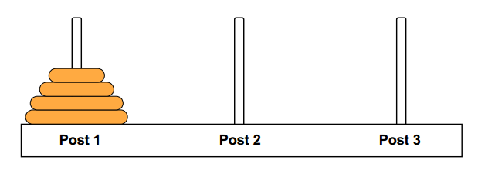
The Towers of Hanoi Puzzle
For n = 3, the fastest solution is:
Move from Left Post to Right Post
Move from Left Post to Middle Post
Move from Right Post to Middle Post
Move from Left Post to Right Post
Move from Middle Post to Left Post
Move from Middle Post to Right Post
Move From Left Post to Right Post
The minimum required number of moves is 7.

Slide 16
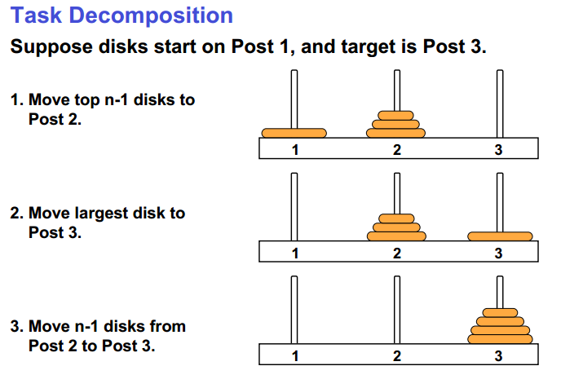
Making an Algorithm

Slide 17
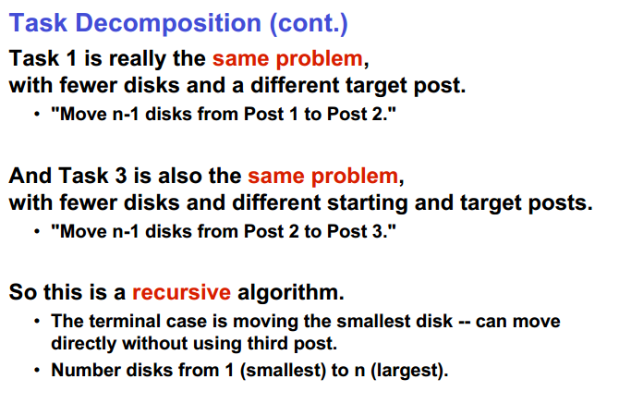

Slide 18
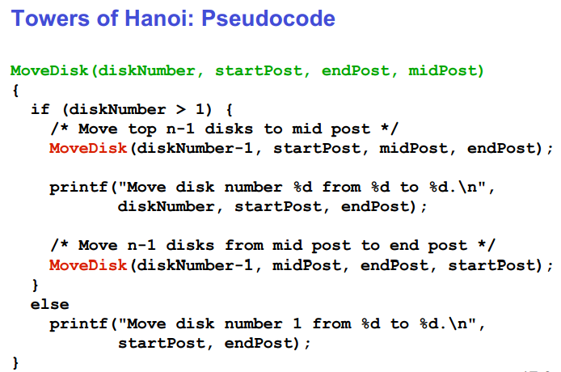

Slide 19
The Towers of Hanoi Puzzle
Run-Time Analysis
Disks Required Moves
1 1
2 3
3 7
4 15
5 31
: :
N
2^{N} - 1
2^{n} – 1 ε Big O(2^{n})

Slide 20
Solving Recurrences
Three methods are used in “solving” recurrences
The Substitution Method
The Recursion Tree Method
The Master Method

Slide 21
Substitution Method
Substitution method has two steps
Guess the form of the solution
Use induction to prove that the solution is correct
The substitution method can be used to establish an upper bound on difficult recurrences.
Its use is based on the strength of the guess
applied in cases when it’s easy to guess the form of answer

Slide 22
Substitution Method
Quick Sort and Merge Sort Evaluation

Slide 23
Substitution Method

Slide 24
Substitution Method
Quick Sort Worst case: pivot is smallest/largest element all the time.
T(n) = T(n-1) + cn
T(n-1) = T(n-2) + c(n-1)
T(n-2) = T(n-3) + c(n-2)
…
T(n-k) = T(n-k-1) + c(n-k)
T(n) = T(n-1) + cn ➔ T(n) = T(n-2) + c(n-1) + cn
T(n) = T(n-3) + c(n-2) + c(n-1) + cn ➔ T(n) = T(n-k) + c(n + n-1 + … n-k)

Slide 25
Substitution Method
Solve the recurrence relation given below.
Solution:

Slide 26
Substitution Method

Slide 27
Substitution Method

Slide 28
Substitution Method

Slide 29
Substitution Method

Slide 30
Substitution Method

Slide 31
Substitution Method

Slide 32
Substitution Method

Slide 33
Recursion Tree Method
Although substitution method can provide a sufficient proof that a solution to a recurrence is correct, sometimes difficult to give a good guess.
Draw a recursion tree
straight forward way to devise a good guess.
In recursion tree, nodes represent costs of a sub-problems in the set of recursive function invocations.
Sum up processing done at each level of the tree
Then sum all per-level costs to determine the total cost of all levels of the recursion.
Useful when recurrence describes running time of divide and conquer algorithms.

Slide 34
Recursion Tree Method
Using recursion tree to generate a good guess, we can often tolerate a small amount of sloppiness since we have to verify it later on.
If we are careful when drawing out a recursion tree and summing costs, then we can use a recursion tree as a direct proof of a solution to any recurrence of any problem.

Slide 35
Recursion Tree Method
Example:
Solve the following recurrence using recurrence tree method
Solution: The above recurrence can be written in the form
Assumption: We assume that n is exact power of 4.
The recurrence tree is given in the next slide

Slide 36
Recursion Tree Method

Slide 37
Recursion Tree Method

Slide 38
Recursion Tree Method
Θ(n^{log}₄³⁾

Slide 39
Recursion Tree Method
Total computation cost = Cost of Children
+ Cost of tree excluding children
= Cost of Child x total number of Children
+ Cost of all levels excluding children level
= total number of Children + sum of costs at each
level excluding children level.

Slide 40
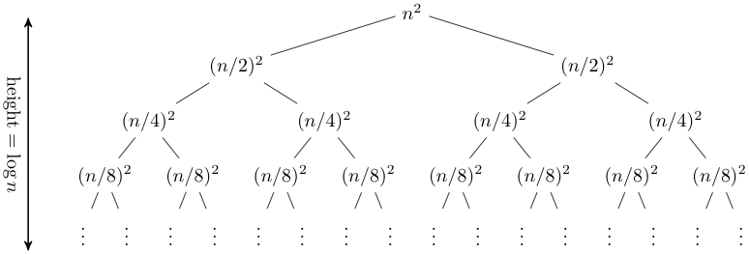
Recursion Tree Method
T(n) = 2T(n/2) + n².

Slide 41
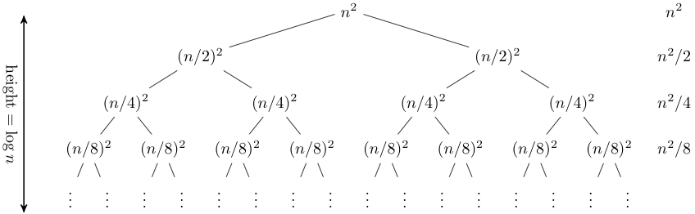
Recursion Tree Method

Slide 42
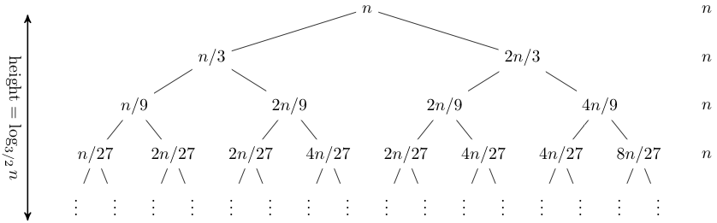
Recursion Tree Method
T(n) = T(n/3) + T(2n/3) + n.

Slide 43
Recursion Tree Method
Solve T(n) = T(n/4) + T(n/2) + n²:

Slide 44
Recursion Tree Method
Solve T(n) = T(n/4) + T(n/2) + n²:
T(n)

Slide 45
Recursion Tree Method
Solve T(n) = T(n/4) + T(n/2) + n²:
n²
T(n/4)
T(n/2)

Slide 46
Recursion Tree Method
Solve T(n) = T(n/4) + T(n/2) + n²:
n²
(n/4)²
(n/2)²
T(n/16)
T(n/8)
T(n/8)
T(n/4)

Slide 47
Recursion Tree Method
Solve T(n) = T(n/4) + T(n/2) + n²:
n²
(n/4)²
(n/2)²
(n/16)²
(n/8)²
(n/8)²
(n/4)²
…
Θ(1)

Slide 48
Recursion Tree Method
Solve T(n) = T(n/4) + T(n/2) + n²:
n²
(n/4)²
(n/2)²
(n/16)²
(n/8)²
(n/8)²
(n/4)²
…
Θ(1)

Slide 49
Recursion Tree Method
Solve T(n) = T(n/4) + T(n/2) + n²:
n²
(n/4)²
(n/2)²
(n/16)²
(n/8)²
(n/8)²
(n/4)²
…
Θ(1)

Slide 50
Recursion Tree Method
Solve T(n) = T(n/4) + T(n/2) + n²:
n²
(n/4)²
(n/2)²
(n/16)²
(n/8)²
(n/8)²
(n/4)²
…
…
Θ(1)

Slide 51
Recursion Tree Method
Solve T(n) = T(n/4) + T(n/2) + n²:
n²
(n/4)²
(n/2)²
(n/16)²
(n/8)²
(n/8)²
(n/4)²
…
…
Θ(1)
Total =
= Θ(n²)
geometric series

Slide 52
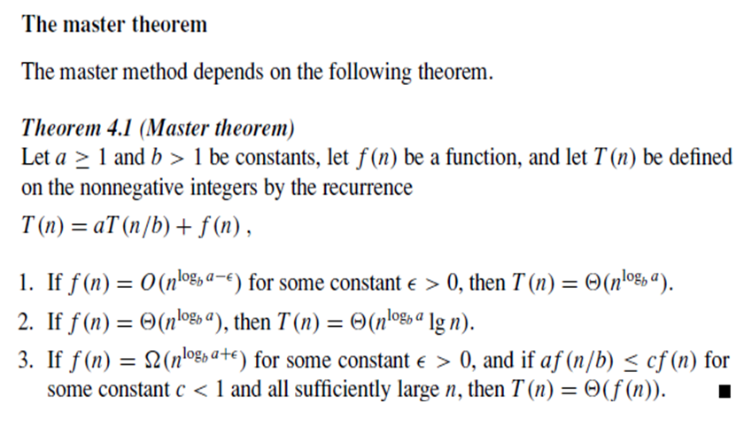
Master Method

Slide 53
Example 1
T(n) = 9T(n/3) + n
f(n) = n,
n^{logba} = n²
compare f(n) = n with the cost of recursiveness..
n = O(n^{2 -ε}) (ε =1, so f(n) =n^{logba} ),
case 1 will apply here T(n) = θ(n²)

Slide 54
Example 2: Binary Search
T(n) = T(n/2) + 1
f(n) = 1, n^{logba} = n⁰ = 1
1 = θ(n⁰)
(driving cost f(n) is polynomial equal to the cost of recursiveness, n^{logba} )
case 2 applies: T(n) = θ(n⁰lgn) = θ(lgn)

Slide 55
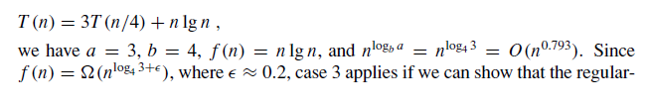

Example 3

Slide 56
Example 4
T(n) = T(n/2) + n²
n^{logb a} = n^{log2 1} = n⁰ = 1 where ε=2
Since f(n) = O(n^{log2 1 + 2})= n², where ε=2, case III applies:
Case III if f(n)= Ω(n^{logB a + ε}) for some constant ε>0, and if af(n/b)<=cf(n) for some constant c<1 and all sufficient large n, then T(n) = Θ (f(n))
af(n/b)<=cf(n)
n²/4 <= cn² → 1/4<=c
Thus the solution is T(n) = Θ(n²)

Slide 57
Example 5
T(n) = 4T(n/2) + n²
D(n) = n², n^{logba} = n^{lg4} = n²
compare both sides, D(n) with n²
polynomially equal, case 2 holds, T(n) = θ(n²lgn)

Slide 58
Example 6
T(n) = 7T(n/3) + n²
f(n) = n², n^{logba} = n^{log37} = n^{1+ ε}
compare f(n) = n² with n^{1+ ε}, n² = Ω(n^{1+ε}) so f(n) is polynomially larger
Since f(n) is a polynomial in n, case 3 holds and T(n) = θ(n²)

Slide 59
Example 7
T(n) = 7T(n/2) + n²
n^{logba} = n^{log27} = n^{2+ ε}
compare f(n) = n² with n^{2+ ε} f(n) is polynomially smaller
Case 1 holds and T(n) = θ(n^{log27})

Slide 60
Example 8 Complexity Of Merge and Quick Sort
T(n)=2T(n/2) + n
A=2 b=2 f(n)=n
n^{logb a} = n^{log}2² = n which is equal to f(n),
Condition of Case II are satisfied
T(n) = Θ(n^{logb a} lgn)
= Θ(nlgn)

Slide 61
Example 9
T(n) = 4T(n/2) + n³
a=4, b=2, f(n) = n³
n^{logb a} = n^{log2 4} = O(n²) where ε = 1
Since f(n) = O(n^{log2 4 + ε}), where ε=1, case III applies:
Case III if f(n)= Ω(n^{logB a + ε}) for some constant ε>0, and if af(n/b)<=cf(n) for some constant c<1 and all sufficient large n, then T(n) = Θ (f(n))
a f(n/b)= 4(n/2)³ <=4/2n³=c f(n) for c=4/2
af(n/b)=4/8n³<=4/2n³=c f(n)
af(n/b)=n³/2<=2n³=c f(n)
Thus the solution is T(n) = Θ(n³)
f(n)= n³
4f(n/2) = 4(n/2)³
af(n/b)=a (n/b)³

Slide 62
Practice Questions
T (n) = 3T (n/2)+ n²
T (n) = 4T (n/2)+ n
T (n) = T (n/2) + 2n
T (n) = T (n/2) + 1 Binary Search
T (n) = 2nT (n/2) + n
T (n) = 16T (n/4)+ n
T (n) = 2T (n/2)+ n log n
T (n) = 2T (n/4)+ n0.51
T (n) = 0.5T (n/2)+ 1/n
T (n) = p2T (n/2) + log n
T (n) = 3T (n/2)+ n
T (n) = 3T (n/3)+ pn
T (n) = 4T (n/2)+ cn
T (n) = 3T (n/4)+ n log n
T (n) = 3T (n/3)+ n/2
T (n) = 6T (n/3)+ n² log n
T (n) = 4T (n/2)+ n/ log n
T (n) = 64T (n/8)− n² log n
T (n) = 7T (n/3)+ n²
T (n) = 4T (n/2)+ log n
T(n)=2T(n-1)+O(n)
T(n) =3T(n/3) + O(n)

Slide 63
Backup Slides
Recursion Tree Method

Slide 64
s(n) =
c + s(n-1)
c + c + s(n-2)
2c + s(n-2)
2c + c + s(n-3)
3c + s(n-3)
…
kc + s(n-k) = ck + s(n-k)

Slide 65
So far for n >= k we have
s(n) = ck + s(n-k)
What if k = n?
s(n) = cn + s(0) = cn

Slide 66
So far for n >= k we have
s(n) = ck + s(n-k)
What if k = n?
s(n) = cn + s(0) = cn
So
Thus in general
s(n) = cn

Slide 67
s(n)
= n + s(n-1)
= n + n-1 + s(n-2)
= n + n-1 + n-2 + s(n-3)
= n + n-1 + n-2 + n-3 + s(n-4)
= …
= n + n-1 + n-2 + n-3 + … + n-(k-1) + s(n-k)

Slide 68
s(n)
= n + s(n-1)
= n + n-1 + s(n-2)
= n + n-1 + n-2 + s(n-3)
= n + n-1 + n-2 + n-3 + s(n-4)
= …
= n + n-1 + n-2 + n-3 + … + n-(k-1) + s(n-k)
=

Slide 69
So far for n >= k we have

Slide 70
So far for n >= k we have
What if k = n?

Slide 71
So far for n >= k we have
What if k = n?

Slide 72
So far for n >= k we have
What if k = n?
Thus in general

Slide 73
T(n) =
2T(n/2) + c
2(2T(n/2/2) + c) + c
2²T(n/2²) + 2c + c
2²(2T(n/2²/2) + c) + 3c
2³T(n/2³) + 4c + 3c
2³T(n/2³) + 7c
2³(2T(n/2³/2) + c) + 7c
2⁴T(n/2⁴) + 15c
…
2^{k}T(n/2^{k}) + (2^{k} - 1)c

Slide 74
So far for n > 2^{k} we have
T(n) = 2^{k}T(n/2^{k}) + (2^{k} - 1)c
What if k = lg n?
T(n) = 2^{lg n} T(n/2^{lg n}) + (2^{lg n} - 1)c
= n T(n/n) + (n - 1)c
= n T(1) + (n-1)c
= nc + (n-1)c = (2n - 1)c

Slide 75
Example
T(n) =
aT(n/b) + cn
a(aT(n/b/b) + cn/b) + cn
a²T(n/b²) + cna/b + cn
a²T(n/b²) + cn(a/b + 1)
a²(aT(n/b²/b) + cn/b²) + cn(a/b + 1)
a³T(n/b³) + cn(a²/b²) + cn(a/b + 1)
a³T(n/b³) + cn(a²/b² + a/b + 1)
…
a^{k}T(n/b^{k}) + cn(a^{k-1}/b^{k-1} + a^{k-2}/b^{k-2} + … + a²/b² + a/b + 1)

Slide 76
So we have
T(n) = a^{k}T(n/b^{k}) + cn(a^{k-1}/b^{k-1} + ... + a²/b² + a/b + 1)
For k = log_{b} n
n = b^{k}
T(n) = a^{k}T(1) + cn(a^{k-1}/b^{k-1} + ... + a²/b² + a/b + 1)
= a^{k}c + cn(a^{k-1}/b^{k-1} + ... + a²/b² + a/b + 1)
= ca^{k} + cn(a^{k-1}/b^{k-1} + ... + a²/b² + a/b + 1)
= cna^{k} /b^{k} + cn(a^{k-1}/b^{k-1} + ... + a²/b² + a/b + 1)
= cn(a^{k}/b^{k} + ... + a²/b² + a/b + 1)

Slide 77
So with k = log_{b} n
T(n) = cn(a^{k}/b^{k} + ... + a²/b² + a/b + 1)
What if a = b?
T(n) = cn(k + 1)
= cn(log_{b} n + 1)
= Θ(n log n)

Slide 78
So with k = log_{b} n
T(n) = cn(a^{k}/b^{k} + ... + a²/b² + a/b + 1)
What if a < b?

Slide 79
So with k = log_{b} n
T(n) = cn(a^{k}/b^{k} + ... + a²/b² + a/b + 1)
What if a < b?
Recall that Σ(x^{k} + x^{k-1} + … + x + 1) = (x^{k+1} -1)/(x-1)

Slide 80
So with k = log_{b} n
T(n) = cn(a^{k}/b^{k} + ... + a²/b² + a/b + 1)
What if a < b?
Recall that (x^{k} + x^{k-1} + … + x + 1) = (x^{k+1} -1)/(x-1)
So:

Slide 81
So with k = log_{b} n
T(n) = cn(a^{k}/b^{k} + ... + a²/b² + a/b + 1)
What if a < b?
Recall that Σ(x^{k} + x^{k-1} + … + x + 1) = (x^{k+1} -1)/(x-1)
So:
T(n) = cn ·Θ(1) = Θ(n)

Slide 82
So with k = log_{b} n
T(n) = cn(a^{k}/b^{k} + ... + a²/b² + a/b + 1)
What if a > b?

Slide 83
So with k = log_{b} n
T(n) = cn(a^{k}/b^{k} + ... + a²/b² + a/b + 1)
What if a > b?

Slide 84
So with k = log_{b} n
T(n) = cn(a^{k}/b^{k} + ... + a²/b² + a/b + 1)
What if a > b?
T(n) = cn · Θ(a^{k} / b^{k})

Slide 85
So with k = log_{b} n
T(n) = cn(a^{k}/b^{k} + ... + a²/b² + a/b + 1)
What if a > b?
T(n) = cn · Θ(a^{k} / b^{k})
= cn · Θ(a^{log n} / b^{log n}) = cn · Θ(a^{log n} / n)

Slide 86
So with k = log_{b} n
T(n) = cn(a^{k}/b^{k} + ... + a²/b² + a/b + 1)
What if a > b?
T(n) = cn · Θ(a^{k} / b^{k})
= cn · Θ(a^{log n} / b^{log n}) = cn · Θ(a^{log n} / n)
recall logarithm fact: a^{log n} = n^{log a}

Slide 87
So with k = log_{b} n
T(n) = cn(a^{k}/b^{k} + ... + a²/b² + a/b + 1)
What if a > b?
T(n) = cn · Θ(a^{k} / b^{k})
= cn · Θ(a^{log n} / b^{log n}) = cn · Θ(a^{log n} / n)
recall logarithm fact: a^{log n} = n^{log a}
= cn · Θ(n^{log a} / n) = Θ(cn · n^{log a} / n)

Slide 88
So with k = log_{b} n
T(n) = cn(a^{k}/b^{k} + ... + a²/b² + a/b + 1)
What if a > b?
T(n) = cn · Θ(a^{k} / b^{k})
= cn · Θ(a^{log n} / b^{log n}) = cn · Θ(a^{log n} / n)
recall logarithm fact: a^{log n} = n^{log a}
= cn · Θ(n^{log a} / n) = Θ(cn · n^{log a} / n)
= Θ(n^{log a} )

Slide 89
So…

Slide 90
Backup Slides
Substitution Method

Slide 91
Example
T(n) = 2 T[(n/2) + 17 ] + n
we neglect 17, because when n is large the difference between T(n/2) and T[(n/2)+17) is not that large: both cut n nearly even in half.
T(n) = 2 T(n/2) + n
Suppose T(n)<=nlgn
T(n/2)<=n/2lgn/2
T(n)= 2n/2lgn/2 +n
= nlgn-nlg2+n
=nlgn-n+n
= lgn

Slide 92
Changing Variables
Sometimes a little algebraic manipulation can make an unknown recurrence similar to one we have seen before.
Consider the following recurrence:
T(n)= 2T( n ) +lgn which looks difficult, We can simply the recurrence with a change of variables.
Introduce two new variables. Renaming m=lgn n=2^{m}
T(2^{m})= 2T(2^{m/2}) + m
Suppose T(2^{m}) = S(m) then T(2^{m/2})=s(m/2) (by placing m=m/2)
S(m) = 2S(m/2) + m
By solving it iteratively O(mlgm), Changing back from s(m) to T(n)
T(n)=T(2^{m})=S(m) = O(mlgm)=O(lgn lg lgn)

Slide 93
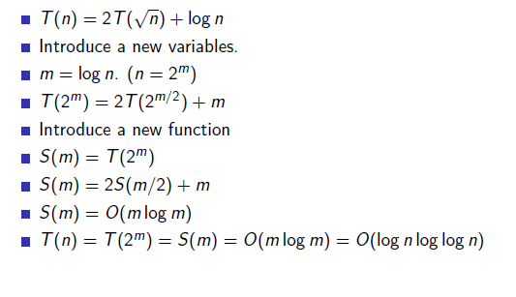
Changing Variables

Slide 94
T(n) = 2T( n) +1
n=2^{m →} n^{1/2}=2^{m/2} m=logn
T(2^{m}) = 2T(2^{m/2}) +1
T(2^{m})=S(m) then T(2^{m/2})=S(m/2) (by placing m=m/2)
S(m) = 2S(m/2) +1 which is much like recurrence
after solving iteratively O(m)
S(m) = O(m)
= O(lgn)

Slide 95
Recursion-tree method
A recursion tree models the costs (time) of a recursive execution of an algorithm.
The recursion tree method is good for generating guesses for the substitution method.
The recursion-tree method can be unreliable, just like any method that uses ellipses (…).
The recursion-tree method promotes intuition, however.

Slide 96

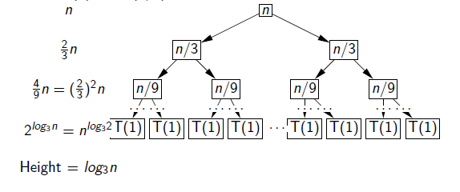
Recursion Tree Method
T(n) = 2T(n/3) + n.

Slide 97
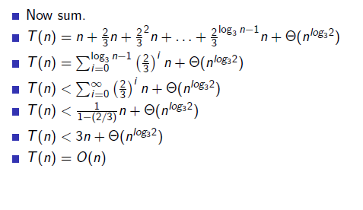
Recursion Tree Method

Slide 98
Master method
A method for solving recurrences of the form
T(n) = a T(n/b) + f (n) ,
If you have a recurrence of this form, the master method allows you to solve these with very little work.

Slide 99
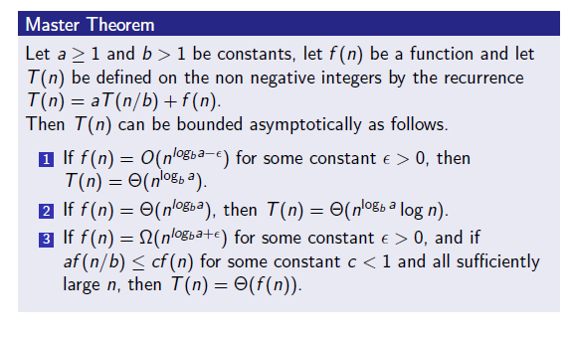
Master method

Slide 100
The master method
The master method applies to recurrences of the form
T(n) = a T(n/b) + f (n) ,
where a ≥ 1, b > 1, and f is asymptotically positive.

Slide 101
Idea of master theorem
Recursion tree:
f (n)
f (n)
a
f (n/b)
f (n/b)
…
f (n/b)
a f (n/b)
a
h = log_{b}n
f (n/b²)
f (n/b²)
…
f (n/b²)
a² f (n/b²)
…
…
#leaves = a^{h}
= a^{logbn}
= n^{logba}
n^{logba}Τ (1)
Τ (1)

Slide 102
Three common cases
Compare f (n) with n^{logba}:
f (n) = O(n^{logba – ε}) for some constant ε > 0.
f (n) grows polynomially slower than n^{logba} (by an n^{ε} factor).
Solution: T(n) = Θ(n^{logba}) .

Slide 103
Idea of master theorem
Recursion tree:
f (n)
f (n)
a
f (n/b)
f (n/b)
…
f (n/b)
a f (n/b)
a
h = log_{b}n
f (n/b²)
f (n/b²)
…
f (n/b²)
a² f (n/b²)
…
…
CASE 1: The weight increases geometrically from the root to the leaves. The leaves hold a constant fraction of the total weight.
n^{logba}Τ (1)
Τ (1)
Θ(n^{logba})

Slide 104
Three common cases
Compare f (n) with n^{logba}:
f (n) = Θ(n^{logba} lg^{k}n) for some constant k ≥ 0.
f (n) and n^{logba} grow at similar rates.
Solution: T(n) = Θ(n^{logba} lg^{k+1}n) .

Slide 105
Idea of master theorem
Recursion tree:
f (n)
f (n)
a
f (n/b)
f (n/b)
…
f (n/b)
a f (n/b)
a
h = log_{b}n
f (n/b²)
f (n/b²)
…
f (n/b²)
a² f (n/b²)
…
…
CASE 2: (k = 0) The weight is approximately the same on each of the log_{b}n levels.
n^{logba}Τ (1)
Τ (1)
Θ(n^{logba}lg n)

Slide 106
Three common cases (cont.)
Compare f (n) with n^{logba}:
f (n) = Ω(n^{logba + ε}) for some constant ε > 0.
f (n) grows polynomially faster than n^{logba} (by an n^{ε} factor),
and f (n) satisfies the regularity condition that a f (n/b) ≤ c f (n) for some constant c < 1.
Solution: T(n) = Θ( f (n) ) .

Slide 107
Idea of master theorem
Recursion tree:
f (n)
f (n)
a
f (n/b)
f (n/b)
…
f (n/b)
a f (n/b)
a
h = log_{b}n
f (n/b²)
f (n/b²)
…
f (n/b²)
a² f (n/b²)
…
…
CASE 3: The weight decreases geometrically from the root to the leaves. The root holds a constant fraction of the total weight.
n^{logba}Τ (1)
Τ (1)
Θ( f (n))

Slide 108
Examples
Ex. T(n) = 4T(n/2) + n
a = 4, b = 2 ⇒ n^{logba} = n²; f (n) = n.
CASE 1: f (n) = O(n^{2 – ε}) for ε = 1.
∴ T(n) = Θ(n²).
Ex. T(n) = 4T(n/2) + n²
a = 4, b = 2 ⇒ n^{logba} = n²; f (n) = n².
CASE 2: f (n) = Θ(n²lg⁰n), that is, k = 0.
∴ T(n) = Θ(n²lg n).

Slide 109
Examples
Ex. T(n) = 4T(n/2) + n³
a = 4, b = 2 ⇒ n^{logba} = n²; f (n) = n³.
CASE 3: f (n) = Ω(n^{2 + ε}) for ε = 1
and 4(cn/2)³ ≤ cn³ (reg. cond.) for c = 1/2.
∴ T(n) = Θ(n³).
Ex. T(n) = 4T(n/2) + n²/lg n
a = 4, b = 2 ⇒ n^{logba} = n²; f (n) = n²/lg n.
Master method does not apply. In particular, for every constant ε > 0, we have n^{ε} = ω(lg n).

Slide 110
The Master Theorem (Proof)
if T(n) = aT(n/b) + f(n) then

Slide 111
Master Theorem Lemma
Let a>= 1 and b<1 be constants, and Let f(n) be a nonnegative function defined on exact powers of b. Define T(n) on exact powers of b by the recurrence.
Θ(1) if n=1
T(n) = aT(n/b ) + f(n) if n= b^{i}
Where i is a positive integer. Then
T(n) = Θ(n^{lg}_{b}ª) + Σ a^{j} f(n/b^{j}) (We will proof this iteratively)
lgbn-1
J=0

Slide 112
T(n) = f(n) + aT(n/b)
= f(n) + a [f(n/b) + a T(n/b²)]
= f(n) + af(n/b) + a²T(n/b²)
= f(n) + af(n/b) + a²f(n/b²)+ a³T(n/b²)
= f(n) + af(n/b) +a²f(n/b²)+a³f(n/b³) +……
…….+ a^{i}T(n/b^{i}) where n = b^{i}
= f(n) + af(n/b) +a²f(n/b²)+a³f(n/b³) +……
…….+ a^{i}T(n/n)
= f(n) + af(n/b) +a²f(n/b²)+a³f(n/b³) +……
…….+ a^{i}T(1) ……………………A

Slide 113
Lemma 2
a ^{lgbn}=n^{lgba}
lgb a ^{lgbn} = lgb n^{lgba}
1=1
lgbn lgb a = lgba lgb n

Slide 114
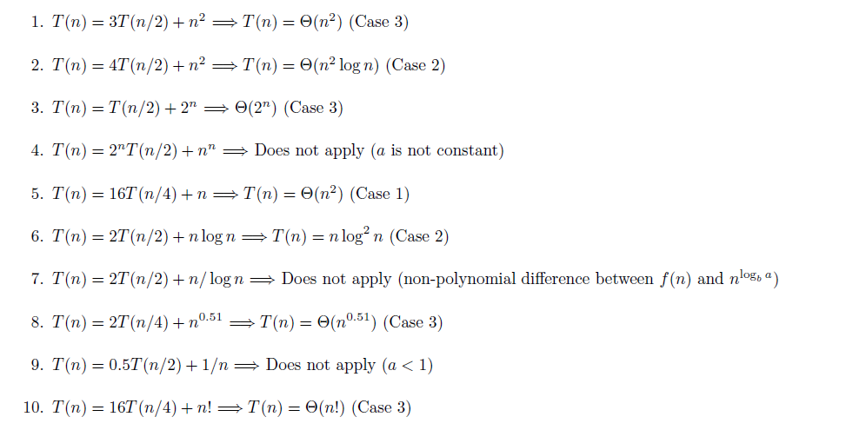
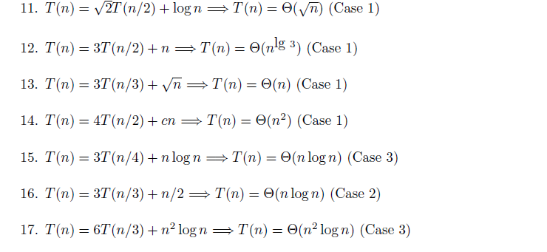

Slide 115
