Slide 1
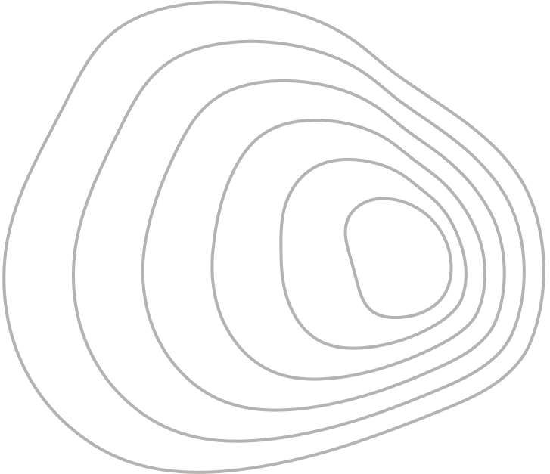



Technical University of Sofia
Development of a blockchain system for processing sensory information
Thesis Defense
Presented by Sladun Arsenov
Faculty Number: 901219011

Slide 2
Overview
01
Introduction
05
Structure and Security
02
Goals
06
Experimental Studies
03
Requirements
04
Blockchain
07
Conclusion

Slide 3
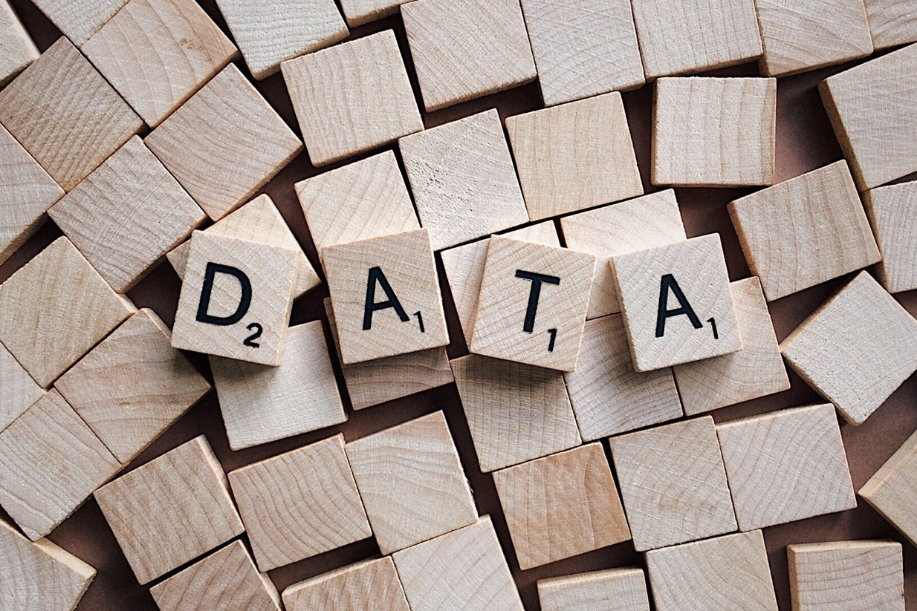
Introduction
Era Driven By Data
Sensory Information
Effective Collection
Secure Storage
Responsible Sharing
<number>

Slide 4
Goals
01
02
03
04
Security
Data Integrity
Tamper-proof
Decentralization
Nodes Network
Reduced Central Points of Failure
Privacy
Secure Sharing
Users’ Control Over Data
Interoperability
Various Sensory Data metrics
Seamless Integration
<number>

Slide 5
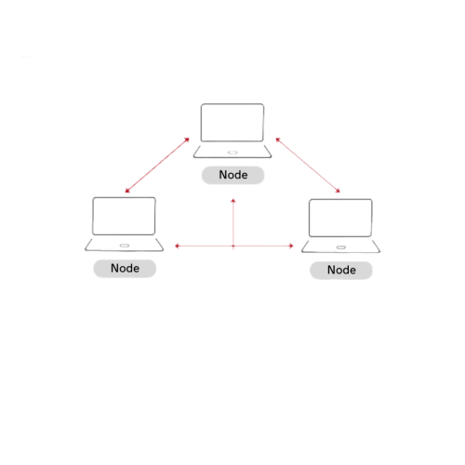
Project Specifications
Decentralized Blockchain System
Data Collection and Distribution from Sensors
Security Measures for Data Protection
<number>

Slide 6
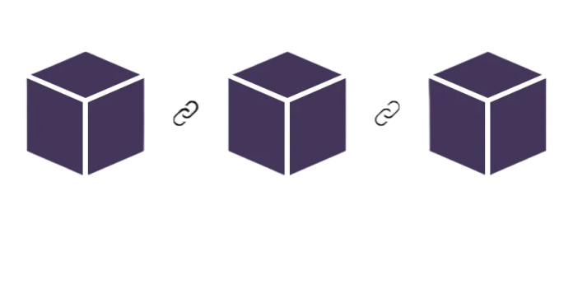
Blockchain
Blockchain:
Distributed and Decentralized Digital Technology for Secure Recording of Data in the Form of Transactions
Blocks
Chains
Decentralization
Cryptographic Security
Block 1 Block 2 Block 3
<number>

Slide 7
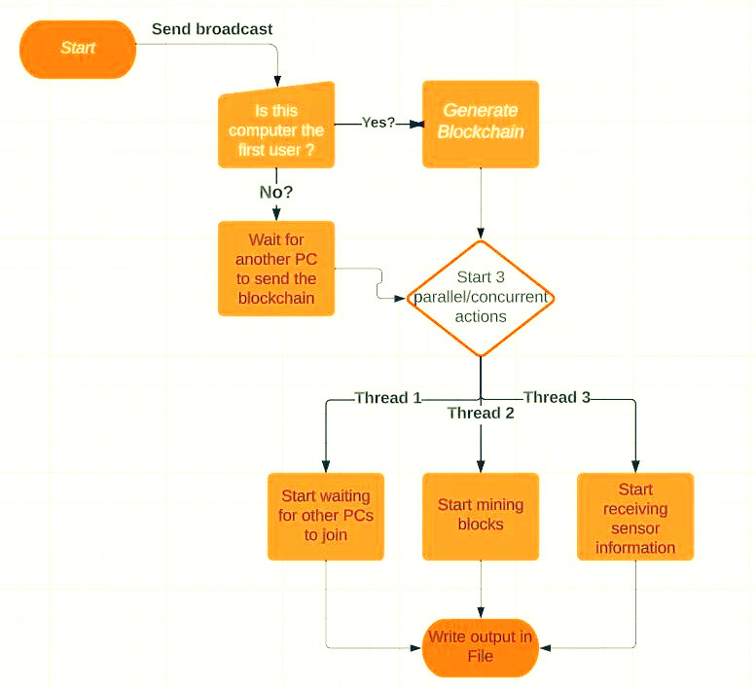
Structure and Security
<number>

Slide 8
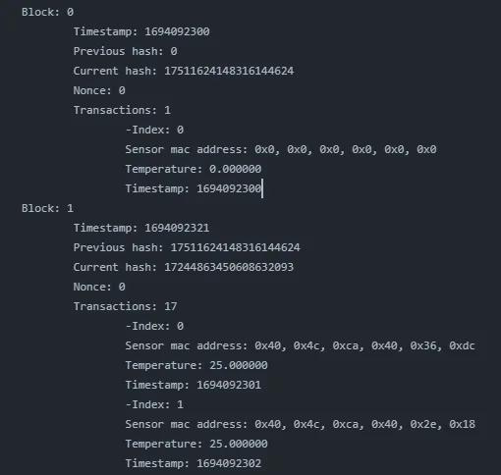
Experimental Studies
<number>

Slide 9

Conclusions
The Project Reaches the Predefined Goals
Efficient Data Collection
Data Integrity and Security
Transparency and Trust
Scalability and Interoperability
Real Life Applications
Room for Improvement
<number>

Slide 10
Technical University of Sofia
Thank You for Your Attention
Presented by Sladun Arsenov
Faculty Number: 901219011

