Slide 1
Group Report
Introduction to PBFT
(Practical Byzantine Fault Tolerance)
Info: @Aibot

Slide 2
Outline
Preliminaries
Motivation
Protocol
Safety and Liveness
Properties
Variations
Notes:
In this article, we want to introduce a long-lasting classic: Practical Byzantine Fault Tolerance, or PBFT for short.
PBFT has already been in existence for over 20 years now, and its birth traces back to the well-known consensus problem in decentralized systems commonly known as the Byzantine Generals Problem.
PBFT is not a consensus protocol fit for fully open environments — in fact, there was no such thing as a Byzantine fault-tolerant consensus for public environments before blockchain emerged. However, the incredible growth of blockchain inspired researchers to re-examine the almost forgotten classic.
PBFT is in fact characterized by a number of distinct features from blockchain, which have been research material during the past few years for improving blockchain.
Some of the ideas include Proof-of-Stake models based on PBFT.
In the following paragraphs, we will provide an overview on the background of PBFT, its consensus model, and the salient characteristics that make it different from blockchain.

Slide 3
Preliminaries
Consensus
Consensus
FLP
Randomized Consensus
Shared Coin
Byzantine Agreement
How many Byzantine Nodes
Asynchronous Byzantine Agreement

Slide 4

Consensus Principals
• Validity The decision value must be one of input values
• Agreement All correct nodes decide for the same value.
• Termination All correct nodes terminate in finite time.

Slide 5

Correctness
Fault Tolerance: There will be one or more traitor node.
Safety: There is only one unique consensus.
Liveness: Consensus will be achieved.
Notes:
Any correct and practical consensus protocol must ensure that the Byzantine generals will reach a unique consensus (safety)
Consensus will eventually be achieved (liveness).

Slide 6
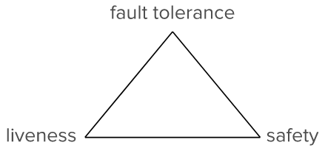
FLP Impossibility
Can a correct consensus always be achieved?
It depends
Both safety and liveness ×
bypassing limitations:
(weakly) synchronous
random factors in the consensus
Notes:
http://ug93tad.github.io/flpcap/
Is a consensus satisfying the properties of both safety and liveness always achieved? The answer: It depends.
In fact, according to FLP, both safety and liveness cannot be achieved in the case of asynchronous network communication if any Crash Fault occurs.
So what can we do about it? There are two ways for bypassing the limitations stemming from FLP impossibility.
The first way through is very simple: it is based on the assumption that network communication is synchronous, which is how PBFT solves the problem.
The second method, on the other hand, is a bit more complicated. It follows by introducing random factors in the consensus, so that from deterministic, the protocol instead becomes non-deterministic.
The advantage of this second option is that the protocol becomes more robust, even under asynchronous network communication.
For example, Honey Badger BFT is a protocol based on asynchronous and non-deterministic consensus.

Slide 7
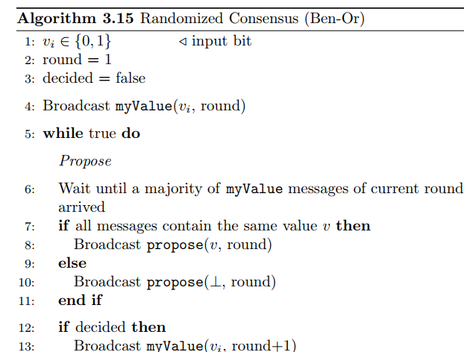
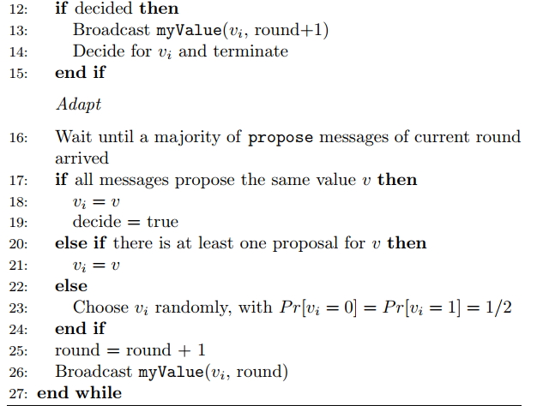
Randomized Consensus

Slide 8
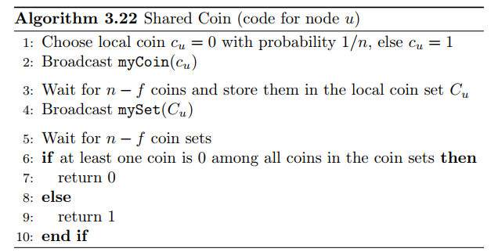
Randomized Consensus & Shared Coin

Slide 9
Motivation
Redundancy
Byzantine General Problem
Correctness

Slide 10

Motivation
Redundancy
A sustainable system must be fault-tolerant
An intuitive way to achieve fault tolerance is to have some degree of redundancy in the system
In a decentralized system, we call this design State Machine Replication.
Notes:
Since ancient times, human beings have been striving to create systems that can operate sustainably.
First and foremost, a sustainable system must be fault-tolerant, which means it must be resilient to failure at any given condition below a certain upper limit of fault in the system.
An intuitive way to achieve fault tolerance is to have some degree of redundancy in the system by allowing multiple individuals with the same composition and state to operate simultaneously. This grants that, when failure in a single individual occurs, the system can go on operating smoothly by simply replacing the failed individual.
In a decentralized system, we call this design State Machine Replication.

Slide 11
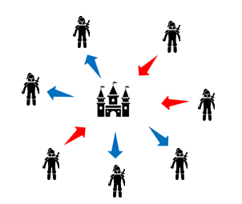
Motivation
Byzantine General Problem (1)
Each general has to decide to whether attack or retreat.
However, there are traitors who may send out the opposite message or only inform some of the generals.
Notes:
In a situation where consensus can be achieved exclusively by relying on communication, some issues will arise, the most infamous of which is the Byzantine General problem.
Imagine now a group of Byzantine generals who have besieged a city. They must unanimously and at the same time decide whether to attack or retreat, and they can only inform each other of their decisions through a messenger.
However, there are traitors between the generals, who may send out the opposite message or only inform some of the generals. How is consensus achieved in the presence of a traitor?

Slide 12
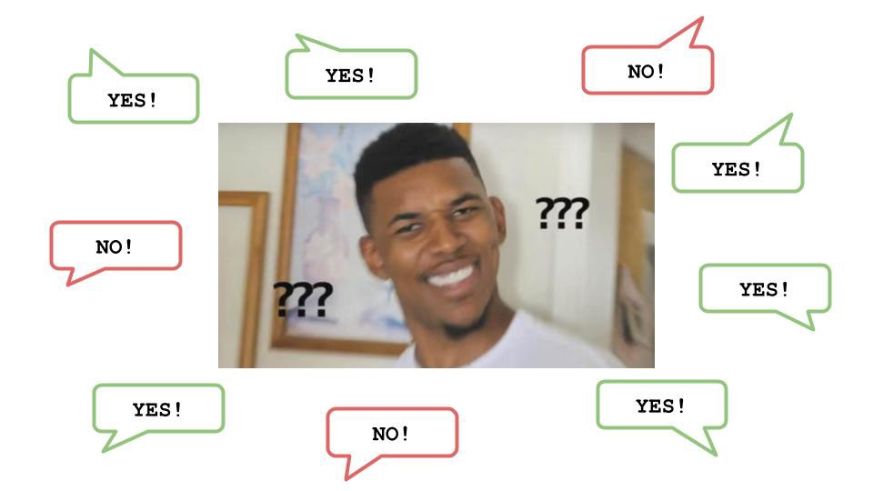
Motivation
Byzantine General Problem (2)
In Replicated State Machine:
General: State machine
Messenger: P2P communication
Attack/Retreat: Order of transitions
Traitor: Byzantine Fault
Byzantine Fault Tolerance.
Notes:
As it is quite easy to see, consensus issues in State Machine Replication can simply be reduced to the Byzantine general problem. Let’s try to wrap up the main pillars:
Each node is a general.
Communication is the messenger.
The decision to attack/retreat is the content of the message the nodes shall agree upon.
The random behavior of the general/state machine is called Byzantine Fault.
The characteristic that makes correct consensus achievable even under the presence of a traitor/hostile state machine is called Byzantine Fault Tolerance.

Slide 13
Protocol
Modeling
Pre-prepare
Prepare
Commit
View Change

Slide 14
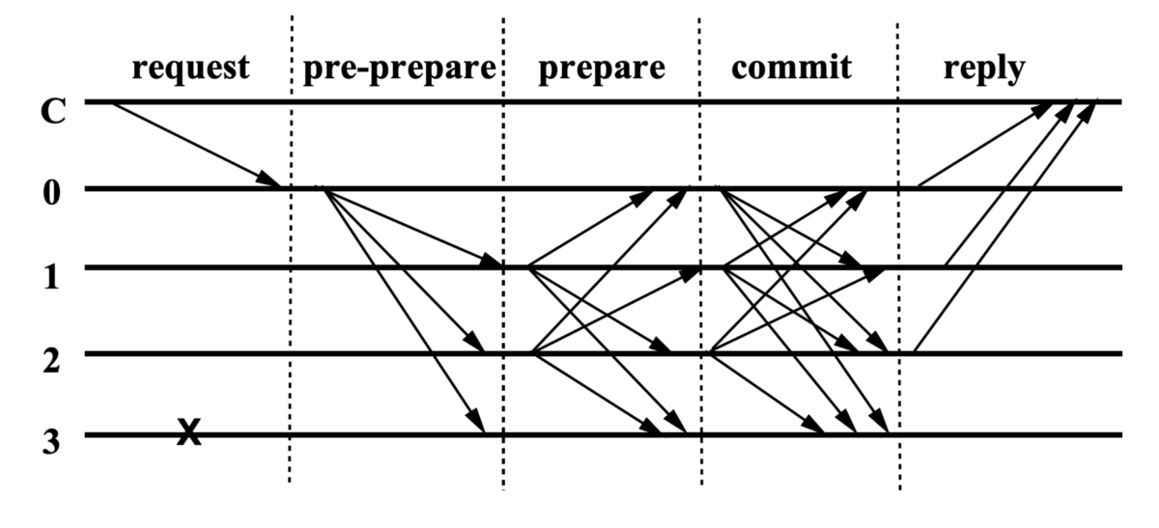
Protocol
Modeling (1)
3 honest nodes, 1 byzantine node. derived from 3f + 1
Each node is assigned to an ID (0~3).
Each node can verify each other’s signature.
Each action carries a sequence number.
Notes:
In a nutshell, PBFT is a State Machine Replication with Byzantine fault tolerance.
An intuitive idea to solve the General Byzantine problem is to use one or more rounds of voting to obtain majority consensus.
But who is going to vote on what? And for how many rounds so as to ensure both safety and liveness? PBFT’s greatest innovation lies in its design with multiple voting rounds, composed of three stages: Pre-prepare, Prepare, and Commit.
For the sake of simplicity, let us make the following assumptions:
Every four generals can tolerate up to one traitor. i.e. 4=3f+1, where f represents the maximum number of traitors that the network can tolerate before failing. The meaning of 3f +1 will be described in further detail in the next paragraphs.
Each general is assigned a number (0~3).
Each general can recognize the validity of each other’s signature.
Each action carries a sequence number.
Attack/retreat decisions form a series of sequenced decisions, e.g. attack — attack — retreat — attack — …..

Slide 15
Protocol
view change round-robin
choose a new leader
Modeling (2)
There is one leader (Primary) and several other validators (Replicas).
A leaders is attached to a view. When the leader is replaced, the view increments by 1.
Notes:
There is one leader (Primary) and several other validators (Replicas).
Decision rounds in a number that is variable, consecutively, are lead by one leader only, which determines what is called the view.
Generals follow a round-robin rotation to determine who will be the leader during the next epoch. As an example, general number 1 will be the leader during the first view, general number 2 during the second one, and so on. When all generals have been called upon to be leaders, the rotation starts again.
The leader is rotated when there is a proposal from the replicas to do so. This mechanism is called a view change.

Slide 16
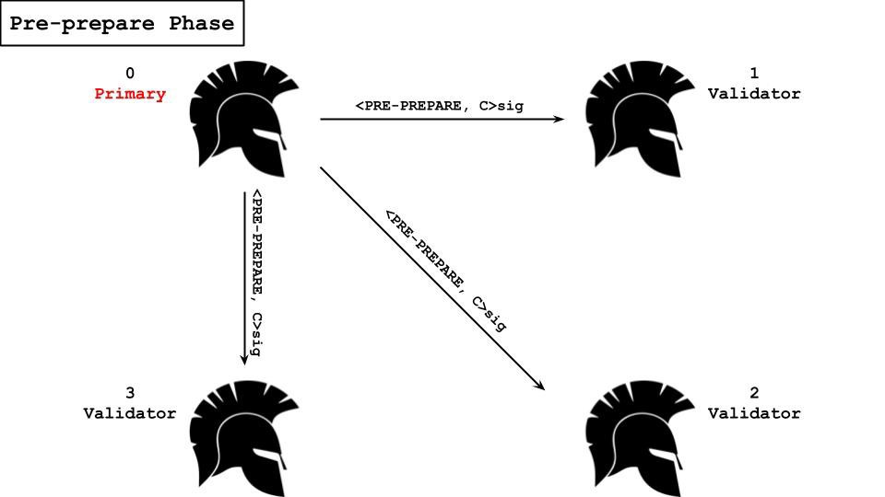
Protocol
Step 1: Pre-prepare
receiving request & initiating the proposal.
<<PRE-PREPARE, v, n, d>, c>
<view num, incremental num, digest(c)>
The leader broadcasts the “pre-prepare” messages with his signature.
Notes:
The leader is responsible for receiving the Byzantine client’s attack/retreat command (Request).
The leader is responsible for initiating the proposal. The said proposal sent to the replicas shall include the message content (attack or retreat), the view number (corresponding uniquely to the leader) and a sequence number, which can be described as the numeral order of the action being undertaken.
The leader sends the “pre-prepare” messages with his signature to the other validators via the messenger (i.e. the communication protocol).
The image below provides a useful representation of the communication between the leader and the other replicas during the pre-prepare phase of the protocol.

Slide 17
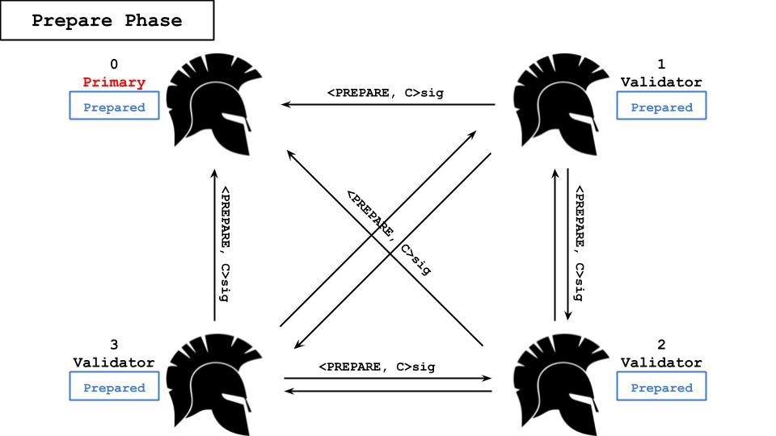
Protocol
Step 2: Prepare
replica can accept or reject
Accepted replicas broadcast a “prepare” message.
replica receives more than 3 “prepare” messages, it enters the “prepare” state.
<PREPARE, v, n, d, i>
The collection of these “prepare” messages is collectively referred to as the “prepared certificate.”
Notes:
After each replica receives the “pre-prepare” message, it can either accept or reject the leader’s proposal. If the replica accepts the leader’s proposal, it will send a “prepare” message with its own signature to all the other replicas (including the leader). If it rejects, it will not send any message.
Each node who issued the “prepare” message enters the “prepare” phase.
If a replica receives more than three (> 2f+1) “prepare” messages, it enters the “prepared” state. The collection of these “prepare” messages is collectively referred to as the “prepared certificate.”

Slide 18
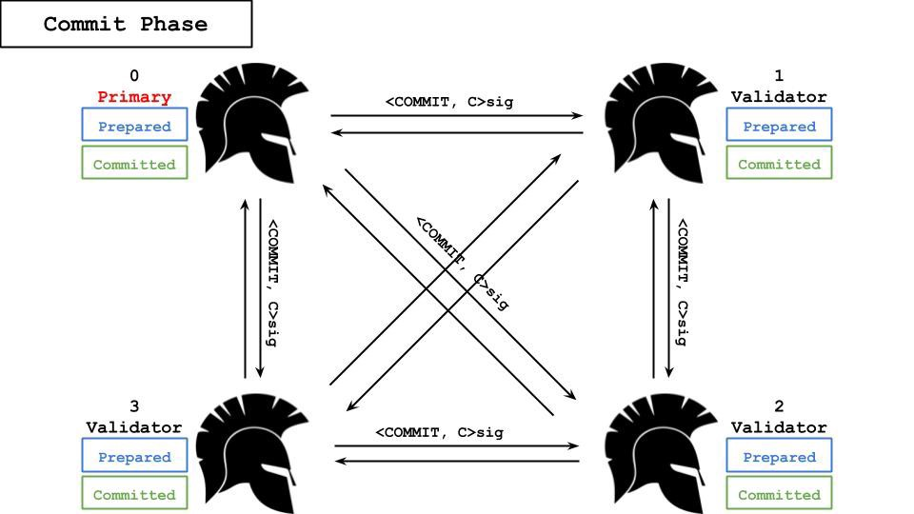
Protocol
Step 3: Commit
“prepare”>2f+1 → “commit” message.
<COMMIT, v, n, D(m), i>sig
“commit”>2f+1 → executed.
“committed” state and reply.
<REPLY, v, t, c, i, r>
Notes:
If the “prepared” general decides to commit, it will send a “commit” message with the signature to all the generals (replicas). If it decides not to execute, no message is sent.
The general who issued the “commit” message enters the “commit” phase.
If the generals receive more than three (> 2f+1) “commit” messages, the message object is executed, which also means that the proposal has reached a consensus.
After the execution of the message, the general enters the “committed” state and returns the execution result (i.e. the reply) to the Byzantine client.
After the reply has been sent, the replicas wait for the next request.

Slide 19
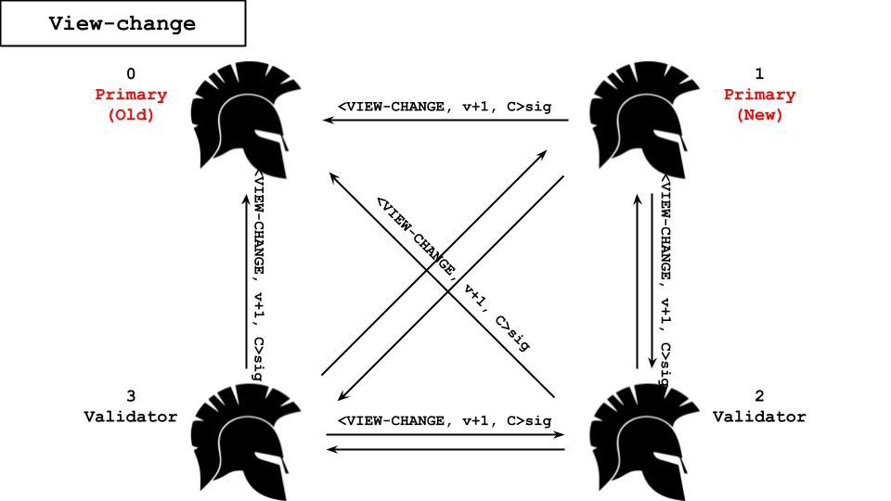
Protocol
View Change (1)
What if the leader is a Byzantine node? → view change.
Each node starts a timer after receiving the “prepare” message, the node will broadcast a “view-change” message while timeout
<VIEW-CHANGE, v+1, n, C, P, i>
Notes:
n 是节点 i 知道的最后一个 stable checkpoint 的消息序号。
C 是节点 i 保存的经过 2f+1 个节点确认 stable checkpoint 消息的集合。
P 是一个保存了 n 之后所有已经达到 prepared 状态消息的集合

Slide 20
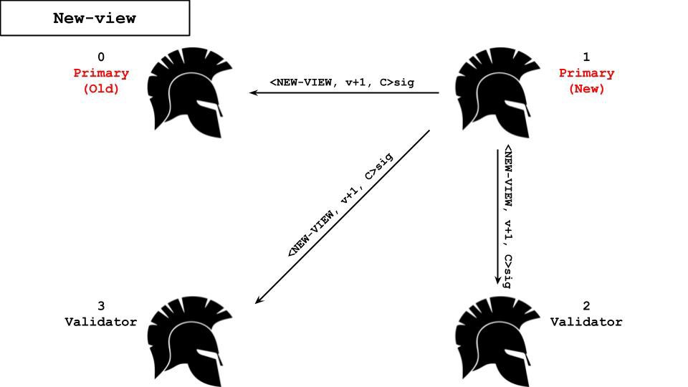
Protocol
View Change (2)
3 (> 2f+1) “view-change” →can broadcast a “new-view” message.
This message includes the new view, “pre-prepare” messages that has prepared certificate, and a number of other components.
<NEW-VIEW, v+1, V, Q>
After receiving the “new-view” message, each replica should follow the three steps (pre-prepare => prepare => commit) of request execution.
Notes:
http://ug93tad.github.io/pbft/
Upon receiving more than 3 (> 2f+1) “view change” messages, the new leader can broadcast a “new view” message to all the replicas. This message shall include the new view number, a proof that the previous request has not been executed, a “prepare” message, and a number of other components.
After receiving the “new view” message, each replica shall follow the three steps of request execution described above, once the new leader broadcasts the client’s request.
The new leader is now responsible for broadcasting requests from the Byzantine client.

Slide 21
Safety & Liveness
Safety (1)
Threshold
If the total number of nodes is 3f+1, then up to f Byzantine nodes can be tolerated
Every step must obtain 2f+1 votes in order to be executed. This ensures that in order to break the safety at least one honest node has to vote twice on the same sequence number, which violates the assumption.
Notes:
http://ug93tad.github.io/pbft/
Ensuring safety implies ensuring that each replica performs the same actions in the same order.
Safety is related to the security threshold. If the total number of Generals is 3f+1, then up to f traitors can be tolerated, so all the protocol steps must obtain a 2f+1 threshold of consent in order to be executed. This is to ensure that if the same sequence number is assigned to two different actions, at least one honest general will reject it.

Slide 22
Safety & Liveness
Safety (2)
“commit” phase
necessary for nodes to ensure that other nodes have collected the prepared certificate of sequence number s.
This ensure that if a view change occurs, sequence number s will not be repeatedly assigned to different content, and the safety of the protocol can be guaranteed.
Notes:
The three-phase is critical to the protocol’s safety. Why not two-phase only but three-phase? Imagine a situation with two-phase voting. Suppose General 2 directly performs the action “attack” (sequence number 6) after collecting the prepared proof, but General 3 and General 4 initiate the view change due to delay, so General 2 was also forced to change. Since General 3 and General 4 did not receive the action labelled with sequence number 6, the content of sequence number 6 would not be re-executed, and the new leader would assign sequence number 6 to the next action. This would result in General 2 executing again the same sequence number 6, thus violating safety. Therefore, the third phase, i.e. the commit phase, is necessary in order for General 2 to ensure that General 3 and General 4 have collected the prepared certificate of sequence number 6 and returned the “commit” message, and therefore execute the content of sequence number 6. This way, even if a view change occurs, sequence number 6 is no longer repeatedly assigned to different content, and the safety of the protocol is thus guaranteed.

Slide 23
Safety & Liveness
Liveness
PBFT assumes a weak synchronous network,
Strategy
If timeouts occur during the view change, the nodes simply initiate another view change and extend the buffer from T to 2T/3T/4T, etc., until the buffer can tolerate the delay.
Notes:
Liveness implies ensuring that the protocol will always eventually proceed. This is granted by the view change action. To overcome the limitations described by the FLP impossibility, PBFT uses the Weak Synchrony assumption, which assumes that the network latency grows slower than the buffer time for each timeout (i.e. the delay T cannot grow indefinitely higher than time). If timeouts occur during the view change process, the Generals simply initiate another view change and extend the wait time from T to 2T/3T/4T… and so on, until the set timer is able to tolerate the communication delay. This implies that the protocol will eventually proceed, even under the worst case scenario, by which a consecutive number of malicious leaders is elected in series.

Slide 24
Properties of PBFT
Permissioned
Communication-based
Safety > Liveness

Slide 25

Properties of PBFT
Permissioned
PBFT is not suitable for public usage.
The PBFT-based PoS model allows participants to register with their own assets.
Notes:
Permissioned: PBFT is not really fit for use in public environments. This is because PBFT needs to enable nodes to verify each other’s messages and the number of nodes active at each moment in time shall always be known. Blockchain is, on the other hand, a permission-less system, i.e. open to anyone. The PBFT-based Proof-of-Stake model allows participants to register in the network with their own assets. This also grants that all nodes are always known at each moment in time.

Slide 26

Properties of PBFT
Communication-based
communication overhead inevitably causes a bottleneck for scalability.
Another problem is that the communication model is subjective. Therefore PBFT cannot resist long-range attacks and sybil attack
Notes:
Communication-based: PBFT’s security is based on 3-phase voting. Although it doesn’t consume a lot of computing resources as proof of work does, the huge amount of communication also inevitably creates a bottleneck for scalability: it is, in PBFT, impossible to expand to more than 1000 nodes. Furthermore, PBFT uses message authentication code (MAC) message format, which requires each node to verify a message for each round of voting. It is easy to see that the large number of signatures/verifications cause another potential bottleneck. A further possible problem is that the communication model is subjective. There is therefore no direct protection toward long-range attacks. In contrast, traditional blockchain is computation-based, therefore its safety is based on a verifiable proof. However inferior in communication efficiency in practice, this model is indeed objective: new nodes follow Nakamoto Consensus by always selecting the most difficult chain.

Slide 27
Properties of PBFT
Safety-over-liveness
Due to the strong safety assumption, PBFT has instant finality.
In contrast, PoW blockchain’s safety relies on a synchronous network.
Notes:
Safety-focused: Safety is more important than the liveness (Safety over Liveness principle). PBFT, whether synchronous or asynchronous, can ensure the safety assumption, which states that a fork is almost impossible, and instant finality is granted. In contrast, blockchain is more focused on liveness than safety, and its safety depends on a synchronous network. Forks happen quite frequently (multiple consensus) and for a block to be safe its chain shall be longer than a certain number of blocks.

Slide 28
Variations of PBFT
Protocol | Contributor | Feature
Tendermint | Cosmos | Rotating Leader
Casper FFG | Ethereum | Abstract Leader Election + Pipelined Voting (2-chain)
HotStuff | VMWare | Rotating Leader + Pipelined Voting (3-chain)
LibraBFT | Facebook | Rotating Leader + Pipelined Voting (3-chain)

Slide 29
Summary
Due to the above properties of PBFT, it is not practical to establish a fully decentralized system based on PBFT.
However, PBFT can be used as a consensus for PoS model, which can be applied to permissionless setting and provide economic incentives.
Taking a look back into PBFT before jumping into newer designs will help researchers understand the essentials.
Notes:
Due to the above properties of PBFT: permissioned, lack of participation incentives, lack of resistance to long-range attacks, and excessive communication costs, we are unable to establish a fully decentralized and practical cryptocurrency on PBFT. However, PBFT can be used as a consensus model for proof-of-stake, which can be applied to permission-less context and can provide economic incentives. As an example, Ethereum Casper is a hybrid model based on computational and communication-based models that determined by Proof of Work leaders. A single round of voting is then carried out by the depositor (Validator) to finalize the consensus. Although there are many problems at present, it is very worth keeping a close look into it.
Despite the booming blockchain, PBFT has witnessed a huge amount of research around it during the latest years, and its subsequent development has spawned many novel protocols and ideas, such as Tendermint / HotStuff / Harmony FBFT. Taking a look back into PBFT before jumping into these new protocols will surely open the doors to a full understanding of them.

Slide 30
Thank You
Info: @Aibot

