Slide 1


Slide 2


Agenda
Building Resilient and Scalable APIs in Azure
Intro & Problem Space
Azure Toolset Overview
High Availability & Disaster Recovery
Resilience Strategies
Monitoring &
Observability
Blueprint & Wrap Up
Q&A

Slide 3
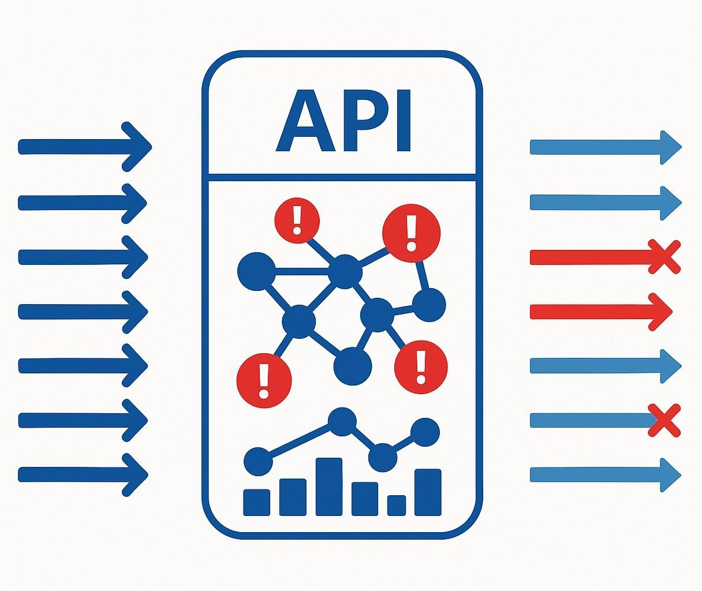

The Resilience Challenge
Building Resilient and Scalable APIs in Azure

Slide 4

Resilience Turnaround
From Fragile to Fault-Tolerant: An API Resilience Transformation
Before (Challenges)
After (Results from Azure Patterns & Services)
Legacy Stack
Unplanned Outages
Cascading
Failures
Protected
Gateway
Multi-Region
Smart
Patterns
No visibility
Manual Recovery
Live Metrics
Scales on Demand

Slide 5
Azure Toolset Overview

Slide 6

Azure Toolset Overview
Primary Trio
Azure API Management
Traffic Shaping and Throttling
Caching
Policy Enforcement
Backend Shielding

Slide 7



Azure Toolset Overview
Primary Trio
Azure Functions
Elastic Capacity
Scale-to-Zero Efficiency
Event-Driven Triggers
Isolation of Workloads

Slide 8


Azure Toolset Overview
Primary Trio
Azure Container Apps
Granular Scaling
Multiple Scale Triggers
Revisions and Blue-Green Deployments
Service-to- Service Communication

Slide 9

Azure Toolset Overview
Primary Trio
Global Routing
Instant Failover
SSL Offload and
Caching
WAF Integration
Azure API Management
Azure Functions
Azure Container Apps
Azure Front Door

Slide 10


Azure Toolset Overview
Primary Trio
Centralized
Control
Versioning and
Rollback
Dynamic
Updates
Secure Access
Azure API Management
Azure Functions
Azure Container Apps
Azure Front Door
Azure Monitor
Application Insights

Slide 11


Azure Toolset Overview
Primary Trio
Centralized
Control
Versioning and
Rollback
Dynamic
Updates
Secure Access
Azure API Management
Azure Functions
Azure Container Apps
Azure Front Door
Azure Monitor
Application Insights
Azure Key Vault
Azure App Configuration

Slide 12


Azure Toolset Overview
Primary Trio
Geo-Replication
Multi-Region
Writes
Consistency
Models
Built-In Backups and Point-in- Time Restore
Azure API Management
Azure Functions
Azure Container Apps
Azure Front Door
Azure Monitor
Application Insights
Azure Key Vault
Azure App Configuration
Azure
Storage
Cosmos DB

Slide 13


Azure Toolset Overview
Primary Trio
Loose Coupling
Retry and Dead-
Lettering
Fan-Out and
Filtering
Backpressure
Protection
Azure API Management
Azure Functions
Azure Container Apps
Azure Front Door
Azure Monitor
Application Insights
Azure Key Vault
Azure App Configuration
Azure
Storage
Cosmos DB
Event Grid
Service
Bus

Slide 14



Azure Toolset Overview

Slide 15
High Availability & Disaster Recovery Design

Slide 16
Framing the Discipline
High Availability vs. Disaster Recovery
High Availability (HA)
Keep Running
Disaster Recovery (DR)
Recover When Stopped
Recovery Time Objective (RTO)
Recovery Point Objective (RPO)

Slide 17
Designing for Redundancy
Availability Zones & Region Pairs
Geographic Redundancy
Availability Zones Region Pairs
Region Region
AZ 1
AZ 1
AZ 2
AZ 3
AZ 2
AZ 3

Slide 18


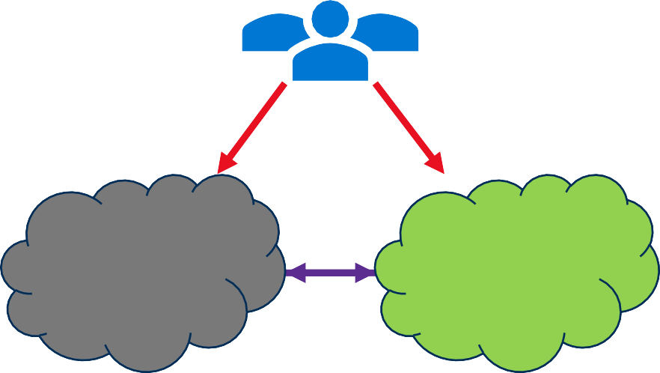
Deployment Strategies for Resilience
Active-Active vs Active-Passive
Active-Active Active-Passive
East US 2
Central US
North Central US
South Central US

Slide 19
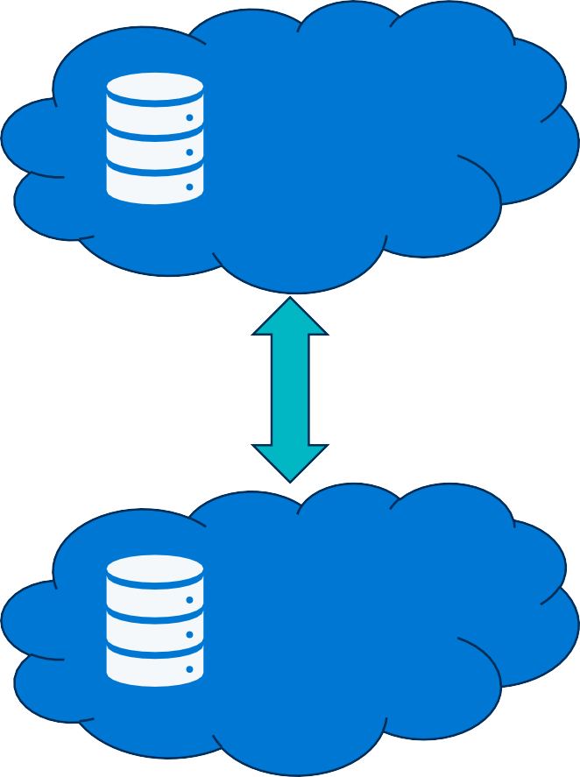
Keeping Data Durable & Available
Data Resilience & Replication
Geo-redundant (GRS, RA-GRS)
Automatic replication across regions
Blob, file, queue, table storage
East US 2
Azure Storage
Multi-region writes, active-active
Tunable consistency models
Automatic failover groups
Central US
Cosmos DB

Slide 20
Operational Readiness
Practice Resilience
Key Practices
Monitoring & Alerts
Chaos Testing / Game Days
Runbooks & Automation
Outcomes
Faster detection of failures
Validated assumptions
Predictable, repeatable recovery
Validate Respond
Detect

Slide 21
Trade-Offs & Cost Lens
Balancing Cost, Complexity, and Risk
Single Region High Availability
Active-Active
Active-Passive Multi-Region
Multi-Region
Choose the level of resilience that matches your business risk.

Slide 22

From Principles to Practice
Recap & Transition
High Availability = survive everyday failures
Disaster Recovery = recovery from rare, catastrophic events
Tools: Zones, Region Pairs, Active-Active/Passive, Data replication, Ops Readiness, Cost Trade-offs

Slide 23
Resilience Strategies

Slide 24

Retry Policies
Smarter Recovery from Failures
Concepts
Exponential Backoff – wait longer between retries
Jitter – add randomness to avoid retry storms
Implementation – SDKs, Polly, APIM retry policies
Why It Matters
Prevents overwhelming a struggling
service
Improves recovery time during outages
Reduces cascading failures

Slide 25

Circuit Breakers
Failing Fast to Protect the System
Concepts
Detect repeated failures
Block further requests while the service
is unhealthy
Allow recovery attempts after cooldown
Why It Matters
Prevents cascading failures
Stops clients from overwhelming a failing service
Enables faster recovery once health improves

Slide 26

Throttling & Rate Limiting
Protecting Capacity
Concepts
Rate Limiting: cap requests per second/minute
Throttling: slow down or reject excess requests
Why It Matters
Prevents overload and cascading failures
Ensures fair usage across clients
Preserves critical functionality under stress

Slide 27

Graceful Degradation
Preserving the Core
Concepts
Disable or reduce non-essential features
Serve cached or static data when live data is unavailable
Switch to read-only-mode for critical services
Provide clear use messaging
Why It Matters
Keeps the core business function alive
Minimizes user frustration and operational damage
Buys time for recovery without total outage

Slide 28

Recap
Retry Policies
Circuit Breakers
Throttling and Rate Limiting
Graceful Degradation

Slide 29
Architecture Patterns

Slide 30





Bulkhead Isolation
Partitioning for Resilience
Router(s)
Service A
Service B
Service C

Slide 31



Queue-Based Load Leveling
Buffering for Stability

Slide 32

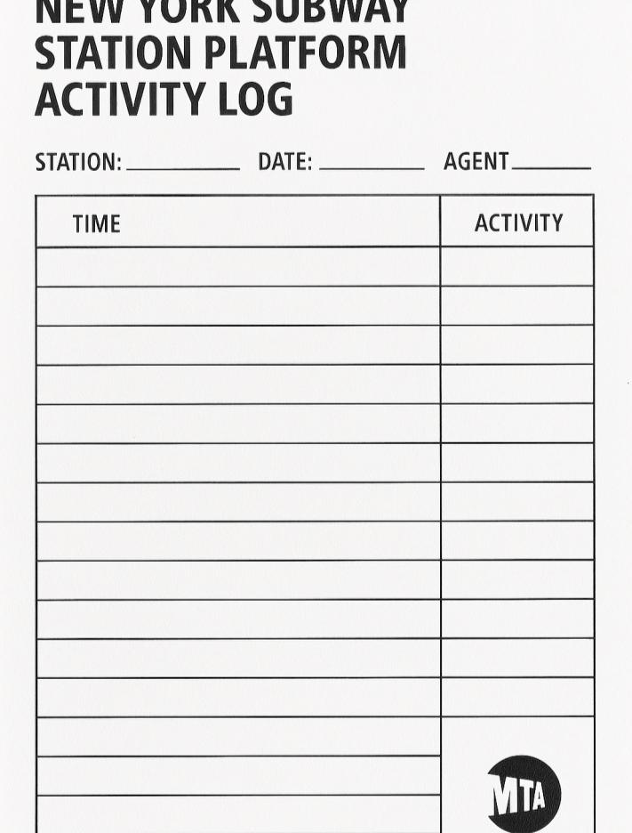





Event Sourcing & CQRS
Recording for Recovery
Commands
Queries
Application
Commands Queries
Read Store
Event Store

Slide 33


Multi-Region Active/Passive
Replicating for Redundancy
East US 2 (Active Region)
Central US (Passive Region)

Slide 34

Multi-Region Active/Active
Replicating for Redundancy
East US 2 (Active Region)
Active Replication
Central US (Passive Region)

Slide 35
Recap
Architecture Patterns
Bulkhead Isolation
Queue-Based Load Leveling
Event Sourcing & CQRS
Multi-Region Active/Passive & Active/Active

Slide 36
Monitoring & Observability

Slide 37

The Tools of Observability

Slide 38



The Tools of Observability
Monitor
Application Insights
Log Analytics Workspaces

Slide 39





The Tools of Observability
Monitor
Application Insights
Log Analytics Workspaces
Metrics
Network Watcher
Diagnostic Settings
Workbooks
Activity Log

Slide 40

The Observability Loop
Detect
Decide
Act
Learn

Slide 41
The Observability Loop
Detect
Act
Decide
Learn

Slide 42
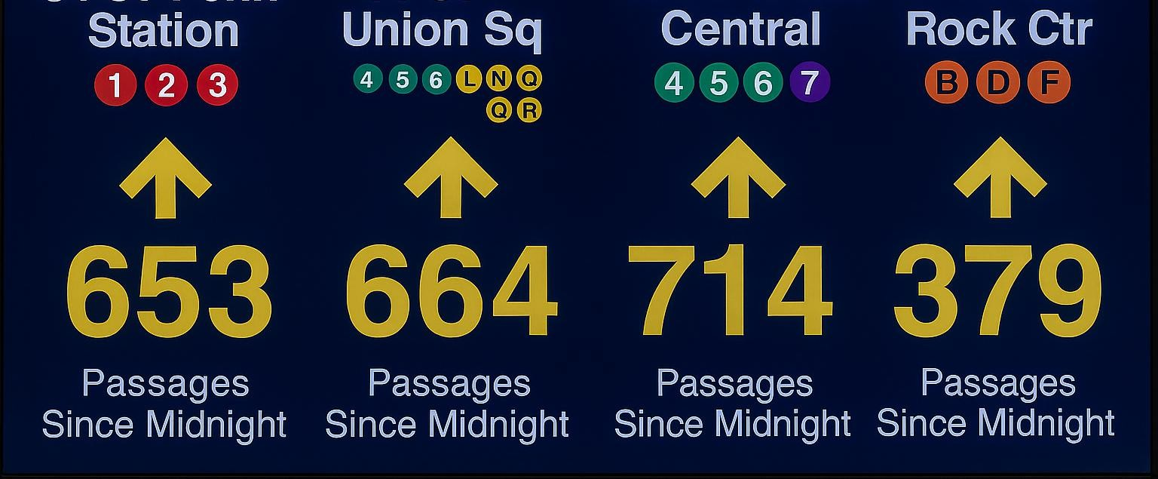
From Signals to Scaling

Slide 43

From Signals to Scaling
CPU /
Memory
Request Latency
Queue Depth
Dependency Failures
Error Rate

Slide 44

Keeping the System on Track

Slide 45
Design Blueprint

Slide 46
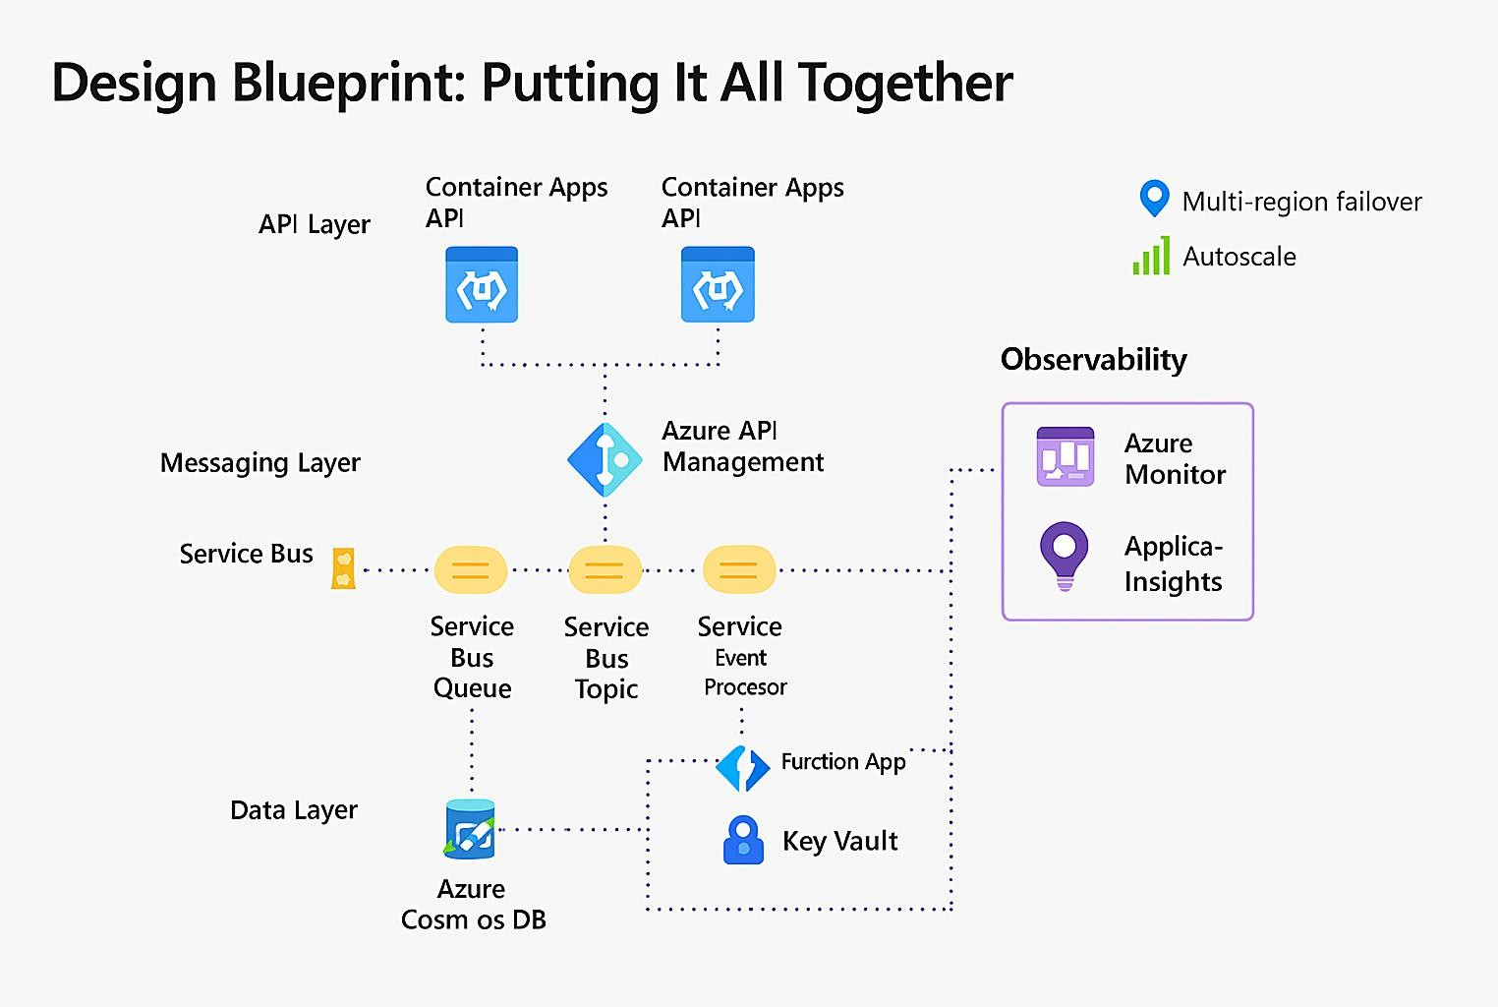
Putting It All Together
Design Blueprint
API Layer (Top)
Messaging Layer (Middle)
Data Layer (Bottom)
Observability (Side Panel)
Resilience Features (Top Right)

Slide 47
Checklist for Resilient APIs
Implement multi-region failover
Use autocale rules for API workloads
Buffer traffic with Service Bus queues
Trigger alerts and scale actions from metrics
Trace requests end-to-end with App Insights
Secure secrets with Key Vault
Broadcast events with Service Bus • Design for observability day one topics
Monitor latency, error rates, and queue depth

Slide 48

Q&A
Intro & Problem Space
Azure Toolset Overview
High Availability & Disaster Recovery
Resilience Strategies
Monitoring & Observability
Blueprint & Wrap Up
Q&A

Slide 49







Slides & Reach Out
chadgreen@chadgreen.com TaleLearnCode ChadGreen.com
ChadGreen & TaleLearnCode ChadwickEGreen

