Slide 1
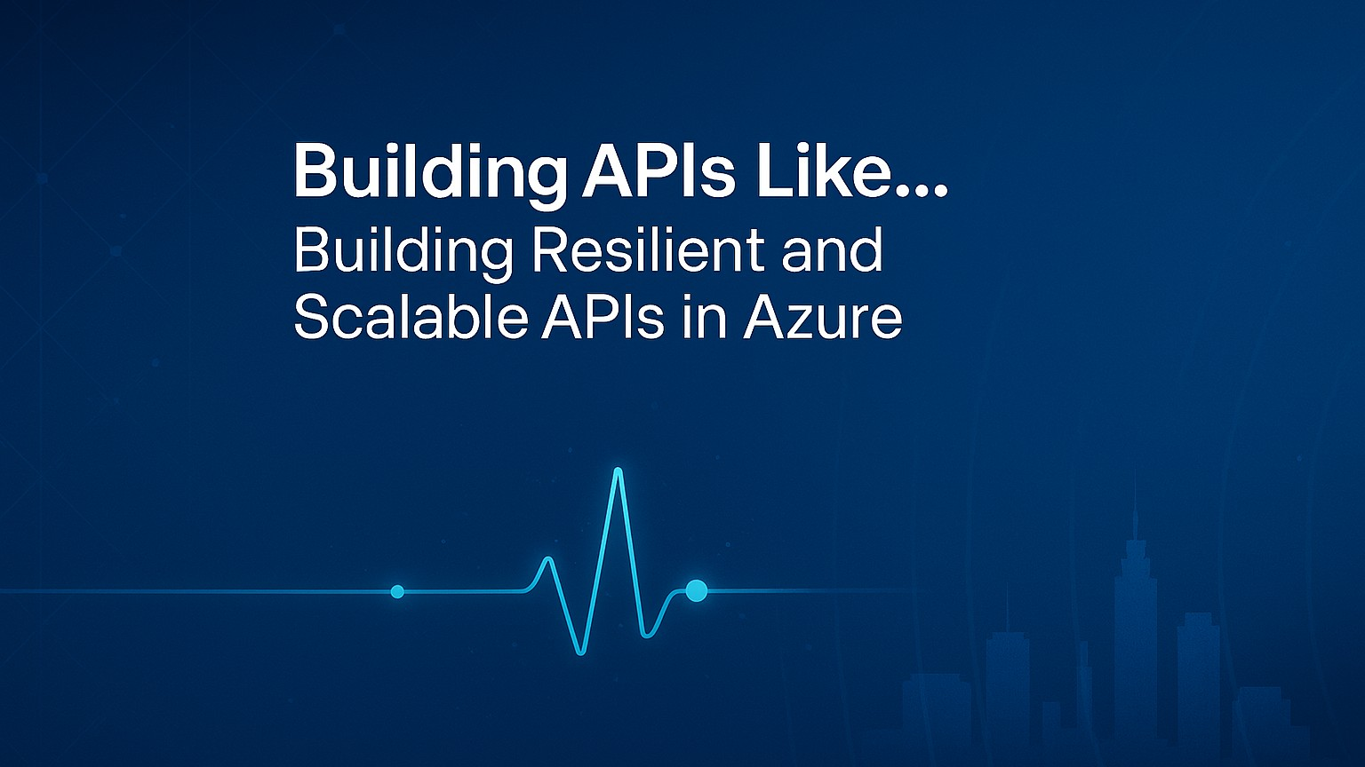
Notes:
Welcome everyone!
Today, we will explore how to design APIs that can handle anything you throw at them — whether that is a sudden traffic spike, a regional outage, or evolving business demands.
Systems must adapt, scale, and endure in every environment. The techniques we will cover today are universally acceptable — patterns and practices you can teach your teams and apply immediately, regardless of your industry or platform.
By the end of this session, you will walk away with:
A clear blueprint for building APIs that stay online under pressure.
Practical Azure patterns for scaling without overspending.
Proven monitoring and recovery strategies you can implement right away.
Like any well-run system, the goal is to keep things moving smoothly even when conditions change. Let’s examine this.

Slide 2








Agenda
Building Resilient and Scalable APIs in Azure
Intro & Problem Space
Azure Toolset Overview
High Availability & Disaster Recovery
Resilience Strategies
Monitoring & Observability
Live Demo
Blueprint & Wrap Up
Q&A
Notes:
Here is our roadmap for the next xx minutes.
We will start by framing the problem space — the real-world challenges APIs face under pressure. Then we will look at the Azure building blocks that give us resilience and scale. From there, we will explore high availability and disaster recovery patterns, followed by resilience strategies you can apply immediately.
We will cover monitoring and observability, run a live demo to see it all in action, and wrap up with a blueprint you can take back to your teams. Then, I’ll open it up for questions.
Think of each section as a checkpoint — by the end, you will have a complete, actionable plan for building APIs that can adapt, scale, and ensure.

Slide 3
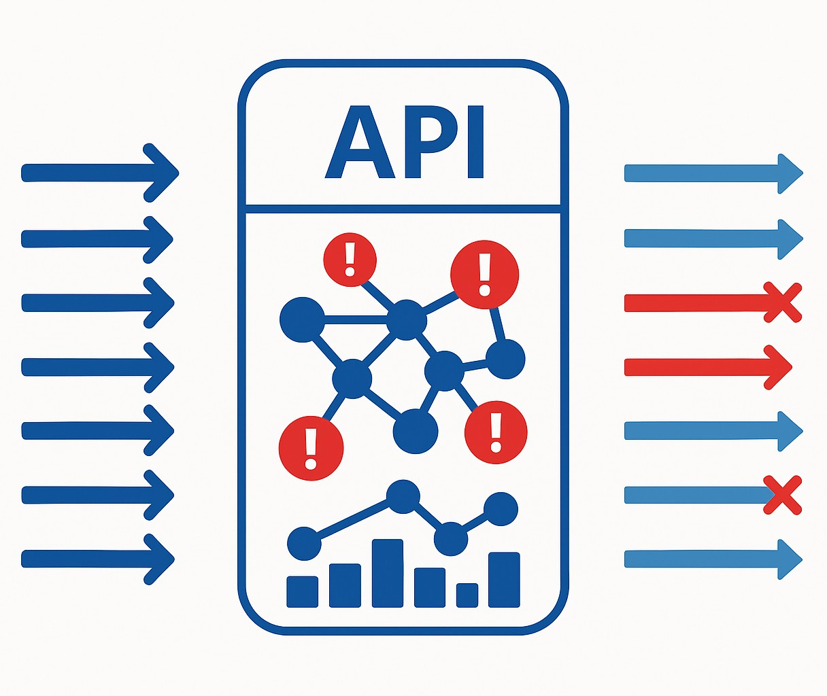

The Resilience Challenge
Building Resilient and Scalable APIs in Azure
Notes:
Let’s start with the reality we all face: APIs are the connective tissue of our systems. They are the bridges between services, the arteries that carry data, the control towers that direct requests. And when they falter, the impact is immediate and widespread.
Picture this: a sudden spike in traffic from a viral campaign. Requests flood in faster than your infrastructure can scale, or an upstream dependency — maybe a payment gateway or identity provider — goes down without warning, and suddenly your API is returning errors.
Then there are latency storms —when a slight delay in one service cascades through the system, multiplying response times until users start refreshing, retrying, and worsening the problem. And of course, the deployment risk: you push a change, and instead of improving things, it triggers a rollback or, worse, an outage.
These are not edge cases. They are everyday realities in modern, distributed cloud-native environments. And here is the thing — your users do not care why it is slow or broken. They just know it is not working.
Over the next few minutes, we are going to look at how to design APIs that can take these hits and keep going. Because resilience is not a “nice to have” — it is the difference between being a trusted platform and being tomorrow’s outage headline.

Slide 4










Resilience Turnaround
From Fragile to Fault-Tolerant: An API Resilience Transformation
Before (Challenges)
After (Results from Azure Patterns & Services)
Legacy Stack
Unplanned Outages
Cascading Failures
Protected Gateway
Multi-Region
Smart Patterns
No visibility
Manual Recovery
Live Metrics
Scales on Demand
Notes:
Let me give you a realistic example.
There is an organization that started with a patchwork of legacy integration systems and a couple of home-grown API gateways. They were fine on a normal day, but when traffic spiked, the cracks showed. Requests piled up, upstream services failed, and without throttling or caching, these failures cascaded.
They had no real-time visibility, so they were always reacting after customers felt the pain. Every failover was manual, expensive in both time and money.
They decided to re-architect with resilience in mind, using the exact patterns and Azure services we will be talking about today. Azure API Management became their consistent front door, enforcing policies, caching responses, and shielding backends. They deployed across multiple regions with Azure Front Door, so it one region had trouble, traffic flowed seamlessly to another. They built retry and circuit breaker logic into both APIM and their service code. They also wired up Azure Monitor and Application Insights to spot trouble before users did.
The result? A platform that now takes traffic surges in stride, shrugs off upstream hiccups, and has cut downtime dramatically — all while delivering a 315% ROI. This is the kind of transformation we are aiming for in this session.

Slide 5
Azure Toolset Overview
Notes:
We have just experienced the reality of API resilience challenges — the surges, dependency failures, cascading slowdowns, and deployment risks.
Before naming specific Azure services, I want to focus on the capabilities that help us meet those challenges head-on.
Resilient APIs are not an accident. They are the result of deliberate design choices — choices that give you:
Control at the edge to shape, protect, and prioritize traffic before it hits your core systems.
Elasticity in the middle so you can scale instantly when demand spikes, and scale back when it does not — without manual intervention.
Intelligence throughout so you can see what is happening in real time and adapt before users feel the pain.
You can build those capabilities on many platforms — Kubernetes in AKS, App Service Web Apps, even traditional VMs — and the principles will apply to all of them.
For this session, though, we will focus on serverless technologies where possible. Why? Because serverless gives us some of those resilience superpowers right out of the box:
It scales automatically with demand.
It removes much of the operational overhead, so we can focus on API logic and resilience patterns instead of patching infrastructure.
And it aligns cost with usage, so you are not paying for idle capacity “just in case.”
Think of it as starting with a building that already has shock absorbers built into the foundation. We will still add the safety rails, the backup generators, and the monitoring systems, but the base structure is already designed to handle stress.
In this next section, we will examine the specific Azure building blocks that give us those capabilities and how they work together to create APIs that not only survive under pressure but thrive.

Slide 6

Azure Toolset Overview
Primary Trio
Azure API Management
Traffic Shaping and Throttling
Caching
Policy Enforcement
Backend Shielding
Notes:
Let’s start at the front door of our API platform, Azure API Management, or APIM.
Think of APIM as the traffic controller and gatekeeper for every request in your APIs. It is the first point of contact, where we can shape, protect, and optimize traffic before it ever reaches our backend services.
From a resilience perspective, APIM gives us several critical capabilities:
Traffic shaping and throttling: So that a sudden surge of requests doesn’t overwhelm downstream systems.
Caching: Serving repeat requests from memory to reduce loads and improve response times.
Policy enforcement: Applying consistent rules for authentication, authorization, transformation, and validation without changing backend code.
Backend shielding: Insulating fragile or high-latency services from direct exposure to the internet.
This is where we can implement circuit breakers, retries, and failover routing at the edge — stopping problems before they cascade deeper into the system.
APIM also gives us a single, consistent entry point for all APIs, which means we can roll out resilience patterns once and have them apply everywhere, rather than re-implementing them in each service.
In short, APIM is our first line of defense and our first opportunity to optimize. It’s where we can absorb the initial shock of a traffic spike, gracefully handle upstream issues, and keep the rest of the platform stable.
As we move through the rest of the toolset, you will see how APIM works hand in hand with our compute and hosting layers to create a flexible and governed platform.

Slide 7

Azure Toolset Overview
Primary Trio
Azure API Management
Azure Functions
Elastic Capacity
Scale-to-Zero Efficiency
Event-Driven Triggers
Isolation of Workloads
Notes:
Once we have controlled and optimized traffic at the edge with APIM, the next question is how to handle the work itself and instant demand changes.
That is where Azure Functions comes in. Functions is an event-driven compute service that can scale out to meet demand and scale back to zero when idle.
From a resilience perspective, Functions gives us:
Elastic Capacity by instantly adding more instances to spike.
Scale-to-zero efficiency, so there is no wasted resources when there is no work to do.
Event-driven triggers that can respond to HTTP calls, queue messages, timers, or other events without polling.
Isolation of workloads, where each function can be deployed, updated, and scaled independently, reducing blast radius.
This means we can handle unpredictable workloads — from sudden traffic surges to batch jobs — without over-provisioning. And because the platform manages the scaling and infrastructure, our teams can focus on the logic and resilience patterns, not on servers.
In short, Functions is our on-demand workforce — always ready, never (completely) idle, and able to respond instantly when the call comes.

Slide 8

Azure Toolset Overview
Primary Trio
Azure API Management
Azure Functions
Azure Container Apps
Granular Scaling
Multiple Scale Triggers
Revisions and Blue-Green Deployments
Service-to-Service Communication
Notes:
Once APIM has managed the flow at the edge and Functions has given us elastic, event-driven bursts of compute, we need a way to run longer-lived, stateful, or interdependent services that still scale intelligently.
That is where Azure Container Apps comes in. It is a fully managed container hosting service designed for microservices and background processing — with KEDA-based scaling that reacts to real workload signals, not just CPU or memory.
From a resilience perspective, Container Apps gives us:
Granular scaling — scale out on demand, scale in when load drops.
Multiple scale triggers — HTTP requests, queue length, event streams, custom metrics.
Revisions and blue-green deployments — roll out changes safely, with instant rollback if needed.
Service-to-service communication — secure, internal calls between microservices without exposing them publicly.
This is where we can host the core services that need to be always on but still want the elasticity and operational simplicity of serverless.
In short, Container Apps is our flexible backbone — the part of the platform that can stretch, contract, and reroute under load without breaking.

Slide 9









Azure Toolset Overview
Primary Trio
Azure API Management
Azure Functions
Azure Container Apps
Azure Front Door
Azure Monitor
Application Insights
Azure Key Vault
Azure App Configuration
Azure Storage
Cosmos DB
Event Grid
Service Bus
Notes:
Let’s start at the front door of our API platform, Azure API Management, or APIM.
Think of APIM as the traffic controller and gatekeeper for every request in your APIs. It is the first point of contact, where we can shape, protect, and optimize traffic before it ever reaches our backend services.
From a resilience perspective, APIM gives us several critical capabilities:
Traffic shaping and throttling: So that a sudden surge of requests doesn’t overwhelm downstream systems.
Caching: Serving repeat requests from memory to reduce loads and improve response times.
Policy enforcement: Applying consistent rules for authentication, authorization, transformation, and validation without changing backend code.
Backend shielding: Insulating fragile or high-latency services from direct exposure to the internet.
This is where we can implement circuit breakers, retries, and failover routing at the edge — stopping problems before they cascade deeper into the system.
APIM also gives us a single, consistent entry point for all APIs, which means we can roll out resilience patterns once and have them apply everywhere, rather than re-implementing them in each service.
In short, APIM is our first line of defense and our first opportunity to optimize. It’s where we can absorb the initial shock of a traffic spike, gracefully handle upstream issues, and keep the rest of the platform stable.
As we move through the rest of the toolset, you will see how APIM works hand-in-hand with our compute and hosting layers to create a platform that’s both flexible and governed.

Slide 10







Who is Chad Green?
chadgreen@chadgreen.com
TaleLearnCode
ChadGreen.com
ChadGreen & TaleLearnCode
ChadwickEGreen

