Slide 1
File New: Build a Serverless Event-Driven Architected Microservice

Slide 2







Who is Chad Green
chadgreen@chadgreen.com
TaleLearnCode
ChadGreen.com
ChadGreen & TaleLearnCode
ChadwickEGreen

Slide 3
Northstar Senior Living
Property Manager
Resident Manager
Care Manager
Lease Manager
Web Application
Web Application
Web Application
Web Application
PM
RM
CM
LM
PM API
RM API
CM API
LM API

Slide 4
User Story – Resident Move-In
User Story
As a community manager, I want to move in prospective resident so they receive the benefits of being a resident.
Acceptance Criteria
Resident record created in Resident Manager.
Lease record is created in Lease Manager and payment activities start.
Resident initialized in Care Manager and care activities start.
Appropriate property records are updated to reflect the move-in.

Slide 5
Resident Move In
Property Manager
Resident Manager
Care Manager
Lease Manager
Web Application
Web Application
Web Application
Web Application
PM
RM
CM
LM
PM API
RM API
CM API
LM API

Slide 6
User Story – Resident Move-In
User Story
As a community manager, I want to move in prospective resident so they receive the benefits of being a resident.
Acceptance Criteria
Resident record created in Resident Manager.
Lease record is created in Lease Manager and payment activities start.
Resident initialized in Care Manager and care activities start.
Appropriate property records are updated to reflect the move-in.
Handle the ability for future actions upon a user move-in

Slide 7
Event-Driven Architecture
A software architecture pattern promoting the production, detection, consumption of, and reaction to events.
- Wikipedia -

Slide 8
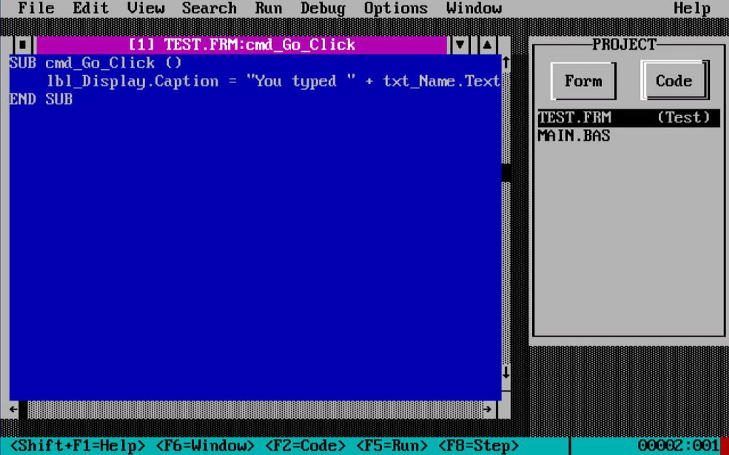
Event-Driven Architecture

Slide 9
Event-Driven Architecture
Event-driven architecture (EDA) is a design paradigm in which a software component executes in response to receiving one or more event notifications.
EDA is more loosely coupled than client/server paradigm because the component that sends the notification doesn’t know the identity of the receiving components at the time of compiling
- Garner -

Slide 10
Event-Driven Architecture
Event-driven architecture (EDA) is a design paradigm in which a software component executes in response to receiving one or more event notifications.
EDA is more loosely coupled than client/server paradigm because the component that sends the notification doesn’t know the identity of the receiving components at the time of compiling
- Garner -

Slide 11
Event-Driven Architecture
Event Producer
Event Consumer
Event Producer
Event Ingestion
Event Consumer
Event Producer
Event Consumer

Slide 12
Resident Move In
Event Ingester
Property Manager
Resident Manager
Care Manager
Lease Manager
Web Application
Web Application
Web Application
Web Application
PM
RM
CM
LM
PM API
RM API
CM API
LM API

Slide 13

Azure Event Hubs
Fully managed, real-time data ingestion service
Notes:
Event Hubs is a fully managed, real-time data ingestion service. Steam millions of events per second from any source to build dynamic data pipelines and immediately respond to business challenges. Keep processing data during emergencies using the geo-disaster recovery and geo-replication features.
Integrate seamlessly with other Azure services to unlock valuable insights. Allow existing Apache Kafka clients and applications to talk to Event Hubs without any code changes – you get a managed Kafka experience without having to manage your own clusters. Experience real-time data ingestion and micro-batching on the same stream

Slide 14




Azure Event Hubs
Simple
Secure
Scalable
Open
Notes:
Simple – Build real-time data pipelines with just a couple clicks. Seamlessly integrate with Azure data services to uncover insights faster.
Secure – Protect your real-time data. Event Hubs is certified by CSA, STAR, ISO, SOC, GxP, HIPPA, HITRUST, and PCI.
Scalable – Adjust throughput dynamically based on your usage needs and pay only for what you use.
Open – Ingest data from anywhere and develop across platforms with support for popular protocols, including AMQP, HTTPS, and Apache Kafka.

Slide 15

PM
RM
CM
LM
PM API
RM API
CM API
LM API

Slide 16



PM
PM
PM API
PM Listener
RM
RM
RM API
Event Hubs
CM
CM
CM API
CM Listener
LM
LM
LM API
LM Listener

Slide 17
Thank You
chadgreen@chadgreen.com
TaleLearnCode
ChadGreen.com
ChadGreen & TaleLearnCode
ChadwickEGreen

