Slide 1

Time Travelling Data
Chad Green
Senior Systems Architect
Jasper Engines & Transmissions
Level: Introductory

Slide 2

Session Survey
Your feedback is very important to us
Please take a moment to complete the session survey found in the mobile app
Use the QR code or search for “Converge360 Events” in your app store
Find this session on the Agenda tab
Click “Session Evaluation”
Thank you!

Slide 4


Slide 6


Slide 7


Slide 8


Slide 9
What are System-Versioned Temporal Tables?
Time-Travelling Data: SQL Server Temporal Tables

Slide 10
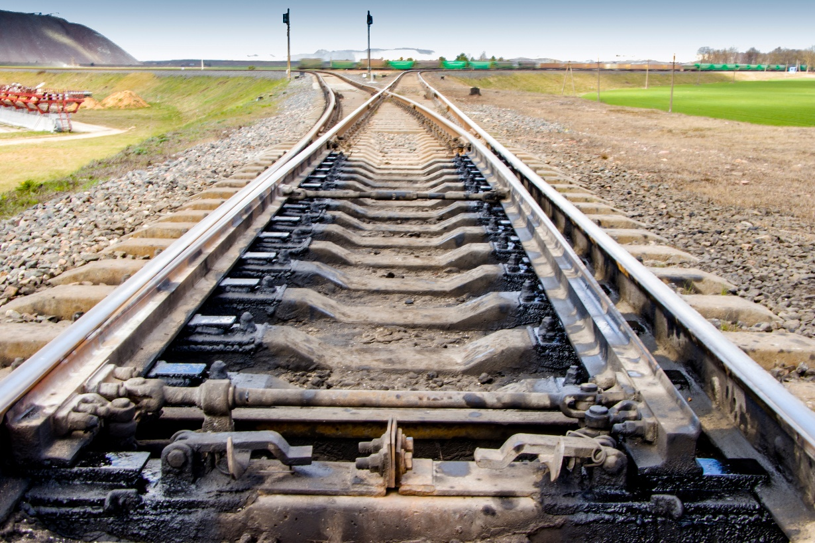
Track Changes
What are system-versioned temporal tables?

Slide 11

System-Versioned
What are system-versioned temporal tables?

Slide 12

Rule of Two
What are system-versioned temporal tables?
Notes:
Rule of Two: 2 tables and 2 new columns
Two period columns of type DATETIME2 (SystemStartTime and SystemEndType)
History table with same column definitions

Slide 13

Availability
What are system-versioned temporal tables?
Notes:
All version of SQL Server starting with 2016
Replaces Change Data Capture and Change Tracking features

Slide 14
Why use temporal tables?
Time Travelling Data: SQL Server Temporal Tables

Slide 16
Why use temporal tables?
Immutable History
Built-In Time-Travelling Query Support
Better DML Performance
Minimal Maintenance Costs

Slide 17

Auditing
Common Use Cases
Notes:
Auding all data changes and performing data forensics when necessary

Slide 18

Reconstructing State
Common Use Cases
Notes:
Reconstructing state of the data as of any time in the past

Slide 19

Calculating Trends
Notes:
Calculating trends over time

Slide 20

Slowly Changing Dimensions
Common Use Cases
Notes:
Maintaining a slowing changing dimension for decision support applications

Slide 21

Accidental Recovery
Common Use Cases
Notes:
Recovering from accidental data changes and application errors

Slide 22
How do temporal tables work?
Time Travelling Data: SQL Server Temporal Tables

Slide 23

Ho do temporal tables work?
Database Table
PrimaryKeyId
Name
ForeignKeyId

Slide 24
Ho do temporal tables work?
Temporal Table (Current)
PrimaryKeyId
Name
ForeignKeyId
ValidFrom
ValidTo
History Table
PrimaryKeyId
Name
ForeignKeyId
ValidFrom
ValidTo

Slide 25
Ho do temporal tables work?
Temporal Table (Current)
PrimaryKeyId
Name
ForeignKeyId
ValidFrom
ValidTo
History Table
PrimaryKeyId
Name
ForeignKeyId
ValidFrom
ValidTo
123
TaleLearnCode
456
2022-08-06 18:00:00
9999-12-31 23:59:59
Insert
Notes:
INSERTS: The system sets the value for the ValidFrom column to the begin time of the current transaction (in the UTC time zone) based on the system clock and assigns the value for the ValidTo column to the maximum value of the 9999-12-31. This marks the row as open.

Slide 26
Ho do temporal tables work?
Temporal Table (Current)
PrimaryKeyId
Name
ForeignKeyId
ValidFrom
ValidTo
History Table
PrimaryKeyId
Name
ForeignKeyId
ValidFrom
ValidTo
123
123
BricksWithChad
TaleLearnCode
TaleLearnCode
456
456
2022-08-06 18:10:00
2022-08-06 18:00:00
2022-08-06 18:00:00
9999-12-31 23:59:59
2022-08-06 18:10:00
Update
Notes:
UPDATES: The system stores the previous value of the row in the history table and sets the value for the ValidTo column to the begin time of the current transaction (in the UTC time zone) based on the system clock. This marks the row as closed, with a period recorded for which the row was valid. In the current table, the row is updated with its new value and the system sets the value for the ValidFrom column to the begin time for the transaction (in the UTC time zone) based on the system clock. The value for the updated row in the current table for the ValidTo column remains the maximum value of 9999-12-31

Slide 27
Ho do temporal tables work?
Temporal Table (Current)
PrimaryKeyId
Name
ForeignKeyId
ValidFrom
ValidTo
History Table
PrimaryKeyId
Name
ForeignKeyId
ValidFrom
ValidTo
123
123
BricksWithChad
BricksWithChad
456
456
2022-08-06 18:10:00
2022-08-06 18:10:00
9999-12-31 23:59:59
9999-12-31 23:59:59
Delete
Notes:
DELETES: The system stores the previous value of the row in the history table and sets the value for the ValidTo column to the begin time of the current transaction (in the UTC time zone) based on the system clock. This marks the row as closed, with a period recorded for the which the previous row was valid. In the current table, the row is removed, Queries of the current table will not return this row. Only queries that deal with the history data return data for which row is closed.

Slide 28
Ho do temporal tables work?
Temporal Table (Current)
PrimaryKeyId
Name
ForeignKeyId
ValidFrom
ValidTo
History Table
PrimaryKeyId
Name
ForeignKeyId
ValidFrom
ValidTo
123
123
BricksWithChad
BricksWithChad
456
456
2022-08-06 18:10:00
2022-08-06 18:10:00
9999-12-31 23:59:59
9999-12-31 23:59:59
Regular queries (current data)
Include historical version
Query
FOR SYSTEM_TIME
ALL, AS OF, BETWEEN..AND, FROM..TO, CONTAINED IN

Slide 29
Ho do temporal tables work?
SELECT * FROM DemoTable
FOR SYSTEM_TIME
BETWEEN '2022-08-05 00:00:00' AND '2022-08-06 23:59:59'
WHERE Id = 123
ORDER BY ValidFrom
Temporal Table (Current)
PrimaryKeyId
Name
ForeignKeyId
ValidFrom
ValidTo
History Table
PrimaryKeyId
Name
ForeignKeyId
ValidFrom
ValidTo
123
123
BricksWithChad
BricksWithChad
456
456
2022-08-06 18:10:00
2022-08-06 18:10:00
9999-12-31 23:59:59
9999-12-31 23:59:59
PrimaryKeyId | Name | ForiegnKeyId | ValidFrom | ValidTo
123 | BricskWithChad | 456 | 2022-08-06 18:10:00 | 9999-12-31 23:59:59
123 | TaleLearnCode | 456 | 2022-08-06 18:00:00 | 2022-08-06 18:10:00
Regular queries (current data)
Include historical version
Query
FOR SYSTEM_TIME
ALL, AS OF, BETWEEN..AND, FROM..TO, CONTAINED IN

Slide 30
Ho do temporal tables work?
SELECT * FROM DemoTable
FOR SYSTEM_TIME
AS OF '2022-08-06 18:05:00’
WHERE Id = 123
Temporal Table (Current)
PrimaryKeyId
Name
ForeignKeyId
ValidFrom
ValidTo
History Table
PrimaryKeyId
Name
ForeignKeyId
ValidFrom
ValidTo
123
123
BricksWithChad
BricksWithChad
456
456
2022-08-06 18:10:00
2022-08-06 18:10:00
9999-12-31 23:59:59
9999-12-31 23:59:59
PrimaryKeyId | Name | ForiegnKeyId | ValidFrom | ValidTo
123 | TaleLearnCode | 456 | 2022-08-06 18:00:00 | 2022-08-06 18:10:00
Regular queries (current data)
Include historical version
Query
FOR SYSTEM_TIME
ALL, AS OF, BETWEEN..AND, FROM..TO, CONTAINED IN

