Slide 1
CAPSTONE FINAL DEFENCE
Linaw PH
A Web-Based Resume Builder and ATS-Inspired Job Matching System for Job Seekers and Partner Companies in the Philippines
Garcia, Byrone · Santos, Francis Allen · Talens, Isaiah
BS Information Technology, Web Development · School of Computing, Holy Angel University
Adviser: Dr. Jeanky Salenga-Mendez · Partner company: Clark Outsourcing
Notes:
SAY: Greet the panel by name if known. State the title once, clearly, then move on — do not re-read the slide.
WHY THIS SLIDE MATTERS: This is the panel's first impression. A clean, confident opening buys goodwill for the rest of the defence.
KEY FACT TO REMEMBER: Linaw means 'clarity' — say this once, it becomes your closing line too.
LIKELY PANEL QUESTION: Why this title and not something shorter?
SUGGESTED ANSWER: The title names the system, both user groups, and the country context — every word maps to something we actually built and evaluated.
POSSIBLE FOLLOW-UP: Why 'Partner Companies' plural when you only worked with one?
FOLLOW-UP ANSWER: The system is designed to support more than one company; this pilot evaluated it with one, Clark Outsourcing, and our Scope section says so directly.

Slide 2
BACKGROUND
Background of the Study
Digital hiring has grown, access has not
Applicant Tracking Systems are now standard even at mid-sized Philippine employers, but the tools to write an ATS-ready resume remain costly or absent for most job seekers.
The literature shows two separate gaps
Resume-quality research addresses the job seeker's side; ATS-adoption research addresses the employer's side. Almost none combine both into one system.
This is where Linaw PH sits
A free platform that closes both gaps together — a guided resume builder feeding directly into a transparent matching engine.
Notes:
SAY: Explain the setting briefly: digital job applications are now the norm, but the tools to succeed at them are not equally available.
WHY THIS SLIDE MATTERS: Establishes the study is grounded in a real, literature-supported gap, not a personal assumption.
KEY FACT TO REMEMBER: The gap is combinatorial: existing tools solve one side or the other, never both together.
LIKELY PANEL QUESTION: Why does this background matter to your specific study?
SUGGESTED ANSWER: Because our system is the first in our review to combine guided resume creation with ATS-inspired matching in one free Philippine-context platform.
POSSIBLE FOLLOW-UP: Isn't 'no existing system does this' a weak claim?
FOLLOW-UP ANSWER: We don't rest on that alone — we cite the specific literature gap on each side (resume-quality studies, ATS-adoption studies) and show neither addresses both.

Slide 3
THE PROBLEM
Statement of the Problem
Two populations, surveyed separately before the system existed, describing the same problem from opposite sides.
4.00
FORMATTING IS FRUSTRATING
job seekers, n=46
48.7%
NEVER TOLD WHY THEY FAILED
of those who applied
4.64
POOR FORMATTING HIDES INFORMATION
HR staff, n=11
Six research questions follow directly from these three findings — three about the problem, three about how the finished system is rated.
Notes:
SAY: State the problem as data, not narrative: these numbers came from our own pre-use surveys, not from assumption.
WHY THIS SLIDE MATTERS: A panel wants to see the problem is measured, not asserted. This slide is your proof.
KEY FACT TO REMEMBER: Neither group saw the other's answers — that's what makes the agreement meaningful.
LIKELY PANEL QUESTION: How do you know this problem is serious enough to justify a whole capstone?
SUGGESTED ANSWER: Because it was independently confirmed by two different populations using two different instruments, administered weeks apart.
POSSIBLE FOLLOW-UP: Could this just be a coincidence?
FOLLOW-UP ANSWER: Unlikely — the specific overlap (formatting difficulty on both sides, silence on rejection reasons) is exactly the combined gap our literature review identified before we surveyed anyone.

Slide 4
SOLUTION
Proposed Solution
Linaw PH: a free resume builder and ATS-inspired job matching system.
• Guides job seekers through building a structured, parser-safe resume.
• Scores every applicant against a posting with a published, fixed formula — never a black box.
• Shows the applicant the same score and the same reasons the recruiter sees.
• Never rejects automatically — every hiring decision stays with a named recruiter.
Notes:
SAY: Walk through the four bullets in order — build, score, explain, decide.
WHY THIS SLIDE MATTERS: This is the slide that answers 'so what did you actually make?' in one breath.
KEY FACT TO REMEMBER: The formula is rule-based, not machine learning — deterministic and fully explainable.
LIKELY PANEL QUESTION: Why rule-based instead of AI/machine learning?
SUGGESTED ANSWER: An applicant is entitled to know exactly why they got a number. A model we can't fully explain can't be shown to the person it judges.
POSSIBLE FOLLOW-UP: Could AI ever be added later?
FOLLOW-UP ANSWER: Only if it stayed fully explainable — that's a design boundary, not a technical limitation we ran into.

Slide 5
OBJECTIVES
Objectives of the Study
All eight objectives are listed in full in the manuscript; six have direct respondent evidence in Chapter 4.
General objective
Design, develop, and evaluate a web-based resume builder and ATS-inspired job matching system connecting job seekers with partner companies.
Specific objectives (of eight)
Build a guided resume builder with three formats and fourteen designs; build job seeker, recruiter, and administrator accounts; build the ATS-inspired matching engine; protect data under RA 10173; verify and evaluate the system.
Notes:
SAY: Read the general objective once in full, then summarise the specific objectives — don't read all eight verbatim.
WHY THIS SLIDE MATTERS: Objectives are what the panel checks your Results chapter against — this slide sets up that comparison for slide 19.
KEY FACT TO REMEMBER: Eight specific objectives; six have direct respondent evidence, two don't (say which, later).
LIKELY PANEL QUESTION: Were all your objectives achieved?
SUGGESTED ANSWER: Six of eight have direct evidence from our evaluation instruments. Two — the administrator account and low-experience accessibility — were built but not directly rated by any respondent group, and we say so.
POSSIBLE FOLLOW-UP: Why weren't those two tested?
FOLLOW-UP ANSWER: No respondent group holds the administrator role, and no instrument specifically asked about low-tech-experience users — a real gap in our evaluation design, not something we're hiding.

Slide 6
SCOPE AND LIMITATIONS
Scope and Limitations
Scope (what we built and tested) | Limitations (what we cannot claim)
Three account types: Job Seeker, Recruiter/HR, Administrator | One partner company (Clark Outsourcing) — not a Philippine-wide claim
Rule-based, deterministic matching engine | No control group — cannot claim the system caused the change measured
Evaluated against ISO/IEC 25010 quality characteristics | Single session per respondent, 20-30 minutes — not sustained use
Data protection under RA 10173 | IT expert panel is 3 people — supports no generalisation
Notes:
SAY: Present scope and limitations side by side — this pairing shows self-awareness, not weakness.
WHY THIS SLIDE MATTERS: Panels specifically probe generalizability; naming the limits yourself removes the easy question.
KEY FACT TO REMEMBER: n=3 for IT experts, one partner company, one session — say these three numbers from memory.
LIKELY PANEL QUESTION: Isn't a single partner company too narrow to draw any conclusion from?
SUGGESTED ANSWER: Yes for generalising beyond it, and we don't — every HR-side finding in our paper is explicitly scoped to Clark Outsourcing, not to Philippine recruiters broadly.
POSSIBLE FOLLOW-UP: What would you need to generalise further?
FOLLOW-UP ANSWER: Exactly what our Recommendations section says: more partner companies, more industries, sessions longer than twenty to thirty minutes.

Slide 7
SIGNIFICANCE
Significance of the Study
Job seekers
Free access to a guided, ATS-ready resume builder — no subscription, no writing-service fee.
Clark Outsourcing
A working system fitted to its multi-department hiring process, and a documented account of how its own screening compares to the system's ranking.
Holy Angel University / School of Computing
A completed, documented web application plus the full reasoning behind every design decision, including where the system falls short.
Future researchers
A deliberately simple, fully documented rule-based matching approach — the weights, thresholds, and known weak points are all on record.
Notes:
SAY: Name each beneficiary and the ONE thing they specifically gain — don't generalise across all four.
WHY THIS SLIDE MATTERS: Shows the study's value reaches beyond the researchers themselves.
KEY FACT TO REMEMBER: The 'future researchers' benefit is the documented formula — genuinely reusable, not vague.
LIKELY PANEL QUESTION: Which of these benefits is best supported by your actual data?
SUGGESTED ANSWER: Clark Outsourcing's, most directly — Instrument D measured their staff's actual response to the finished system, at 4.22 overall.
POSSIBLE FOLLOW-UP: Isn't the job seeker benefit just assumed?
FOLLOW-UP ANSWER: No — Instrument C measured it directly: 46 job seekers rated the finished system 4.28 overall after using it themselves.

Slide 8
USERS
Target Users / User Roles
Role | Responsibilities
Job Seeker | Builds and manages resumes, browses and applies to postings, tracks application status
Recruiter / HR | Manages company profile and postings, reviews ranked applicants, updates status, sends interview invites
Administrator | Approves recruiter access requests, assigns departments, views anonymised study metrics
Notes:
SAY: State each role's core responsibility in one sentence — this slide should take under a minute.
WHY THIS SLIDE MATTERS: Confirms the system architecture matches a real, three-sided use case, not a two-sided toy.
KEY FACT TO REMEMBER: Administrator is held by the research team — not an external, evaluated user role.
LIKELY PANEL QUESTION: Why does the administrator matter if no one evaluated it?
SUGGESTED ANSWER: It's a governance role that keeps the two public account types trustworthy — it approves recruiters and routes departments correctly, even though it wasn't rated directly.
POSSIBLE FOLLOW-UP: Could a job seeker and a recruiter be the same person?
FOLLOW-UP ANSWER: No — account type is fixed at registration and determines which parts of the system that account can access.

Slide 9
RELATED LITERATURE
Related Literature and the Research Gap
Resume-quality research
Confirms formatting and ATS-compatibility strongly affect callback rates (Greenhouse Software, 2023; Fuller et al., 2021: 88% of employers report losing qualified candidates to their own ATS).
Job-matching research
Content-based filtering matches applicant profiles to postings effectively even for new users (Abdul Rashid et al., 2022) — the technique this system's matching engine is built on.
The gap
No study in our review combines guided, ATS-ready resume creation with transparent, ATS-inspired matching in one free, Philippine-context platform.
How we close it
Linaw PH does both, in one system, evaluated end to end with real respondents from both sides.
Notes:
SAY: Name only the two or three strongest sources — do not attempt to summarise the whole literature review.
WHY THIS SLIDE MATTERS: Proves the system is grounded in existing research, not built from instinct alone.
KEY FACT TO REMEMBER: The gap is combinatorial — no single study addresses both the applicant and employer sides together.
LIKELY PANEL QUESTION: How is your system different from JobStreet's AI matching feature?
SUGGESTED ANSWER: JobStreet requires a full, active profile many first-time job seekers haven't built, and gives no transparency into how a match score was reached. Ours is guided from a blank resume and shows the full formula.
POSSIBLE FOLLOW-UP: Why not just use an existing job board instead of building a new system?
FOLLOW-UP ANSWER: Existing boards are keyword-searched job boards, not matching systems — they don't compare structured resume data against posting requirements, and don't give recruiters a scored, ranked list.

Slide 10
METHODOLOGY
Methodology
Research design: quantitative descriptive
Measures how widely a difficulty is shared and how highly the system is rated — not why, using closed items only.
Development model: Waterfall
The evaluation is a research instrument, not a development activity — it needs one finished, unchanging system rated by every respondent.
Sampling: purposive
Job seekers recruited through the School of Computing; HR staff are a full census of the partner department, not a sample of it.
One inferential test
A Wilcoxon rank-sum test on the four items repeated before and after use — the study's only inferential claim; everything else is descriptive.
Notes:
SAY: State the design, the development model, and the sampling method as three separate, clean facts.
WHY THIS SLIDE MATTERS: This slide pre-empts the single most common methodology question a panel asks.
KEY FACT TO REMEMBER: Waterfall is a research reason, not a preference — say the reason, not just the name.
LIKELY PANEL QUESTION: Why Waterfall and not Agile?
SUGGESTED ANSWER: The evaluation needs one finished system rated by every respondent. An iterative build would give different respondents different versions, and the ratings couldn't honestly be averaged together.
POSSIBLE FOLLOW-UP: Why quantitative and not qualitative or mixed methods?
FOLLOW-UP ANSWER: Our six research questions ask how many and how highly rated — questions answered by counting and averaging closed responses, not by interpreting open narratives.

Slide 11
DEVELOPMENT
System Development
1. Planning and requirements — mapped what job seekers and recruiters need using the 5W1H framework
2. System design — interface layouts, database schema, and the matching algorithm, before any code
3. Development — resume builder, posting/application modules, matching engine, admin module
4. Testing and quality assurance — 232 automated tests, ~120 browser walkthroughs, ISO 25010 evaluation
5. Deployment — release, respondent task sheets, then the five research instruments
Notes:
SAY: Walk through the five Waterfall phases in order, one sentence each.
WHY THIS SLIDE MATTERS: Shows the system wasn't built ad hoc — every phase has a clear deliverable feeding the next.
KEY FACT TO REMEMBER: Correctness is established before evaluation, by testing — not discovered by respondents.
LIKELY PANEL QUESTION: What happens if testing finds a defect after respondents have already rated the system?
SUGGESTED ANSWER: It's reported as a finding, not silently fixed and re-rated — a repaired system is no longer the system earlier respondents rated. This actually happened once: a broken calendar-invite link was found and fixed, and it's documented as a defect caught by our own testing.
POSSIBLE FOLLOW-UP: Isn't 'no loop back to design' a weakness of Waterfall?
FOLLOW-UP ANSWER: It's a stated trade-off, not an oversight — accepted because a fixed evaluation target matters more here than mid-project flexibility.

Slide 12
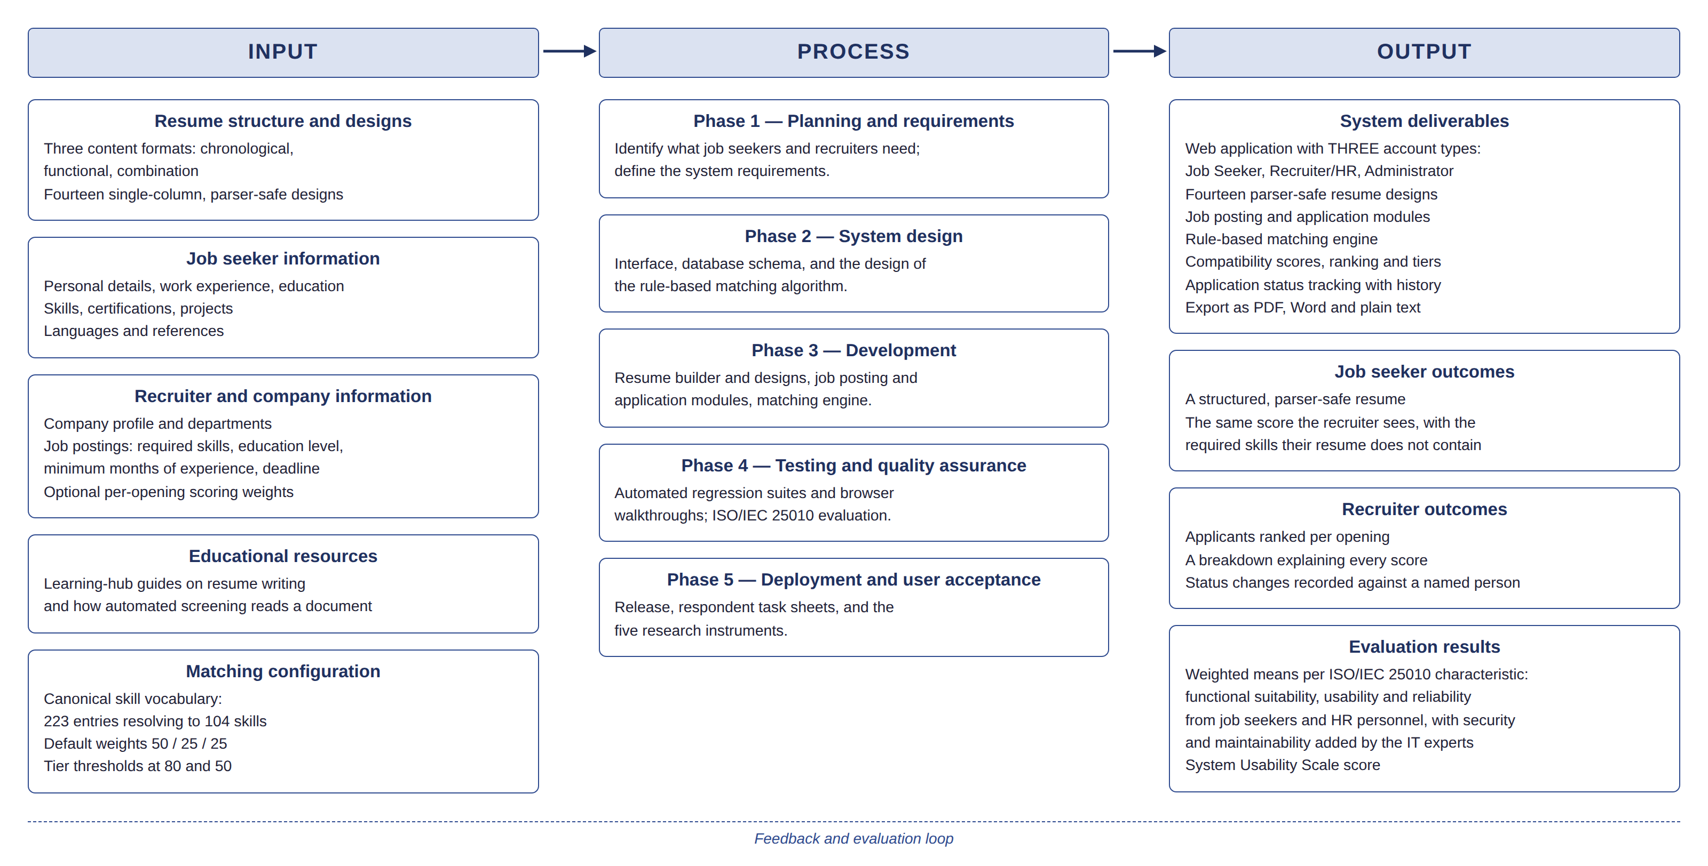
ARCHITECTURE
System Architecture Overview
Input, Process, Output — the whole system in one diagram.
Structured input makes content legible to software; an explained score makes the decision legible to the applicant.
Notes:
SAY: Walk left to right across the three columns — don't read every box.
WHY THIS SLIDE MATTERS: Gives the panel the whole system's shape in fifteen seconds before the detail slides.
KEY FACT TO REMEMBER: The matching configuration (weights, thresholds, vocabulary) lives in Input, not buried in Process.
LIKELY PANEL QUESTION: Where does the AI feature fit into this diagram?
SUGGESTED ANSWER: Under Input, job seeker information — it's an optional file-reading step that produces structured fields; it never touches scoring, which stays in the deterministic Process column.
POSSIBLE FOLLOW-UP: Why is Output split into three separate boxes?
FOLLOW-UP ANSWER: Because the system produces genuinely different things for job seekers, recruiters, and the evaluation itself — deliverables, outcomes, and results are not the same category.

Slide 13
FEATURES
System Features
Guided resume builder
3 content formats, 14 parser-safe designs, live preview, export to PDF/Word/plain text
Transparent matching engine
Published 50/25/25 default formula, adjustable per posting (min 10% each, total 100%)
Two-resume design
A structured resume the engine reads, plus an optional uploaded file forwarded untouched to the recruiter
Full audit trail
Nine tracked application statuses, every change recorded with who made it and when
Interview scheduling
Recruiters send interview invites with a one-click Google Calendar link
Notes:
SAY: Pick the two features most likely to draw a follow-up — matching engine and the two-resume design — and give those the most airtime.
WHY THIS SLIDE MATTERS: This is the slide the panel will point at and ask 'walk me through this feature.'
KEY FACT TO REMEMBER: The two-resume design exists specifically so a badly-parsed upload can't lower anyone's score.
LIKELY PANEL QUESTION: What happens if an applicant's uploaded file can't be read by the system?
SUGGESTED ANSWER: Nothing is lost — the uploaded file is always forwarded to the recruiter untouched. Only the structured resume, built inside the platform, is ever used for scoring.
POSSIBLE FOLLOW-UP: Can a recruiter see an applicant's raw uploaded resume, or only the structured one?
FOLLOW-UP ANSWER: Both — the recruiter sees the structured resume for scoring and can open the original uploaded file alongside it.

Slide 14
SYSTEM FLOW
System Flow
Job seeker
↓ Register & verify email
↓ Build resume (guided)
↓ Browse & apply to postings
↓ Track status
Recruiter
↓ Get admin approval
↓ Create posting, set weights
↓ Review ranked applicants
↓ Update status / invite
Notes:
SAY: Trace one finger down each column as you speak — this is a flow, not a list.
WHY THIS SLIDE MATTERS: Confirms the system's logic matches what was just described in the architecture diagram.
KEY FACT TO REMEMBER: Both flows converge on the same application record — that's the point of the design.
LIKELY PANEL QUESTION: What if a recruiter changes the scoring weights after applicants have already applied?
SUGGESTED ANSWER: Each application stores a score snapshot taken at the time it was submitted — changing a posting's weights afterward does not retroactively change scores already given.
POSSIBLE FOLLOW-UP: Can an applicant withdraw an application after submitting it?
FOLLOW-UP ANSWER: Yes — withdrawal is one of the tracked statuses, and it's recorded in the same audit trail as every other status change.

Slide 15
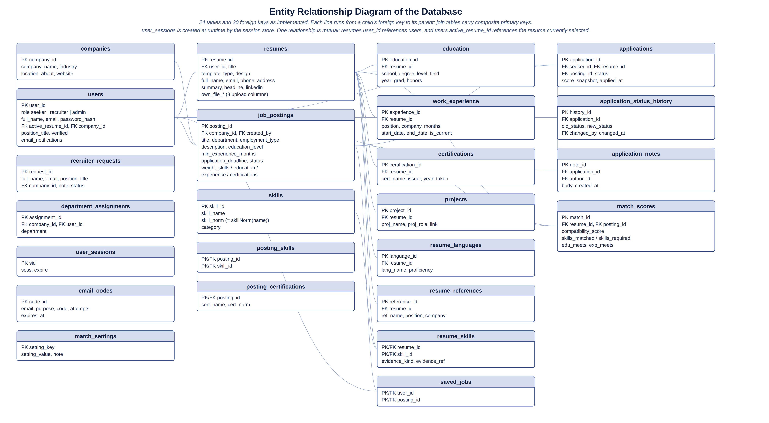
DATABASE
Database / Data Structure
24 tables, 30 foreign keys, PostgreSQL on Supabase.
match_scores links one resume to one posting with a timestamped, snapshotted result.
Notes:
SAY: Point at application_status_history and match_scores specifically — those two tables carry the study's core claims.
WHY THIS SLIDE MATTERS: Proves the audit trail and scoring claims made earlier are real database structures, not just prose.
KEY FACT TO REMEMBER: application_notes and posting_certifications are two tables easy to forget when asked to name them.
LIKELY PANEL QUESTION: Why PostgreSQL instead of MySQL, which was in your original proposal?
SUGGESTED ANSWER: PostgreSQL enforces the permitted application statuses at the database level with CHECK constraints, and schema migrations are transactional — a failed migration can't leave the database half-changed.
POSSIBLE FOLLOW-UP: How do you prevent one company from seeing another company's applicants?
FOLLOW-UP ANSWER: Access is controlled by the signed-in account's role and company_id at the database query level — a recruiter's queries are scoped to their own company's postings only.

Slide 16
DEMONSTRATION
System Demonstration
1. Job seeker: build a resume, see a match score, apply
2. Job seeker: open the score breakdown — missing skills named
3. Recruiter: open the same posting's ranked applicant list
4. Recruiter: open that applicant's breakdown — same numbers
5. Recruiter: change status, send an interview invite
Notes:
SAY: This is a live system demo — switch away from slides. Full click-by-click script is in the companion demo script.
WHY THIS SLIDE MATTERS: Proves the system is real and working, not a mockup — panels often ask to see 'that feature' immediately after.
KEY FACT TO REMEMBER: The one sentence to repeat: 'applicant and recruiter are looking at the same score, same reasons.'
LIKELY PANEL QUESTION: Can you show us what happens when there's no strong match?
SUGGESTED ANSWER: Yes — [have a low-scoring test applicant ready] — the system still shows the score honestly and suggests related postings instead of hiding the result.
POSSIBLE FOLLOW-UP: Can you show the admin approving a recruiter?
FOLLOW-UP ANSWER: Yes if time allows — sign in as admin, open pending recruiter requests, approve one, and show the department assignment step.

Slide 17
TESTING
Testing and Evaluation
Correctness verified before a single respondent used the system.
232
AUTOMATED TESTS
across eleven suites
~120
BROWSER WALKTHROUGHS
every page, every account, both themes
3
VERIFICATION LEVELS
automated, browser, respondent-based
The engine suite includes a parity check: the browser's copy of the matching formula and the server's copy must return the same score for the same input, or the suite fails.
Notes:
SAY: Distinguish verification (did it work correctly) from evaluation (did users think it was good) — this distinction is a common trap question.
WHY THIS SLIDE MATTERS: Shows rigor before respondents were ever involved — protects the evaluation from being a bug hunt.
KEY FACT TO REMEMBER: 232 tests, eleven suites — memorise this number cold.
LIKELY PANEL QUESTION: What's the difference between your testing and your evaluation?
SUGGESTED ANSWER: Testing verifies the system works as specified — 232 automated tests plus browser walkthroughs. Evaluation asks whether respondents judge the finished, already-verified system to be good.
POSSIBLE FOLLOW-UP: Did you find any real bugs during this process?
FOLLOW-UP ANSWER: Yes — the 'Add to Google Calendar' link in interview invitations was broken; we found it, fixed it, and added a regression test so it can't silently break again.

Slide 18
RESULTS
Results / Findings
Instrument | Respondents | Overall result
A — Job seekers, before use | n=46 | Formatting frustration 4.00; 80.4% never paid for resume help
B — HR, before use | n=11 | Poor formatting hides info 4.64 — the strongest single finding
C — Job seekers, after use | n=46 | 4.28 overall — good band; SUS 74.7, above the 68 average
D — HR, after use | n=10 | 4.22 overall — good band; trust in ranking unanimous at 4/5
E — IT experts | n=3 | 4.80 overall — the only excellent-band result
Notes:
SAY: Read down the 'overall result' column only — don't restate the respondent counts, they're on the slide.
WHY THIS SLIDE MATTERS: This is the single slide the panel will refer back to most; know every number on it cold.
KEY FACT TO REMEMBER: The pattern: use-based ratings (C, D) are 'good'; the inspection-based rating (E) is 'excellent' — different kinds of evidence.
LIKELY PANEL QUESTION: Why did the IT experts rate it higher than the actual users?
SUGGESTED ANSWER: They inspected code and structure rather than using it to do a job — where the two disagree, we treat the people who used it as the more meaningful number.
POSSIBLE FOLLOW-UP: Is a sample of 3 IT experts enough to draw any conclusion?
FOLLOW-UP ANSWER: No, and we say so directly — three respondents support no inference beyond themselves, and no generalising claim is made from that number alone.

Slide 19
OBJECTIVE ACHIEVEMENT
Objective Achievement
Objective | What we did | Result
Guided resume builder | 3 formats, 14 designs built and deployed | 4.30 functional suitability, job seekers
Transparent matching engine | Published, fixed 50/25/25 formula | 4.64 explainability rating, HR; 4.78 functional suitability, IT experts
Protect user data (RA 10173) | Hashed passwords, RBAC, data export/deletion | 4.89 security rating, IT experts — highest of any characteristic
Verify and evaluate the system | 232 tests + ~120 walkthroughs + 5 instruments | All three respondent groups rated the finished system good or above
Accessible to low-experience users | Mobile-responsive, guided tour, light/dark mode | Built; not directly measured by any instrument
Notes:
SAY: This is the slide that proves the study answers its own objectives — go slowly, one row at a time.
WHY THIS SLIDE MATTERS: Directly answers 'were your objectives achieved' before the panel has to ask it.
KEY FACT TO REMEMBER: The last row is the honest exception — say it plainly, don't rush past it.
LIKELY PANEL QUESTION: Which objective are you least confident was fully achieved?
SUGGESTED ANSWER: Accessibility for low-experience users — it was designed for (mobile-responsive, guided tour) but no instrument directly asked whether a low-experience user found it usable.
POSSIBLE FOLLOW-UP: Would you call that objective a failure?
FOLLOW-UP ANSWER: No — it was built. What's missing is direct evidence, which is a gap in our evaluation design, not evidence the feature doesn't work.

Slide 20
CONCLUSION
Conclusion
The two-sided problem is confirmed
Job seekers and recruiters, surveyed independently, described the same difficulty from opposite ends — the strongest evidence in the study.
Transparency is the best-supported outcome
Explainability and human-control ratings are the highest and most consistent results across every instrument that measures them.
The system does not save time, and we do not claim it does
Neutral at 3.00 before use; the joint-lowest quality item after use. Recruiter trust rests on seeing the reasoning, not on speed.
Within its stated limits, the system meets its objectives
One partner company, small panels on two instruments, no control group — and still, every quality characteristic rated good or above.
Notes:
SAY: Deliver line three without hedging or rushing — it's your strongest credibility asset, not a weakness to bury.
WHY THIS SLIDE MATTERS: A conclusion that names its own weakest claim is far harder for a panel to corner than one that has to be pushed to admit it.
KEY FACT TO REMEMBER: Time-saving is the one claim the paper does NOT make — say this from memory, word for word if needed.
LIKELY PANEL QUESTION: If the system doesn't save time, what's the actual case for using it?
SUGGESTED ANSWER: Trust and fairness — every HR respondent said they'd trust it to order applicants for a real opening, and that trust comes from seeing the reasoning, not from speed.
POSSIBLE FOLLOW-UP: Would you say the study succeeded, then?
FOLLOW-UP ANSWER: Yes, within the limits we state — it met the objectives evidence can support after one evaluation session, and it's honest about what it doesn't yet prove.

Slide 21
RECOMMENDATIONS
Recommendations
Add a relevance measure to experience scoring
Four of ten HR respondents identified, unprompted, that the engine measures months worked, not relevance to the posting.
Make the per-posting weight control easier to find
Three of ten recruiters never noticed it existed, though eight of eleven in the earlier survey said they wanted exactly that control.
Collect a linking code for a true paired comparison
Would let repeated items be tested as matched pairs, a stronger test than the independent-groups comparison this study could run.
Extend beyond one company and one session
Test across more employers, more industries, and repeated use over weeks rather than a single twenty-minute sitting.
Notes:
SAY: Say which finding each recommendation traces back to — that's what makes them defensible instead of generic.
WHY THIS SLIDE MATTERS: Shows recommendations are grounded in this study's actual findings, not a wish list.
KEY FACT TO REMEMBER: Every recommendation names the specific number or finding behind it — none are invented.
LIKELY PANEL QUESTION: Which recommendation would you personally prioritise first?
SUGGESTED ANSWER: The relevance measure for experience scoring — it's a correct criticism of the current formula that four respondents raised independently, and it's the most technically straightforward to implement.
POSSIBLE FOLLOW-UP: Are any of these recommendations things you wanted to do but ran out of time for?
FOLLOW-UP ANSWER: The linking-code recommendation, yes — we chose an optional, anonymous email field for the reasons in our Ethical Consideration section, and a future study could design that differently from the start.

Slide 22
SUMMARY
Problem → Solution → System → Result
Linaw means clarity. The system does not decide who gets hired — it makes the reasoning visible to the person it is about.
Notes:
SAY: Deliver this line slowly — it's the sentence you want the panel to remember.
WHY THIS SLIDE MATTERS: A strong closing line outlasts any single slide of data in the panel's memory.
KEY FACT TO REMEMBER: This sentence answers 'what's the point of your whole system' in one breath if asked cold.
LIKELY PANEL QUESTION: If you had to explain your entire study in one sentence, what would it be?
SUGGESTED ANSWER: This slide's sentence — the system doesn't decide who gets hired, it makes the reasoning visible to the person it's about.
POSSIBLE FOLLOW-UP: N/A
FOLLOW-UP ANSWER: No likely follow-up — this is a closing statement.

Slide 23
THANK YOU
We are ready for your questions.
Notes:
SAY: Say exactly this: 'Thank you. We are ready for your questions.' Then stop talking and wait.
WHY THIS SLIDE MATTERS: A clean, confident stop signals control of the room and invites questions rather than looking like you ran out of things to say.
KEY FACT TO REMEMBER: Do not fill silence after this line — let the panel lead.
LIKELY PANEL QUESTION: N/A
SUGGESTED ANSWER: N/A
POSSIBLE FOLLOW-UP: N/A
FOLLOW-UP ANSWER: N/A

