Slide 1
CAPSTONE VIDEO PRESENTATION
Linaw PH
A Web-Based Resume Builder and ATS-Inspired Job Matching System for Job Seekers and Partner Companies in the Philippines
Garcia, Byrone · Santos, Francis Allen · Talens, Isaiah
BS Information Technology, Web Development · School of Computing, Holy Angel University
Adviser: Dr. Jeanky Salenga-Mendez · Partner company: Clark Outsourcing, Clark Freeport Zone
Notes:
TIME: 20-25 sec. SAY: 'Good day. We are Garcia, Santos and Talens, BS Information Technology, Web Development track, School of Computing, Holy Angel University. Our capstone is Linaw PH — a free web-based resume builder and ATS-inspired job matching system for job seekers and partner companies in the Philippines, developed with our partner company Clark Outsourcing.' VISUAL: title card only. TRANSITION: cut straight to the problem — no extra preamble.

Slide 2
THE PROBLEM
Background and Problem
Measured directly, before the system existed — not assumed.
Job seekers can't get past the resume
Many Filipino job seekers, especially fresh graduates, write resumes without guidance, in layouts automated screening reads poorly. 80.4% have never paid for help with a resume.
...and they're told nothing when it fails
Of those who had applied for work, 48.7% are told why an application failed never or rarely.
Recruiters have the mirror problem
HR staff at our partner company screen mostly by hand, and rated poor formatting getting in their way at 4.64 out of 5 — the strongest finding in the whole recruiter survey.
Notes:
TIME: 75-90 sec. SAY: 'New job seekers face two problems at once. Their resumes are hard for both software and people to read, and when they get rejected, nobody tells them why. On the other side, recruiters at our partner company, Clark Outsourcing, screen applications mostly by hand and told us formatting gets in their way more than anything else. We didn't assume this problem — we surveyed 46 job seekers and 11 HR staff before building anything, separately, and neither group saw the other's answers. They described the same problem from opposite ends.' VISUAL: the three stat cards on screen while narrating. TRANSITION: 'So here is what we built to fix it.'

Slide 3
THE SOLUTION
What We Developed
Linaw means clarity — the system's one design commitment, in one word.
Linaw PH gives job seekers a guided resume builder and gives recruiters a scored, ranked applicant list — built from the same transparent formula on both sides.
• A rule-based, published score — not a black box. The same resume and posting always give the same result, and the formula is shown to both sides.
• The applicant sees exactly what the recruiter sees — the score, and which required skills their resume is missing.
• The system never rejects anyone automatically. It ranks and explains; a named recruiter always makes the final call.
Notes:
TIME: 50-60 sec. SAY: 'We built Linaw PH, a free system with two sides. Job seekers get a guided builder that produces a resume screening software can actually read. Recruiters get that same resume already scored and ranked against what their posting asks for. We chose a rule-based formula on purpose, not machine learning — because an applicant deserves to know exactly why they got a number, and a model we can't fully explain can't be shown to the person it judges.' VISUAL: simple before/after split — unstructured resume vs structured score breakdown, if a graphic is available; otherwise stay on the bullets. TRANSITION: 'Here's exactly who this is for and what it does.'

Slide 4
OBJECTIVES, SCOPE, USERS
Who It's For, and What It Set Out to Do
Scope: one partner company (Clark Outsourcing) piloted this version; the system is designed to support more.
User | What they get | Objective it answers
Job seeker | Guided builder, 14 designs, match score with a skills breakdown, application tracking | Build a free, guided resume tool
Recruiter / HR | Company profile, postings with adjustable weights, ranked applicants, status tracking, interview invites | Automate scoring without removing human judgement
Administrator | Approves recruiter access, assigns departments, views anonymised study metrics | Keep access controlled and departments routed correctly
Notes:
TIME: 70-85 sec. SAY: 'The system serves three account types. Job seekers build resumes and apply. Recruiters post openings, review ranked applicants, and manage the hiring pipeline. An administrator — our research team — approves recruiter access and keeps departments routed correctly. Our scope is one partner company for this evaluation, Clark Outsourcing in Clark Freeport Zone, though the system itself is built to support more than one.' VISUAL: the table stays up the whole time. TRANSITION: 'Let's look at the features that matter most.'

Slide 5
FEATURES
Key System Features
Guided resume builder
Three content formats, 14 single-column parser-safe designs. Why it matters: the design never changes how the resume is scored — only how it looks.
Transparent matching score
50/25/25 skills-education-experience split by default, adjustable per posting. Why it matters: both sides see the same number and the same formula behind it.
Never auto-rejects
No strong match still returns related openings and a skills gap, not a rejection. Why it matters: this is the system's central design commitment, drawn directly from fairness research.
Full status tracking with an audit trail
Nine tracked stages, every change recorded with who made it. Why it matters: recruiters and applicants both see the real hiring pipeline, not a black box.
Notes:
TIME: 70-85 sec. SAY: 'Four features carry the whole system. The guided builder — three resume formats, fourteen designs, all parser-safe. The matching score — transparent, adjustable per job posting, and shown in full to the applicant. The system never auto-rejects — if there's no strong match it still shows the score honestly and suggests related openings. And every application moves through nine tracked stages with a full audit trail, so nothing happens invisibly.' VISUAL: screenshots of the builder and the score breakdown if available. TRANSITION: 'Here's how those pieces actually connect end to end.'

Slide 6
SYSTEM FLOW
How the System Works
The same flow, from both directions.
Job seeker
↓ Register & verify email
↓ Build a resume (guided steps)
↓ Browse postings, see match score
↓ Apply
↓ Track status to hired/rejected
Recruiter
↓ Register & get admin approval
↓ Create a posting, set weights
↓ View ranked applicant list
↓ Review score breakdown
↓ Update status / send interview invite
Notes:
TIME: 45-55 sec. SAY: 'On the job seeker side: register, verify your email, build your resume step by step, then browse postings and see your match score before you even apply. On the recruiter side: once approved, they create a posting, optionally adjust the scoring weights, then get a ranked list of every applicant with a full score breakdown, and manage status from there. Both paths meet at the same database record — the application.' VISUAL: the two-column flow stays on screen. TRANSITION: 'That flow runs on a specific technology stack — quickly, what's under the hood.'

Slide 7
TECHNOLOGY
System Structure and Technology
Three layers, one language.
Frontend — Angular. Builds every screen the user sees: the resume builder, the recruiter dashboard, the applicant lists.
Backend — Node.js with TypeScript. Runs the matching engine, checks logins, and talks to the database. Using TypeScript on both front and back end means the same scoring formula is written once and shared, not duplicated and risked drifting apart.
Database — PostgreSQL, hosted on Supabase. Stores users, resumes, postings, applications and scores across 24 tables.
How they connect: the frontend calls 56 API endpoints on the backend; the backend reads and writes to PostgreSQL and returns the result. The whole thing is deployed and live on Render.
Notes:
TIME: 45-55 sec. SAY: 'In simple terms: Angular builds what you see on screen. Node with TypeScript runs the logic behind it — checking logins, computing scores. PostgreSQL stores everything — users, resumes, postings, applications. We used the same language, TypeScript, on both the browser side and the server side specifically so the scoring formula is written once, not copy-pasted twice where it could quietly go out of sync.' VISUAL: stay on the three-layer text; a simple boxes-and-arrows diagram works if you have one. TRANSITION: 'Here's how that data is actually organised.'

Slide 8
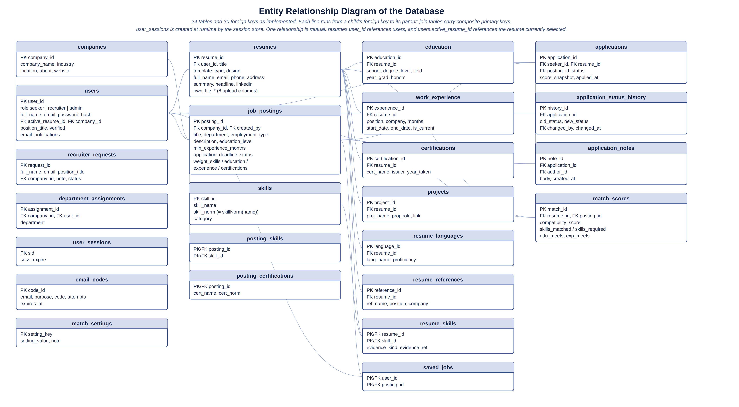
DATABASE
Database Design
24 tables, 30 foreign keys — generated directly from the live schema.
Every score is traceable: match_scores links one resume to one posting with a timestamped result.
Notes:
TIME: 40-50 sec. SAY: 'This is the actual database, twenty-four tables. The important relationships: one user has many resumes; one posting has many applications; every application links one applicant, one resume and one posting, with its score and full status history recorded. Nothing about a hiring decision is invisible or untracked.' VISUAL: full ERD on screen, zoom into the applications/match_scores area if recording lets you. TRANSITION: 'Enough diagrams — let's see it running.'

Slide 9
LIVE DEMO
System Demonstration
The one journey that proves the research problem is actually solved.
1. Job seeker builds a resume — guided steps, live preview, pick a design
2. Job seeker browses postings and sees a match score before applying
3. Job seeker applies — score breakdown shows exactly which skills are missing
4. Recruiter opens the same posting — sees the ranked applicant list
5. Recruiter opens the applicant's score breakdown — same numbers, same reasons
6. Recruiter changes status and sends an interview invite with a calendar link
Notes:
TIME: 3.5-4.5 min — THIS IS THE LONGEST SLIDE. Keep it on screen while you screen-share/switch to the live system; do not click back to this slide until the demo is done. FULL STEP-BY-STEP SCRIPT IS IN THE COMPANION DEMO SCRIPT DOCUMENT — follow it exactly for what to click and what to say at each step. The one sentence to repeat during the demo: 'Notice the applicant and the recruiter are looking at the exact same score and the exact same reasons.' That single sentence is the whole research problem being solved on screen. TRANSITION after demo: 'Now — how do we know this actually works, and how do we know it's any good?'

Slide 10
METHODOLOGY
Methodology and Development
Quantitative descriptive design
We measure how widely a difficulty is shared and how highly the finished system is rated — not why, using closed survey items only.
Waterfall development
The evaluation needed one finished, unchanging system rated by every respondent — an iterative build would have given different people different versions to judge.
Five instruments, three respondent groups
46 job seekers and 11 then 10 HR staff, before and after using the system; 3 IT experts inspected the finished build and its source code.
Verified before it was ever evaluated
232 automated tests across eleven suites, plus roughly 120 scripted browser checks, all passing before a single respondent touched the system.
Notes:
TIME: 75-90 sec. SAY: 'We used a quantitative descriptive design — we're measuring how widely a problem is shared and how highly the system is rated, using closed survey questions, not interviews. We built the system using Waterfall, on purpose: the evaluation needed one finished system that every respondent rates, and an agile, constantly-changing build would have given different people different versions to judge. Five survey instruments went to three groups — job seekers, HR staff, and IT experts — some before the system existed and some after. And before any of that, we ran two hundred thirty-two automated tests and about a hundred twenty browser walkthroughs, so correctness was checked by testing, not left for respondents to discover.' VISUAL: bullets on screen. TRANSITION: 'Here is what those respondents actually said.'

Slide 11
RESULTS
Results and Evaluation
All in the 'good' band or above, on a scale fixed before any data was collected.
Quality characteristic | Job seekers (n=46) | HR personnel (n=10) | IT experts (n=3)
Functional suitability | 4.30 | 4.17 | 4.78
Usability | 4.28 | 4.22 | 4.67
Reliability | 4.23 | 4.33 | 4.83
Overall | 4.28 | 4.22 | 4.80
Notes:
TIME: 75-90 sec. SAY: 'The people who actually used the system rated it good across the board — 4.28 from job seekers, 4.22 from HR. The IT experts, who inspected the code rather than using it day to day, rated it higher, 4.80. We also ran a System Usability Scale, the one published, industry-standard instrument in our study — we scored 74.7, above the typical average of 68. And on the items we asked twice, before and after using the system, worry about computer screening dropped from 3.93 to 2.65 — a large, statistically significant improvement.' VISUAL: table full-screen. TRANSITION: 'Does that mean we hit every goal we set out to hit?'

Slide 12
OBJECTIVES VS RESULTS
Objective Achievement
Six of eight objectives have direct respondent evidence; two — the admin account and low-experience accessibility — do not, and we say so.
Objective | What we did | Result
Guided resume builder | 3 formats, 14 designs, step-by-step flow | Built and rated 4.30 functional suitability by job seekers
Transparent matching | Published 50/25/25 formula, shown to both sides | Rated 4.64 by HR for explainability — the strongest single finding
Never auto-reject | No strong match still shows score + related jobs | Confirmed by design and by every respondent instrument
Accessible to low-experience users | Mobile-responsive, light/dark mode, guided tour | Built; not directly measured by any instrument — an honest gap
Notes:
TIME: 50-60 sec. SAY: 'Six of our eight objectives are directly supported by respondent data. Two are not — nobody rated the administrator account, because none of our three respondent groups uses it, and no instrument specifically asked whether a low-experience user found the system usable. We say that plainly rather than assume it. That is what an honest capstone looks like.' VISUAL: table on screen. TRANSITION: 'So who actually benefits, and where are the real limits?'

Slide 13
BENEFITS, LIMITS, CONTRIBUTION
Benefits, Limitations, and Contribution
Who benefits
Job seekers get a free, guided path to an ATS-ready resume. Clark Outsourcing gets applications that arrive pre-scored against its own criteria.
Our contribution
A working, evaluated system plus a fully documented, deterministic scoring formula — no black box, reusable by future researchers.
The honest limits
One partner company, one twenty-to-thirty-minute session, no control group. We do not claim the system saves recruiters time — that specific claim tested neutral to weak across every instrument that measured it.
Notes:
TIME: 55-65 sec. SAY: 'Job seekers get a completely free tool that produces a resume screening software can actually read. Our partner company gets applications that arrive already scored against its own stated requirements. Our contribution to research is a fully transparent, documented scoring formula — nothing hidden, nothing learned by a black-box model. But we're direct about the limits: one partner company, one short session per respondent, no control group. And we do not claim the system saves recruiters time — that was the one claim our own data does not support, and we say so rather than hide it.' VISUAL: bullets. TRANSITION: 'So, to close —'

Slide 14
CONCLUSION
Conclusion and Recommendations
The problem is real, confirmed on both sides
Job seekers and recruiters, surveyed separately and never shown each other's answers, described the same problem independently.
The system's transparency is its strongest result
Explainability and human control scored highest across every instrument — stronger evidence than any time-saving claim.
What we recommend next
Add a relevance measure to the experience score; make the per-posting weight control easier to find; extend the evaluation beyond one company and one session.
Notes:
TIME: 45-55 sec. SAY: 'Our conclusion: the two-sided hiring problem we set out to study is real, and Linaw PH's transparency and human-control design is its most strongly supported result — stronger than any claim about saving time, which we don't make. Going forward, we recommend adding a relevance measure to the experience score, making the weight control easier to find, and testing this at more than one company.' VISUAL: bullets. TRANSITION: to the closing summary slide.

Slide 15
SUMMARY
Problem → Solution → System → Result → Impact
Linaw means clarity. The system doesn't decide who gets hired — it makes the reasoning visible to the person it's about.
Notes:
TIME: 25-35 sec. SAY: 'A two-sided hiring problem, a transparent scoring system, built and tested end to end, rated good to excellent by everyone who touched it, with an honest account of its limits. Thank you for watching.' VISUAL: closing card. END OF VIDEO.

