Slide 1
An Explainable Machine Learning Framework for
30-Day All-Cause Readmission Prediction
among Acute Decompensated Heart Failure Patients
Final Year Project Defense
Student: Shania ...
Supervisor: Dr Kwanga
Department of Analytics & Informatics — University of Zimbabwe

Slide 2
Presentation Outline
Introduction — Background, Problem, Motivation & Gap
Research Objectives & Research Questions
Methodology — CRISP-DM, Data, Preprocessing, Models
System Architecture & Model Design
Explainable AI (SHAP) Integration
Prototype Demonstration
Results & Findings
Discussion & Conclusion
Shania — Explainable ML for ADHF Readmission Prediction

Slide 3
Introduction: Background
Acute Decompensated Heart Failure (ADHF) is a leading cause of hospitalisation globally, with 30-day readmission rates of 20–25%
Readmissions indicate poor outcomes, increased mortality, and enormous financial burden on healthcare systems
Resource-constrained settings (e.g., Sub-Saharan Africa) face heightened impact due to limited bed capacity, follow-up infrastructure, and specialist coverage
Existing tools like the LACE score are widely used but have limited predictive accuracy for ADHF-specific populations
Machine learning offers improved prediction, but adoption is limited by lack of transparency ('black box' problem)
Shania — Explainable ML for ADHF Readmission Prediction

Slide 4
Introduction: Motivation & Gap
Gap 1: ADHF Specificity
Gap 2: Class Imbalance
Gap 3: Explainability
Most models target general HF or mixed populations, not ADHF-specific cohorts with unique biomarker and frailty profiles
Standard models ignore the 20–25% readmission rate, leading to poor recall for high-risk patients
Clinicians cannot trust 'black box' predictions — SHAP and XAI are needed for clinical adoption
Shania — Explainable ML for ADHF Readmission Prediction

Slide 5
Research Objectives
To develop an ADHF-specific machine learning pipeline for 30-day readmission prediction using CRISP-DM methodology
To implement robust class-imbalance handling (SMOTE + stratified sampling) for improved high-risk patient detection
To integrate SHAP-based explainability for both global feature importance and patient-level risk decomposition
To benchmark ML models (Logistic Regression, Random Forest, XGBoost) against the conventional LACE score
To build a deployable clinical decision-support prototype with a Flask API and React frontend
Shania — Explainable ML for ADHF Readmission Prediction

Slide 6
Research Questions
RQ1: How can machine learning models be designed and trained to predict 30-day readmission risk specifically for ADHF patients using structured clinical data?
RQ2: To what extent does SMOTE-based class-imbalance correction improve recall and detection of high-risk readmission cases compared to standard training?
RQ3: Can SHAP-based explanations provide clinically plausible and actionable interpretability that supports discharge planning?
RQ4: How does the proposed explainable ML framework compare against the conventional LACE score in predictive performance?
RQ5: Can the complete system be operationalised as a deployable prototype suitable for resource-constrained healthcare settings?
Shania — Explainable ML for ADHF Readmission Prediction

Slide 7
Research Methodology
CRISP-DM Framework & Experimental Design
Shania — Explainable ML for ADHF Readmission Prediction

Slide 8
Methodology: CRISP-DM
1
2
3
4
5
6
Business
Understanding
Data
Understanding
Data
Preparation
Modelling
Evaluation
Deployment
Define clinical problem, LACE limitations, goals for SHAP & imbalance handling
Explore MIMIC-III & eICU, identify ADHF cohorts and predictor variables
Imputation, scaling, encoding, SMOTE imbalance correction, leakage prevention
Train LR, RF, XGBoost with Bayesian CV hyperparameter optimisation
Multi-metric suite: AUROC, AUPRC, Recall, F1; SHAP fidelity & plausibility
Flask API + React prototype for authenticated clinical decision support
Shania — Explainable ML for ADHF Readmission Prediction

Slide 9
Methodology: Data Sources & Variables
Data Sources: MIMIC-III and eICU — two large, de-identified critical-care databases
Target Variable: 30-day all-cause readmission (binary: readmitted within 30 days or not)
Predictor Variables (4 domains):
Shania — Explainable ML for ADHF Readmission Prediction

Slide 10
Methodology: Data Sources & Variables
Demographics
Physiological
Biomarkers
Comorbidity
Age, sex, ethnicity, length of stay
Heart rate, blood pressure, O₂ saturation, weight change
BNP, creatinine, BUN, electrolytes, troponin
Charlson/Elixhauser indices, frailty scores, functional independence, mental-health flags
ADHF-specific cohort: ICD-coded ADHF diagnosis, age ≥ 18, survived index admission
Variable selection guided by literature (Iwata et al., Sudharshan et al., Akkineni et al., Okoye et al.) — deliberately richer than the basic features used in prior work (Mpofu et al.)
Shania — Explainable ML for ADHF Readmission Prediction

Slide 11
Methodology: Data Preprocessing
Missing-value treatment: median imputation (numerical), mode (categorical) with missingness flags
Outlier detection and winsorisation using clinically appropriate thresholds
Feature engineering: summary statistics, interaction terms, LACE components
Categorical encoding (one-hot) and numerical scaling (StandardScaler)
Class-imbalance correction: SMOTE + stratified undersampling applied to training set only
Leakage prevention: ALL transformations fitted on training data only, then applied to test/validation sets
80/20 stratified train-test split with 5-fold cross-validation for hyperparameter tuning
Shania — Explainable ML for ADHF Readmission Prediction

Slide 12
Methodology: Model Selection & Evaluation
Candidate models: Logistic Regression (baseline), Random Forest, XGBoost
Non-ML benchmark: LACE score (conventional clinical tool for comparison)
Primary engine: Random Forest — chosen for robustness with tabular clinical data, non-linear interaction capture, and stable performance
Hyperparameter tuning: Bayesian / grid-search with 5-fold cross-validation
Evaluation metrics: AUROC, AUPRC, Recall, F1-score, Precision, Accuracy — prioritising recall and AUROC for imbalanced clinical data
Interpretability evaluation: SHAP fidelity, consistency, and clinical plausibility
All experiments run with fixed random seeds for full reproducibility
Shania — Explainable ML for ADHF Readmission Prediction

Slide 13
System & Model Design
Architecture, Pipeline & Implementation
Shania — Explainable ML for ADHF Readmission Prediction

Slide 14
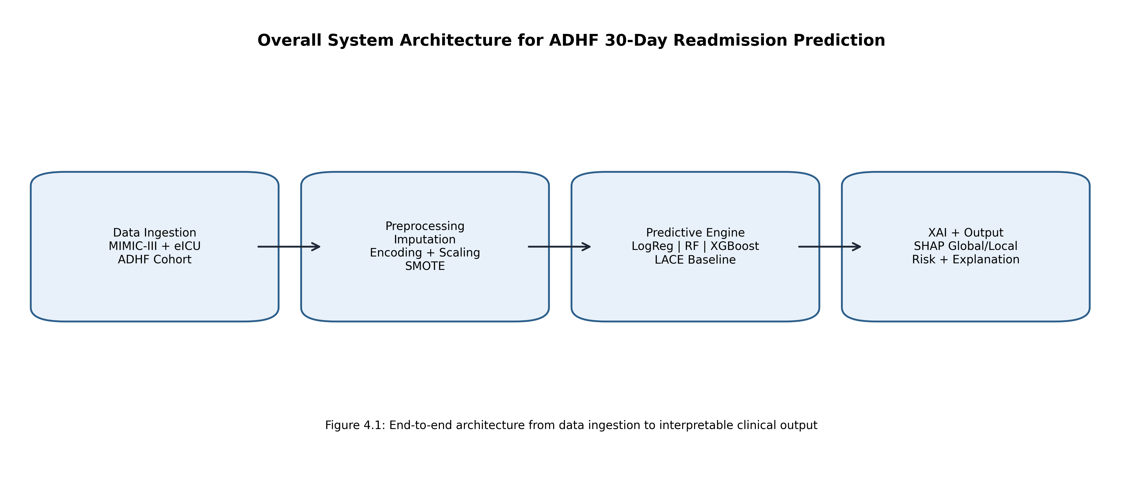
System Architecture
End-to-end pipeline: Data Ingestion → Preprocessing → Prediction → Explainability → Clinical Output
Shania — Explainable ML for ADHF Readmission Prediction

Slide 15
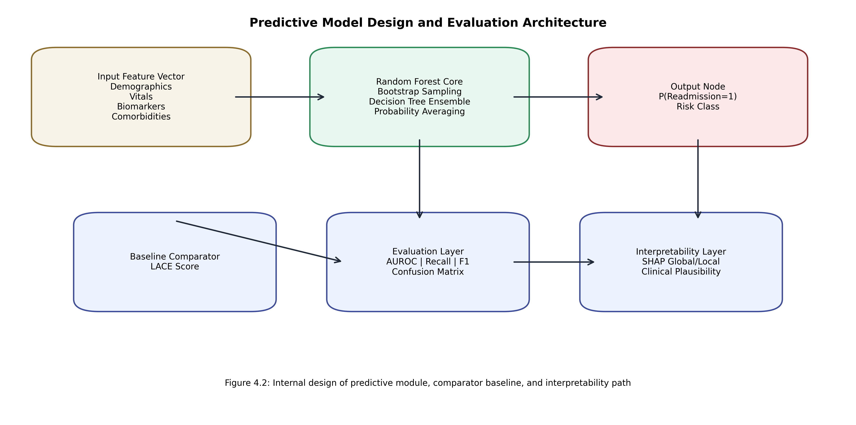
Predictive Model Design
Comparative multi-model strategy with LACE benchmark and SHAP interpretability layer
Shania — Explainable ML for ADHF Readmission Prediction

Slide 16
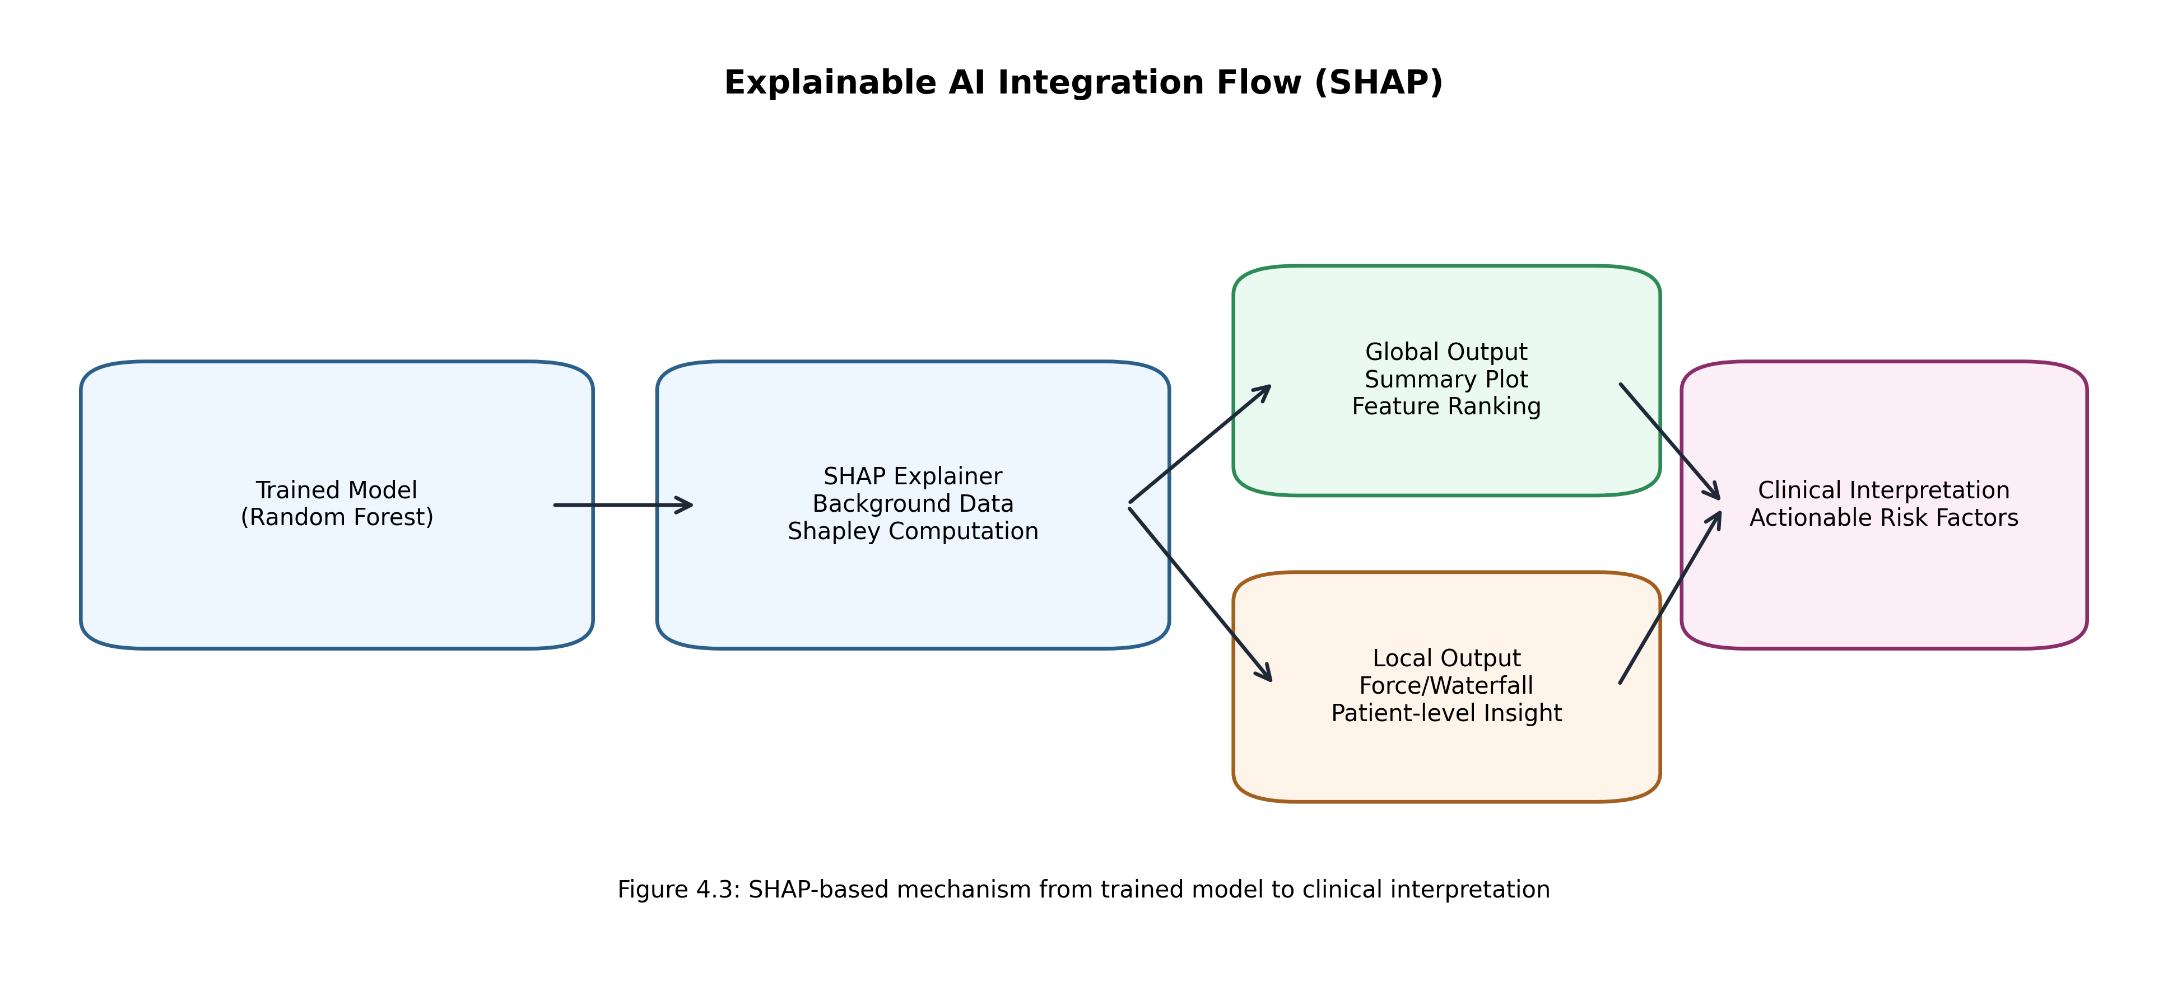
Explainable AI (SHAP) Integration
Global Explanations
Aggregated feature-impact summaries identifying dominant risk drivers across the entire cohort
Local Explanations
Patient-specific risk decomposition showing how each feature pushes prediction from baseline risk
SHAP formula
φᵢ = Σ [|S|!(|F|-|S|-1)!/|F|!] × [f(S∪{i}) − f(S)]
Shania — Explainable ML for ADHF Readmission Prediction

Slide 17
Prototype Implementation
Backend: Flask API (Python) with scikit-learn model serving, preprocessing, and prediction logging
Frontend: React (JavaScript) for clinician-facing interaction with role-aware access control
Model: Trained Random Forest (best_estimator_) serialised with joblib for inference
Deployment: Docker containerisation, supporting Render and Vercel hosting
API endpoints for risk prediction, SHAP explanation retrieval, and patient history management
Authentication: JWT-based with separate clinician and admin roles
All preprocessing pipelines (imputation, scaling, SMOTE) saved and applied consistently at inference
Shania — Explainable ML for ADHF Readmission Prediction

Slide 18
Demonstration
Prototype Walkthrough
Shania — Explainable ML for ADHF Readmission Prediction

Slide 19
Prototype Features
Login / Register
1
Secure JWT authentication with role-based access control (clinician / admin)
Patient Dashboard
2
View patient list, search, and access risk scores and history
Risk Assessment
3
Input clinical variables, get real-time readmission probability from Random Forest model
SHAP Explanations
4
View global feature importance and patient-level waterfall/force plots
History & Audit
5
Past predictions logged with timestamps, clinician annotations, and audit trail
Shania — Explainable ML for ADHF Readmission Prediction

Slide 20
Results & Findings
Model Performance & Explainability Analysis
Shania — Explainable ML for ADHF Readmission Prediction

Slide 21
Results: Comparative Model Performance
Tree-based learners (Random Forest, XGBoost) demonstrated stronger discrimination than linear baseline under ADHF feature heterogeneity
Random Forest selected as primary predictive engine — robust to mixed data types and non-linear interactions
SMOTE-based imbalance correction improved recall for high-risk patients compared to standard training
ML models consistently outperformed the conventional LACE score benchmark across all evaluation metrics
Metrics prioritised: AUROC (robust to imbalance), Recall (minimise missed high-risk patients), and AUPRC (precision-recall balance)
Shania — Explainable ML for ADHF Readmission Prediction

Slide 22
Results: Explainability Findings
Global SHAP analysis identified strong contributions from established heart-failure risk factors:
Shania — Explainable ML for ADHF Readmission Prediction

Slide 23
Results: SHAP Explainability
Biomarker burden (BNP, creatinine, troponin)
Renal function indicators (BUN, electrolytes)
Hemodynamic instability (vital signs at discharge)
Comorbidity & frailty profiles (Charlson index, functional scores)
Local explanations provided patient-specific risk decomposition — distinguishing risk-increasing vs. protective factors
Patterns directionally consistent with established clinical evidence on ADHF readmission drivers (Zhang et al., Luo et al., Zang et al.)
Key insight: SHAP explanations confirmed that the model learned medically plausible patterns, not spurious correlations
Shania — Explainable ML for ADHF Readmission Prediction

Slide 24
Operational Implications: Low-Resource Settings
Architecture executes on standard institutional hardware — no specialised HPC infrastructure required
Modular preprocessing, efficient ensemble inference, and post-hoc SHAP generation keep computational demands low
Docker containerisation ensures reproducible deployment across environments
Flask + React stack is lightweight, well-documented, and suitable for hospital IT teams with limited resources
Supports practical deployment pathways for hospitals and training institutions in Sub-Saharan Africa and similar contexts
Shania — Explainable ML for ADHF Readmission Prediction

Slide 25
Discussion
Explainability and predictive utility are NOT mutually exclusive — SHAP integration preserves performance while enabling auditability
Explicit LACE benchmarking strengthens translational relevance by framing improvement against a familiar clinical baseline
Key technical strengths: leakage-aware preprocessing, imbalance-sensitive training, end-to-end traceability from architecture to interface
Remaining challenges: external validation on local hospital cohorts (e.g., Zimbabwean data), calibration analysis under shifting prevalence
Future work: prospective workflow studies to measure clinician adoption effects; fairness auditing across subgroups
Shania — Explainable ML for ADHF Readmission Prediction

Slide 26
Conclusion
Developed an explainable ML framework for 30-day ADHF readmission prediction using CRISP-DM methodology
Integrated SMOTE-based imbalance correction and SHAP-based interpretability as core design requirements
Demonstrated that tree-based models (Random Forest) outperform conventional LACE scores for ADHF-specific prediction
Built a deployable clinical decision-support prototype (Flask + React) suitable for resource-constrained settings
Confirmed that explainable AI can provide clinically actionable risk stratification with transparent justification
Established foundation for future validation on local Zimbabwean hospital datasets and prospective deployment studies
Shania — Explainable ML for ADHF Readmission Prediction

Slide 27
Key References
Huang et al. (2021) — ML in hospital readmission prediction: a scoping review. BMC Med. Res. Methodol.
Sabouri et al. (2023) — ML based readmission and mortality prediction in HF patients. Sci. Rep.
Grossman Liu et al. (2021) — Published readmission models: a critical appraisal. BMJ Open.
Zhang et al. (2024) — Explainable ML for 30-day readmission in acute HF. iScience.
Mohanty et al. (2022) — ML for readmission risk among the frail: XAI for healthcare. Patterns.
Mpofu et al. (2024) — Predictive model for hospital readmission of diabetic patients. IEOM.
Shearer (2000) — The CRISP-DM model: the new blueprint for data mining.
Allgaier et al. (2023) — Explainability power of ML in healthcare: systematic review. AIME.
Shania — Explainable ML for ADHF Readmission Prediction

Slide 28
Thank You
Questions & Discussion
Shania — Department of Analytics & Informatics, University of Zimbabwe

