Slide 1


Slide 2


Slide 3

https://chrome.google.com/webstore/detail/redux-devtools/lmhkpmbekcpmknklioeibfkpmmfibljd

Slide 4


Slide 5


Slide 6




Slide 7

https://chrome.google.com/webstore/detail/redirect-url-modify-heade/mdnleldcmiljblolnjhpnblkcekpdkpa

Slide 8
registry=https://pkgs.dev.azure.com/talentechdev/_packaging/HRMTS/npm/registry/
always-auth=true
; begin auth token
//pkgs.dev.azure.com/talentechdev/_packaging/HRMTS/npm/registry/:username=talentechdev
//pkgs.dev.azure.com/talentechdev/_packaging/HRMTS/npm/registry/:_password=NmY2NnljaHpvYTdqcmhhajd5b2s1aGI2dXlzajN1cjNhbHFpN3ZqZTI0aHJta2tlcmp2cQ==
//pkgs.dev.azure.com/talentechdev/_packaging/HRMTS/npm/registry/:email=npm requires email to be set but doesn't use the value
//pkgs.dev.azure.com/talentechdev/_packaging/HRMTS/npm/:username=talentechdev
//pkgs.dev.azure.com/talentechdev/_packaging/HRMTS/npm/:_password=NmY2NnljaHpvYTdqcmhhajd5b2s1aGI2dXlzajN1cjNhbHFpN3ZqZTI0aHJta2tlcmp2cQ==
//pkgs.dev.azure.com/talentechdev/_packaging/HRMTS/npm/:email=npm requires email to be set but doesn't use the value
; end auth token

Slide 9


Slide 10
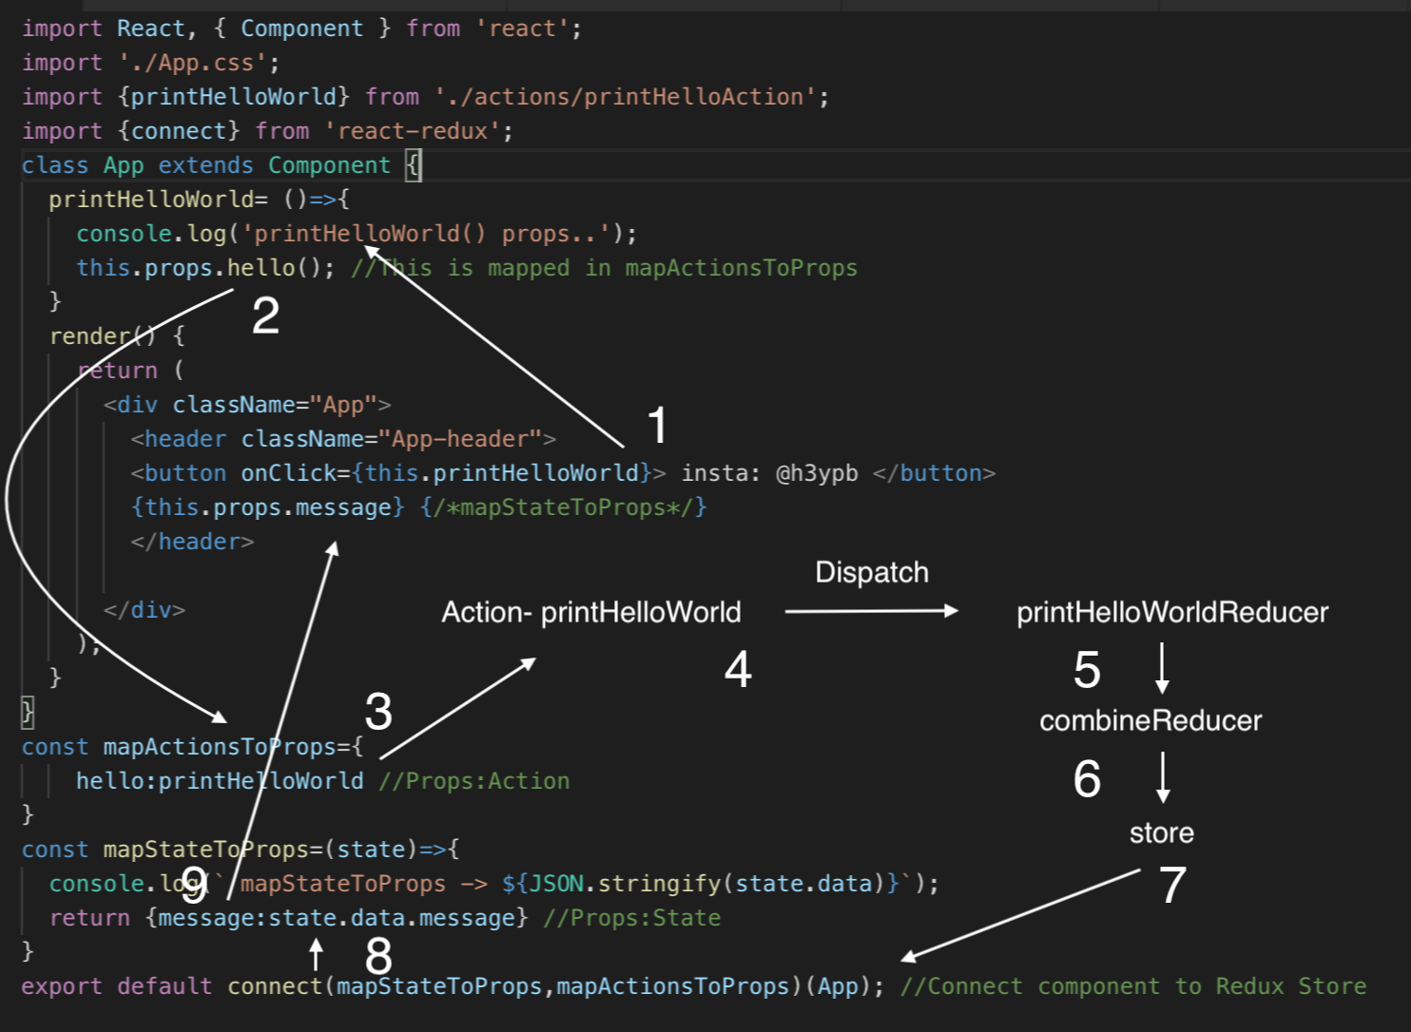

Slide 11
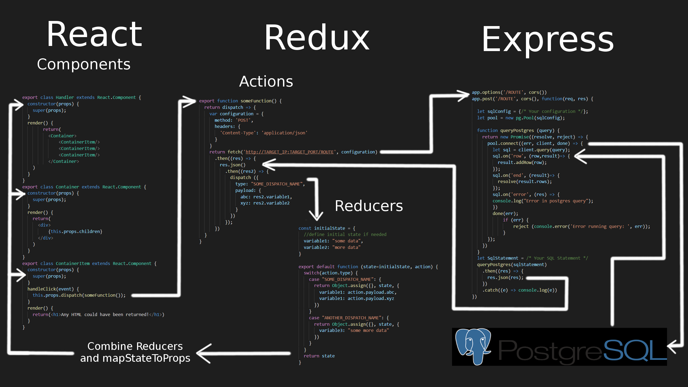

Slide 12
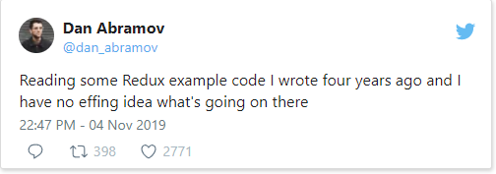

Slide 13
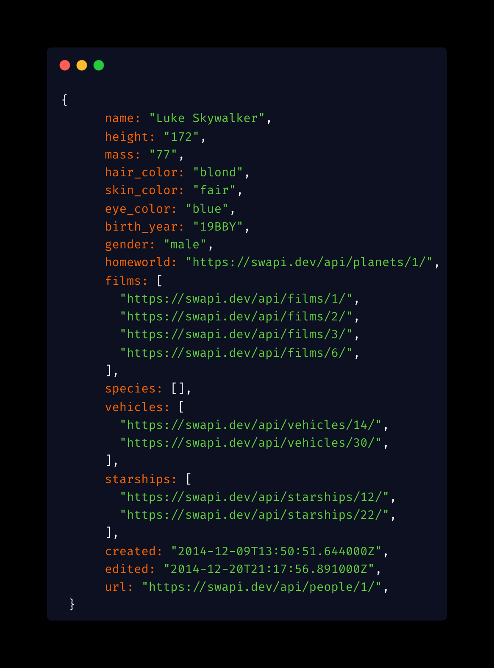

Slide 14


Slide 15

