Slide 1
Password Store Manager
Students Names :
Ibrahim Demdoum
Talha Punjabi
Mohamed Omar

Slide 2
Introduction
What is our idea ?
- Online password storage made to secure multiple passwords.
- Users access their Data by remembering only one password.
- Password storage help people who have a hard time remembering credentials or people struggling to secure their passwords.

Slide 3
Section A : Literature Survey
-Study of relevant topics to strengthen concept, theories and methodologies
used in project.
-Went through articles, Books and papers mentioned below in the appendix
-Topics are well explained in theory and the ideas are ready to be implemented

Slide 4
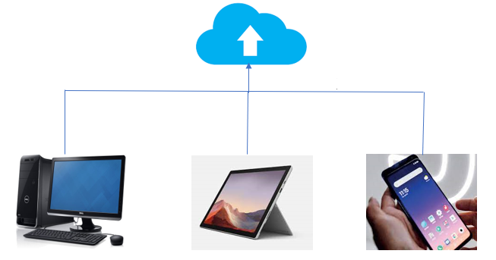
Chapter 1: An Insight to the Password Store
- Benefits of Password Storage:
- Making Process Easier
- No more Filling
Secure Password Sharing
Cross-Platform Support
Multi-factor authentication

Slide 5
Chapter 2: Symmetric Cryptography (AES)
It is a robust security protocol since it is implemented both in hardware and software.
It is one of the most spread open-source solutions and commercial across the world.
The high key sizes make AES algorithm harder for hackers to break, making it a very safe protocol.

Slide 6
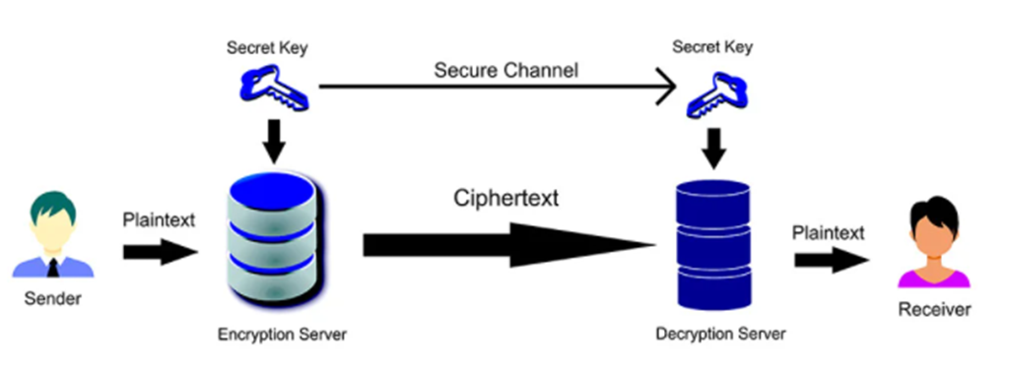

Slide 7
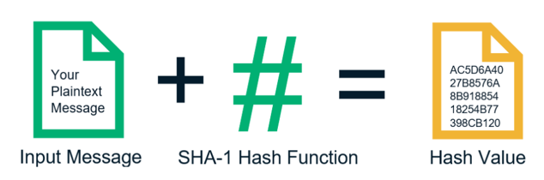
Chapter 3 : Hashing A Fingerprint Against Malware
It is a processing method that takes an input value of any length and outputting it into a result
Hashing is used to check the authenticity of user entry

Slide 8
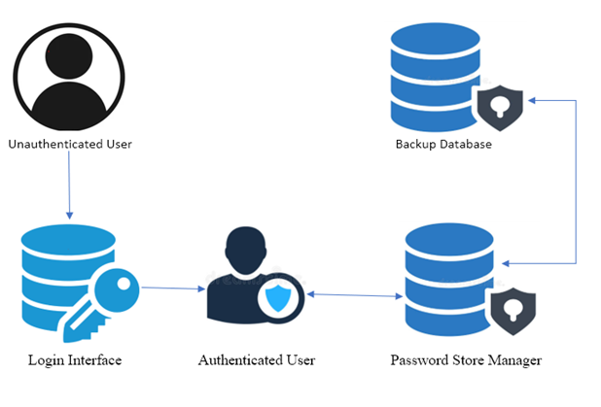
Chapter 4 : Cloud Data back up
- Type of data backup used in our system which has a copy of the database
- The data inside the server is regularly saved

Slide 9
Advantages of Data Backup
Cost Effectiveness- Cloud backup data are readily available, and we can use its services at a reasonable price.
On-demand access- Cloud backup store can be accessed from anywhere across the globe through any device.
Storing in the backup data adds additional security, if the main system is attacked, the data copy is safe and can be backed up anytime once the attack has finished.
The backup processes are often simple and need not need much of configuration. It is automatic, hence only which and how many files need to be backed up is to be mentioned.

Slide 10
Chapter 5 : Encrypting the DataBase
Encrypt the stored data inside of the database from plaintext into cipher text to avoid any kind of thefts
-Every password stored by the user into our system is encrypted and stored in the database
- Once the user decides to know or view the password, it is decrypted and sent to him accordingly.

Slide 11
Types of Database encryption used
- Full Data Encryption
- File-Level encryption
Benefits of Database Encryption
Data will be protected- Complete encryption protects the passwords of the user. Protected data is hard and time consuming for the hacker to break into
Data Integrity- The passwords are same as they are stored. Encryption techniques will not change the content of the passwords stored by the user. Hence, data integrity of the user is assured

Slide 12
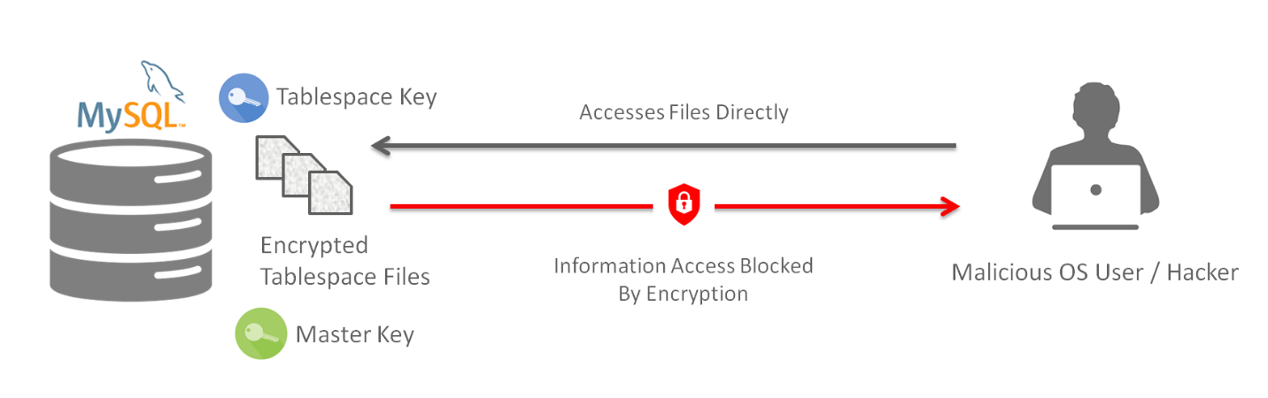
Illustration of Database Encryption

Slide 13
Section B : Security analysis
- Description of how proposed cryptographic mechanism/protocols encounter threats identified in Phase II
- Documentation of the threat not protected against

Slide 14
Threats Faced | Solutions and Methodologies used to Counter the Threat
1- Viruses and Worms | Use Data backup for the system. Securing data stream input queries. (Validating the data entered by the user to be stored, making sure it’s safe from any virus injections)
2- Distributed Denial-of-service (DDOS) attack | Use Data backup for the system. Authentication for the user and timeout after several attempts. Using Artificial intelligence for checking unusual activity.
3- Ransomware | Hijacking information is pointless as 1) Our user’s login passwords are not saved rather; the hashed values of the password are stored in our database. 2) Users stored data (passwords) are encrypted inside the database. Hence, the attacker cannot be in possess of the user’s passwords.
4- Rootkit Attacks | Emphasize authentication by further requesting for Biometric authentication.
5- Brute Force Attacks | AES encryption safely secures the transfer of data between user and the system. It is practically impossible to counter AES encryption technique.
6- Social Engineering | Excessive background checks for new employees. Limited access to system functions depending on area of expertise.

Slide 15
Section C : Results and Further Improvement Ideas - Feedback from Users through survey - Application of the program in real life - Improvements that can be done

Slide 16
Common Feedback received:
Password auto-generation by the system, password generations for the user, evaluating password strength by the user, constantly reminding the user to change his/her password.
Average Rating of the System: 8.5/10
Average Security Satisfaction response: Satisfied
Average Response on buying the service: Yes, I am willing to buy the service.

Slide 17
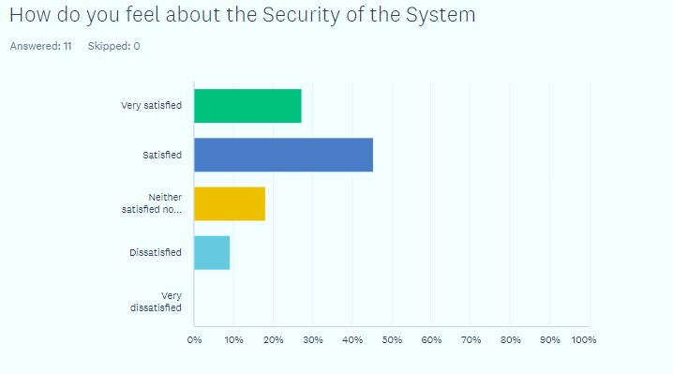
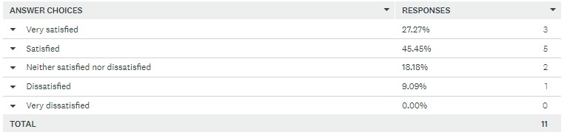

Slide 18
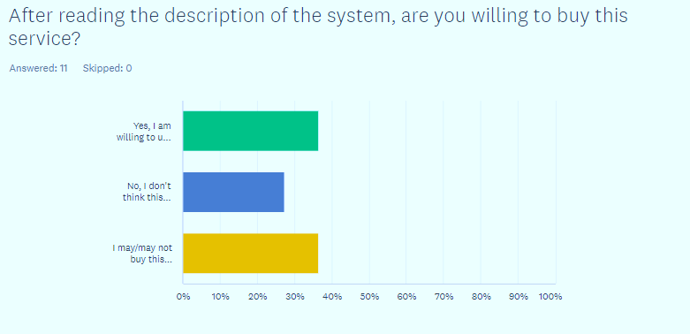
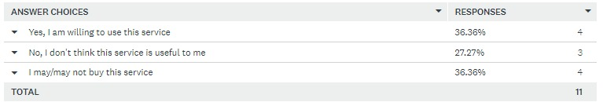

Slide 19
Application of the program in real life : -Where ? -How ? Improvements that can be done: -Where ? -How ?

Slide 20
Thank you, DR. Armstrong

