Slide 1

I2C
Talha Ahmed

Slide 2
I2C
I2C – Inter-Integrated Circuit.
It transmits data synchronously.
Hardware peripheral present inside the microcontroller.
It is useful to connect multiple masters and multiple slaves.
Clock signal is always controlled by masters.

Slide 3
Why I2C
Different other protocols like USB, WIFI are used for fast communication.
However, when fast communication is not necessary I2C is being used.
I2C is cheap as it is using less hardware.
It can use only 2 wires.

Slide 4
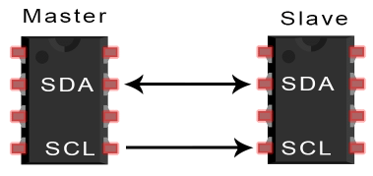
Pins of I2C
SDA – Serial Data
For masters and slaves to send data.
SCL – Serial Clock
Clock signal which is always followed by masters.

Slide 5
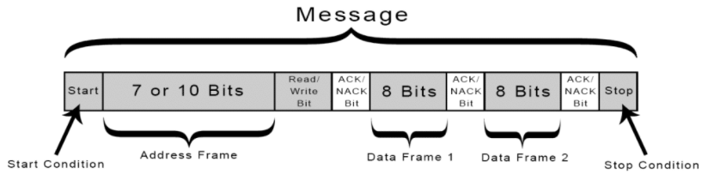
Message Format
1- Start bit which is 0.
2- Address bits mostly 7.
3- 0 for write and 1 for read.
4- 0 for acknowledge and 1 for no-acknowledge
5- Stop bit which is 1.

Slide 6
Data Transmission
Start
The master sends the start condition to every connected slave by switching the SDA line from a high voltage level to a low voltage level before switching the SCL line from high to low.
2) Address + R/W Bits
The master sends each slave the 7bit address of the slave it wants to communicate with, along with the read/write bit.
3) Slave Comparing Address
Each slave compares the address sent from the master to its own address. If the address matches, the slave returns an ACK bit by pulling the SDA line low for one bit. If the address from the master does not match the slave’s own address, the slave leaves the SDA line high.
4) Data Frame
The master sends or receives the data frame of 8 bit.

Slide 7
5) Acknowledgment
After each data frame has been transferred, the receiving device returns another ACK bit to the sender to acknowledge successful receipt of the frame.
6) Stop
To stop the data transmission, the master sends a stop condition to the slave by switching SCL high before switching SDA high.

Slide 8
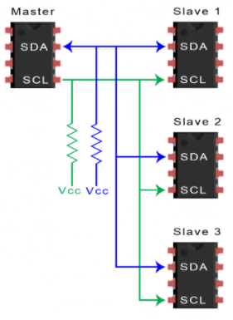
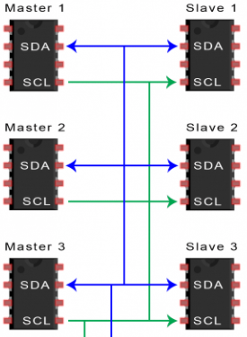
Master with multiple slaves
Multiple master with multiple slaves

