Slide 1

Interrupts
Talha Ahmed

Slide 2
Early Computing
Processor must wait for the signal for processing.
Processor must check every hardware and software program in the system if it has any signal to process.
Processor wastes number of clock cycles just for checking the signal in the system.
System performance also will be degraded, and response time of the system will also decrease.

Slide 3
Interrupts
To overcome this problem, engineers introduced a new mechanism.
Processor will not check for any signal from hardware or software.
Hardware/software will only send the signal to the processor for processing.
These signals have the highest priority.
So basically, interrupt is a signal which has highest priority from hardware or software which processor should process its signal immediately.

Slide 4
Types of Interrupts
1- Hardware Interrupts
If the signal for the processor is from external device or hardware is called hardware interrupts.
Example: If we move mouse, it will create an interrupt in the processor.
- Maskable Interrupt:
The hardware interrupts which can be delayed when a much highest priority interrupt has occurred to the processor.
- Non-Maskable Interrupt:
The hardware which cannot be delayed and should process by the processor immediately.
To mask an interrupt is to disable it, while to unmask an interrupt is to enable it.

Slide 5
Types of Interrupts (cont.)
2- Software Interrupts
A software interrupt is requested by the processor itself upon executing some particular instructions, or when certain conditions are met.
- Normal Interrupt:
The interrupts which are caused by the software instructions are called normal interrupts.
- Exception:
Unplanned interrupts while executing a program is called Exception. For example: while executing a program if we got a value which should be divided by zero is called an exception.

Slide 6
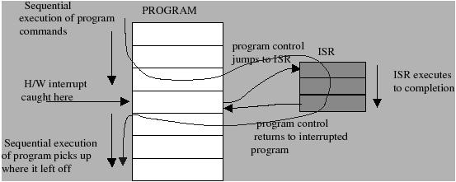
Interrupt Handler
Hardware generates interrupt to the processor.
Interrupt forces the hardware to save the current state and abandoned the current process.
Processors PC jumps to the Interrupt Vector.
Interrupt vectors contains special functions which are known as Interrupt Service Routine (ISR) also known as interrupt handler.
So basically, when an interrupt occurs program execution jumps to the interrupt handler and executes the code in that handler.
When the handler is done program, control returns to the processor and awake the previously running process and start executing it.

