Slide 1

SPI
Talha Ahmed

Slide 2
SPI
SPI – Serial Peripheral Interface
It transmits data synchronously.
Hardware peripheral present inside the microcontroller.
It is common communication protocol which is followed by many devices.

Slide 3
Why SPI
Different other protocols like USB, WIFI are used for fast communication.
However, when fast communication is not necessary SPI is being used.
SPI is cheap as it is using less hardware.
It can transfer data without interruption.

Slide 4
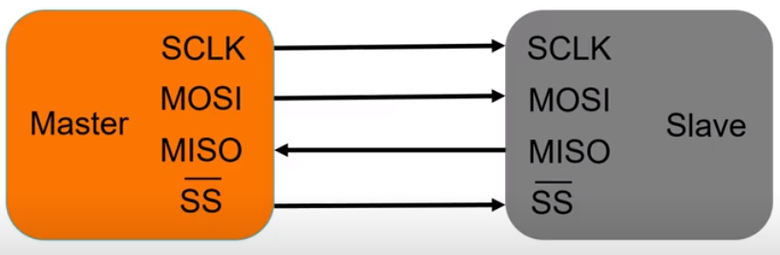
Pins of SPI
SCLK – Serial Clock
MOSI – Master Out Slave In
MISO – Master In Slave Out
SS – Slave Select

Slide 5
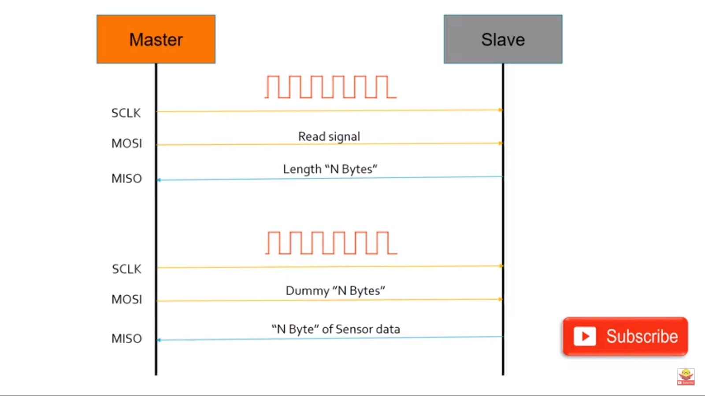
Working of SPI
- Master generates clock and send the read signal to the slave.
- Slave give response about the nature of data.
- Master generates more clock based on slave’s response and send dummy bytes.
- Slave gives the actual data to the master.

Slide 6
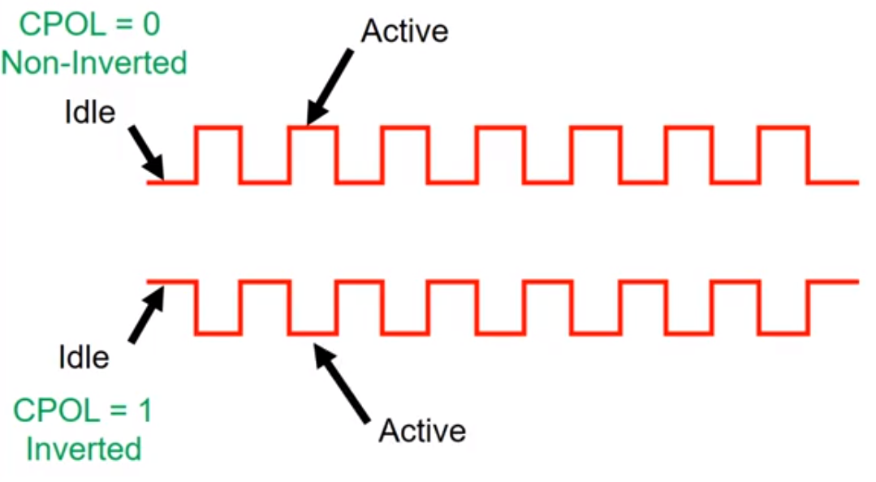
CPOL
CPOL – Clock Polarity
1- If CPOL is 0 the idle state of clock is 0 and active state is 1.
2- If CPOL is 1 the idle state of clock is 1 and active state is 0.

Slide 7

CPOL-Clock Polarity
1- If CPOL is 0 the idle state of clock is 0 and active state is 1.
2- If CPOL is 1 the idle state of clock is 1 and active state is 0.
1- If CPHASE is 0 data will be sampled at leading edge of clock.
2- If CPHASE is 1 data will be sampled at trailing edge of clock.
CPHASE-Clock Phase

Slide 8
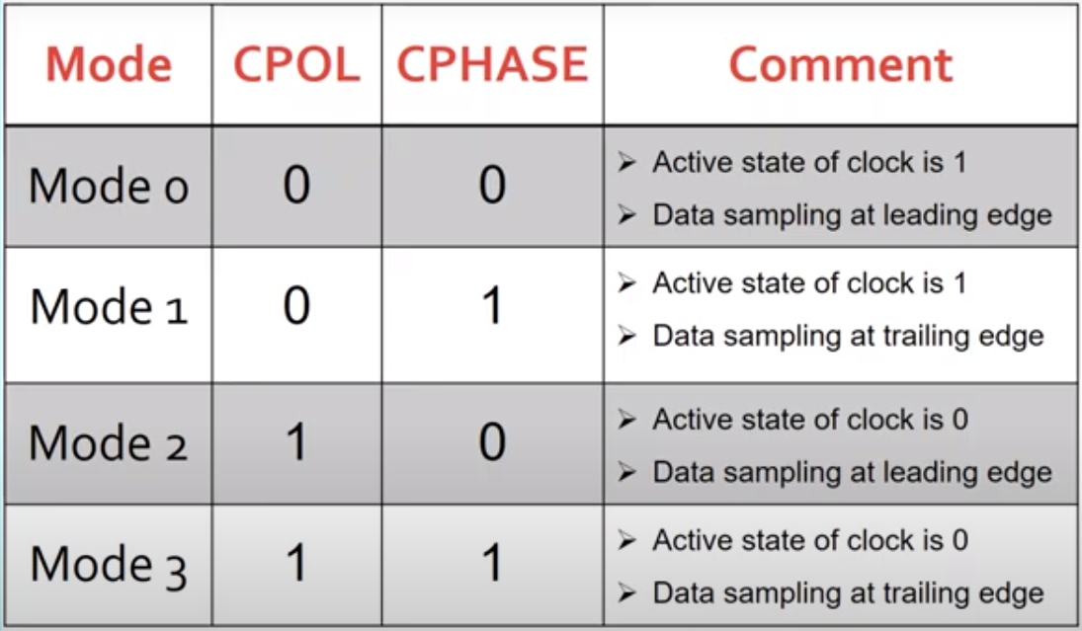
SPI Configuration

Slide 9
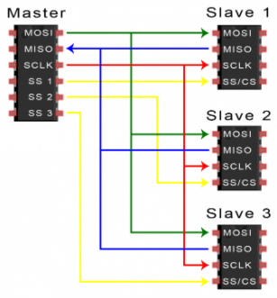
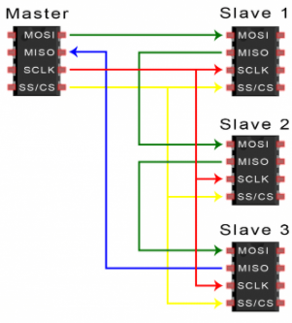
Connection Between Multiple Slaves to Master
Multiple slave pins
Single slave pin
Daisy-Chained

